Slide 1
Test Information Distribution Engine (TIDE)
Training Module
2023–2024
Copyright © Cambium Assessment, Inc. All rights reserved.
Notes:
Welcome to the online training module for the Test Information Distribution Engine, also known as TIDE. This training module includes many examples of TIDE’s features. The TIDE User Guide on your state’s portal has additional information about features in your state's version of TIDE.
Please note that your state’s version of TIDE may differ from the images shown in this presentation.

Slide 2
Objectives
Preparing for Testing
Activating your new TIDE account and logging in to TIDE
Navigating the TIDE interface
Understanding account permissions
Managing user accounts
Managing student information and test settings
Managing test windows
Administering Tests
Managing appeals
Monitoring test progress
After Testing
Managing participation codes
Notes:
This presentation will address numerous topics in TIDE, including tasks that typically take place while preparing for testing, during test administration, and after testing has concluded.
At its core, TIDE is a registration system for users who will access CAI systems and students who will take CAI tests. All CAI systems users must be added to TIDE before they can access any CAI system. Students must be added to TIDE before they can test in the Test Delivery System, also known as the TDS. During testing, TIDE users can print test tickets, manage invalidation requests, and monitor test progress. After testing, TIDE users can clean up data and track return shipments of paper testing materials.

Slide 3
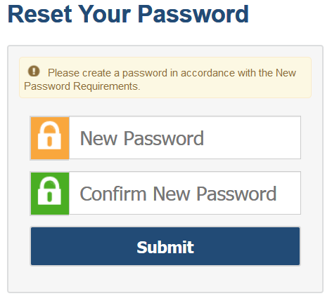
Activating Your Account
Follow the activation link in your email.
Create a password for TIDE that meets the following password requirements:
At least eight characters
At least one uppercase letter
At least one lowercase letter
At least one special character
At least one number
Submit your new password.
Notes:
At the beginning of the 2023-2024 school year, all previous district/school/teacher users were removed from TIDE. OSPI assessment staff added accounts for District Coordinators (DCs). DCs are responsible for adding school/district users.
When you are first added to TIDE, you will receive an account activation email containing a temporary link to reset your password. The sender’s address will appear as DoNotReply@cambiumassessment.com.
The email contains the following two important links:
An activation link
A second link to request a new activation email
The activation link is only valid for 15 minutes. After that time, the link will expire, and you will need to click the second link to request a new activation email.
When you click the activation link, the Reset Your Password page will appear. Create the password you will use to access TIDE. If the password you enter is not processing, please ensure that you have met all system password requirements.
Your TIDE password must contain at least eight characters, one uppercase letter, one lowercase letter, one special character, and one number.
If you do not reset your password, you will not be able to access the system.
If your password meets all requirements, click Submit.

Slide 4
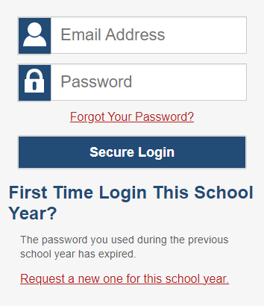
Logging in to TIDE
Notes:
After activating your account, you will have access to the various systems located on your portal.
To access TIDE, go to your portal and select the TIDE icon. On the login page, enter your email and password and click Secure Login.

Slide 5
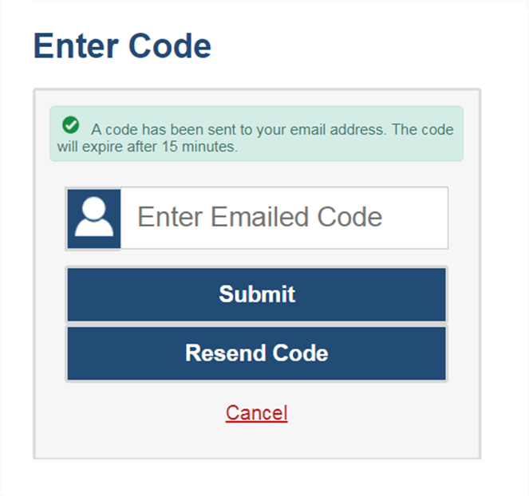
Logging in to TIDE, continued
The system has an authentication process that will be triggered when you log in from a different device or browser, or after clearing your browser’s cache.
If you see this screen, an email containing the code will have been sent automatically to your email address.
Enter the code and click Submit.
If you need the code to be resent, click Resend Code.
Notes:
When logging in to the system using a new device or browser, or after clearing the cache on a previously used browser, you will see an Enter Code page.
If you see this screen, will need to enter the code on this page within 15 minutes of receiving the email. If you do not receive a code or do not enter the code within the 15-minute time limit, click Resend Code. Click Submit after entering the authentication code to access the system. You will be taken to the Reset Your Password page.

Slide 6
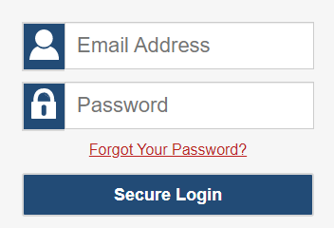
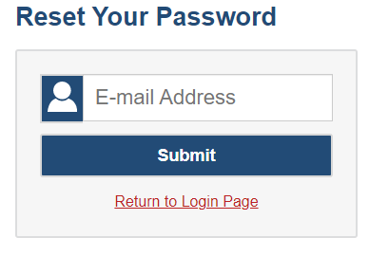
Resetting Your Password
Notes:
If you forget your password, you will need to reset it in order to access TIDE.
You may need to reset your password in the following situations:
You forgot your password.
Your activation link expired.
Your account is locked because you exceeded the account login attempt limit.
It is a new school year.
To reset your password, click the Forgot Your Password? link. You will be taken to the Reset Your Password page. Enter your email address and click Submit. You will receive an email with an activation link. Follow the same steps you performed when initially setting up your TIDE account.

Slide 7
Roles and Permissions
Task | District Test Coordinator (DC) | School Test Coordinator (SC) | School Test Administrator (TA)
Viewing Students | ✔ | ✔ | ✔
Editing Student Settings | ✔ | ✔
Adding User Accounts | ✔ | ✔
Viewing and Editing User Details | ✔ | ✔
Creating Appeal Requests | ✔
Working with Rosters of Students | ✔ | ✔ | Edit only
Generating Plans and Managing Testing Reports | ✔ | ✔ | ✔
✔ = Access to all records in the district
✔ = Access restricted to records in their assigned school
For a detailed list of user roles and associated permissions, see your TIDE User Guide.
Notes:
Your TIDE account is assigned a role, and that role has certain permissions. This table gives an example of the permissions associated with roles in your state. For example, a district-level user may be able to perform tasks that are not available to a school-level user.
Permissions also limit the scope of data access. A district-level user can work with data pertaining to that district, and a school-level user can work with data pertaining to that school. Because the district-level user has access to data pertaining to the entire district, including the data at each school, it is unnecessary for a district-level user to have additional school-level roles. Similarly, a School Test Coordinator (SC) already has all of the access that a School Test Administrator (TA) has so it is unnecessary for an SC to also have a TA role. It is the best practice for users to only be in TIDE with their highest level role.

Slide 8
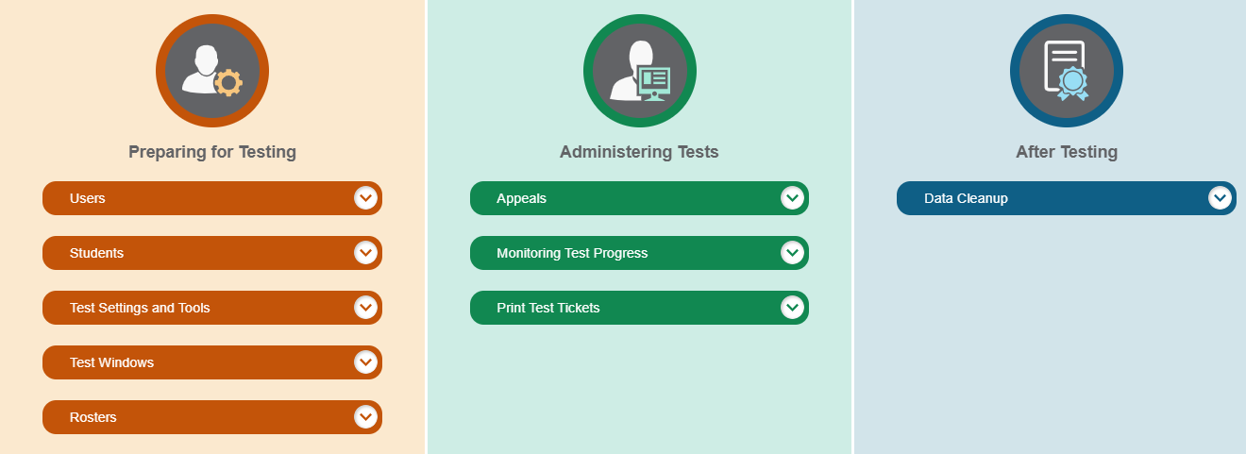
TIDE Home Page
Notes:
The TIDE home page appears after you log in. The home page is designed to reflect the stages of the testing process as directly and simply as possible. These three sections in TIDE list menus for the tasks available in that section. For example, the Users menu contains options for adding users; viewing, editing, or exporting users; and uploading users. To expand a task menu and view its set of related tasks, click the down arrow on the end of that menu. To perform a task, click the name of that task listed in the menu.

Slide 9
TIDE Tasks: Preparing for Testing
Notes:
Tasks in the Preparing for Testing section are typically performed before testing begins. Depending on your state program, this category includes tasks for managing records for users, students, test settings, and rosters. This category may also include tasks for placing orders for paper testing materials and for setting up test windows.
TIDE can group students into rosters. A roster is a collection of students sharing a similar characteristic who are assigned to a specific teacher. Rosters typically represent classrooms, but they can also be used to group students with special needs or students participating activities or programs.
Note: The rosters created in TIDE are not automatically transferred to the Smarter Reporting System (SRS). Rosters or “student groups” must be created in the SRS for TAs to see results from assessments. District-level users and SCs can create the student groups in the SRS.

Slide 10
TIDE Tasks: Administering Tests
Notes:
Tasks in the Administering Tests section are typically performed during the test window.
Test administrators may use TIDE to invalidate a test, reset a test, or re-open a test.
In this section, you may also monitor test progress, generate test participation reports, and print test tickets.

Slide 11
TIDE Tasks: After Testing
Notes:
In the After Testing section, you can perform data cleanup operations such as entering codes to explain student participation and resolving test discrepancies.
In states that administer paper-pencil tests, users can use TIDE to track returning packages containing student answer documents.

Slide 12
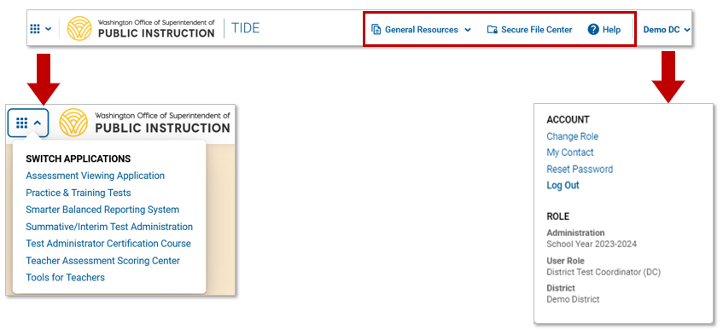
TIDE Banner
Notes:
A banner appears at the top of each TIDE page.
On the left, there is a drop-down list for accessing other Cambium Assessment applications.
In the dropdown menu located on the right side, you can find the Account section where account details can be managed. Additionally, there is a Role section where you can view the current test administration and your current role.
You will also find a General Resources drop-down list, a Secure File Center button, and a Help button that displays the TIDE User Guide.
The district and school information is also displayed along with the user role and test administration (if available in your state).

Slide 13
TIDE Banner: General Resources
Notes:
To download resources that may be needed for online testing, such as forms and secure materials used for handscoring, click the General Resources drop-down list in the banner.

Slide 14
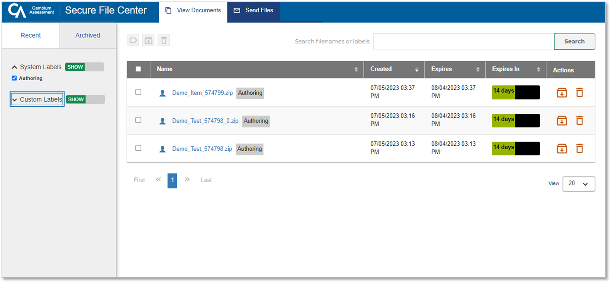
Secure File Center: View Documents
Notes:
To access secure documents and files you have previously exported in TIDE and other Cambium Assessment systems, click the Secure File Center button in the banner. Note that files are displayed in the order that they are generated, uploaded, or archived. The Secure File Center displays the name of the file, creation and expiration dates, days until expiration, and an actions column. To show system and custom labels, click Show on the corresponding toggle bar and mark checkboxes for the label(s) you wish to display. To hide labels, click Hide on the appropriate toggle bar.
For more information on the Secure File Center and its features, refer to the TIDE User Guide.

Slide 15
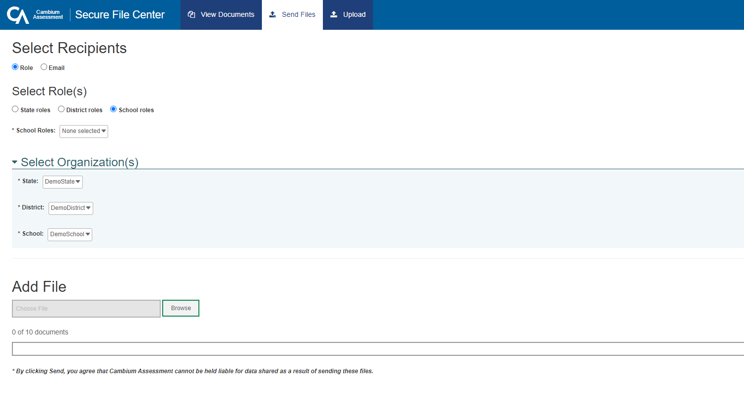
Secure File Center: Sending Files
Notes:
You can send a file or files from TIDE to individual recipients by email address or to groups of recipients by user role.
To send files, click the Secure File Center button from the TIDE banner. Next, click the Send Files tab at the top of the window.
To send files by role, select the role group to which you want to send a file or files. A drop-down list appears.
Next, select the role or roles to which you want to send a file or files. You can choose Select all to send a file or files to all roles in the selected role group.
From the Select Organization(s) drop-down lists, select organizations that will receive the file or files you will send.
To send files by email, enter the email address of the recipient to whom you wish to send a file or files.
After selecting recipients, click Browse under the Add File field to select a file or files to send. A file browser appears.
From the file browser, select up to 10 files to send.
Click Send.

Slide 16
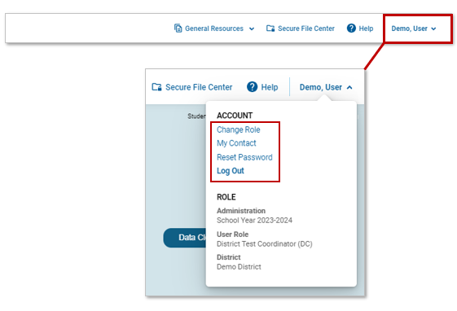
TIDE Banner: Manage Account
Notes:
TIDE accounts can be managed through the dropdown menu on the right side of the TIDE banner. Here, you can change the role you are using in TIDE (if you have been assigned multiple roles), update your contact information, reset your password, and logout of your account.

Slide 17
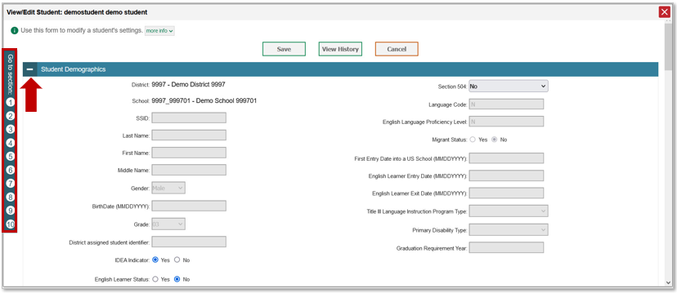
Navigation Toolbars
Notes:
When you enter any task page, a navigation toolbar appears at the top of the page. This toolbar allows you to access each task and action that is available on the dashboard. To view the task menus for a particular TIDE category, click the icon for that category above the toolbar.
Some pages in TIDE are divided into multiple panels. Each panel contains a group of related settings and fields that you can edit. You can click the minus sign in the upper-left corner of a panel to collapse it or click the plus sign in a collapsed panel to expand it. Additionally, a floating Go to Section toolbar appears on the left side of each page with multiple panels. This toolbar includes a numbered button for each panel in the form. You can hover over a button to display the label of the associated panel and select the button to jump to that panel.

Slide 18
Help Text
Notes:
Most pages in TIDE have help text that describes the page and how to use it. To show or hide help text on a page, click the gray ‘more info’ link under the page title.
To read more-detailed information about the page that you are currently viewing, click the Help button in the banner.

Slide 19
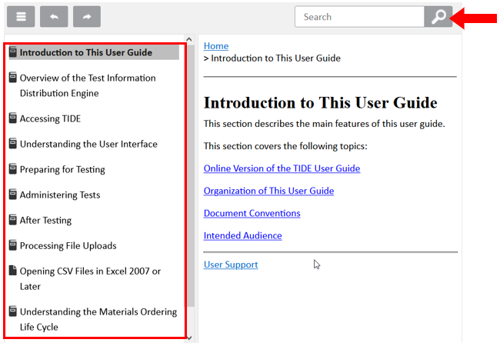
Online Guide
Notes:
The online version of the TIDE User Guide is available to provide assistance with each task in TIDE. You can navigate to each page manually by clicking on topics on the left-hand side of the guide or search for information by entering keywords in the search box at the top. To help with this, the help button link at the top of the page will automatically open to reference information relevant to the task you are performing. For instance, if you are on the Upload Users page and click on the Help button, the online version of the TIDE User Guide will open to the page containing information about uploading users.

Slide 20
Quick Search
Notes:
To quickly search for a user or student to view or edit, enter the user’s email address or student’s Statewide Student Identifier (also known as an SSID) in the search box. Then, click the magnifying glass to the right of the search box.
If you are searching for a user to view or edit, the View/Edit User form will appear. If you are searching for a student to view or edit, the View/Edit Student form will appear.
When you are finished viewing/editing a student or user, click the Save button.

Slide 21
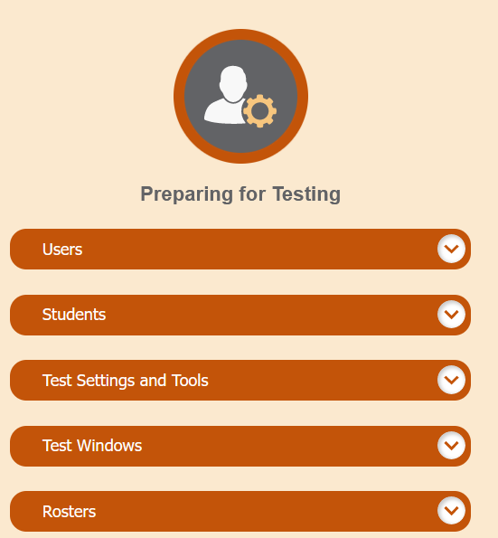
Three Things All TIDE Users Must Know How To Do
You can add new records one at a time.
You can view or modify existing records one at a time.
You can upload multiple new records or modify existing records in the same file.
Notes:
Records for users, students, and rosters must be added to TIDE and kept up to date for the testing process to flow properly. Users not added to TIDE will not have access to any CAI systems and students who are not added will be unable to test. The process for adding and modifying records is similar for users, students, and rosters. This next section of the module will walk you through how to add records one at a time, how to view or modify existing records one at a time, and how to upload multiple new records or modify existing records in the same file.

Slide 22
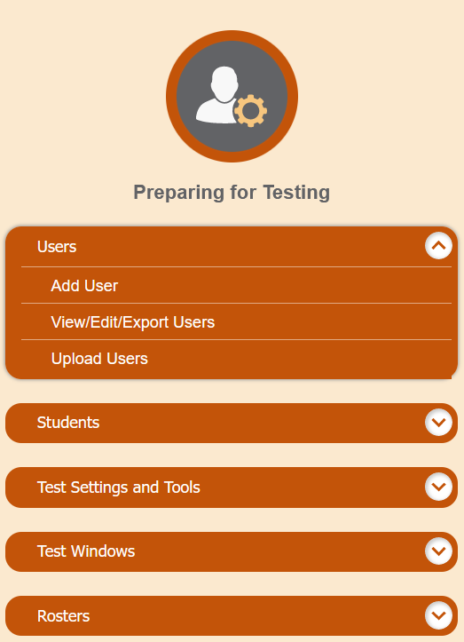
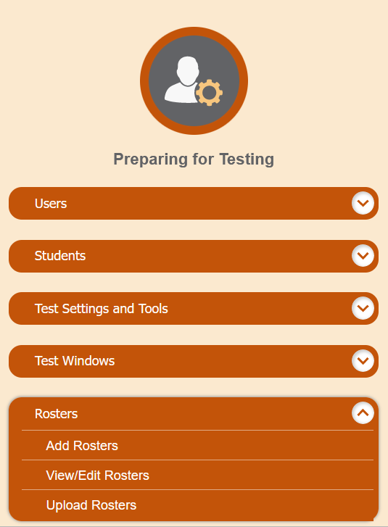
Add Records One at a Time
Notes:
To add records one at a time, start on the TIDE home page. In the Preparing for Testing section, choose the task for which you want to add a new record: users or rosters, then click add.
On the following page, fill out the information, verify its accuracy, and select Save.

Slide 23
Add Users One at a Time
Notes:
When adding users one at a time, enter the email address for the user you want to add. Click + Add user or add roles to user with this email. If the email exists, then options will be available to add multiple roles for the user.
The new user’s email address will serve as his or her username when he or she logs in to any Cambium Assessment system. The new users you add will receive an activation email from DoNotReply@cambiumassessment.com.

Slide 24
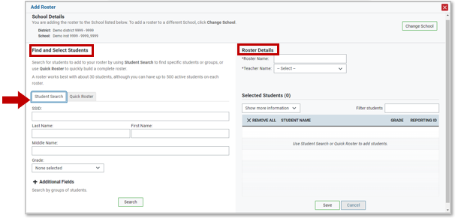
Add Rosters One at a Time
Notes:
The Add Roster page contains two panels, a Find and Select Students panel and a Roster Details panel.
To search for students, complete the student search fields in the Find and Select Students panel. The fields marked with an asterisk are mandatory. You can further refine your search by selecting criteria under the Additional Fields section.
Refine the list of available students by completing the fields in the Add Students to the Roster panel. Then, click Search.

Slide 25
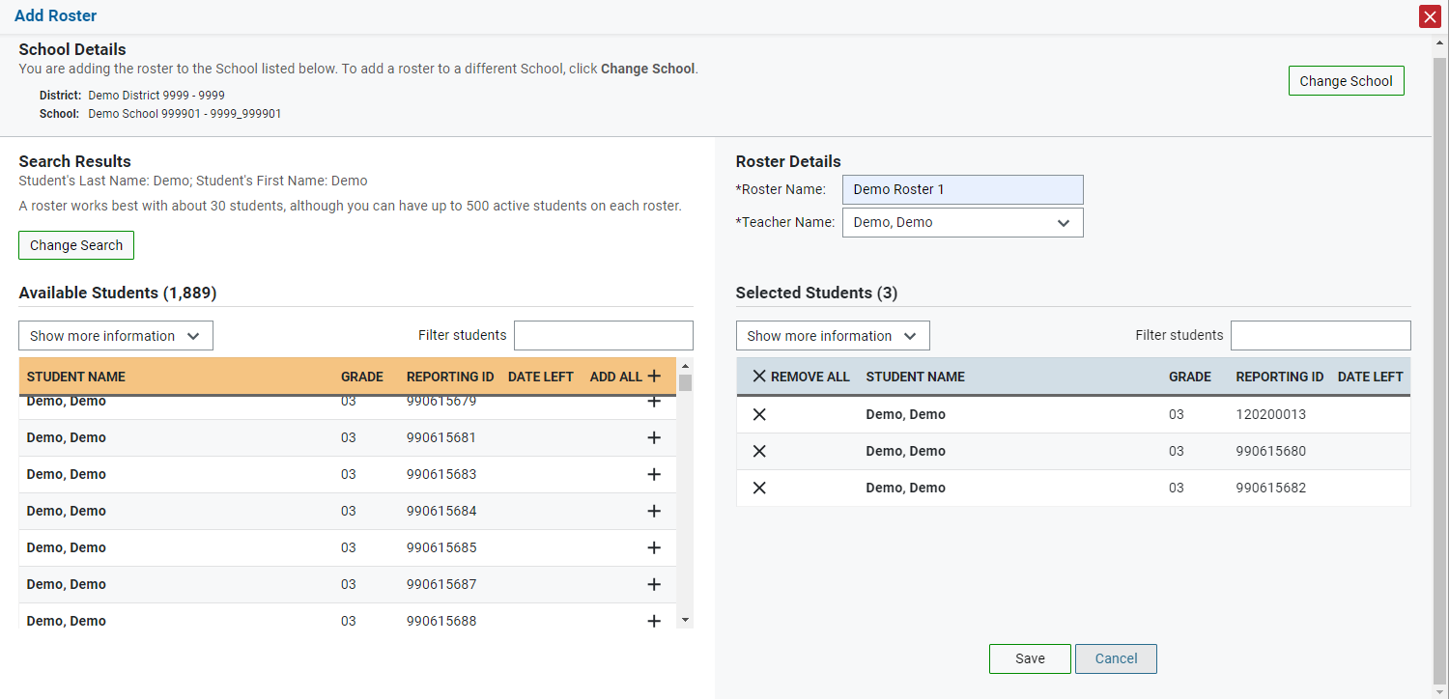
Add Rosters One at a Time, continued
Notes:
The students listed in the Search Results panel are available to be added to the roster.
First, in the Roster Details panel, enter a name for the roster and select the teacher who should be associated with the roster.
Next, add students to the new roster. To add a single student to the roster, click the plus sign next to a student in the left column. You can add all available students to the roster by clicking Add All.
Students will display under Selected Students as they are added to the roster.
To remove a single student from the roster, click the X next to a student in the right column. Remove all students from the roster by clicking Remove All. click Save to save the roster.

Slide 26
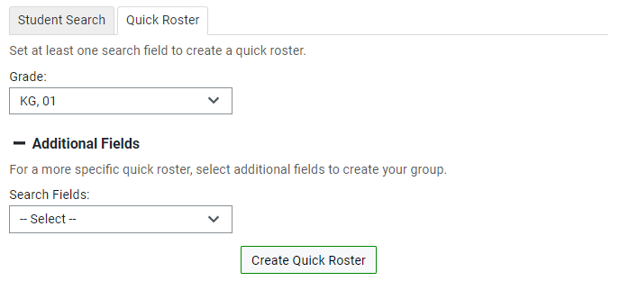
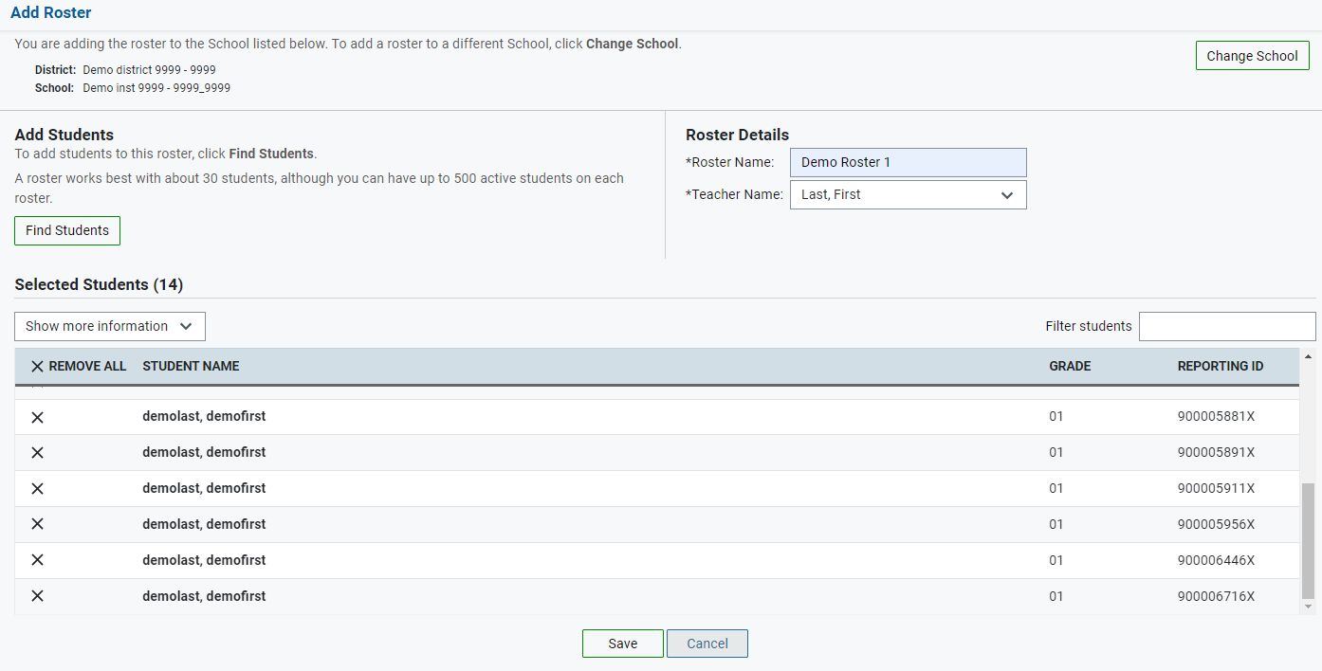
Add Rosters One at a Time, continued
Notes:
The Quick Roster tab can be utilized to create a complete roster from a group of students. To search for students, complete the fields in the Quick Roster panel. You can further refine your search by selecting criteria under the Additional Fields section. click Create Quick Roster.
All students who meet the criteria in your search are automatically added to the roster. You can manually remove students by clicking the X next to individual students or click Remove All from the top of the grid. click Save to create your roster.

Slide 27
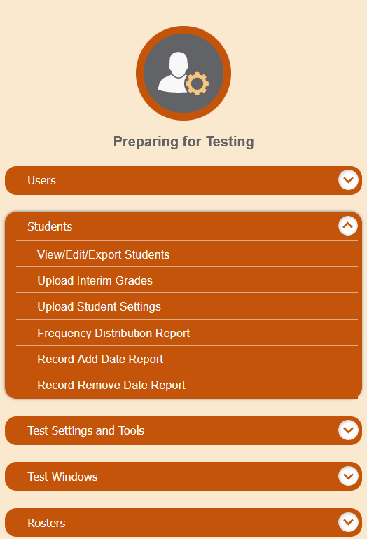
Modify Records One at a Time
Notes:
If a record’s information changes after you’ve added the record to TIDE, you must edit the record to match the most up to date information. You can do this by modifying existing records one at a time.
Begin on the TIDE homepage. In the Preparing for Testing section, choose the task for which you want to modify a record: users, students, or rosters, then click View/Edit/Export.

Slide 28
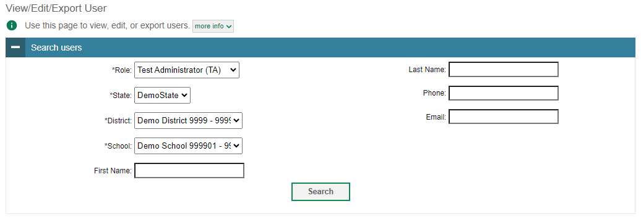
Modify Users One at a Time
Notes:
The View/Edit/Export Users page includes a form for setting selection criteria to retrieve users. In this example, the required criteria are the user’s role, state, and district. Other criteria are optional, such as the first or last name. Your particular version of TIDE may have other fields by which you can retrieve users. Click Search to continue. The search panel will automatically collapse, and your search results will appear below.
After you click Search, TIDE will display all the users satisfying the search criteria. If your user role permits, you can edit a user’s information by clicking the green pencil icon. Another page will appear for you to edit and save information.
To export user information, mark the checkboxes next to the users you wish to export and click the green export button above the search results. A pop-up window will appear with the option to export to the Secure Inbox in either Excel or CSV format.
To delete users from TIDE, mark the checkboxes next to the users you wish to delete and click the orange trash can button above the search results.
To make the search form reappear and search for additional users, click the plus sign in the Search users panel, which appears as a blue bar.
For more-detailed information on managing users, see your TIDE User Guide.

Slide 29
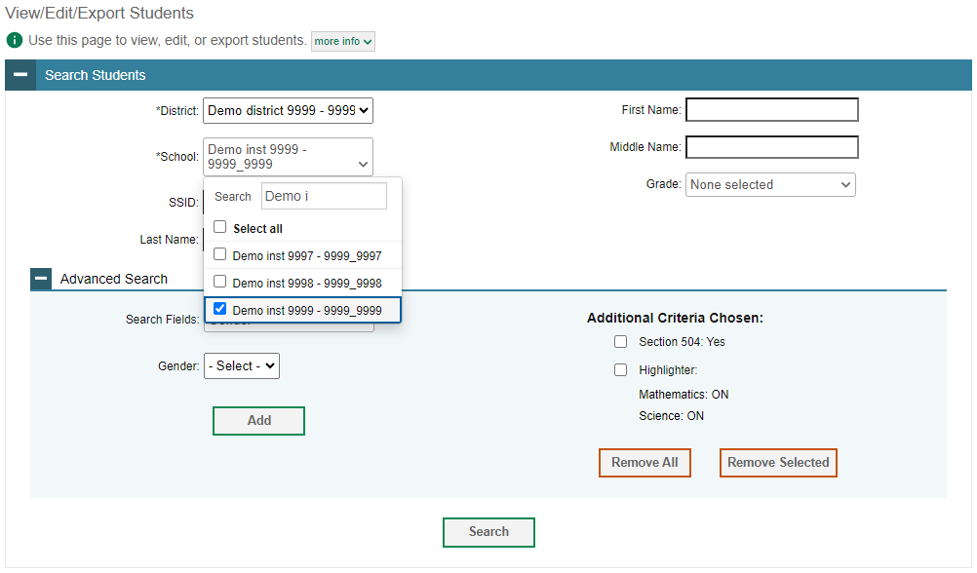
Modify Students One at a Time
Notes:
The View/Edit/Export Students page includes a form for setting selection criteria to retrieve students. Required criteria, such as the district and school in this example, are marked with asterisks. In the School drop-down list, users can begin typing in the Search field to filter results. You can enter part of or your complete school name or school ID in the search field.
Other criteria are optional, such as the external ID and the student’s first or last name. Your state’s TIDE may have other fields by which you can retrieve students.
If available, you can further refine your criteria by entering additional demographic information or test settings in the Additional Search panel.
The students you can retrieve on this page are limited by your role’s scope. For example, if you are a district-level user, you can retrieve only students enrolled within your district. If you are a school-level user, you can only retrieve students enrolled within your school.
Click Search to continue.

Slide 30
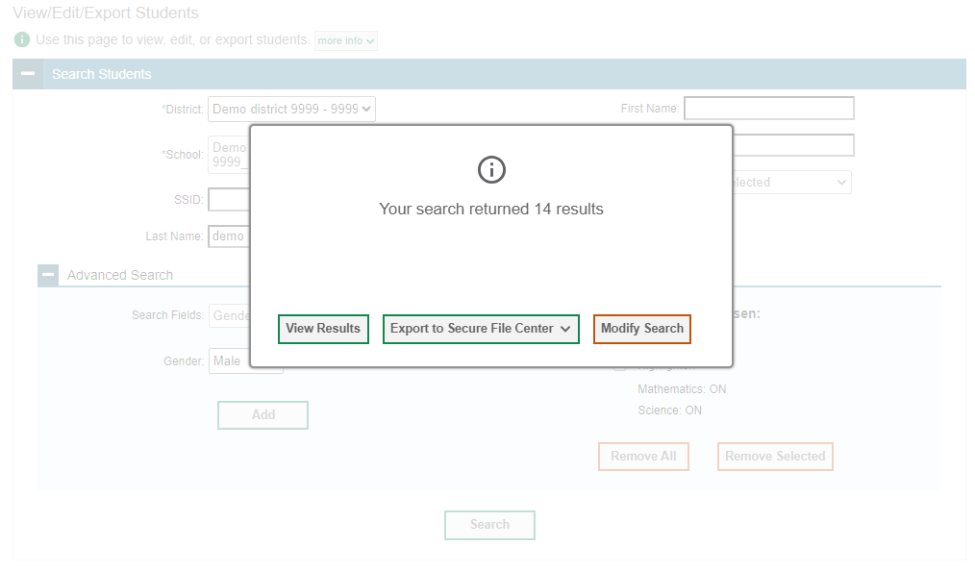
Modify Students One at a Time, continued
Notes:
After you click Search, you will see a message asking whether you would like to view the results of your search, export the list of students to your Secure File Center, or modify your search criteria and try again. If you choose to export the results to your Secure File Center, you will receive an email when the file is ready for you to download.

Slide 31
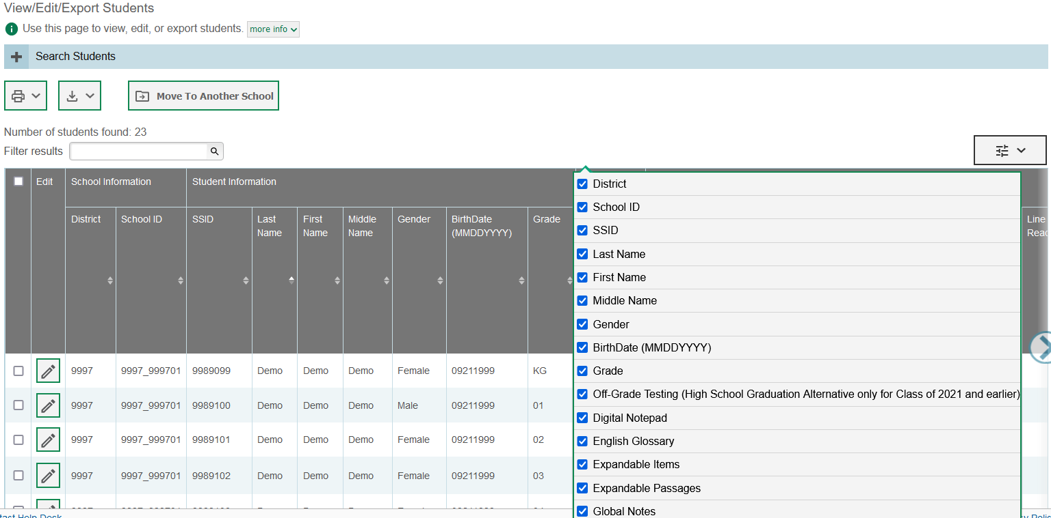
Modify Students One at a Time, continued
Notes:
When you click View Results, TIDE will display all the students satisfying the search criteria. Because not all columns can fit on the screen at once, click the blue arrow on the right side of the screen to scroll right and display more information. To add or delete columns to display, click the drop-down menu at the upper-right corner of the results. You can edit a student’s information, including test settings and accommodations and student test participation data, by clicking the green pencil icon.
You can also view a student’s test participation report and rosters to which students are active, if available. The student’s history is also available on the view/edit student page.
Print students from TIDE by selecting the desired students and clicking the Print button above the search results.
To export the results, mark the checkboxes next to the results you wish to export and click the green export button above the search results. A pop-up window will appear with the option to export to the Secure Inbox in either Excel or CSV format.
To make the search form reappear and search for additional students, click the plus sign in the Search Students panel, which appears as a blue bar.
State- and district-level users can also move selected students from one school to another by clicking Move to Another School.
For more-detailed information on managing students, see your TIDE User Guide.

Slide 32
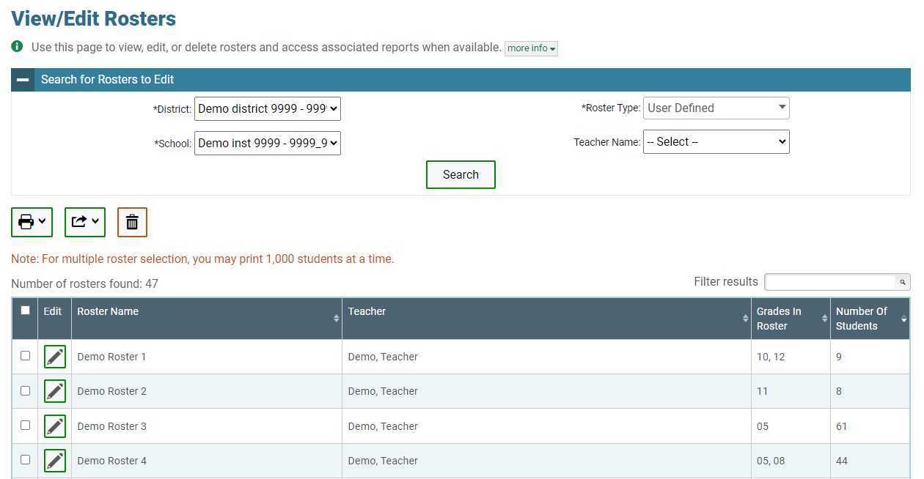
Modify Rosters One at a Time
Notes:
The View/EditRoster page includes a form for setting selection criteria to retrieve rosters. In this example, the district, school, and roster type criteria are required. Your version of TIDE may have other fields by which you can retrieve rosters. click Search to display a list of rosters matching your criteria.
Print, export, or delete rosters from TIDE by selecting the desired rosters and selecting the Print, Export, or Delete buttons above the search results.
Click the pencil icon next to a roster to view or edit its details. You may also view rosters to which the student is currently active, if available.
The Edit Roster form will appear. This form is similar to the form used to add rosters, and you may edit the roster name, teacher name, and students to display in the roster in the same way that you would for a new roster.

Slide 33
Add and Modify Multiple Records at Once
33
Notes:
You also have the option to add and modify multiple records at once. To upload records, you must be familiar with spreadsheet applications or comma-separated value files. When you upload files to TIDE, records not previously set up will be added and records already set up in TIDE will be modified with the updated content from the upload.
Begin on the TIDE homepage. In the Preparing for Testing section, choose the task for which you want to add or modify records: users or rosters. To explain the four-step upload process, we will use the Upload User function. The steps apply in the same way to Upload Students and Upload Rosters tasks.

Slide 34
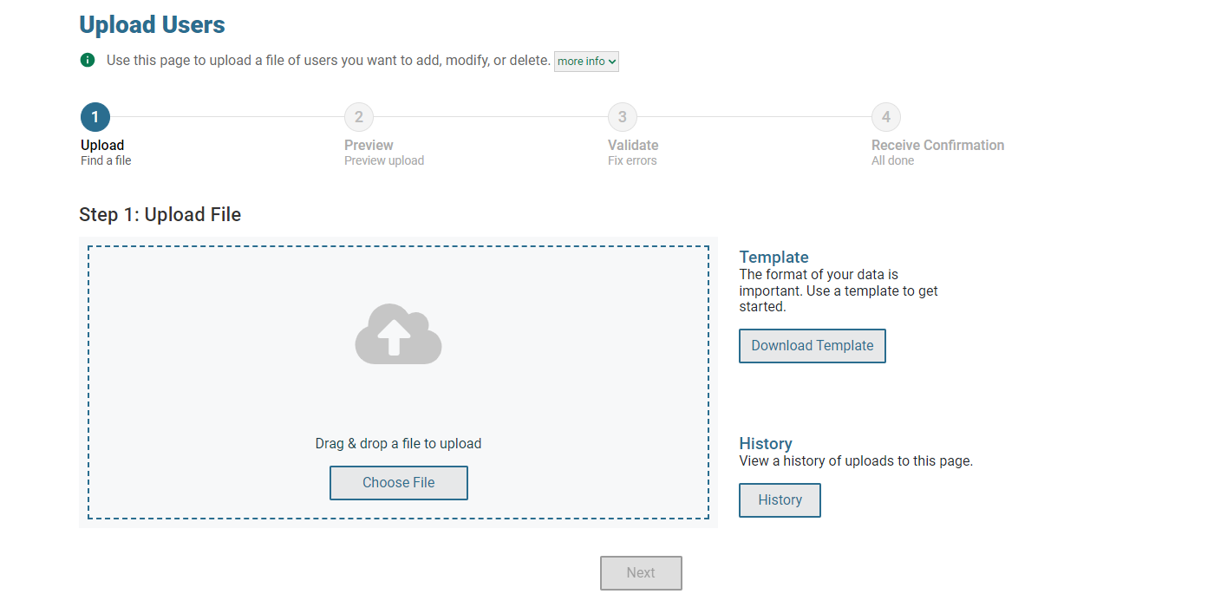
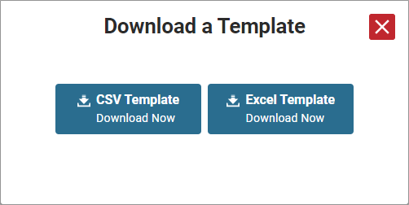
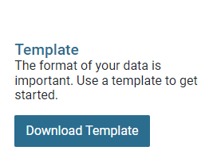
Add and Modify Multiple Records at Once, continued
Notes:
On the upload screen, click Download Template to download a CSV or Excel file template. Once you have downloaded and filled out the template, return to the upload screen, click Choose File, or use the drag-and-drop feature to upload your file to TIDE. Then, click Next.

Slide 35
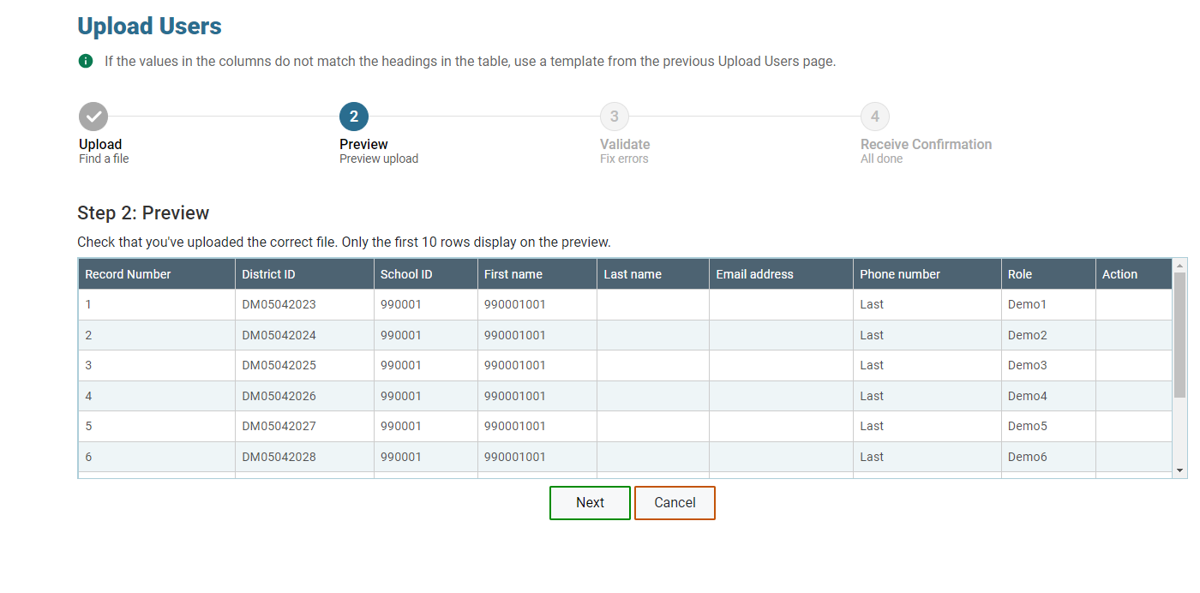
Add and Modify Multiple Records at Once, continued
Notes:
When you click Next, the preview upload screen will appear. Verify that the information is correct, then click Next. To cancel the upload, click Cancel.

Slide 36
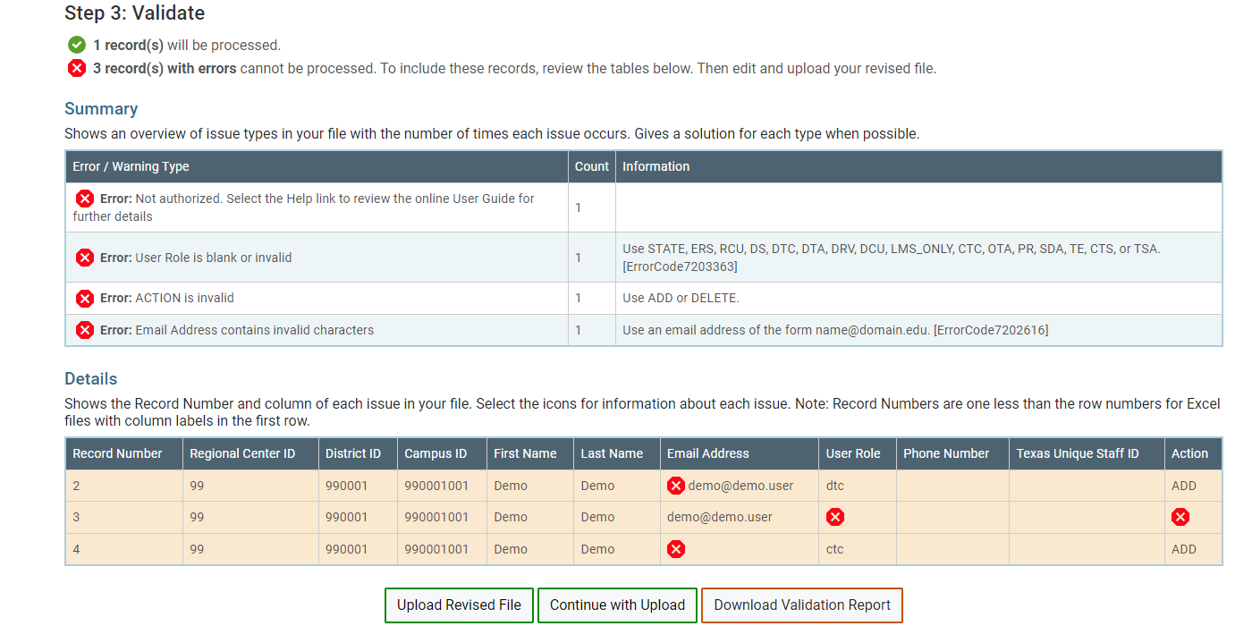
Add and Modify Multiple Records at Once, continued
Notes:
TIDE will validate the file and display any errors or warnings according to the legend on the page. Click the error icons and warning icons in the validation results to view the reason that a field is invalid. If a record contains an error, that record will not be included in the upload. If a record contains a warning, that record will be uploaded, but the field with the warning will be invalid.
To upload a different file, click Upload Revised File.
To complete the upload, click Continue with Upload.
To view a PDF file listing the validation results for the upload file, click Download Validation Report.
If your file contains a large number of records, TIDE will process the file offline and send you a confirmation email when complete. While TIDE is validating the file, do not click Cancel, as TIDE may have already started processing some of the records.
When the upload is complete, a confirmation page will appear with a message that summarizes how many records were uploaded and how many were excluded.

Slide 37
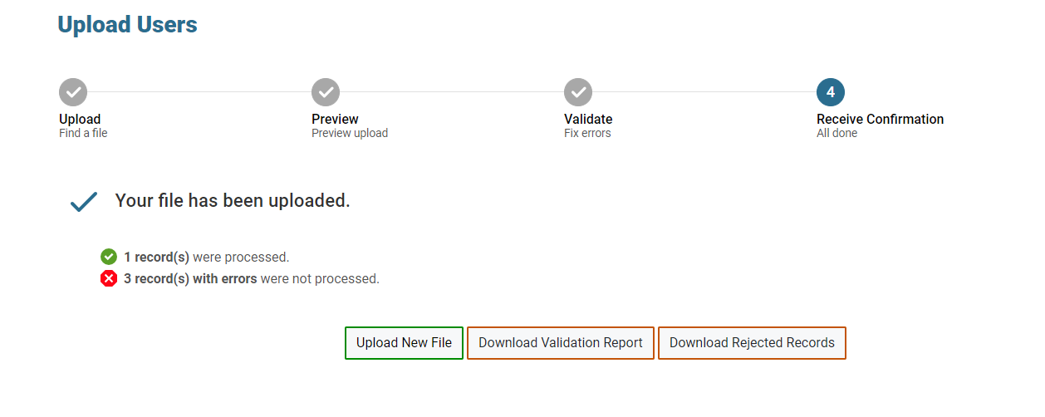
Add and Modify Multiple Records at Once, continued
Notes:
When the upload is complete, a Confirmation page will appear with a message that summarizes how many records were uploaded and how many were excluded. Click Upload New File to upload additional files. The Validation Report and any rejected records can be downloaded by selecting the appropriate button at the bottom of the confirmation screen.
You may use the upload records process with other tasks too, such as uploading interim grades.

Slide 38
Students
Notes:
TIDE also manages student information and keeps track of which assessments students are eligible to take. The Students task menu allows you to view, edit, or export students; upload interim grades; and generate frequency distribution reports. We have shown you how to perform most of the tasks in the Students Task Menu. As you plan for testing it is helpful to use the Frequency Distribution Report to double check student information and test settings.

Slide 39
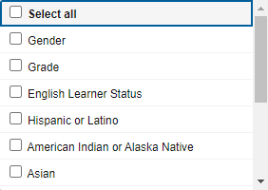
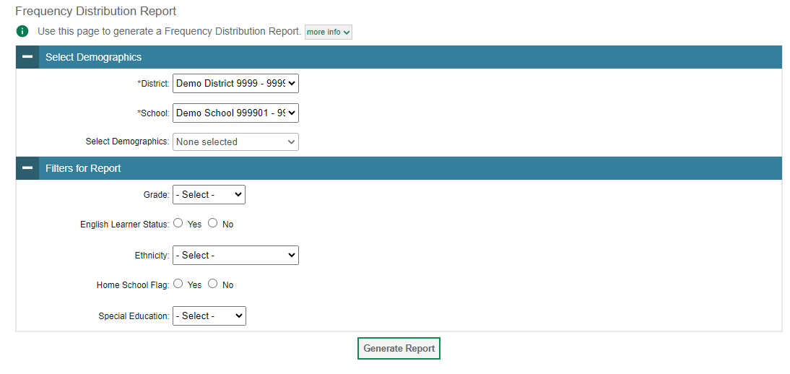
Frequency Distribution Reports
Notes:
A frequency distribution report pulls demographic and enrollment information based on the selected criteria.
To generate a report from the Frequency Distribution Report page, select a district and school from the drop-down lists (if available). Mark checkboxes in the Select Demographics panel to filter the report for additional demographics and accommodations, as desired.
Click Generate Report to display a frequency distribution report using the selected criteria.

Slide 40
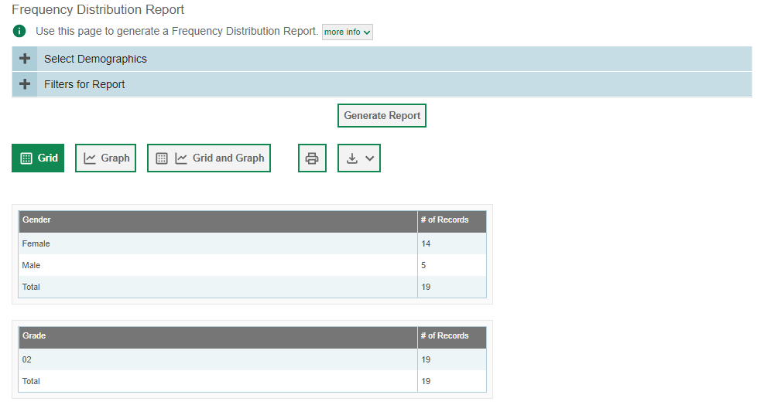
Frequency Distribution Reports, continued
Notes:
TIDE will display the frequency distribution report in grid format. This example shows a report by gender and grade.
To display the report in tabular format, click Grid.
To display the report in graphical format, click Graph.
To display the report in both tabular and graphical format, click Grid and Graph.
To download the report as a PDF file, click the print icon and then save the file to your computer. To export the report in Excel format, click the export button located next to the print button, and choose “Export to Excel” from the drop-down menu.

Slide 41
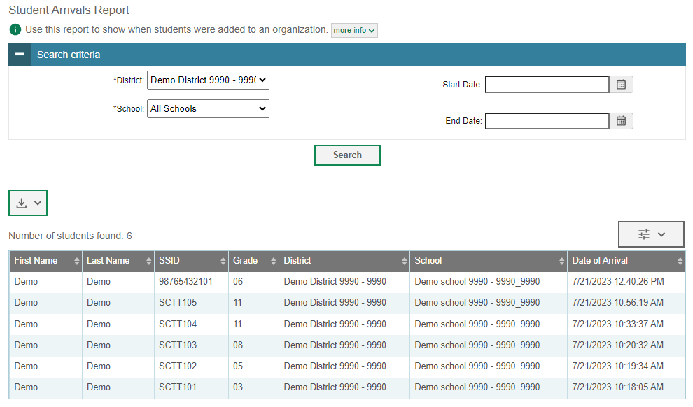
Record Add/Remove Date Reports
Notes:
The Record Add Date Report and Record Remove Date Report selections for District- and School-level users. These reports displays the date of when student records were added to or removed from their organization for either single-enrolled or dual-enrolled statuses by following the steps below.
From the Students task menu on the TIDE dashboard, select Record Add Date Report or Record Remove Date Report. The selected page appears.
Enter search criteria.
Select Search.
The report appears, displaying student records matching the search criteria.

Slide 42
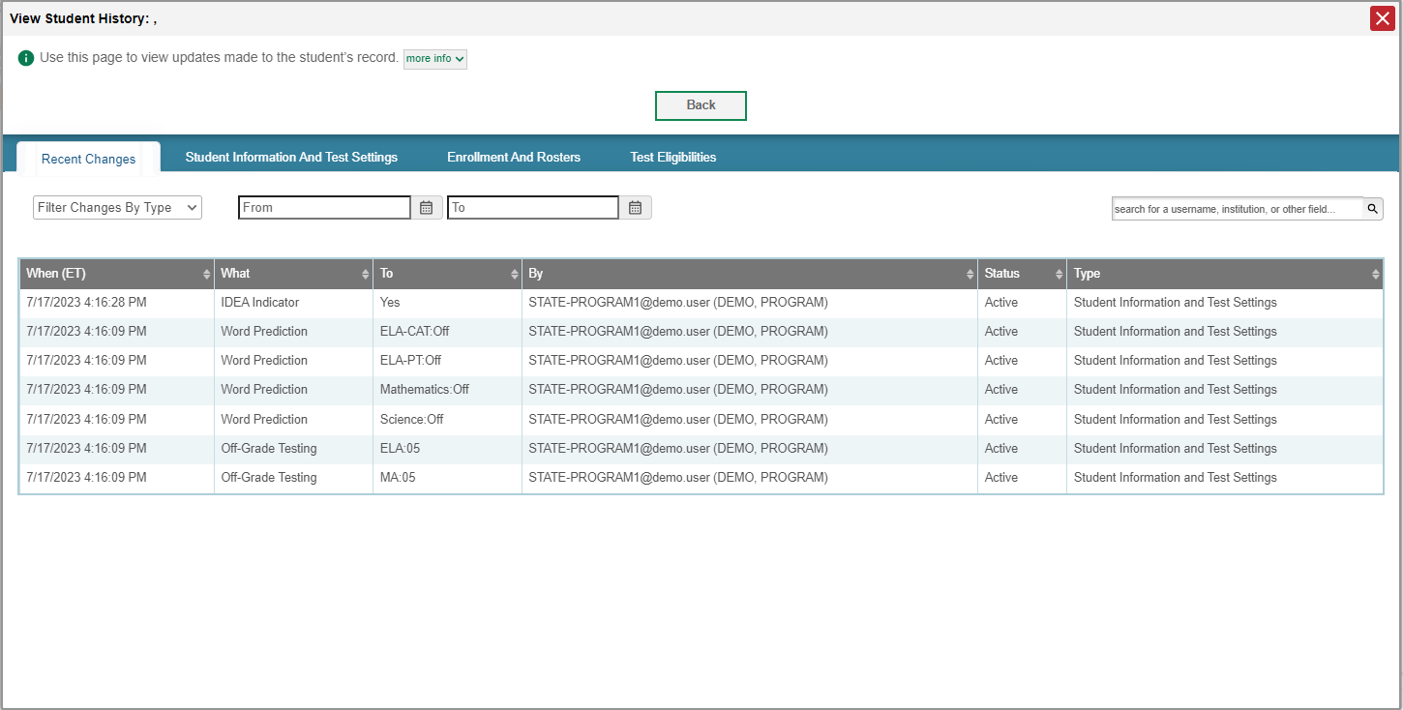
View Student History
Notes:
To access a student’s history, district-level users can view the Student Record History report by clicking the View History button located on the View/Edit student page. The Student Record History displays all changes made to a student's record, including active and inactive statuses, along with the username or process that made the change. When a student is first saved in TIDE, the recent changes will display all settings, including default settings. If the updates to the student were loaded in from the nightly student file from CEDARS, the By column will read “System (system, system).”
Authorized TIDE users can use the tabs to filter through the history of recent changes, student information and test settings, enrollment and rosters, and test eligibility for the selected student. The history is limited to displaying changes from August 22, 2023 to the present.

Slide 43
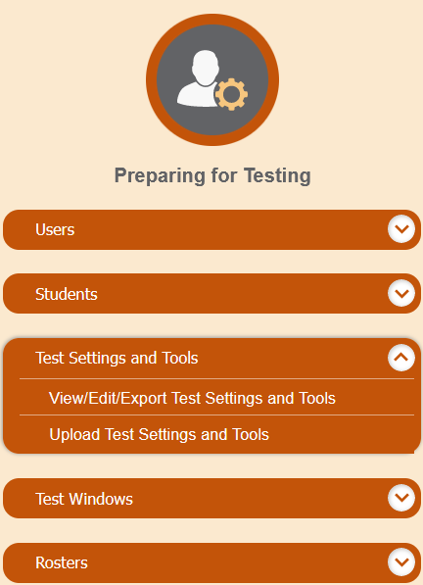
Test Settings and Tools
Notes:
TIDE keeps track of student test settings, such as font size and text-to-speech. The Test Settings and Tools task menu allows you to view, edit, export, or upload test settings and tools.

Slide 44
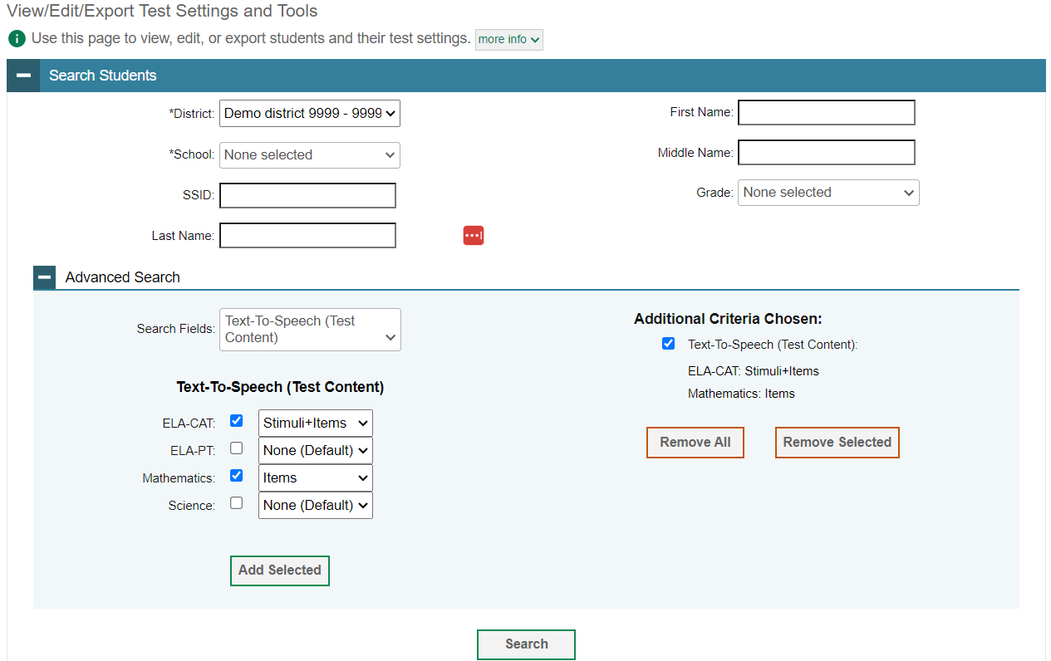
View/Edit/Export Test Settings and Tools
Notes:
The View/Edit/Export Test Settings and Tools page includes a form for setting selection criteria to retrieve a student’s test settings and tools. Required criteria, such as the district and school in this example, are marked with asterisks. Other criteria are optional, such as the student ID and the student’s first or last name. Your state’s TIDE may have other fields by which you can retrieve students’ test criteria.
You can further refine your criteria by entering additional demographic information or test settings in the Additional Search panel, if the panel is available.
The students you can retrieve on this page are limited by your role’s scope. For example, if you are a district-level user, you can retrieve settings for those students enrolled within your district. If you are a school-level user, you can retrieve settings for those students enrolled within your school.
Click Search to continue. You will see a message asking whether you would like to view the results of your search, export the list of students to your Secure File Center, or modify your search criteria and try again. If you choose to export the results to your Secure File Center, you will receive an email when the file is ready for you to download.

Slide 45
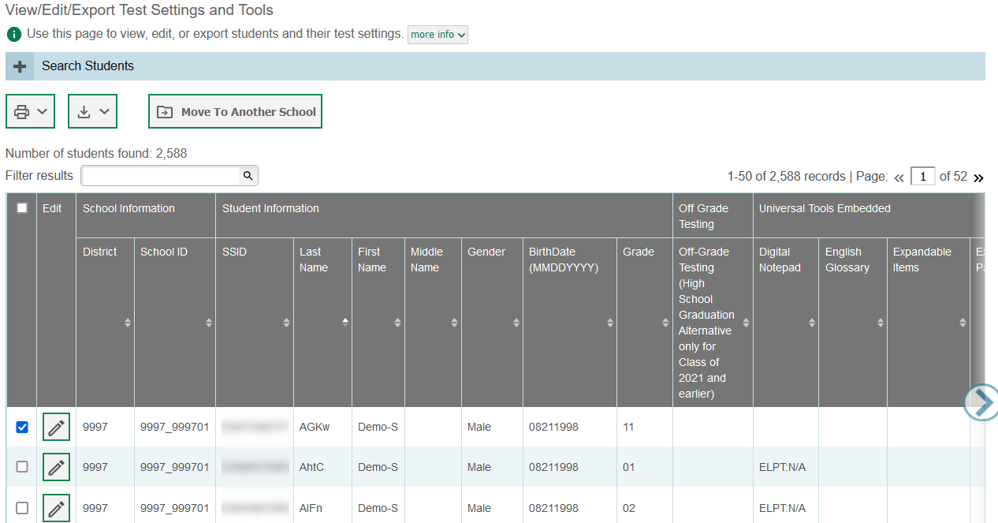
View/Edit/Export Test Settings and Tools Results
Notes:
When you click Search, TIDE will display all the students who satisfy the search criteria. If all columns cannot fit on the screen at once, click the arrow on the right side of the screen to scroll right and display more information. You can edit a student’s test settings and accommodations by clicking the pencil icon.
To make the search form re-appear and search for additional students, click the plus sign in the Search for Test Settings and Tools to Edit panel, which appears as a blue bar. For more-detailed information on managing student test settings and tools, refer to your TIDE User Guide.

Slide 46
View/Edit/Export Test Settings and Tools Results, continued
Notes:
Print or export student information or delete students from TIDE by selecting the desired students and clicking the Print or Export buttons above the search results.
To export the results, mark the checkboxes next to the results you wish to export and click the export button above the search results. A pop-up window will appear with the option to export to the Secure File Center in either Excel or CSV format.
State- and district-level users can also move selected students from one school to another by clicking Move to Another School.

Slide 47
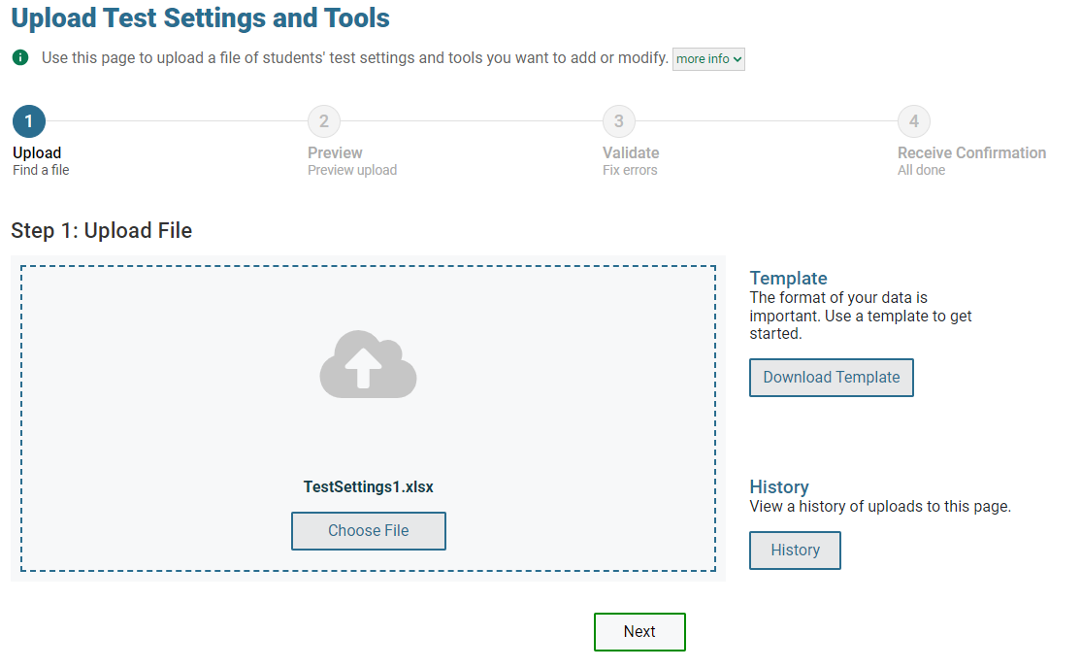
Upload Test Settings and Tools
Notes:
A second way to edit test settings and tools in TIDE is to use the Upload Test Settings and Tools page to create a file in Excel or CSV format and then upload that file. This task is performed by following the same steps you would use to upload new users and students.

Slide 48
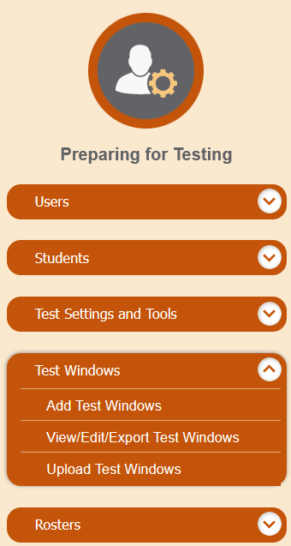
Test Windows
Notes:
The Test Windows task menu allows you to add customized test windows; view, edit, or export test windows; and upload test windows from an external file.

Slide 49
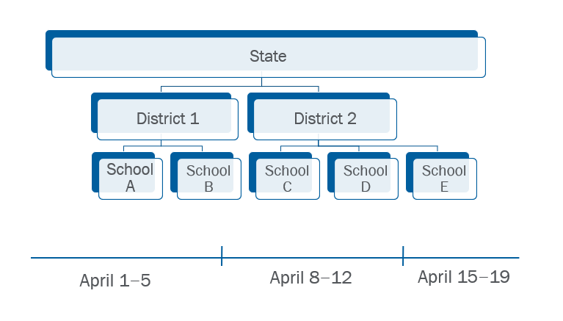
Test Windows Example
Notes:
Prior to the beginning of a school year, OSPI establishes the test windows for each assessment and each subject. Individual districts or schools need to create customized test windows within those state mandated windows. Local staff will need to create windows for ELA and math online testing, and separate windows for WCAS online testing. Creating these test windows helps ensure summative assessments cannot be administered outside of the school or district's designated test window.
In this example, a state has two districts: District 1 and District 2. The state sets a default test window of April 1–19 for a particular test. The schools in District 1 (School A and School B) offer the tests during that time. District 2 has some disruptions in the academic year, so it changes its test window to April 8–12 for the same test; therefore, its subsidiary schools (School C and School D) also offer the test during that time. School E, also part of District 2, encounters extenuating circumstances and moves its test window a week further, to April 15–19. Please note that this is only an example to demonstrate how the test windows in TIDE function. Schools/Districts should avoid waiting to test until the last week of the state test window if at all possible.

Slide 50
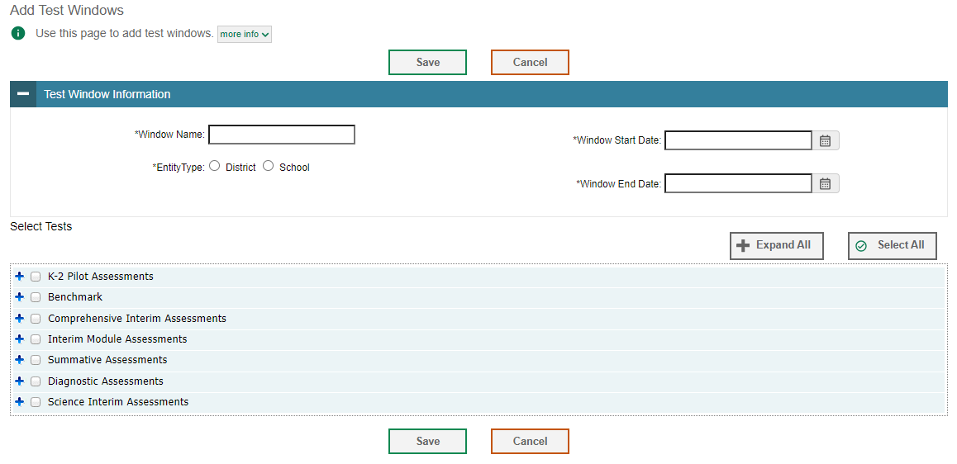
Add Test Windows
Notes:
You can manually create a customized test window on the Add Test Windows page.
Begin by entering a name for the test window in the Window Name field. Next, select an entity type for which you want to add a test window: District or School. From the State, District, and School drop-down lists (as available), make selections for the district, state, and school. Then, enter the test window’s start and end dates.

Slide 51
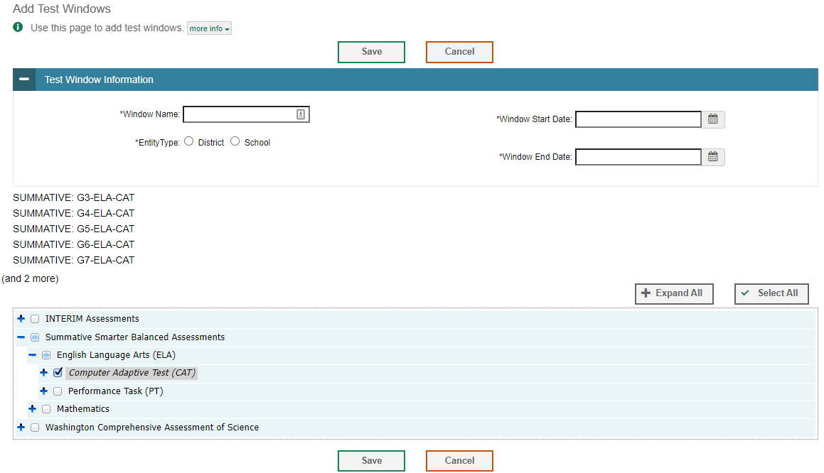
Add Test Windows, continued
Notes:
Next, in the test category section, select tests to add to this test window. Use the plus and minus icons to expand or collapse options under each category.
To add a single test to the window, select the checkbox next to a test. You can add multiple tests to the window by marking checkboxes next to the tests you want to add.
To remove tests from the window, select the checkboxes next to the tests you want to remove to deselect them.
Click Save to save the new test window. The new test window will take effect immediately in the Test Administrator (also known as TA) Interface.

Slide 52
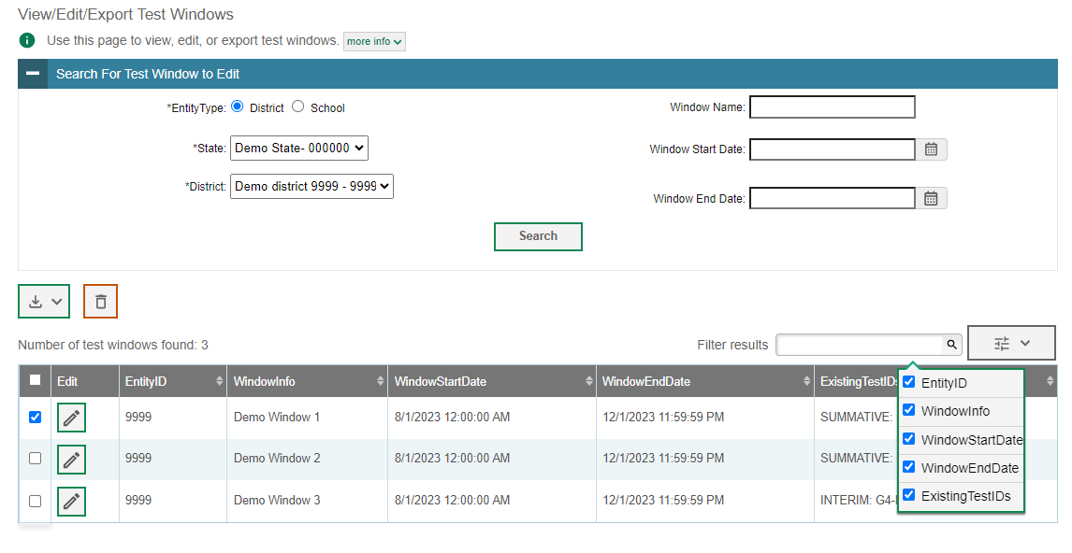
View/Edit/Export Test Windows
Notes:
The View/Edit/Export Test Windows page includes a form for setting selection criteria to retrieve test windows. Select the district and/or school associated with the test window you wish to retrieve and enter additional criteria as desired. Click Search to display a list of test windows matching your criteria. The search panel will automatically collapse, and your search results will appear below. To show or hide table columns, click the drop-down menu in the upper-right corner above the results table. Check the boxes next to the columns you want to appear in your table.
Click the pencil icon next to a test window to view or edit its details. The Edit Test Window form will appear. This form is similar to the form used to add test windows. You may edit the test-window label, start and end dates, and tests in the same way that you would edit a new test window.
To export the results, mark the checkboxes next to the results you wish to export and click the Export button above the search results. A pop-up window will appear with the option to export to the Secure File Center in either Excel or CSV format.
Delete test windows from TIDE by selecting the desired windows and clicking the trash can icon.

Slide 53
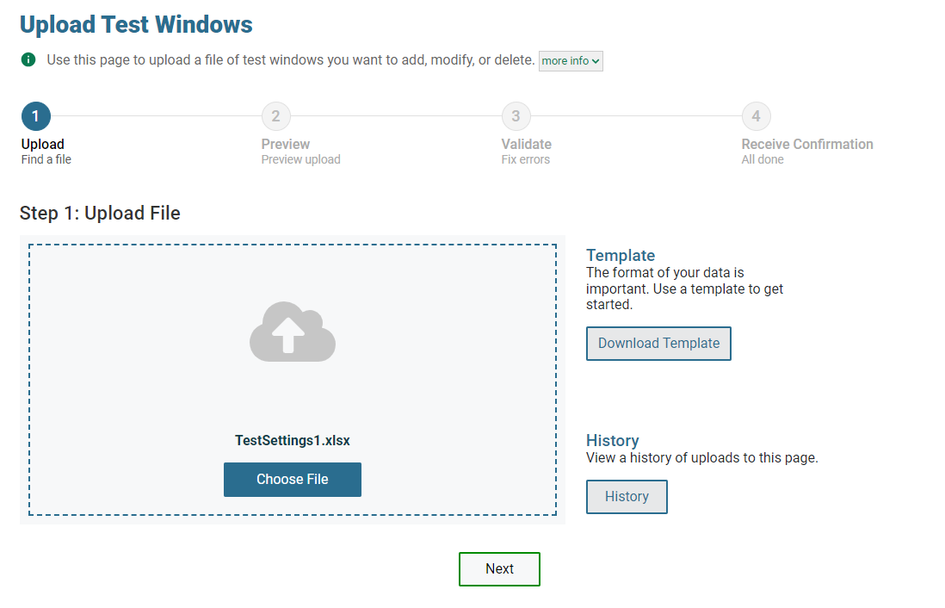
Upload Test Windows
Notes:
A second way to add new test windows to TIDE is to use the Upload Test Windows page to create a file in Excel or CSV format and then upload that file. This task is performed by following the same steps used for uploading new records, such as users and students.

Slide 54
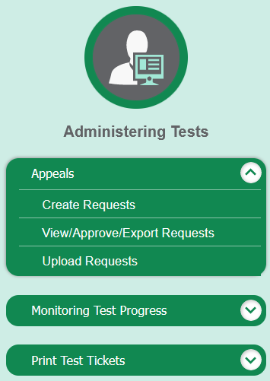
Appeals
Notes:
In the Administering Tests section of the TIDE dashboard, the Appeals task menu allows you to view pending appeals; create new appeals; view, approve, or export appeals; and upload appeals.
In the normal flow of a test opportunity, a student takes the test in the test delivery system (TDS) and then submits it. Next TDS forwards the test for scoring, and the Smarter Reporting System reports the test scores.
Appeals are a way of interrupting this normal flow. Reasons for appeals can vary. For example, a student may need the test reopened to complete the test opportunity. A test administrator may need to invalidate a test because of a hardware malfunction or an impropriety.
For information on Washington’s particular terminology, policies, and procedures, please consult the Professional Assessment Standards Security, Appeals, and Reporting Guidelines.

Slide 55
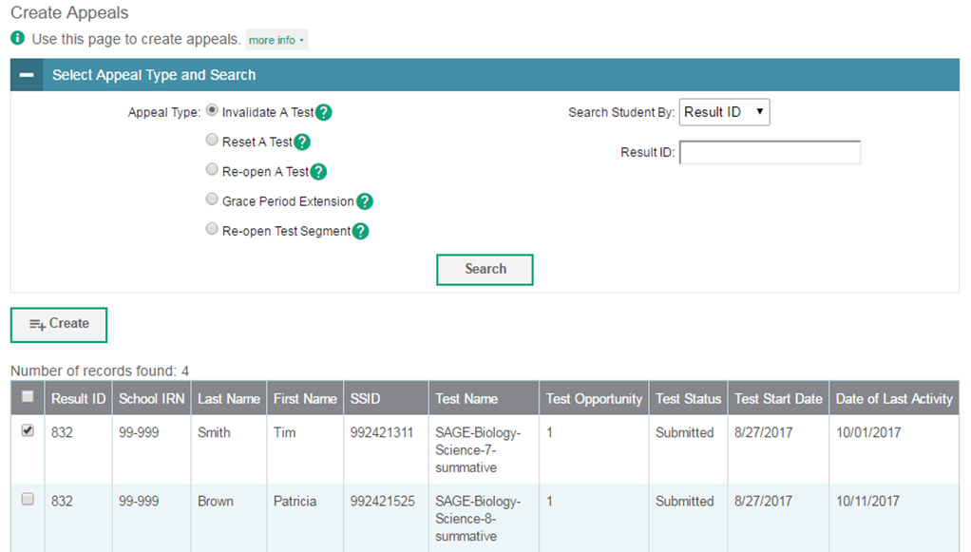
Create Appeals
Notes:
The Create Appeals page is where you can create an appeal for a test.
The first step is to select the type of appeal you want to create. The TIDE User Guide lists the available appeal types and explains the implications of each.
Next, search for the test result for which you wish to create an appeal. From the drop-down lists and in the text field, enter your search criteria and click Search. TIDE will display the search results below.
Mark the checkbox next to each test result for which you wish to create an appeal, and click Create. A pop-up window will ask you to enter a reason for the appeal. To create the appeal, enter a reason and click Submit.

Slide 56
Status of Appeals
Appeal Status | Description of Status
Error Occurred | An error occurred while the appeal was being processed.
Item Information Sent | Information regarding a Report Problem with Item appeal was sent to the designated recipients.
Pending Approval | The appeal is pending approval.
Processed | The appeal was successfully processed and the test opportunity has been updated.
Rejected | Another user rejected the appeal.
Rejected by System | The TDS was unable to process the appeal.
Requires Resubmission | The appeal must be resubmitted.
Retracted | The originator retracted the appeal.
Submitted for Processing | The appeal was submitted to the TDS for processing.
Notes:
After an appeal is created, its status can change throughout its life cycle. This table describes the possible statuses an appeal can have.

Slide 57
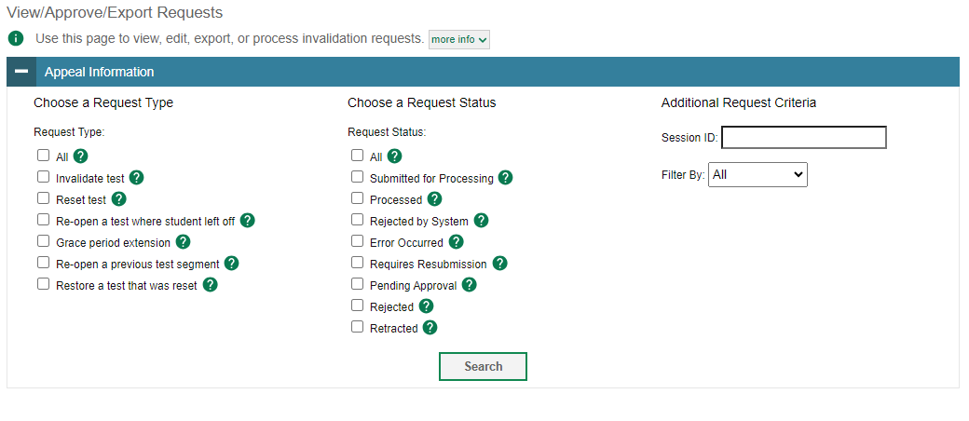
View/Approve/Export Appeals
Notes:
You can review submitted appeals from the View/Approve/Export Appeals page. Select an appeal type and status and enter additional search criteria as desired. Click Search to display appeals matching your criteria.

Slide 58
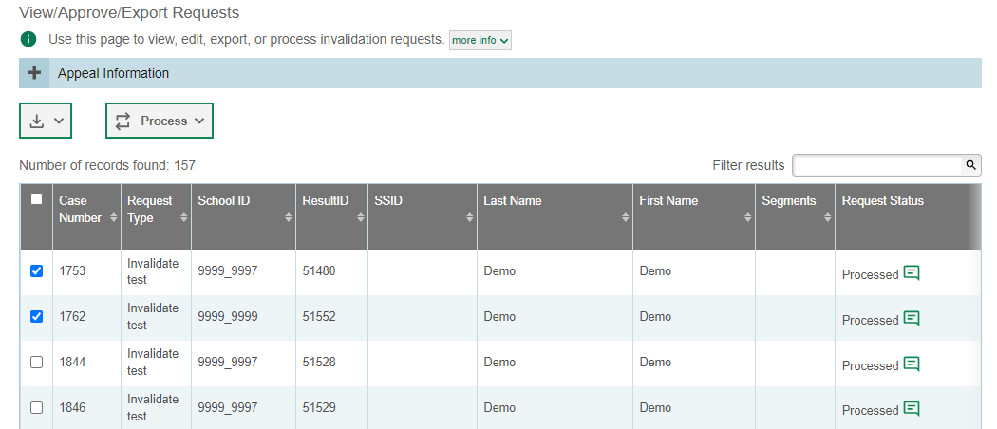
View/Approve/Export Appeals Results
Notes:
When you click Search, the search panel will automatically collapse, and your search results will appear below.
To view the approval and processing status of an appeal, click the green comment icon in the Appeal Status column.
To retract, or resubmit an appeal, mark the checkbox next to it, click Process, and then select the action you wish to perform.
To export the results, mark the checkboxes next to the results you wish to export and click the green export button above the search results. A pop-up window will appear with the option to export to the Secure Inbox in either Excel or CSV format.
Approving an appeal will update the test opportunities and results accordingly. Rejecting an appeal will continue the processing of test results as if the appeal had never been submitted.

Slide 59
Upload Appeals
Notes:
A second way to create new appeals in TIDE is to use the Upload Appeals page to create a file in Excel or CSV format and then upload that file. This task is performed by following the same steps used to upload new users and students.

Slide 60
Monitoring Test Progress
Notes:
The tasks available in the Monitoring Test Progress task menu allow you to generate various reports that provide information about a test administration's progress.
Several types of participation reports are available:
The Plan and Manage Testing report details all of a student’s test opportunities and the status of those test opportunities.
The Test Completion Rates report summarizes the number and percentage of students who have started or completed a test.
The Test Status Code Report displays all the participation codes for a test administration.
The Participation Search by SSID report shows test participation for specified students.

Slide 61
Plan and Manage Testing
Notes:
The Plan and Manage Testing reports detail all of a student’s test opportunities and the status of each test opportunity. Because the report lists testing opportunities, a student can appear more than once on the report.
To generate a report from the Plan and Manage Testing page, in the Search Students panel, select a district, school, and teacher if applicable. The fields marked with an asterisk are mandatory. You can refine your search by adding additional criteria under the Advanced Search section.
Next, select a test instrument and administration in the Choose What panel.
Finally, in the Get Specific panel, choose one of the filter options available and select parameters for that option.
Click Generate Report to view your Plan and Manage Testing report, or click Export Report to open the report in Excel.

Slide 62
Plan and Manage Testing Results
Notes:
Clicking Generate Report will display the report and collapse the Report Criteria panel. Because not all columns can fit on the screen at once, you must click the blue arrow on the right side of the screen to scroll right and display more information.

Slide 63
Plan and Manage Testing Examples
Which students have not yet tested?
Which students need to test in the next five days?
Which students have paused tests?
Did all students in a test session submit their tests?
Notes:
This slide illustrates some common questions that can be answered using the options available in the View Participation PMT Test Filter Report panel.
To find students who have not yet tested, click the first radio button and search for students who have not completed their test opportunity in the selected administration.
To find students whose test opportunities are expiring, click the second radio button for Which students need to test in the next five days? and specify the number of days or range of days you want to search.
To find students who have paused tests, click the third radio button and search for students on their first test opportunity in the selected administration with a status of paused.
To find out if all students in a test session submitted their tests, click the fourth radio button and search for students by test session ID between the dates when the test session took place.

Slide 64
Test Session Status Report
Notes:
The Test Session Status Report details active and inactive test sessions happening in a district and/or school. These reports show how many students in each school are testing and how many have started, paused, and completed their test. School-Level Test Session Status reports also include additional information such as proctor name, test name, and test session start time.
From the Test Session Status Report page, select a district and school from the drop-down lists. Then, click Generate Report. A detailed report page will appear.

Slide 65
Test Completion Rates
Notes:
The Test Completion Rates report summarizes the number and percentage of students who have started or completed a test.
To download a report from the Test Completion Rates page, choose the type of report you wish to export from the Report Types drop-down list. Select a district and school from the corresponding drop-down lists, if available. Finally, select a test name and administration. Note that fields marked with an asterisk are mandatory. The Additional Options search field can be utilized to further refine your search.
To download the report as an Excel spreadsheet, click Export Report.

Slide 66
Test Completion Rates, continued
Notes:
If multiple schools were selected, a Summary Report page will first appear. From this page, select a school name to view a detailed report for that school.
Details of sessions created on the day that the Test Session Status Report will appear. To view inactive test sessions, mark the inactive test sessions checkbox. The list of tests administered at the school, the start time of the session, the number of students currently testing, the number of students paused, and the number of students who have completed their tests are all displayed here.

Slide 67
Test Status Code Report
Notes:
The Test Completion Rates report summarizes the number and percentage of students who have started or completed a test.
To download a report from the Test Completion Rates page, choose the type of report you wish to export from the Report Types drop-down list. Select a district and school from the corresponding drop-down lists, if available. Finally, select a test name and administration. Note that fields marked with an asterisk are mandatory. The Additional Options search field can be utilized to further refine your search.
To download the report as an Excel spreadsheet, click Export Report.

Slide 68
Participation Search by SSID
Notes:
The Participation Search By SSID page allows you to generate participation reports for specified students. Enter a single SSID or multiple SSIDs separated by commas into the Student ID(s) box. You can also upload a single-row Excel file containing student ID numbers. Click Generate Report to view the results.

Slide 69
Print Test Tickets
Notes:
A test ticket is a printed form that includes a student’s login information to start taking a test. You can print test tickets from a student list or from a previously uploaded roster.

Slide 70
Print Test Tickets from a Student List
Notes:
To print test tickets from a student list, click Print from Student List from the Print Test Tickets task menu. Complete the fields under the Search Students panel. The fields marked with an asterisk are mandatory. To further refine your search results, select additional search fields in the Advanced Search panel. Click Search to view your results.

Slide 71
Print Test Tickets from a Student List, continued
All
Students
Specific
Students
Notes:
Next, select the students for whom you want to print test tickets. To print test tickets for specific students, mark the checkboxes for the students you want to print. To print for all students on the page, mark the checkbox at the top of the table. To print for all retrieved students, no additional action is necessary. This option is available by default.
Click the printer icon and select an option from the drop-down menu. A test-ticket layout screen will appear. Choose a test-ticket layout and the test-ticket Print option. When you click Print, a PDF file of the test tickets will be downloaded.

Slide 72
Print Test Tickets from a Roster List
Notes:
To print test tickets from a roster list, click Print from Roster List from the Print Test Tickets task menu. Complete the fields under the Search for Rosters to Edit panel. The fields marked with an asterisk are mandatory. Click Search to display your results.

Slide 73
Print Test Tickets from a Roster List, continued
All
Rosters
Specific
Rosters
Notes:
Next, select the roster for which you want to print test tickets. To print test tickets for specific rosters, mark the checkboxes for the rosters you want to print. To print for all rosters on the page, mark the checkbox at the top of the table.
Click the printer icon and click the Test Tickets option from the drop-down menu. A test-ticket layout screen will appear. Choose a test-ticket layout and print option and click Print. A PDF file of the test tickets will be downloaded.

Slide 74
Sample Student Test Ticket
Notes:
Here is a sample image of what a student test ticket looks like.

Slide 75
Data Cleanup
Notes:
In the After Testing section of the TIDE dashboard, the Data Cleanup task menu lets users enter participation codes to explain student participation and resolve test discrepancies.

Slide 76
Participation Codes
A participation event occurs when a student does not take a test as scheduled.
A code is assigned to explain the student’s non-participation.
Participation codes persist until they are changed.
Participation codes may also be referred to as special codes. There are two types of special codes:
Student Exemption Codes: Student exemptions are entered at the subject level and can be added before, during, or after testing
Attempt Codes: Attempt codes can only be added after the student begins a specific test opportunity.
Notes:
There are circumstances in which a student did not participate in an expected test or participated in a test but in a non-standard way. Examples could include a student inadvertently taking an incorrect test, a parent opting a student out of testing, or the student not receiving appropriate instruction prior to the test. In such instances, you need to assign a participation code to the student’s test so that the Reporting System can accurately explain the participation.
Please note that once you apply a participation code, that code persists until it is changed. For example, if you apply a participation code for an interim assessment, that code also applies to a summative assessment unless you explicitly change it.
Participation codes are for your records only, OSPI does not collect or use this information. For a list of participation codes and their descriptions, consult the TIDE User Guide.

Slide 77
View Participation Codes
Notes:
To view or edit a student’s participation codes from the Participation Codes page, select a district and school from the drop-down lists, if available. You may enter a student’s first or last name, external ID, or assessed grade, if desired. You can further refine your criteria by entering additional demographic information or test settings in the Additional Search panel.
Click Search to retrieve a list of students matching your selected criteria. If your user role permits, you can edit a student’s participation codes by clicking the pencil icon.

Slide 78
View/Edit Participation Codes Results
Notes:
When you click the pencil icon, another page will appear where you can edit and save the student’s participation codes. The Student Information panel provides the student’s demographic information. The student’s available tests and special codes are listed in the Special Codes panel.
To edit the student’s participation codes, from the drop-down lists in the Special Codes panel, select the special code for each available test, as required, and click Save.

Slide 79
Upload Participation Codes
Notes:
A second way to upload participation codes in TIDE is to use the Upload Participation Codes page to compose an upload file in Excel or CSV format and then upload that file. The Test Name and Special Code columns of the Excel file are pre-populated with possible selections. This task is performed by following the same steps used to upload new users and students.

Slide 80
Contact Your Help Desk
You can contact the Help Desk for assistance with any technical issues you encounter.
When contacting the Help Desk, please be ready to provide the following information:
•Any error messages that are appearing (including codes)
•Your operating system and browser information
•Your network configuration information
•Your contact information for follow-up by telephone or email
•Any other relevant information, such as test names or content areas, student IDs, session IDs, and search criteria
For test administration or policy issues, please contact your District Test Coordinator.
Notes:
You can find the TIDE User Guide and other helpful resources on your state assessment portal. However, if you still require assistance with troubleshooting a technical issue, you may also contact your Help Desk. When contacting your Help Desk, please be ready to provide the following information:
Any error messages that are appearing (including codes)
Your operating system and browser information
Your network configuration information
Your contact information for follow-up by telephone or email
Any other relevant information, such as test names or content areas, student IDs, session IDs, and search criteria
For questions about test administration or policy issues, please contact your District Test Coordinator.

Slide 81
Thank You!
Further Information
•Washington Comprehensive Assessment Program Portal:
wa.portal.cambiumast.com
• Washington Help Desk:
Tel 1.844.560.7366
wahelpdesk@cambiumassessment.com
Notes:
Thank you for taking the time to view this training module. For additional information, refer to your TIDE User Guide located on the WCAP Portal or contact the Help Desk.

