Slide 1
Teacher assessment scoring center
Training module
2023–2024
Training Module
2022–2023
Copyright © 2022 Cambium Assessment, Inc. All rights reserved.
Copyright © 2023 Cambium Assessment, Inc. All rights reserved.
Notes:
Welcome to the Teacher Assessment Scoring Center training module. The Teacher Assessment Scoring Center (TASC) allows authorized users to enter scores for item responses that require human scoring. After students complete Smarter Balanced Interim Assessments in ELA and Math in the Student Testing Site, their responses to machine-scored items are scored automatically, while their responses for hand-scored items are sent to TASC. To complete the scoring process, you must enter and submit scores or condition codes for every hand-scored item on that test.

Slide 2
Objectives
TOPICS | SLIDES
How to Access TASC | 3–4
How to Score and Submit Item Responses | 5–9
How to Change Schools | 10
Overview of Condition Codes | 11-12
More Information | 13
Notes:
This presentation covers tasks you can perform within TASC. First, we show you how to access the system. Then we cover the two-step process of scoring item responses and submitting them. If you score tests for students in more than one school, we show you how to change schools without logging in to the system again. We conclude with an overview of the condition codes available for use if a student response is not scorable.

Slide 3
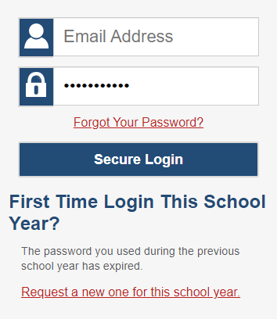
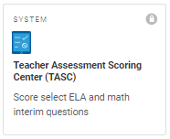
How to Access TASC
Notes:
To log in to TASC, go to your portal. Select the Smarter Balanced ELA and Math Assessment card. Next, select the TASC card. Enter the email address associated with your Test Information Distribution Engine (TIDE) account and your password. Then select Secure Login.

Slide 4
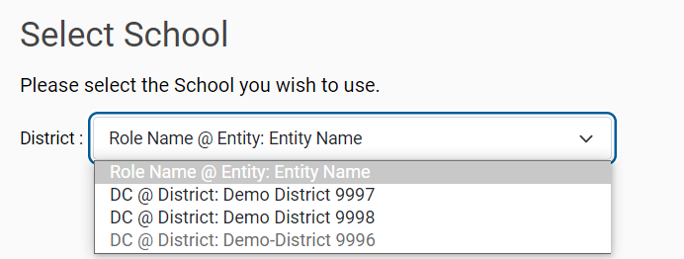
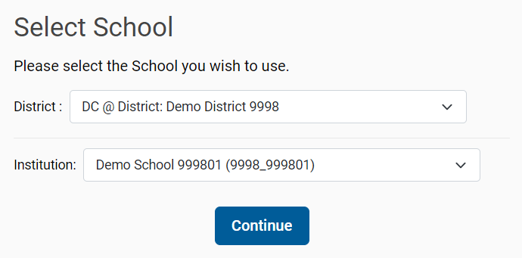
Select School
Notes:
If the Select School page appears, select the appropriate school for which to score student responses. You can change your selected school after logging in if you need to score tests for students at another school.
Note: If the school’s name is grayed out in the Teacher drop-down there are no unscored items in TASC for this school.

Slide 5
Dashboard
Tests to Score Process = Scoring + Submitting the Scores
5
Notes:
The Dashboard includes assessments completed by students in your jurisdiction. For TAs, this includes students in your TIDE rosters and/or students who finished an interim in one of your test sessions. For those with the SC and IS roles, you can see all the interim tests that need to be scored for students in your school. For those with the DC and DA roles, you can see all the interim tests that need to be scored for students in your district.
The table displays the test reason, the number of your students who completed it, the number of item responses you need to score, the number of scored responses you need to submit, and the most recent date on which a student of yours completed the test. You can click the arrows in any column header to sort the table by that column.
Select an underlined assessment name (or the magnifying glass view button beside it) to begin the scoring process for the items on that test.

Slide 6
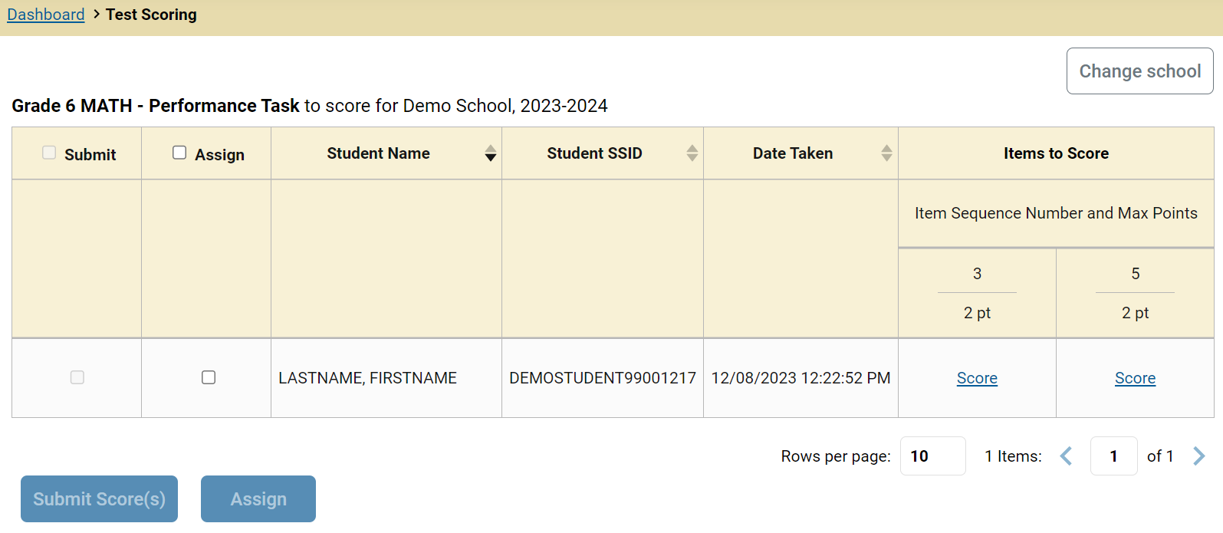
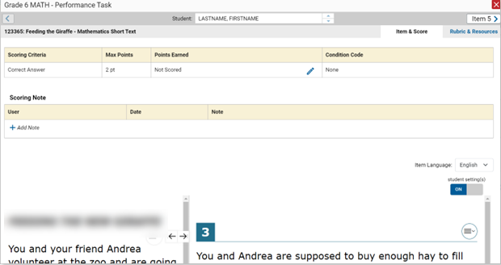
Test Scoring Page and Scoring Window
Notes:
The Test Scoring window now displays a list of students and items awaiting scoring for the selected test. Items 3 and 5 need to be scored. The Submit Scores button will remain grayed out until all the unscored items have been scored.
To enter scores for an item, click the Score link. The scoring window opens to the Item & Score tab. You can toggle to the Rubric & Resources tab to review the item’s scoring rubric and any other available resources for help in scoring the item.
Click the edit icon in the Scoring Criteria table to score the item.

Slide 7
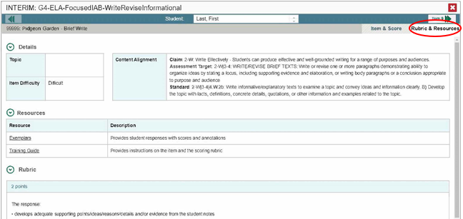
Rubric & Resources Tab
7
Notes:
Here you see the Rubric & Resources tab open for a Brief Write for an Interim that needs to be hand-scored. The various sections of the window provide detailed information regarding the item, some resources to access for guidance in scoring, and a detailed rubric outlining the characteristics of each point value allowed for the item. Information varies according to the type of test and type of item.

Slide 8
Scoring Window
Notes:
When you click the pencil icon, the scoring criteria table adjusts to display a drop-down menu for adding Points Earned, and a drop-down menu for selecting a Condition Code if the student response is un-scorable. Below those fields is a Scoring Note box, allowing you to enter comments regarding the student response and why it was scored the way it was. Scroll down to read the student response to the item.
After entering data in the Scoring Criteria and Scoring Note sections, click Save in both places.
To advance to the next item needing a score, click the advance arrow in the banner to the right of the student's name, in the upper-right corner.

Slide 9
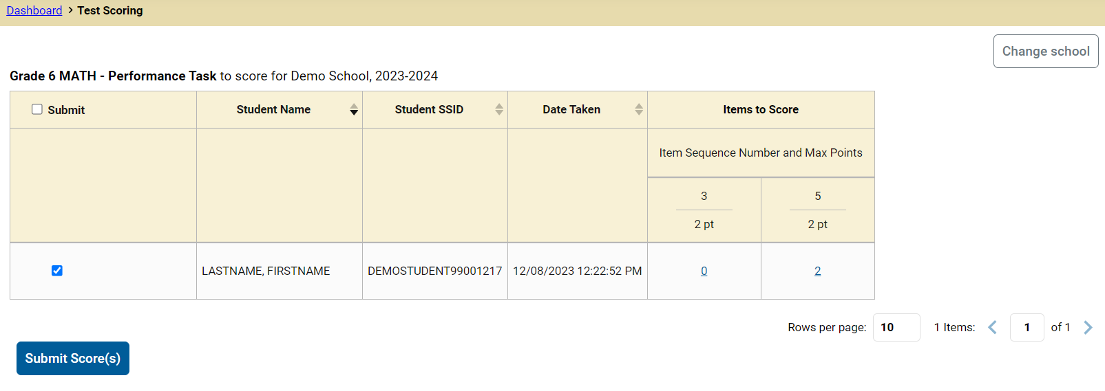
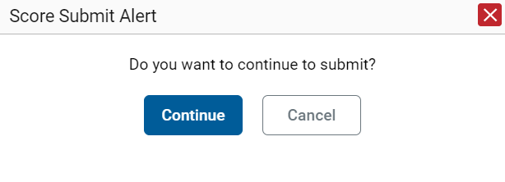
Submit the Scores
Notes:
When scoring for all items has been completed, the Test Scoring page will display the points assigned to each item.
Check the box to the left of the student's name and then click the Submit Scores button to send the scores to officially submit the scores.
The Score Submit Alert window will appear. Click Continue to confirm. The selected items will be submitted for processing and reporting and removed from the table.

Slide 10
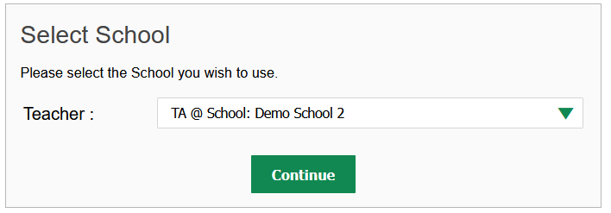
Change the Selected School
10
Notes:
You may have access to more than one school’s students and tests needing hand scoring. If so, you can click the Change School button to the upper right of the assessments table. The Select School page appears. From the Teacher drop-down, select the school whose student responses you wish to score. Click Continue. The Dashboard page appears, displaying the tests available for the selected school. You don’t need to sign out and log back in again.

Slide 11
Overview of Condition Codes
Condition Code | Description
Blank | The student did not enter a response.
Insufficient Text | The student has not provided a meaningful response. Random keystrokes. “I don’t know.” The response is too brief to determine whether it is on purpose or on topic.
Non-Scorable Language | Written in language other than English.
Off Purpose | A writing sample judged off-purpose should be scored on conventions.
Off Topic | A writing sample will be judged off topic when the response is unrelated to the task or the sources or shows no evidence that the student has read the task or the sources (especially for informational/explanatory and opinion/argumentative).
Notes:
Condition codes are required when a student’s response is not scorable and result in a score of zero for the item, with the exception of the Off Purpose code. Here is a brief overview of some of the condition codes that may be available to you in the Scoring window. These vary by state, test, and type of item. The full table can be found in the Interim Administration Manual and TA Script of Student Directions on the WCAP portal.

Slide 12
Scoring Rules for Off-Purpose Condition Codes
Notes:
For the ELA Full-Write responses, if the response is blank, insufficient, off topic, or in a non-scorable language, the condition code should be applied to all three scoring criteria rows.
However, if the Full-Write response is off-purpose, that condition code only needs to be applied to the Evidence/Elaboration row and the Organization/Purpose row. The Conventions scoring criteria should receive a numeric score of 0, 1, or 2.

Slide 13
More Help
Interim Administration Manual and TA Script of Student Directions
WCAP Helpdesk
Toll-Free Phone Support:
1.844.560.7366
Email Support:
wahelpdesk@cambiumassessment.com
Notes:
Thank you for viewing this presentation on the Teacher Assessment Scoring Center. For more assistance, Interim Administration Manual and TA Script of Student Directions on the WCAP portal or contact the WA Help Desk.

Slide 14
Thank You
Notes:
Thank you for taking the time to view this training module.

