Slide 1
Test Administrator (TA) Interface for Online Testing
Training Module
2023–2024
Copyright © 2023–2024 Cambium Assessment, Inc. All rights reserved.
Notes:
Welcome to the Test Administrator Interface for Online Testing training module. This presentation describes the Test Administrator (TA) Interface that you will use to administer online tests.

Slide 2
Objectives
After viewing this presentation, you should be able to:
Use the TA Interface to start and administer a test session.
View student test settings and accessibility resources.
Monitor the testing process.
Pause and stop a test session.
Transfer sessions between computers and mobile devices.
Print test session information.
Exit and log out of the TA Interface.
Notes:
After viewing this presentation, you should be able to:
Use the TA Interface to start and administer a test session.
View student test settings and accessibility resources.
Monitor the testing process.
Pause and stop a test session.
Transfer sessions between computers and mobile devices.
Print test session information.
Exit and log out of the TA Interface.

Slide 3
Logging In to the TA Interface
Notes:
The TA Interface is used to create and manage test sessions that students join to complete online tests. We will begin with detailed instructions on how to log in to the interface, followed by a detailed review of each feature.

Slide 4
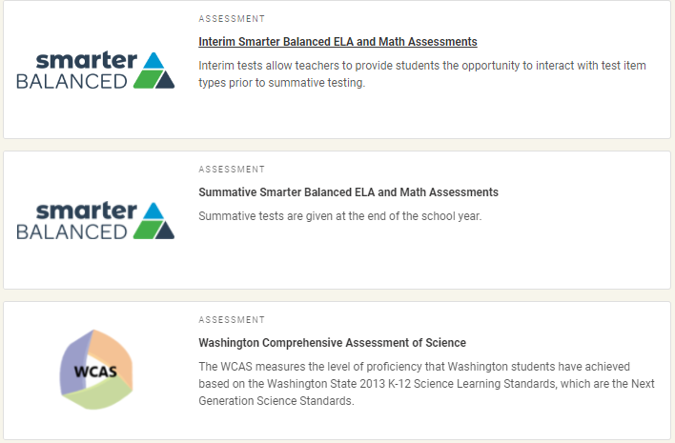
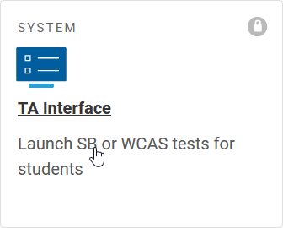
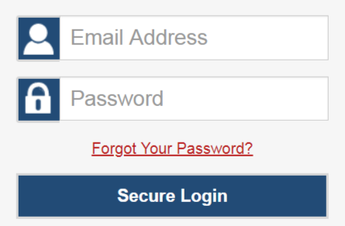
Logging in to the TA Interface
Notes:
To log in to the TA Interface, go to the WCAP Portal. Select the assessment you want to administer, scroll down to the Administering Tests section and select TA Interface. Enter your username and password and click Secure Login.

Slide 5
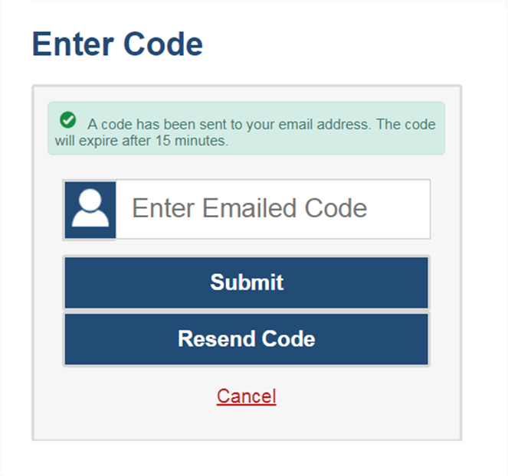
Logging In (continued)
The system has an authentication process that will be triggered when you log in from a different device or browser, or after clearing your browser’s cache.
If you see this screen, an email containing the code will have been sent to your email address automatically.
Enter the code and select Submit.
If you need the code resent, select Resend Code.
Notes:
When logging in to the system using a new device or browser, or after clearing the cache on a previously used browser, you will see an Enter Code page.
If you see this screen, you will need to enter the emailed code on this page within 15 minutes of receiving the email. If you do not receive a code or do not enter the code within the 15-minute time limit, select Resend Code. Select Submit after entering the authentication code to access the system.
Next, we will walk through how to create a test session.

Slide 6
Creating a Test Session
Notes:
The first step in administering any test is to create a test session.

Slide 7
TA Interface Feature Overview
Notes:
In the top right corner of the window, you will see your username with a dropdown menu and a Help button. Select your username to access the Logout button. Select the Help button to access the online Help Guide.
Below the Help button and username on the left side of the window, you will see an Operational Session ID tab, Select Tests tab, Student Lookup tab, and a Menu button.
The session ID is displayed in the Session ID tab. NOTE: This is a change from previous years when the session ID was not displayed until the session was started.
Select the Select Tests tab to add tests to a session.
Select the Student Lookup tab to search for student information using Quick Search and Advanced Search.
Select the Menu button to access the screensaver function and view any approved requests.

Slide 8
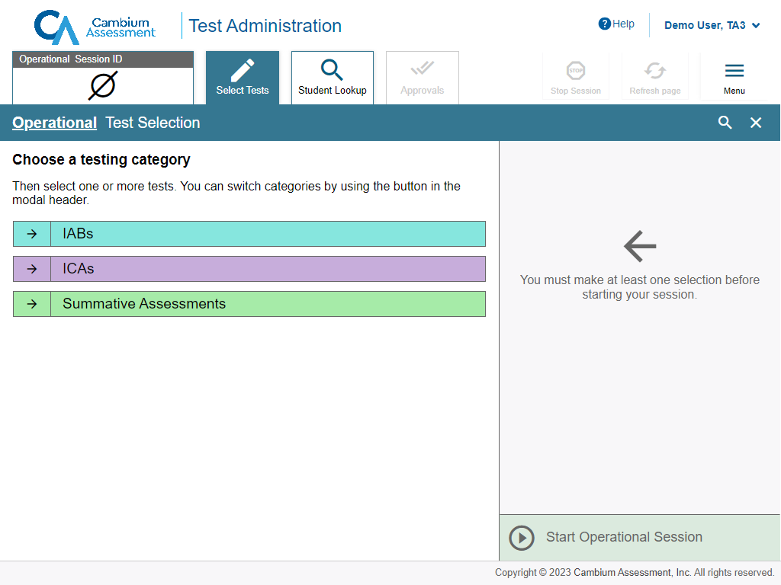
Create a Test Session: Test Categories
Expand category
Notes:
After logging in, the Test Selection tab displays color-coded test categories. It will also list a category for teacher-authored tests if any tests have been created in Authoring.
Select the arrow next to the category name to view all tests in that category.

Slide 9
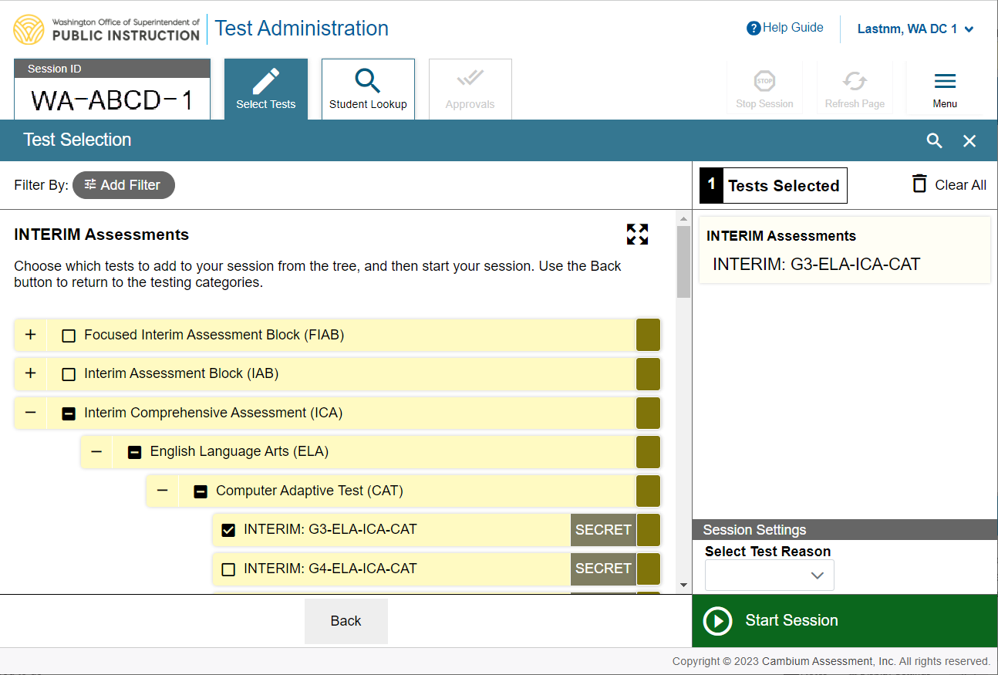
Create a Test Session: Test Selection
Expand test category
Collapse test category
Notes:
Select the plus sign (+) next to a test group name to view the tests in that group. To create a test session, select one or more tests to administer, or select the checkbox for a test group to include all tests in that group. Once you select tests to add to the session, they will appear in the “Tests Selected” column on the right side of the window. If you need to remove a test that you have previously selected, uncheck the box next to that test in the left column.
To add tests from a different test category, select the back button to return to the list of test categories.

Slide 10
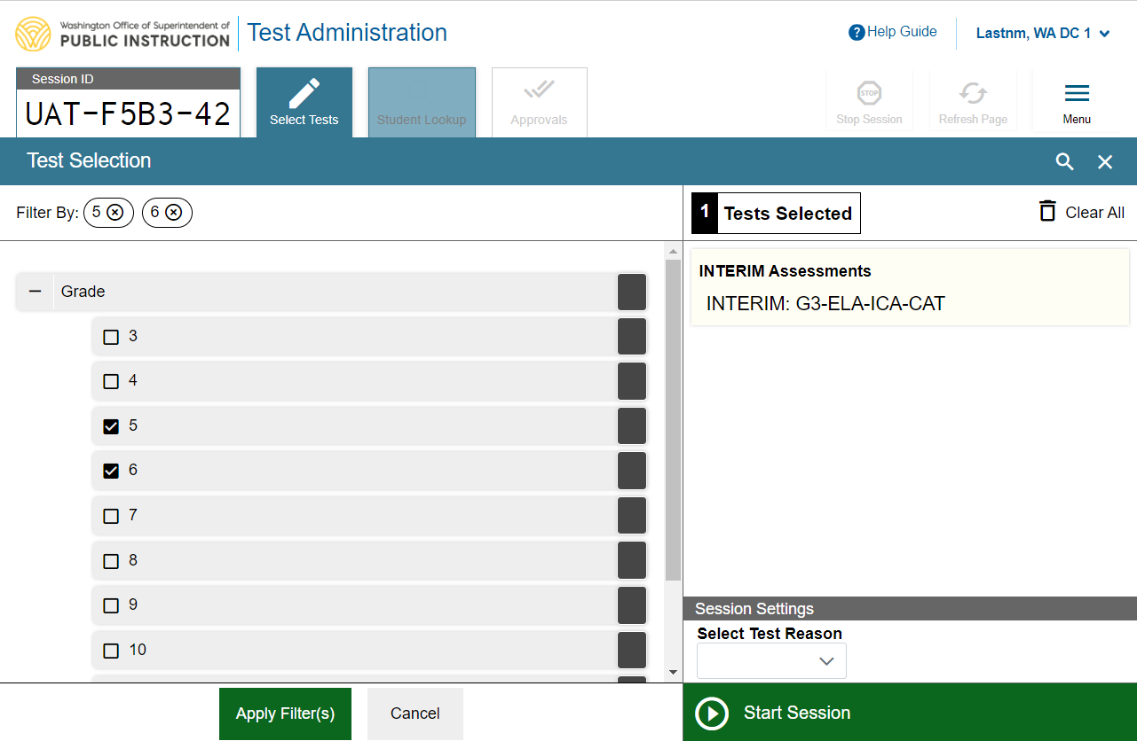
Create a Test Session: Add Filter
Remove filter
Add Filter
Apply Filter
Notes:
You can also filter a list of tests by grade and subject, in order to focus on specific types of assessments.
To filter a list of tests, first select the Add Filter button and the filters panel will appear. Then select the plus sign (+) button next to the grade and/or subject to expand the category and see a list of available grades and subjects. Mark the checkboxes next to the grades and/or subjects you want to filter by. Your selected filters will appear at the top of the window. If you want to remove a filter, select the “x” button next to the filter you want to remove.
Once you are finished selecting filters, select Apply Filter(s).

Slide 11
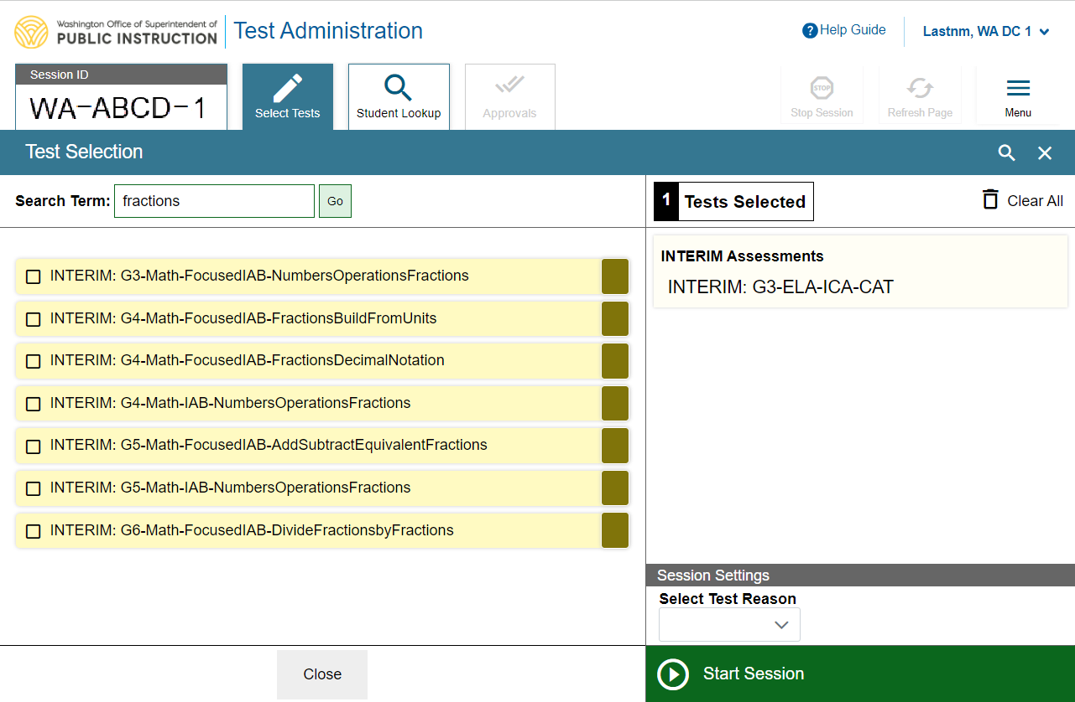
Create a Test Session: Global Search
Search
Add Test
Close
Notes:
You can also search for specific tests to add to your session by using the global search feature.
To search for tests, select the magnifying glass in the upper right corner of window. On the search panel that appears, enter the full or partial test label in the Search Term field and select Go. A list of tests containing your search terms will appear below. Select the test(s) you want to add to your session by marking the checkbox next to the test name. If you want to close the search window, select the Close button at the bottom of the panel.

Slide 12
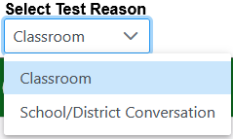
Create a Test Session: Test Reasons
Test Reason
Start Session
Notes:
To administer interim assessments, a test reason must be selected. A drop-down list appears in the Session Settings section. From the drop-down list, select a reason for the session.
For more information on test reasons, see your Test Administrator User Guide.
Once you are finished selecting tests, select Start Session.

Slide 13
Create a Test Session: Summative Agreement
I Agree
Notes:
New this year, test administrators attempting to administer a Summative assessment will receive a prompt when selecting the Start Session button. The TA will need to type “I Agree” before proceeding with the test session.

Slide 14
TA Interface Features After Testing Has Begun
Notes:
Once students are waiting for approval, the Operational Session ID tab displays the session ID and will show the test session table after students are approved to enter the test session and have logged in.
The Approvals tab will become active when any students are waiting for approval. In this example, two students are waiting for approval. In addition, the Stop Session button will become active.
Below the Menu button, you will see a Print icon. Select the print icon to print the test session information.

Slide 15
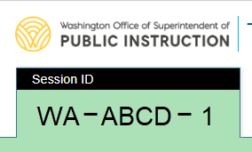
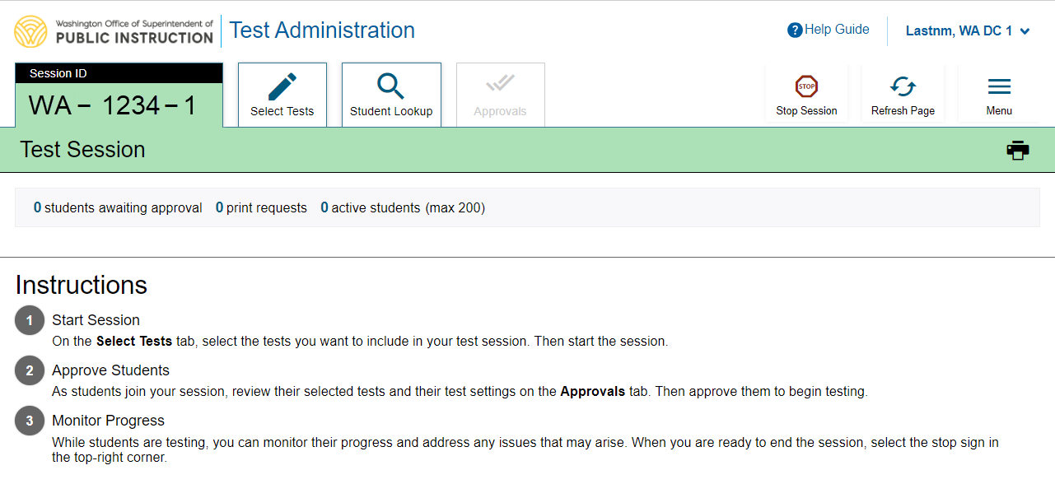
Session ID
Notes:
Once you start a session, the system will automatically generate a session ID. The session ID will show in a tab at the top of the TA Interface. This ID must be given to students for them to log in. You may display it on a whiteboard or provide it to students using a printed card or similar method. If you provide students with the information on paper, be sure to collect and destroy the papers when the session is complete.
You should also note the session ID for your own records. If you accidentally close your browser, entering the session ID will allow you to resume the session. If you do not have this information when you try to resume, you will be unable to do so.
When students start signing into the test session, the Approvals tab will become active. Once you approve students for testing, the Test Session table will show in the center of the TA Interface, displaying students’ testing progress. We will discuss more about this in later slides.

Slide 16
Screensaver Mode
Notes:
Since the student test progress tables in the TA Interface often contain sensitive student information, such as student IDs, the TA Interface contains a screensaver function to hide the data from view. If the screensaver mode is auto-enabled, the screensaver will automatically turn on if you are not active in the TA Site for five minutes.
To turn on screensaver mode, select Menu, select Toggle Screensaver, and then the Session ID displays as a screensaver. It also displays notifications if students are awaiting approval, if there are pending print requests, or if students require other interventions.
The screensaver will turn off automatically if any mouse or keyboard activity is detected. It will also turn off automatically if the test session times out due to TA or student inactivity or once the allotted time expires for a timed test.

Slide 17
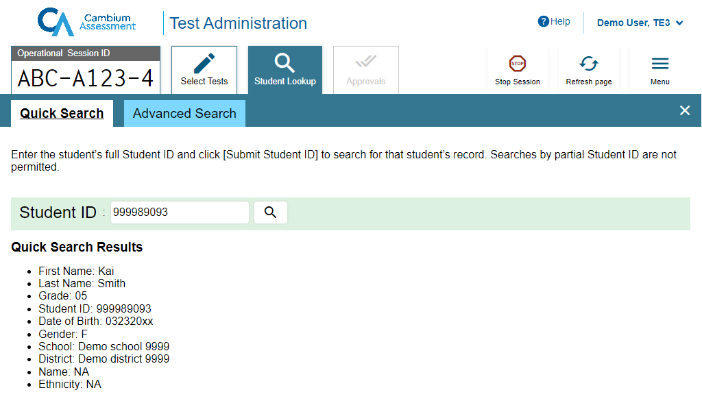
Student Lookup: Quick Search
Search
Notes:
If a student is having trouble logging in, use the Student Lookup feature to verify that the student’s login credentials are correct. You can use either the Quick Search or Advanced Search option to view the information entered for the student in TIDE.
With Quick Search, you simply enter the student’s SSID and select the Search icon.
Results will display. If there is no match, you will see an error message.

Slide 18
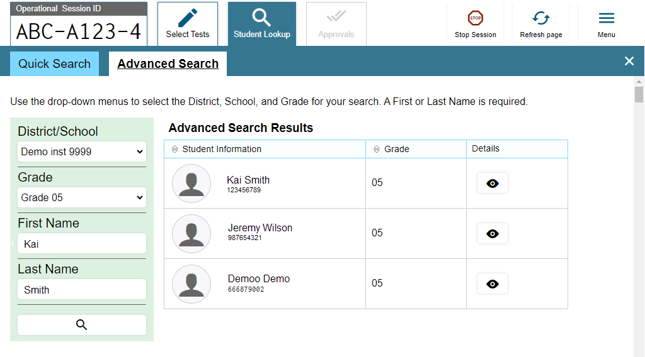
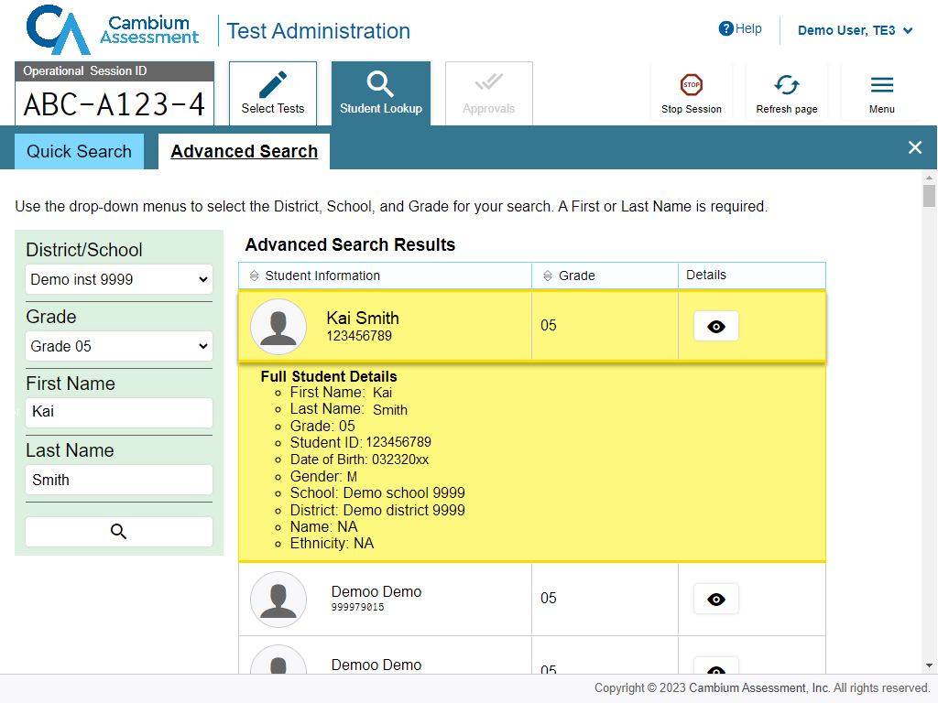
Student Lookup: Advanced Search
Search
Notes:
Advanced Search allows you to narrow your search using several filters, including District/School, Grade, First Name, and Last Name. Enter the criteria in the fields listed and select the Search icon. Results will display. If you see the student you are looking for, select the Eye button next to the student’s name. The student’s information will display below that student’s row in the table. Note that the information displayed may vary slightly from what is shown here.

Slide 19
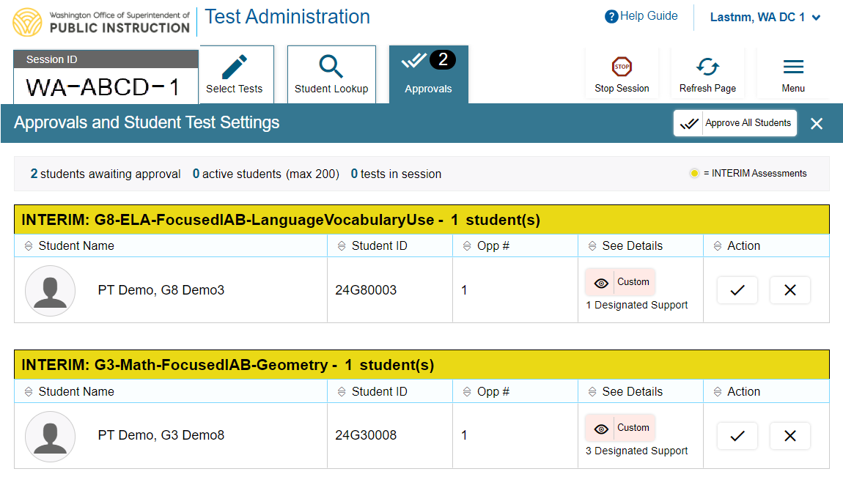
Approving Student Entry
Notes:
Once you start the test session and students log in, you must review and approve their test settings before they can access their tests. It is important that you pay close attention to the test name prior to approval to be sure that students have selected the appropriate test. To approve students for testing, select the Approvals tab. A list of students will display, organized by test name. You should review the list to make sure that all students chose the correct content area and test. You should also ensure that each student’s test settings are accurate. To do this, select the Eye icon in the See Details column. We will talk more about that in a few moments.
If no changes are needed, select Approve All Students to admit all students to the session. You will see a confirmation message appear after selecting Approve All Students.

Slide 20
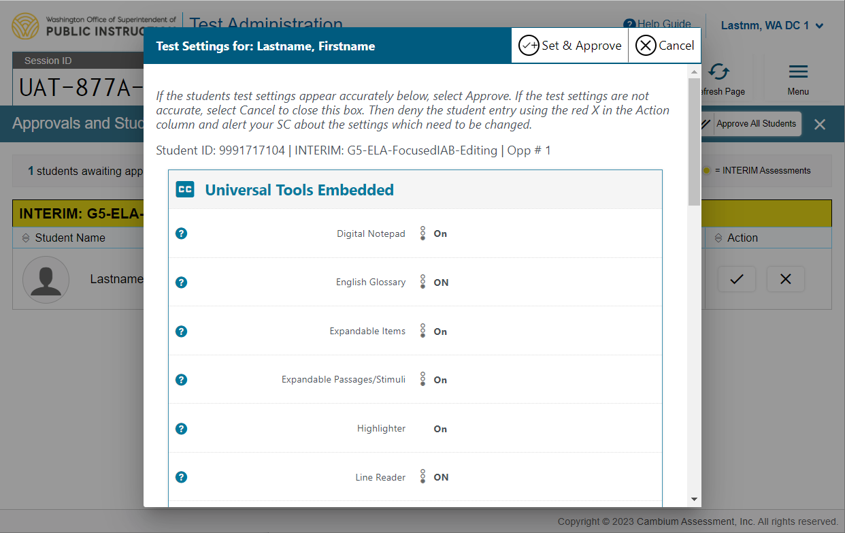
Editing Student Details: See/Edit Details
Notes:
To verify a student’s test settings, click the Eye button in the See Details column. The Test Settings screen will appear, with the student’s information at the top. No settings can be changed in the TA Interface window, only viewed. If the student’s test settings are incorrect, the settings must be updated in TIDE by an authorized user. Contact your School or District Test Coordinator to have the settings updated.
Correcting the setting prior to allowing the student to begin testing will prevent a testing irregularity that may have invalidated the students test results.
Note: If a student has started a test with incorrect settings, have the student pause the test. A change in Presentation setting Braille, Presentation setting Spanish, ASL Videos, and Closed Captioning will require a reset to the test, and the student will have to begin the test again. All other test settings may be changed when a test is paused. Once a student’s correct settings have been saved in TIDE, a student may resume testing right away.
If the test settings are accurate and to approve the student for testing, click the Set & Approve button.

Slide 21
Denying Student Entry
Deny entry to a test session in these circumstances:
The student is not supposed to enter this session.
The student’s demographic information is incorrect.
The student’s required accommodations are incorrect.
Notes:
If a student selected an incorrect test, you must deny that student entry to the test session by selecting the X button in the Action column. Although you can approve all students at the same time, students must be individually denied entry into the test session.
You should deny students entry into the session in these circumstances:
• The student is not supposed to enter this session.
• The student’s demographic information is incorrect.
• The student’s required accommodations are incorrect.
Denying the student entry into the test session will not prevent other approved students from beginning their tests.
If the student’s test settings are incorrect, the settings must be updated in TIDE before the student takes the test. Contact your School Test Coordinator or District Test Coordinator to have the settings updated. This will prevent the need to reset the test for the student later. Please note that the changes may not be immediate.

Slide 22
Monitoring a Test Session
Notes:
Once students log in and are approved for testing, you can monitor their status from the table(s) displayed on the TA Interface.

Slide 23
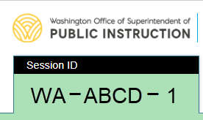
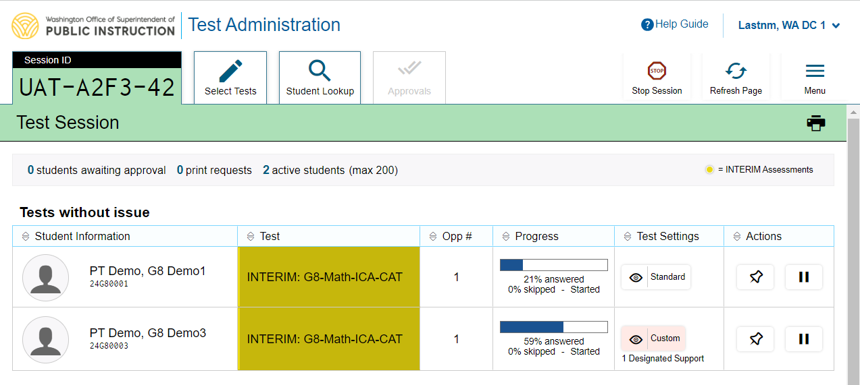
Monitoring Student Progress
Notes:
Once students log in and are approved for testing, you can monitor their status from the table(s) displayed on the TA Interface. The table shows Student Information, Test Name, Opportunity Number, Progress, Test Settings, and Actions options.
The Progress column displays the student’s progress through the items in the test. It may display a progress bar to indicate the student’s progress through the test or display the total number of items completed thus far and the total number of items in the test.
The Test Settings column displays either Standard or Custom. This column displays Custom when a student’s test settings are different from the default settings for that test. Select the Eye button to view a student’s test settings. The number of accommodations and designated supports will also appear.
The Actions column allows you to pause a student’s test or pin a student’s information to the top of the test session table.

Slide 24
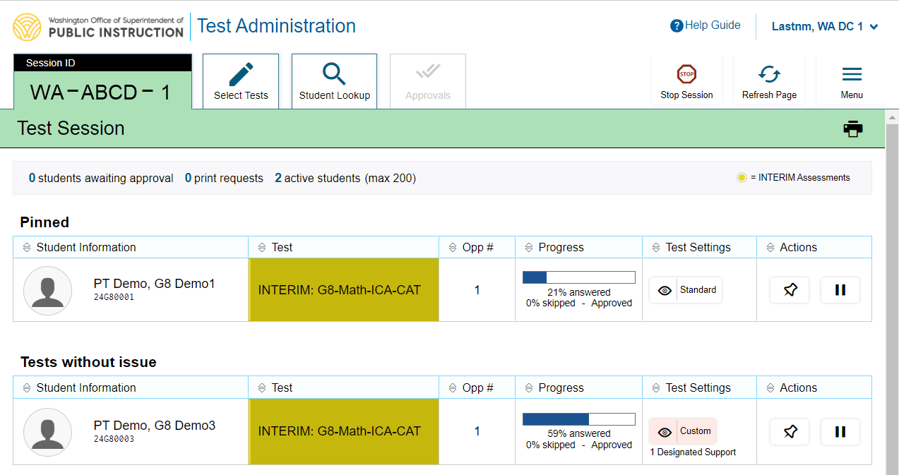
Pin Student
Unpin student
Notes:
If you want to closely follow a student, you can use the pin student function. Select the push pin icon in the Actions column of the student you want to monitor. The student’s row will appear in a separate table and move to the top of the test session tab.
To unpin a student, select the pushpin icon again. The student’s row will no longer appear at the top of the Test Session tab.

Slide 25
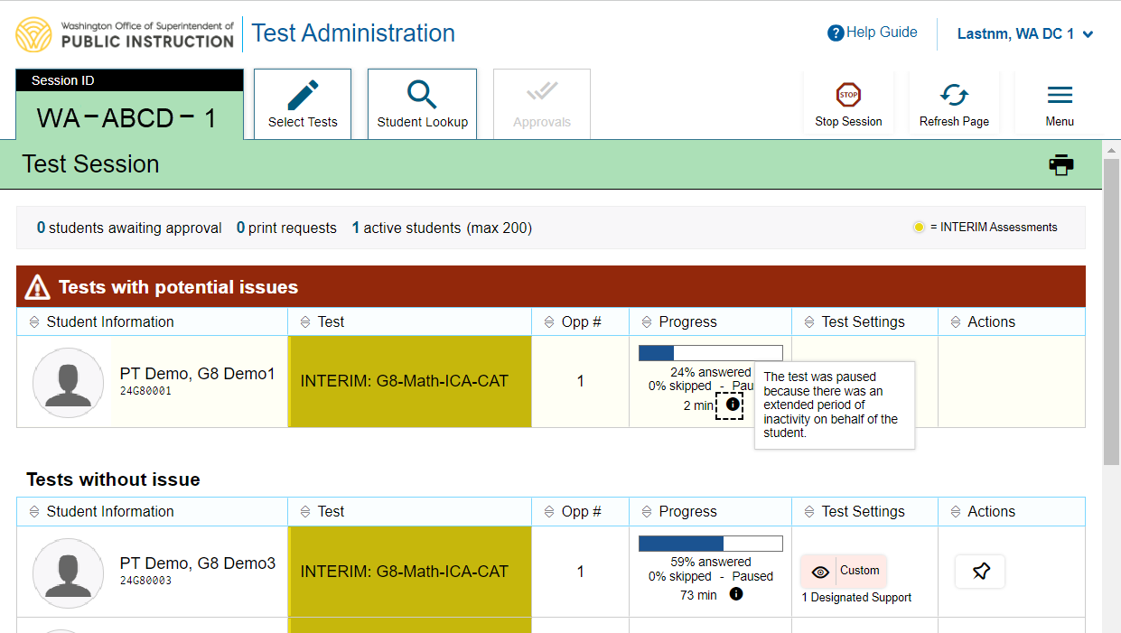
Test with Potential Issues Table
Notes:
If the Test Delivery System (TDS) detects that a student may be having technical issues or requires assistance, a “Test with potential issues” table will appear above the “Tests without issue” table. Hovering over the “i” icon will display more information about the issue.

Slide 26
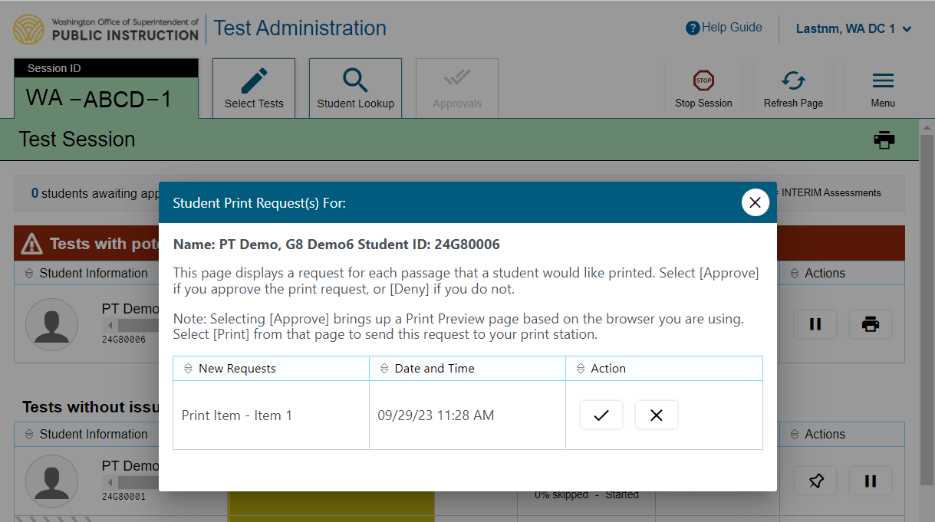
Print on Demand
Notes:
The Print on Demand feature is available only for students who require it. Please contact your School Test Coordinator if your student needs this accommodation. It is a testing incident to apply this restricted resource for a student who does not have an IEP or Section 504 Plan documenting their need for the accommodation.
Students with this accommodation can request printouts of stimuli and/or items, depending on their settings.
• When a student sends a print request, the Printer button will appear in the Actions column of the Tests with potential issues table on the TA Interface. Select the button to view the request.
• If you select the Check button to approve the print request, a cover sheet containing the student’s name and SSID will display in a new browser window. No test content will ever display on your screen.
• If you select the X button to deny the print request, nothing will be printed.
Before approving the student’s print request, ensure that it will be sent to a printer that is monitored by staff who have been trained in test security. All printed test items, stimuli, and reading passages must be securely stored and destroyed immediately following a test session.

Slide 27
Approved Requests
Notes:
The Approved Requests option allows you to view a list of every print request you approved during the current session. To see all approved requests, select the Menu button, and then select Approved Requests.
If you wish to print this list for your own records, select Print at the top of the Approved Requests window.

Slide 28
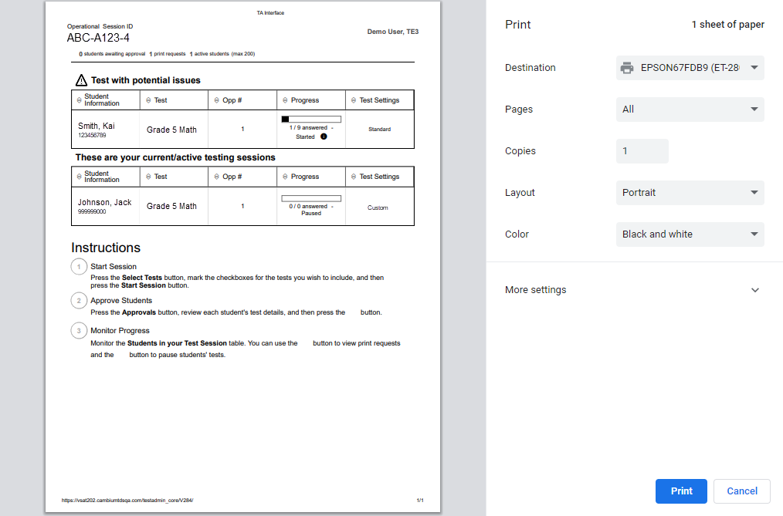
Printing Test Session Information
Notes:
If you wish to print a snapshot of the TA Interface in its current view, select the Print icon located below the Menu button. Printing a snapshot of the test session information can be useful for tracking which students did not complete their tests and may need to be scheduled for another session.
Remember that any printouts containing personally identifiable student information must be securely stored and should be destroyed after use.

Slide 29
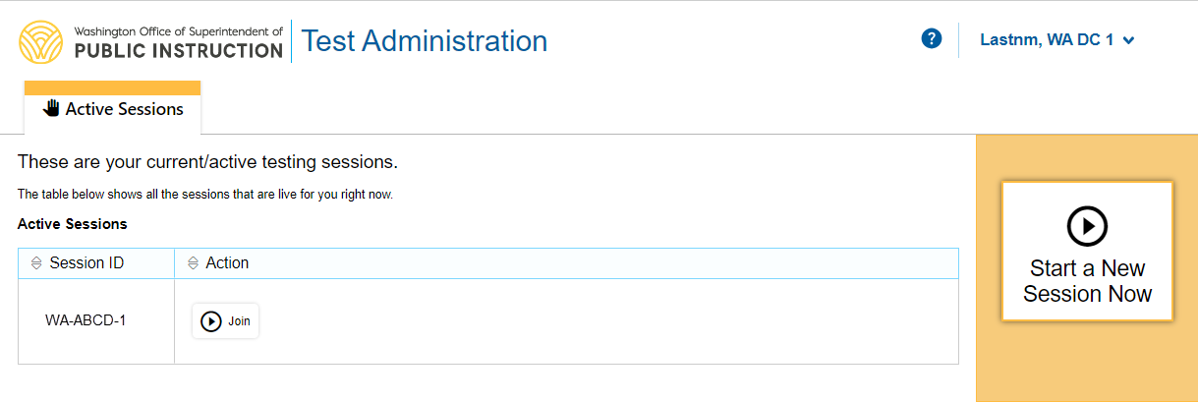
Transferring Sessions
New device or browser
Start the session
Previous device or browser
Notes:
In the event that you have problems with your computer or web browser or need to change computers during an active test session, you can transfer the session from one computer, mobile device, or browser to another without stopping the session or interrupting in-progress tests. To transfer a test session to a new device or browser, remember the following:
Do not log out of the session you are currently in or stop the test session. If you do, you will end the test session and pause all students’ tests.
Log in to the TA Interface on the new machine or in the new browser. You will see an Active Sessions table listing all active testing sessions.
Select the session you want to transfer and select the Start icon in the Actions column. The session will become active on the new browser or device.
A message will appear on the previous device or browser, and the window will close automatically. This will not stop the session or pause student tests.

Slide 30
Pausing and Stopping Sessions
Stop all tests
Pause a test
Notes:
You have two options within the TA Interface to pause or stop testing once it has begun. You can pause an individual student’s test or stop the entire session, which will stop all students from testing. To pause an individual student’s test, select the Pause button in the Actions column for that student. When prompted, select OK to confirm that you want to pause the test. This option would be appropriate if a student becomes ill, for example. In the event of an emergency that requires all students to stop testing, you can pause all students’ tests by stopping the session.
If you stop the session, all in-progress tests will be paused. If a session stops, it cannot be resumed. You will have to create a new test session and give the new session ID to students so that they can resume testing. To stop the entire test session for all students, do the following:
• Select the Stop Session button next to the session ID. A pop-up message will appear requesting verification to end the session and log students out.
• When prompted, select OK to continue.
If you forget to log out before leaving the testing area, the session will close automatically after 20 minutes of inactivity on both the TA and student computers. You would then need to create a new session and provide the new session ID to students in order to resume testing.

Slide 31
Logging Out of the TA Interface
Notes:
To log out of the TA Interface, select the Logout button in the upper-right corner of the page. It is preferable for you to log out only after stopping your active test session, as logging out will cause all in-progress tests to be paused. A confirmation message will appear, asking you to confirm that you want to exit the website and pause all students’ in-progress tests. This scenario also occurs when you navigate to another website from the TA Interface.
However, regardless of when or how you log out or navigate away from the TA Interface, student data will NOT be lost. If you need to access another application, we encourage you to open it in a separate browser window.
When all students have completed testing, refer to your Test Administration Manual for instructions on destroying any printed testing materials and reporting testing improprieties or irregularities.

Slide 32
Troubleshooting
Description | What to Do
What should I do if a test session ends? | Log in and start a new session. Provide the students with a new session ID.
What should I do if a student gets logged out of a test while a session is still active? | If a student’s test session is interrupted, the student should log back in and rejoin the session.
What should I do if forbidden applications are running? | The Secure Browser will not allow the student to begin testing if forbidden applications are running. You will see messages advising you which applications must be closed before testing can begin.
What should I do if a student’s test freezes? | Force-quit the Secure Browser and log back in. For instructions, refer to the Test Administration Manual.
Notes:
This table presents some of the common issues that you or your students may encounter during a test session. Please take a moment to review this information. For more detailed information please refer to your Test Administration Manual.

Slide 33
Thank You!
Further Information
WCAP Portal
https://wa.portal.cambiumast.com/
WA Help Desk
wahelpdesk@cambiumassessment.com
1.844.560.7366
Known Issues
New this year: Known issues with CAI systems are documented on the WCAP Portal Known Issues page accessible in the Secure Browser/Technical Resources section of the site.
https://wa.portal.cambiumast.com/resources/known-issues
Notes:
Thank you for taking the time to view this training module. If you have general questions or need further information, please visit the WCAP Portal or consult your help desk for assistance.

