Slide 1
Secure Browser for Student Online Testing
Training Module
2023–2024
Copyright © Cambium Assessment, Inc. All rights reserved.
Notes:
Welcome to the Student Interface for Online Testing training module. This presentation is designed to help Test Coordinators and Test Administrators (TAs) understand the interface that students use to take online tests.
Individual states’ systems may vary. Consult your state documentation for detailed information.

Slide 2
Objectives
After viewing this presentation, you should understand the following:
Please note: The navigation instructions that follow are from the viewpoint of a Windows PC user with a two-button mouse. Your steps may vary slightly depending on the device and operating system you are using.
How students log in to the testing system and select a test
The layout of the test and functionality of test tools
How students navigate through the test
Notes:
After viewing this presentation, you should understand the following:
How students log in to the testing system and select a test
The layout of the test and functionality of test tools
How students navigate through the test
Please note, the navigation instructions that follow are from the viewpoint of a Windows PC user with a two-button mouse. Your steps may vary slightly depending on the device and operating system you are using.

Slide 3
The Secure Browser and Logging In
Notes:
First, we will discuss the Secure Browser and how students log in to take a test.

Slide 4
What Is the Secure Browser?
The Secure Browser is designed to ensure test security by prohibiting students from accessing any other programs or websites during testing.
If you have questions about installation of the Secure Browser, contact your Technology Coordinator.
Notes:
Students must use the Secure Browser to log in to the Student Interface. The Secure Browser is designed to ensure test security by prohibiting students from accessing any other programs or websites during testing.
Your school’s Technology Coordinator is responsible for ensuring that the Secure Browser has been correctly installed on all testing devices. If you have questions about installation of the Secure Browser, please contact your Technology Coordinator.

Slide 5
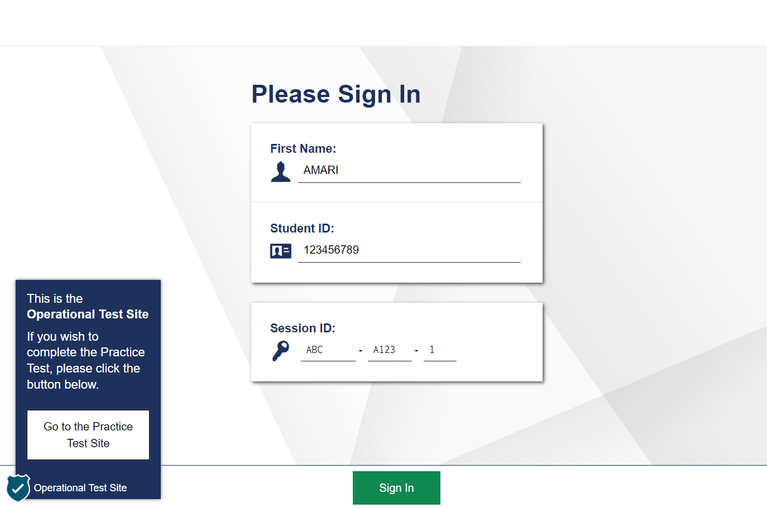
Secure Browser Login
Notes:
To log in to the online testing system, students must use the Secure Browser on a computer or device separate from the one used by the TA. Students must enter three pieces of identifying information: their first name, their state-assigned student identifier (SSID), and the current test session ID. The test session ID is generated when the TA creates the test session. It needs to be given to students by the TA when it is time for them to log in to the test.
After entering their information, students will select the Sign In button to log in to the test. The TA may assist students with logging in, if necessary.

Slide 6
Student Login Errors
Issue | Error Message | What to Do
Student first name and SSID do not exactly match what is in the system. | Please check that your information is entered correctly. If you need help, ask your Test Administrator. | Verify that the student has entered the correct first name and exact SSID. You may need to use the Student Lookup tool, located in the TA Interface, to verify that the student is in the system.
Student enters the session ID incorrectly. | The session is not available for testing. | Verify that the student has entered the correct session ID with no extra spaces or characters.
Student enters a session ID that has not yet started. | Session not ready | Verify that tests have been added into the session in the TA Interface and press the Start Session button.
Student enters a session ID for an incorrect or expired session. | Session has expired. | Ensure that the student enters the correct session ID for the current session. If this does not work, verify that your session is open using the TA interface.
One person (either the TA or the student) is using the Operational Test Administration site, and the other is using the Practice and Training Test site. | The session is not available for testing. | If taking a practice test, make sure that you and the student are both in the Practice and Training Test site. If taking an operational test, make sure that the student is using the Secure Browser and you are using the Operational Test Administration site.
Notes:
If a student is having difficulty logging in, an error message and code will display on the Login screen. The most common errors occur when the student’s first name and SSID do not match what is in the system and when SSIDs are entered incorrectly. If the student receives an error message indicating that he or she has entered incorrect information in the first name or SSID fields, the TA should use the Student Lookup tool in the TA Interface to verify the student’s information.
Another common error occurs when the student enters an incorrect session ID. If a student receives the message “The session is not available for testing,” verify that the session ID was entered correctly, with no extra spaces or characters. The session ID can be found in the TA Interface.
If a student receives the error message “Session has expired,” ensure that the student has entered the correct session ID for the current session. If the student has entered the session ID correctly, use the TA Interface to verify that your session is still open.
Finally, if administering a practice test, make sure that the TA and the student each use the appropriate Practice and Training Test site. If administering an operational test (an interim or summative test), ensure that the TA is using the Operational Test Administration site and the student is using the Secure Browser.

Slide 7
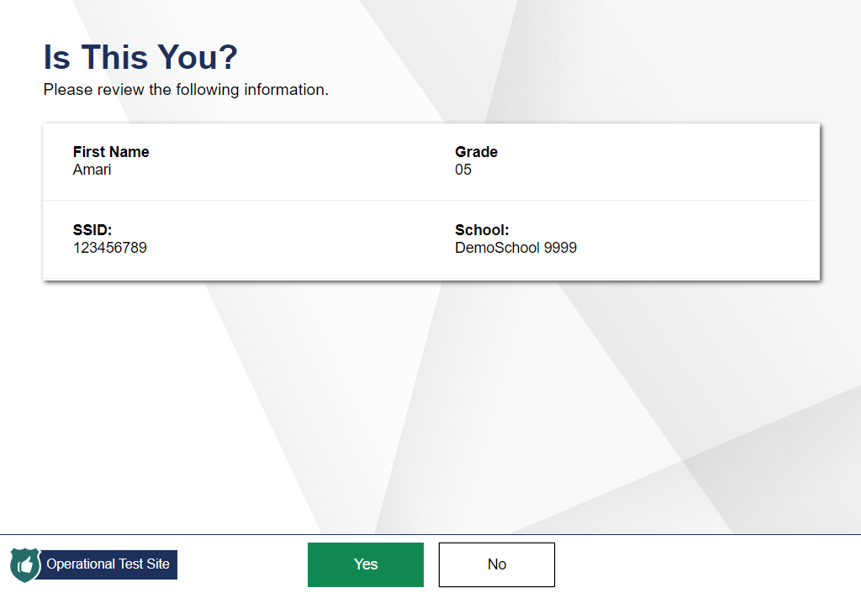
Student Verification
Notes:
After logging in, students need to complete a few more steps before they begin testing. Students will be asked to view and verify their personal information. If their information is correct, they should select Yes to proceed. If their information is incorrect, they should select No to return to the login page. You must then contact your School or District Test Coordinator to have the student’s information updated in the Test Information Distribution Engine (TIDE) before the student attempts to log in again.

Slide 8
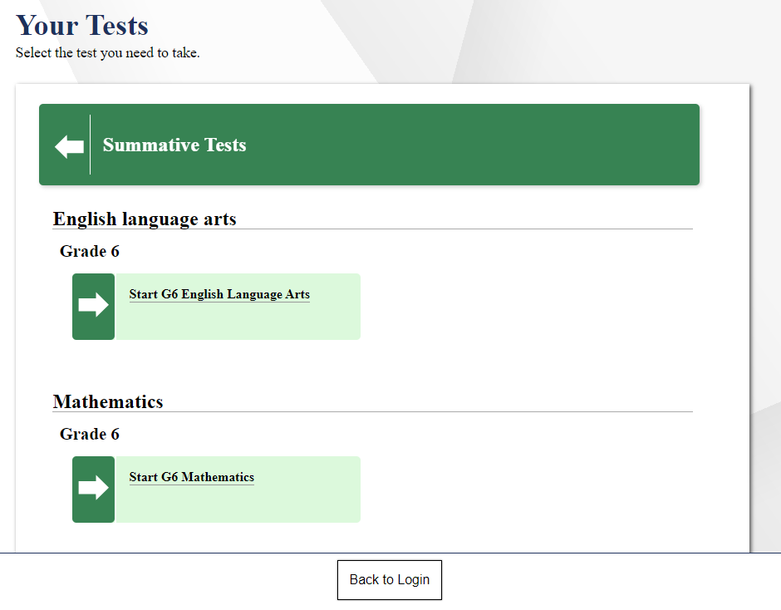
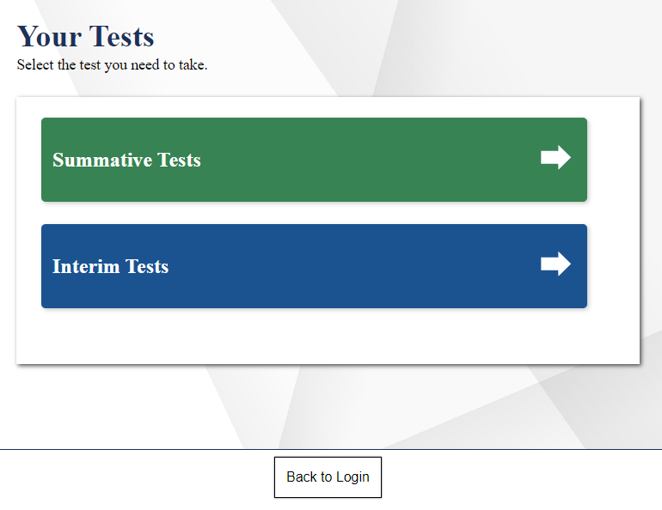
Student Test Selection
Notes:
On the Your Tests page, students will see a list of their assigned tests for this test session, color-coded by test category. Students may first need to select a category to see the tests available in that category as shown in the left image. The right image shows the tests available in the category selected.
If the tests displayed are incorrect, a test is inactive, or the expected test is not listed, students should select the Back to Login button to return to the login page and consult the TA to resolve the issue.
If there are no errors, students should select the correct test and wait for TA approval to proceed.

Slide 9
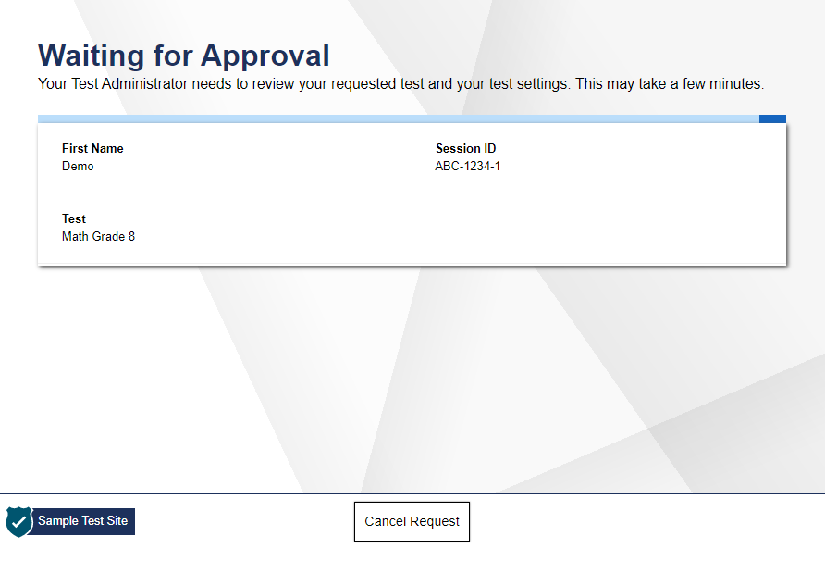
Waiting for Approval
Notes:
After selecting the test they need to take, students will see a Waiting for Approval screen. Once the TA approves a student’s request, the student will be taken to the next screen, the Your Test Settings page.

Slide 10
Functionality Checks
Notes:
Now we will look at the various functionality checks students may see before beginning their test.

Slide 11
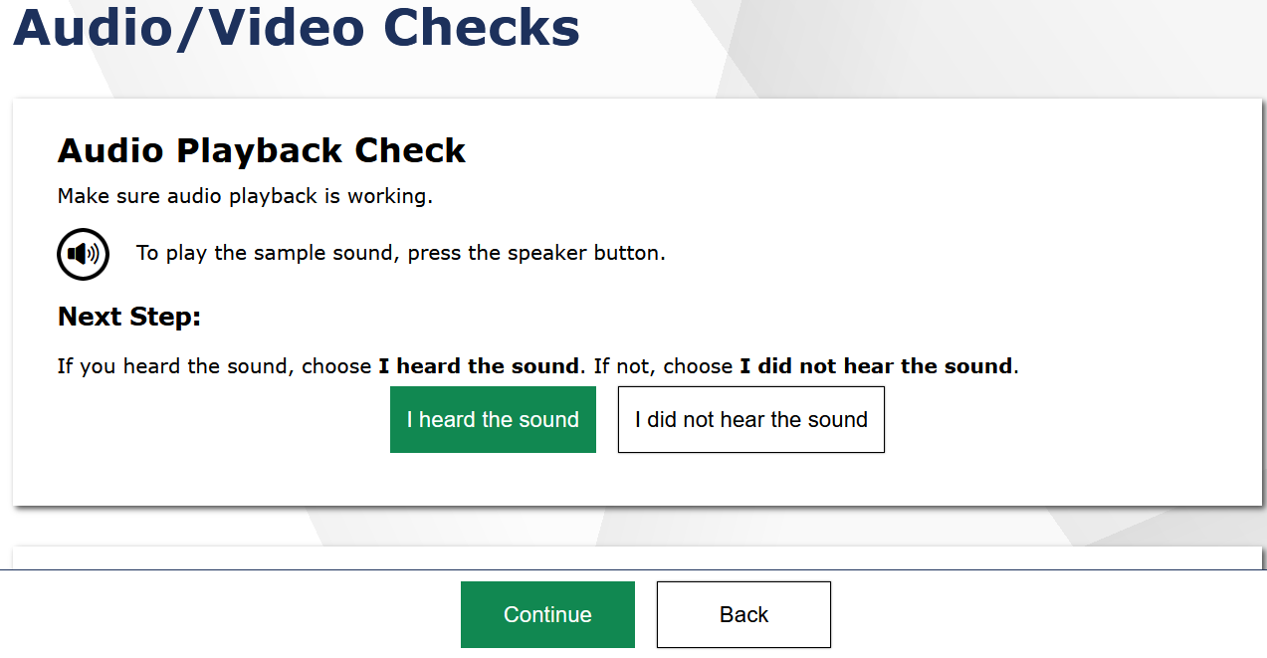
Audio/Video Checks
Notes:
If required by the test content or specified test settings, students will see an Audio/Video Checks page where they will need to perform functional checks to ensure that their testing devices are working properly. Depending on the test students are taking, students may see one or more panels. We will walk through each of these audio/video checks in the next few slides. When students have finished all audio/video checks, they will need to select Continue to proceed.

Slide 12
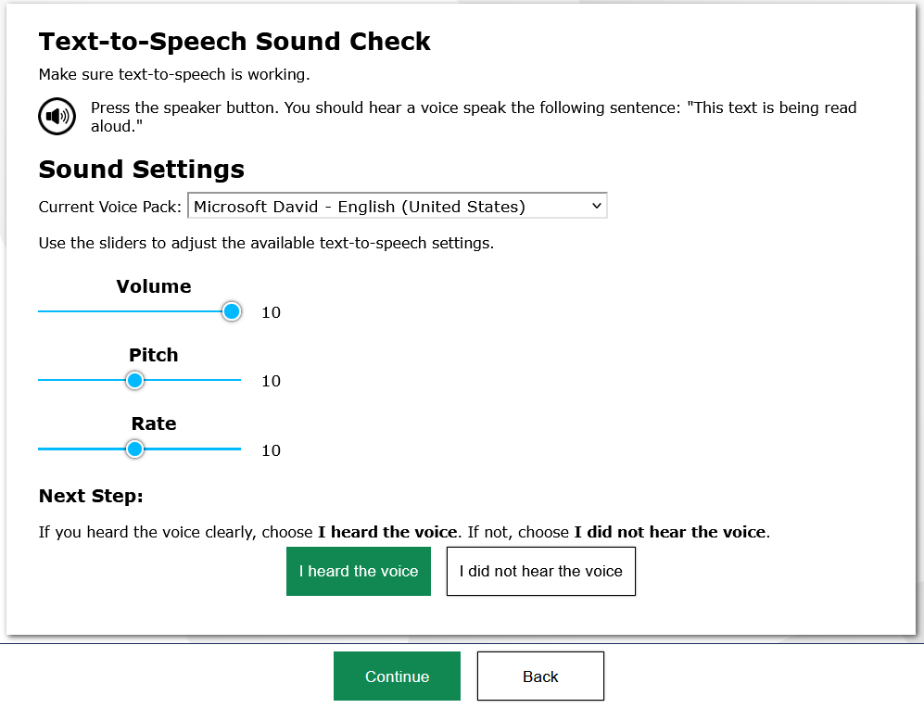
Text-to-Speech Check
Notes:
Students with text-to-speech (TTS) enabled will be presented with a TTS Sound Check panel on the Audio/Video Checks page that verifies that text is being spoken correctly on their device. Students should press the speaker button to hear sample text being read aloud. If the voice is audible, students should select I heard the voice to proceed. If not, students may adjust their TTS settings using the sliders on this page and try again. If they still cannot hear the voice, they should log out of the Secure Browser and ask their TA for assistance with their headset and/or audio settings.
Students will not be able to continue into the assessment without completing the TTS check. Students with Spanish presentation and TTS enabled will be required to complete a second TTS check for the Spanish voice pack.

Slide 13
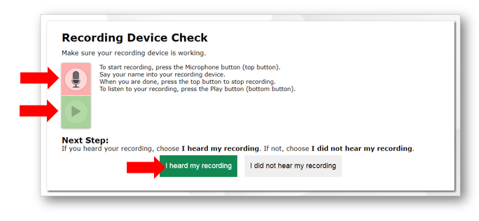
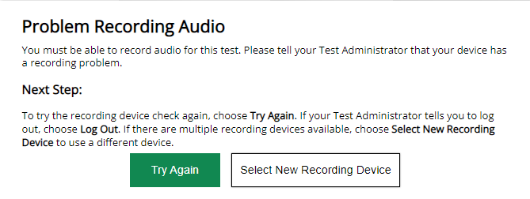
Recording Device Check
Notes:
Students with speech-to-text (STT) enabled will be presented with the Recording Device Check screen that verifies that their voice is heard by the Speech-to-Text tool. Be sure that these students are equipped with headphones and microphones. Students should click the Microphone button. The microphone will be replaced with a Stop button. Students should say their names into their microphones, and then click the Stop button. Students should then click the Play button to hear their recording.
If students clearly hear their names, they should click the I heard my recording button.
If the audio is not clear, students should click the I did not hear my recording button. The student will receive a message advising them to tell the TA about the recording device problem.
The student can click the Try Again button to record an audio sample again.
Click the Select New Recording Device button to try recording using a different attached device; or
Click the Logout button and work with the TA to adjust his or her recording device settings.

Slide 14
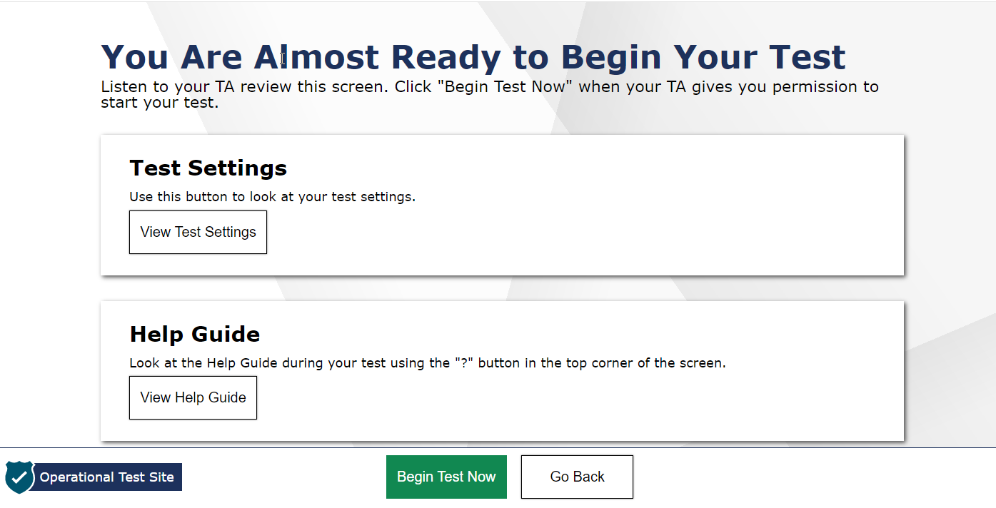
Instructions and Help
Notes:
Next, students have the opportunity to review detailed information about the tools and navigation features they will use during testing from the Instructions and Help screen.
The Test Settings section allows students to view their current test settings.
The Help Guide section contains an overview of the test site, test rules, and information on text-to-speech and print-on-request features.
When students select Begin Test Now, they will be presented with the first question of the test. Test Administrators should use the TA Script of Student Directions to walk students through the following checks.

Slide 15
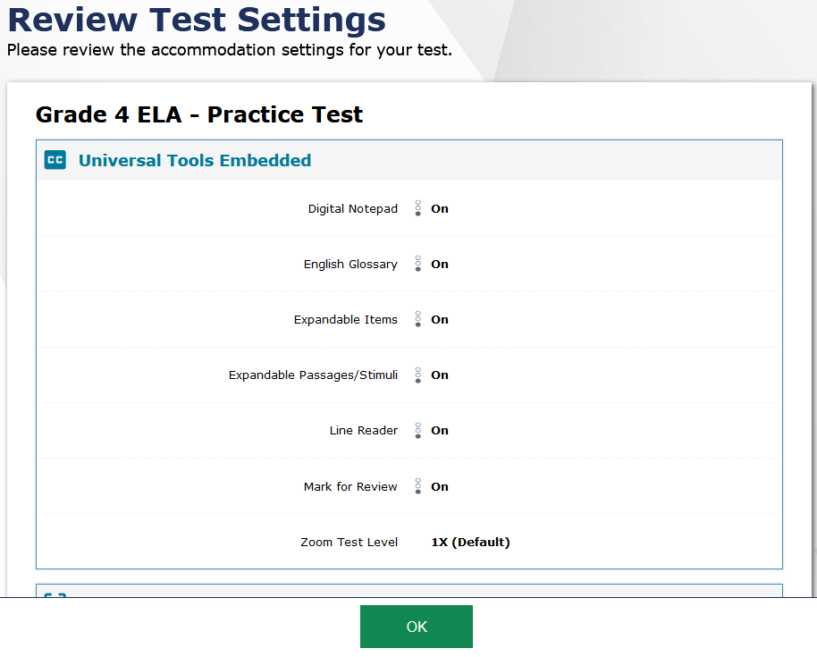
Verifying Test Information
Notes:
When the students select the View Test Settings button, students will see the Review Test Settings screen. This screen displays the name of the test and any selected accessibility resources. If the information is correct, students should click the OK button to return to the previous screen. If any of the information is incorrect, they should raise their hand and then wait to be advised by the TA. Note that the actual settings students see may vary from what is shown on this slide. Be sure to refer to the TA Script of Student Directions for online tests to guide students through the login and confirmation process.

Slide 16
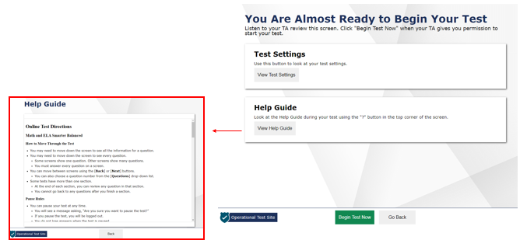
Instructions and Help
Notes:
The Additional Test Information screen lists any additional information that is necessary for students to know while in the testing session. This section will only appear for the summative ELA, math, and science tests in the spring.
The Test Administrator should instruct students to open the Help Guide. The Help Guide contains information the student will find useful throughout the test and can be accessed at any point during the test by clicking the ? button. It includes the sections How to Move Through the Test, Pause Rules, Overview of Test Screen, Tools, Menu, and Other Tools. The Test Administrator should now instruct students to click on the Back button to return to the previous screen.
When students click the Begin Test Now button, they will be presented with the first question of the test.

Slide 17
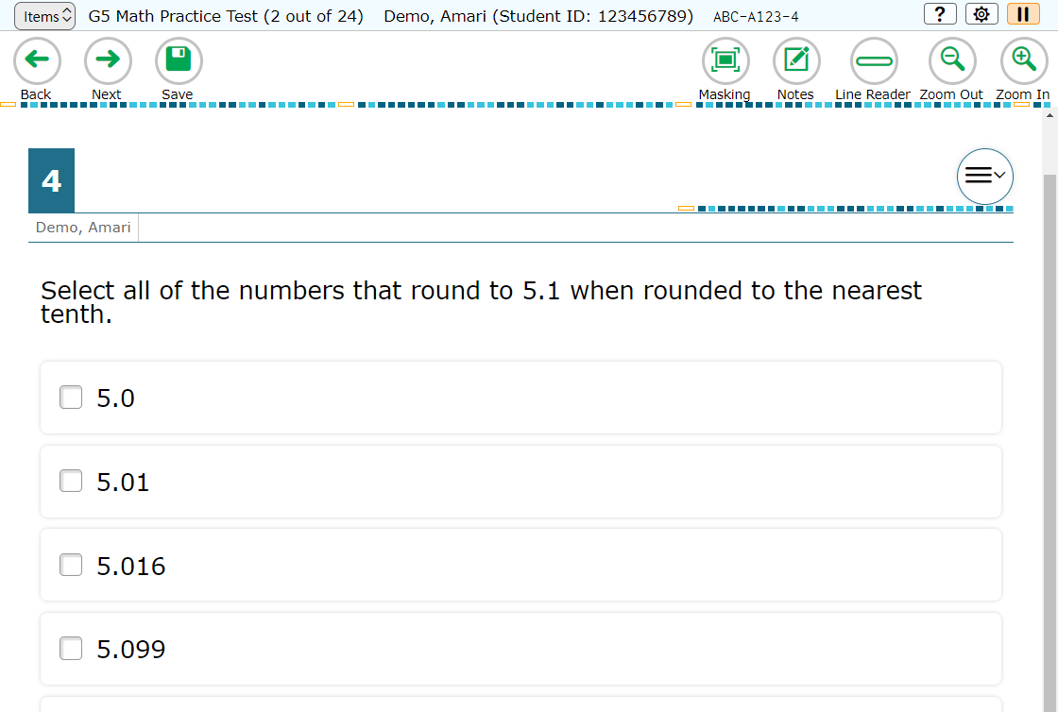
Test Interface
Notes:
After students log in, they will see the first item of the test. An example of the test interface is shown here. We will discuss more about the various features of the interface on the following slides.

Slide 18
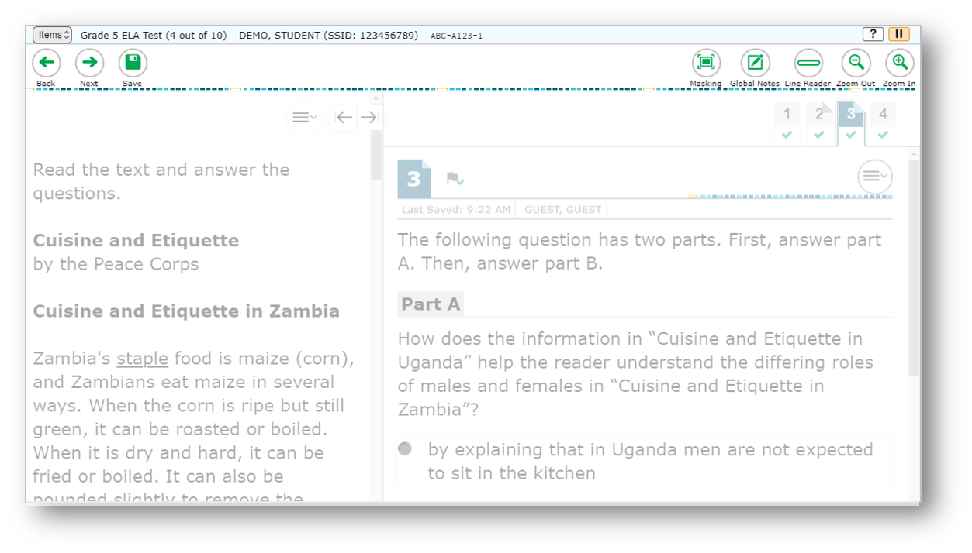
Global Menu
Navigation Buttons
Test Tools
Notes:
The global menu appears at the top of the Student Interface. The left side of the menu contains navigation buttons that students use to advance through the test.
All students can navigate between pages using the Back and Next arrow buttons. Students can also navigate between items using the Items drop-down menu located above the navigation buttons. We will discuss the Items menu later in this module.
The Save button ensures that a response is committed to the system. However, the Save button is not required to save an item. Other actions, such as moving forward to the next question, will also save the response.
The right side of the menu contains test tools that students may use during testing. Some test tools, such as the Zoom In and Zoom Out buttons, are universal tools available to all students. The Pause button pauses a student’s test and logs the student out of the Student Interface. We will discuss more about pausing a test later in this presentation.
Other tools are designated supports or accommodations that must be set up in TIDE for students to use them.
The sample image on this slide is just one example of the test tools that may appear.

Slide 19
Items Drop-Down Menu
Items Menu
Notes:
In addition to using navigation buttons in the global menu, students can move through the test using the Items drop-down menu. The Items drop-down menu lists all items completed thus far and displays a blue flag for items that have been marked for review. If the test allows students to skip items, an orange triangle will appear next to the item number of any items the student does not answer. Students can jump directly to an item at any time during the test by selecting the item number.

Slide 20
Context Menus
Context menus allow students to:
Mark items for review
View item tutorials
Send print requests to the TA (if available)
Access additional features depending on test settings and item types
Context Menu
Notes:
Test items and stimuli contain context menus. Students may use context menus to mark items for review, view item tutorials explaining how a particular item type works, send print requests to the TA (if test settings allow), and access additional test tools and features.

Slide 21
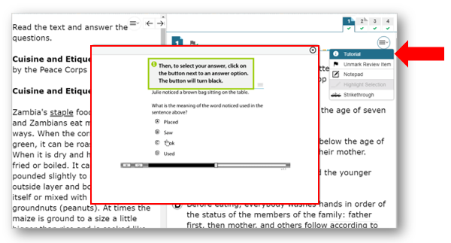
Item Tutorial
Notes:
Students can use the Item Tutorial tool to get more information about a particular item type. Selecting the Tutorial button from the context menu for a question opens a pop-up box that will show the student how that type of item works (for example, whether they should select an answer, drag-and-drop answers, or type a response in an answer space).

Slide 22
Universal Tools
Notes:
Universal tools and other features are available for all students to use during testing. These tools and features will be discussed in detail on the following slides.

Slide 23
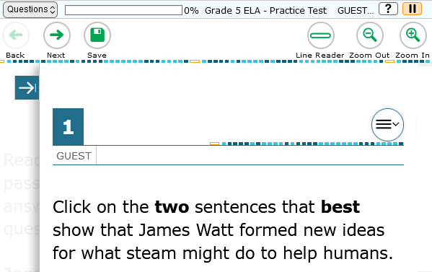
Universal Tools: Expandable Items
Passage
Notes:
Students can expand passages, stimuli, and test items so that they take up a larger area of the screen for easier reading. This can be done by selecting the double-arrow icon in the upper-right corner of the passage, stimulus, or item. This slide shows an expanded item in an ELA test. Note that the passage is hidden. To collapse the image and make the passage or stimulus viewable, students should select the arrow icon.

Slide 24
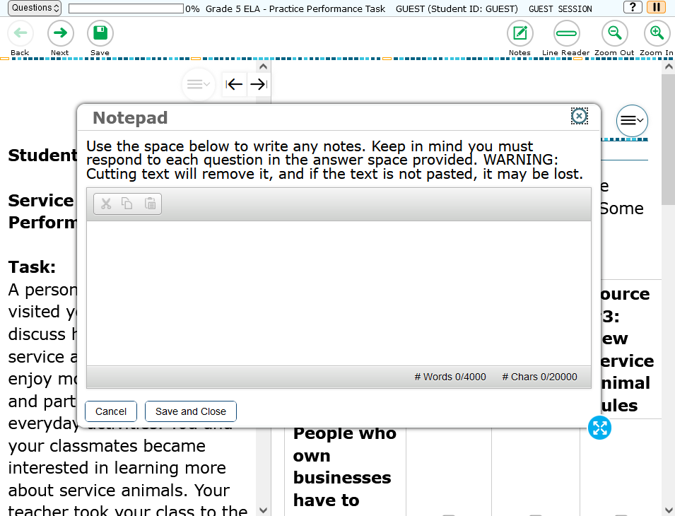
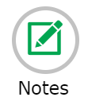
Universal Tools: Global Notes
resize
Notes:
Students can use the Global Notes tool when taking the ELA Performance Task. Students can make notes in this tool while in Part 1, and the notes will still be available when the student moves to the full-write question in Part 2.
The Global Notes will also be retained if the student logs out of the test to resume later. Students can copy and paste text from Global Notes into the item response area, but this can only be done at the page level.
In addition, the Global Notes window can be resized by dragging the blue dots on the outer edge.

Slide 25
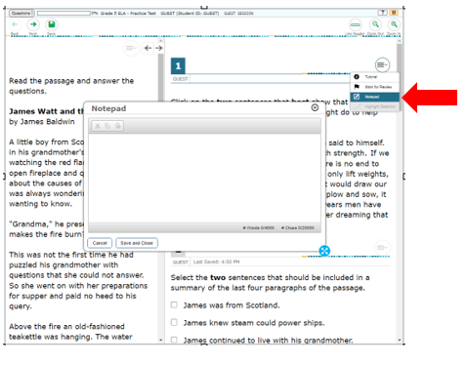
Universal Tools: Item Notepad
Notes:
Students can use the Notepad located in the context menu to make notes about an item. The Notepad is item specific, so students can only access their notes for a question when they are on that question’s test page. Notes will continue to be saved if the test is paused. Test items with notes will display with a small notepad and pencil badge next to the item number. The Notepad can be moved around the screen and resized.
The Notepad window can also be resized by dragging one of the blue dots on the outer edges. If the copy/paste feature is enabled, the text entered in this tool can be copied and pasted into text response areas of items displayed on that page. For example, students cannot copy notes taken on item #1 and paste them to an item displayed on the next page.

Slide 26
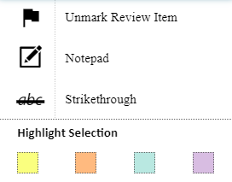
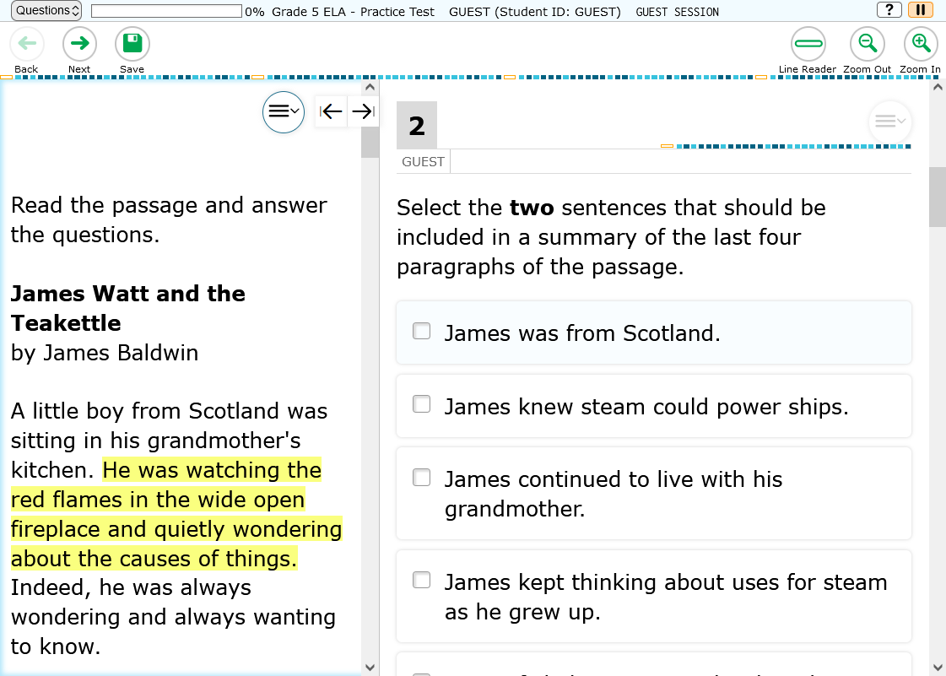
Universal Tools: Highlighter
Notes:
Students can use the Highlighter tool to mark text that they want to remember in reading passages, mathematics stimuli, and in text-based answer options, such as those that ask the student to select a section of text to choose an answer. To do this, students must select the desired text, right-click, and then select the Highlight Selection button that pops up. Students can select the color in which to highlight the text. To remove highlighting, students will right-click in the area of the highlighted text and select the Reset Highlighting button that pops up. If a student pauses the test, any highlighting made before pausing will be retained. The Highlighter tool can also be accessed from the context menu.

Slide 27
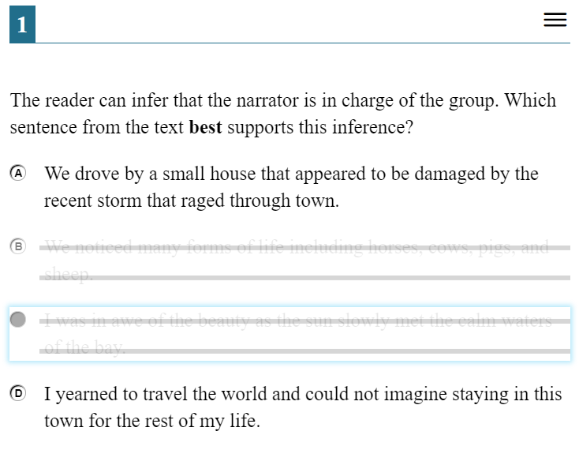
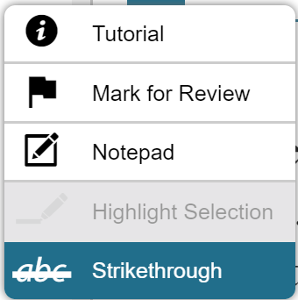
Universal Tools: Strikethrough
Notes:
For multiple-choice questions, students can use the Strikethrough tool to strike out the answer options they do not wish to choose.
To do this, students can right-click the answer option they want to strike out, and then select the Strikethrough button that pops up. The answer option will then be displayed with a line through it. If an answer option spans multiple lines, as shown in this image, and if the enhanced Strikethrough mode is enabled, the entire answer text will be displayed with lines through it. To remove the strikethrough, students must right-click and then select the Undo Strikethrough button that pops up. Alternatively, students can open the context menu and select Strikethrough to activate Strikethrough mode and then select each answer option they wish to strike out. To deactivate Strikethrough mode, they can press Esc or select outside the question’s response area.
It is important to note that striking through answers does not indicate a response to the question. Students must still select a response to answer each question. Also, striking out an answer option does not prevent the student from selecting that answer option as a response.

Slide 28
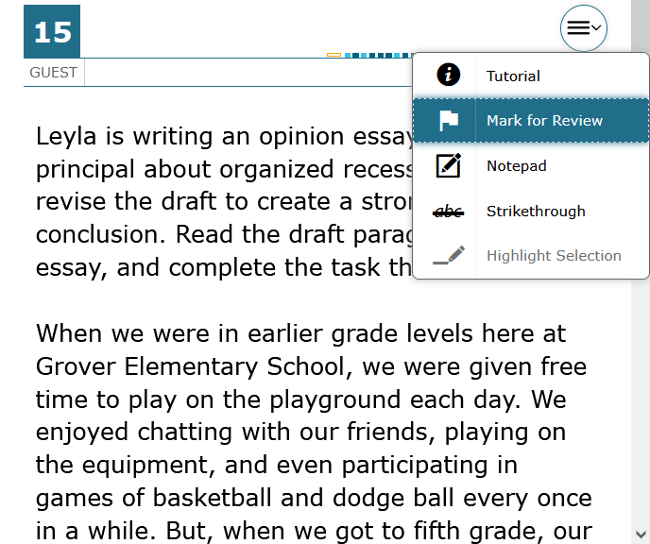
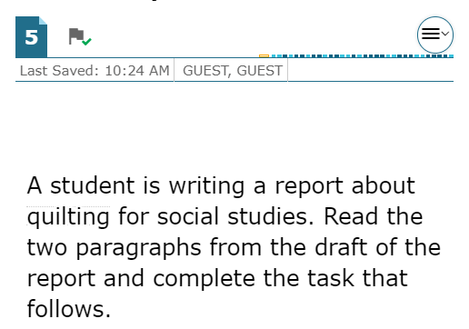
Universal Tools: Mark for Review
Notes:
Another element of the online test that helps students succeed is the Mark for Review feature. As they proceed through a summative test, students are required to answer each question on the screen before they can go on. If they are unsure of an answer, they should provide what they think is the best answer; there is no penalty for guessing. Students can then mark these items to review before completing the test segment. To mark an item for review, the student can open the context menu for an item and select Mark for Review. The item number will display a dog-eared corner and a small flag badge. For items with tabs, items marked for review will display a dog-eared tab.
At any time during a test segment, students can navigate back to marked items (within the segment) and review and change their answers as desired. This can be done either by selecting the Back button in the navigation toolbar until they reach the desired item or by using the Items drop-down menu, located in the upper-left corner of the page, to select a specific item. To unmark an item, students can open the context menu for the item and select Unmark Review Item. Note that once a student has completed a test segment in a test that prohibits navigation to previous segments, or if his or her test is paused for more than 20 minutes, returning to the items marked for review will not be allowed. However, the 20-minute rule does not apply to performance tasks.

Slide 29
Universal Tools: Zoom
Notes:
During testing, students can use the Zoom feature to increase the size of text and graphics from 1.5 to 20 times their default size by using the Zoom In button. Text can be returned to a smaller size using the Zoom Out button. The default size for all tests is 14-point type. If desired, prior to testing, a Test Coordinator may increase the default print size for the entire test by setting the zoom level in TIDE, or the TA can change the text size setting in the TA Interface during the approval process.
Zoom levels beyond three times the default size will require Streamlined mode to be enabled for the student. Please note that the Zoom tool is not the same as magnification, which students can access using their own assistive devices.

Slide 30
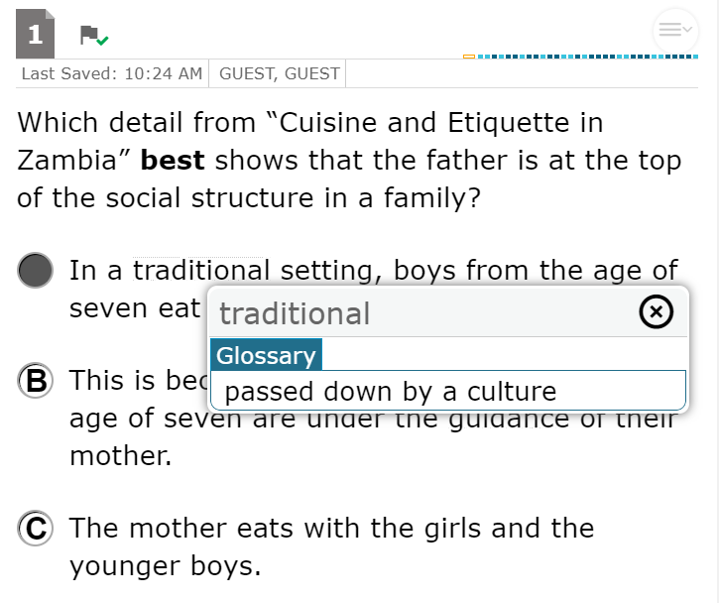
Universal Tools: English Glossary
Notes:
An English Glossary feature is available for students to use for some ELA and mathematics items during testing. The glossary is not available for ELA Reading items. The student can access the glossary by selecting any of the pre-selected terms, which are indicated on the screen by a gray dotted outline. When the student hovers the mouse over the term, it will be highlighted in blue. If the student selects a highlighted term, a pop-up box will appear with a definition of the term. Students can return to the item by selecting the X in the upper-right corner of the pop-up box to close it.
If the TTS feature is enabled, students can select the TTS icon in the Glossary pop-up window to listen to the content. While the text is being read aloud, the TTS icon is replaced by the speaking icon.

Slide 31
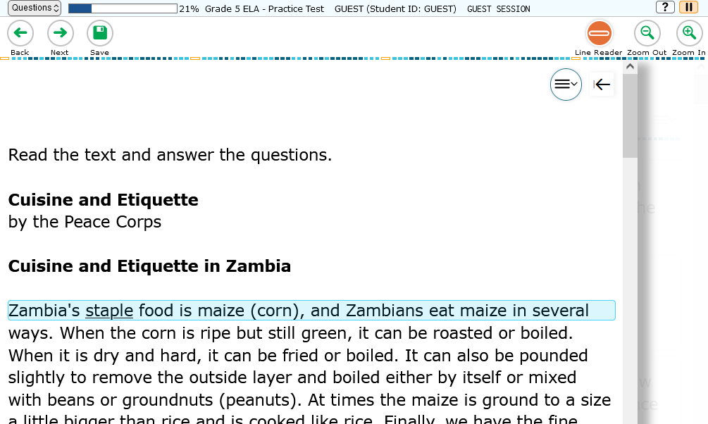
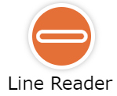
Universal Tools: Line Reader
Notes:
Students can highlight an individual line of text in a passage or question by selecting the Line Reader button in the global menu near the top of the window. To turn off the Line Reader tool, students select the Line Reader button again.
Note that the Line Reader tool is not available when the Highlighter tool is in use.

Slide 32
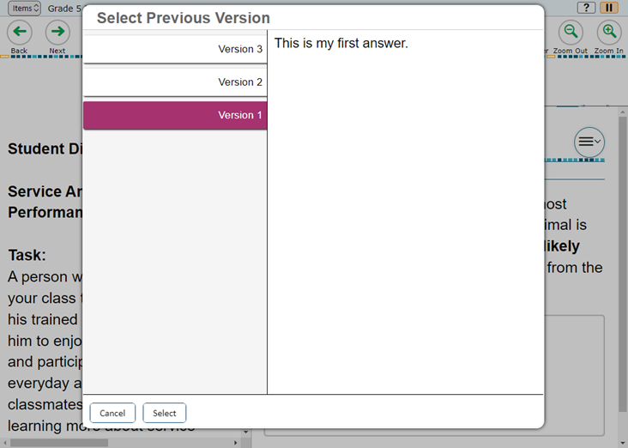
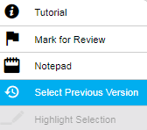
Universal Tools: Select Previous Version
Notes:
The Select Previous Version tool allows students to view and restore responses that they previously entered and saved for a Text Response item. To use this tool, students open the context menu for a Text Response item and choose Select Previous Version. A window will appear, listing any saved responses for the item and the text associated with each one. To view previous responses, students select a response version in the left panel and read the associated text in the right panel. To restore a selected response, students choose Select at the bottom of the window. The selected response will appear in the answer area for the item.
Please note that the Select Previous Version tool cannot restore responses that were entered before pausing a test.

Slide 33
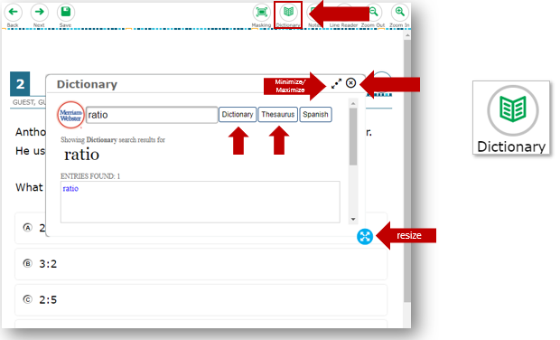
Universal Tools: Dictionary
Notes:
The Dictionary tool allows students to look up definitions and synonyms in the Merriam-Webster Dictionary or Thesaurus. To launch the dictionary, students select the Dictionary button from the global menu near the top of the screen. Students will enter a word in the search box and select Dictionary or Thesaurus. If any entries are found, they will be shown in the text box.
The dictionary window can be resized by dragging the resizing handle on the outer edge of the dictionary window. Students can also maximize or minimize the window by selecting the arrows in the upper- right corner of the window. To remove the dictionary window, students will select the X button in the upper-right corner. NOTE: The Dictionary tool is only available for the full write portion of the ELA Performance task.

Slide 34
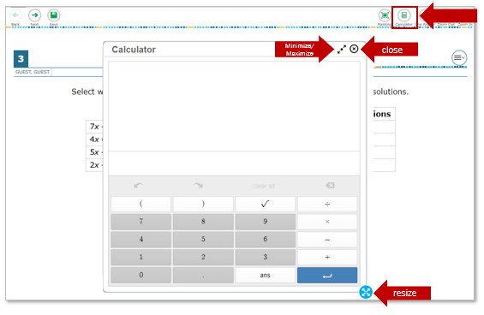
Universal Tools: Calculator
Notes:
For certain mathematics tests and all science tests, students can use the on-screen calculator. To use the calculator, students need to select the Calculator button from the global menu near the top of the page. The calculator window can also be resized by dragging the resizing handle on the outer edge of the calculator window. Students can also maximize or minimize the window by selecting the arrows in the upper-right corner of the window. To remove the calculator window, students will select the X button in the upper-right corner.

Slide 35
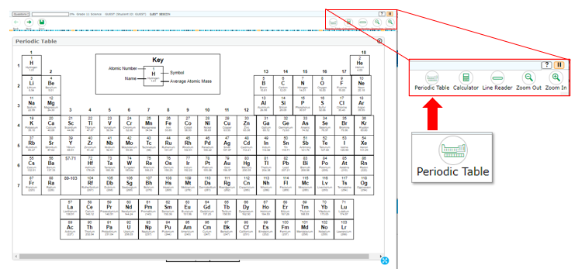
Universal Tools: Periodic Table
Notes:
Students can use the Periodic Table when taking the grade 8 or grade 11-12 science tests. To use the periodic table, students need to select the Periodic Table button from the global menu near the top of the page. The Periodic Table window can also be resized by dragging the blue dots on the outer edge of the Periodic Table window. To remove the Periodic Table window, students will click the X button in the upper-right corner. The periodic table is in Spanish if the student’s Presentation is set for the Spanish language.

Slide 36
Accessibility Resources
Notes:
Now let us take a look at the various accessibility resources available for students.
In addition to universal tools, which are available to all students, designated supports are available for use by any student for whom the need has been indicated by an educator. Accommodations are changes in procedures or materials that increase equitable access during the test. Accommodations are available for students with documentation of the need for the accommodations on an Individualized Education Program (IEP) or Section 504 accommodation plan.
For detailed information about designated supports and accommodations, please refer to the Usability, Accessibility, and Accommodations Guidelines on the Smarter Balanced website.

Slide 37
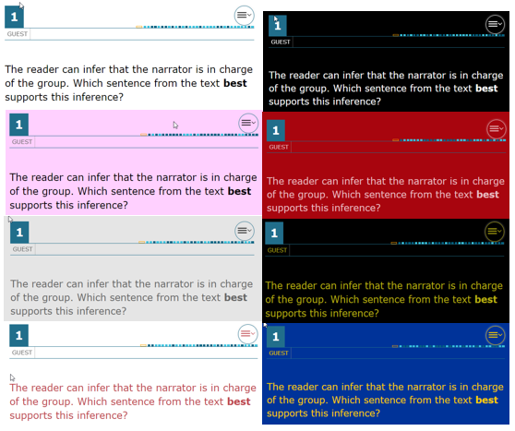
Accessibility Resources: Color Contrast
Black on White
Black on Rose
Medium Gray on Light Gray
Red on White
Reverse Contrast
White on Red
Yellow on Black
Yellow on Blue
Notes:
Color Contrast is a designated support that is available to eligible students. By default, tests are presented with black text on a white background. Students who require a different combination of font color and background color should be assigned the appropriate accommodation in TIDE.
The color contrast selected will apply to all tests for that student. Color contrast options may include the following: Black on White; Black on Rose; Medium Gray on Light Gray; Red on White; Reverse Contrast; White on Red; Yellow on Black; Yellow on Blue.

Slide 38
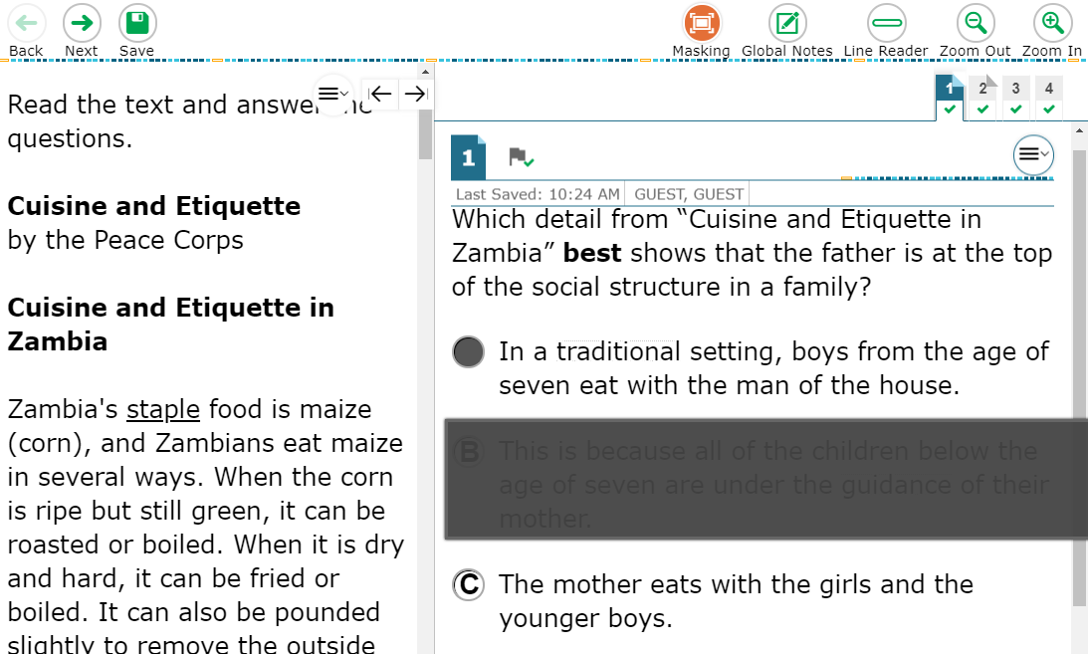
Accessibility Resources: Masking
Notes:
The Masking tool allows students to cover up a distracting area of the test page. To use this tool, students select the Masking button and then select and drag their mouse to choose a rectangular area on the screen that they wish to mask. To deactivate Masking mode, students must select the Masking button again. Masked areas remain on the screen even after Masking mode is deactivated. To remove a masked area, students select the X button in the upper-right corner of the masked area.

Slide 39
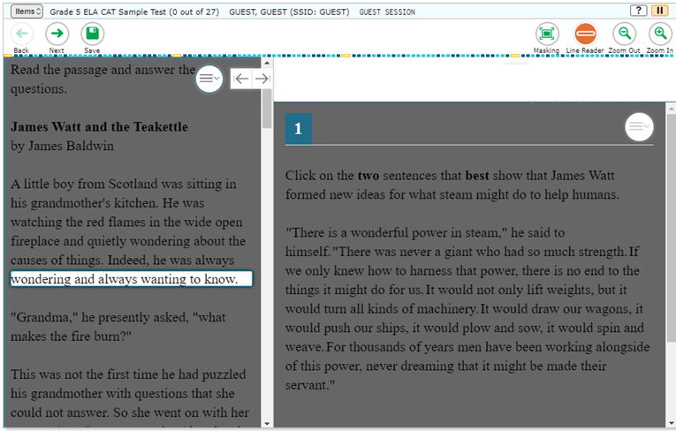
Accessibility Resources: Hybrid Masking Tool
Notes:
The Hybrid Masking tool is an embedded designated support that combines the functions of the Masking tool and Line Reader. Activating the Hybrid Masking tool blacks out the page content and only highlights the line the student clicks. The student can navigate using their arrow keys to change which line is being highlighted.

Slide 40
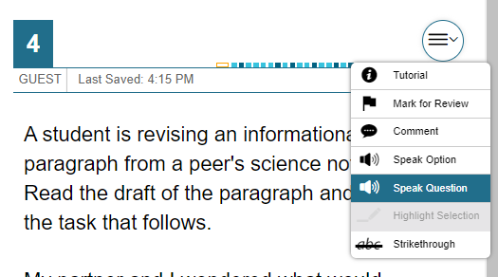
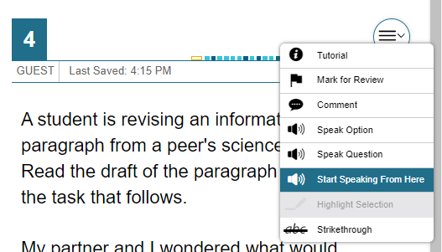
Accessibility Resources: Text-to-Speech
Notes:
TTS allows eligible students to listen to test content, including passages, questions, and answer options. Students may also listen to their responses to constructed-response items if they have the appropriate accommodations. TTS must be set up in TIDE before testing. It is available either as an embedded designated support or as an embedded accommodation for students with an identified need.
Please note that a test may include text that is not permissible to be read aloud. This text will be skipped when using TTS.
New this year, the student can click on the speaker icon to initiate TTS from the start of the question. The student can also select the desired TTS option from the menu to hear the audio (for example: Speak Passage, Speak Question, or Speak Question and Options).
Students can also use the Start Speaking From Here option to have TTS read from anywhere in a passage or item to the end of that passage or item. To use this feature, students will right-click where they want TTS to begin reading and select Start Speaking From Here.
We recommend that students who will be using this feature can try it by taking the practice test prior to testing. As mentioned earlier, you should ensure that all students requiring the TTS feature have headphones and that they have completed the audio check successfully.
Some tests may also display ear icons by questions and answer options when TTS is enabled. The student can select these icons to listen to the content.
If a student’s test settings require the test page to be mandatorily read out in its entirety, TTS will automatically read the entire page and will prevent the student from performing any action until the content has been fully read.

Slide 41
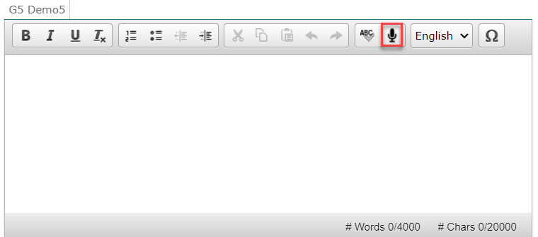
Accessibility Resources: Speech-to-Text
Notes:
Students with the STT accommodation may use the STT tool when responding to text response items. The STT tool allows a student to dictate responses to items that support the use of STT, and the student’s spoken words are then transcribed as text in the item response areas.
To begin dictating, the student selects the microphone button that appears at the top of the item’s text response area. As the student speaks, words are transcribed into the text response area. Note that there may be a slight delay while text is being transcribed. While text is being transcribed, dots will appear in the text response to indicate that transcription is in progress. To stop the transcription, the student will select the stop button that appears after the microphone is selected. Students can dictate for five minutes at a time. Depending on the test and the accommodation settings, students may also be able to select whether to dictate text in English or Spanish from the language drop-down list in the formatting toolbar.
Depending on the tool settings, the text may be auto-punctuated. The student can also control some punctuation and grammar of the text through speech commands. For example, the student can say, “New Paragraph” to create a new paragraph. The student will need to ensure the accuracy of the speech transcription before continuing to the next item or submitting his or her test. Note that a student cannot navigate away from the test page while dictation is on.

Slide 42
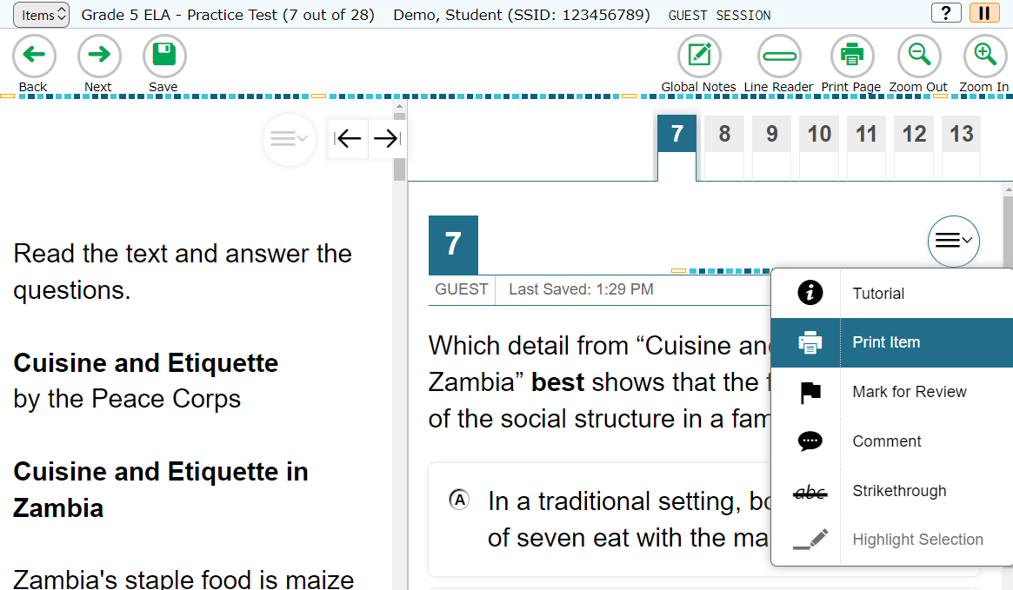
Accessibility Resources: Print-on-Request
Notes:
The Print-on-Request feature is available only for students who require it. It is a testing impropriety to apply this restricted resource for a student without documentation of actual need. This feature is not intended as a method for printing the test in order to administer it on paper. Depending on whether they are allowed to print items, passages, or both, students with this accommodation will see either a Print Page button at the top of the screen, a Print Item option in the context menu, or both. When a student selects either print option, the TA will receive a request for approval. The student will see a pop-up message that indicates that the request for approval has been sent. Before approving the request, the TA should ensure that the printer is monitored by staff who have been properly trained in test security.
Test items that students have requested to print will be displayed with a small printer badge next to the item number.

Slide 43
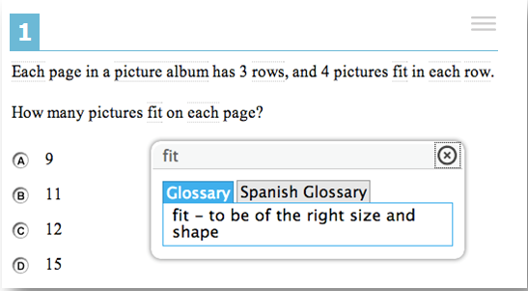
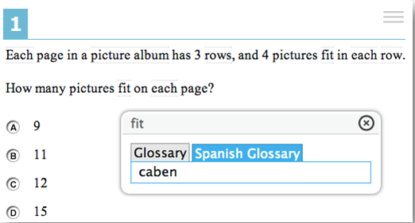
Accessibility Resources: Translation Glossaries
Notes:
Students who are English learners (ELs) may benefit from using a Translation Glossary for some tests. These students should have the Translation Glossary option selected in TIDE for the appropriate language. See the Translation Glossaries section in the Usability, Accessibility, and Accommodations Guidelines, available on the Smarter Balanced website, for information on how to determine if this support is appropriate for particular students. Available languages include Arabic, Burmese, Cantonese, Filipino, Hmong, Korean, Mandarin, Punjabi, Russian, Spanish, Ukrainian, and Vietnamese. A dual-language option is also available, which allows students to see both the English glossary and another language glossary at the same time.
When the Translation Glossary is enabled, some terms in mathematics items will appear with a gray dotted outline around them. When the student hovers the mouse over the term, it will be highlighted in blue. If the student selects a highlighted term, a pop-up box will appear with the translation of the term. Students can also select the audio icon next to the glossary term and listen to the audio recording of the glossary. Selecting the X in the upper-right corner of the pop-up box will close it. If the student has Dual-Language mode enabled, the glossary will appear with two tabs, one for each language.

Slide 44
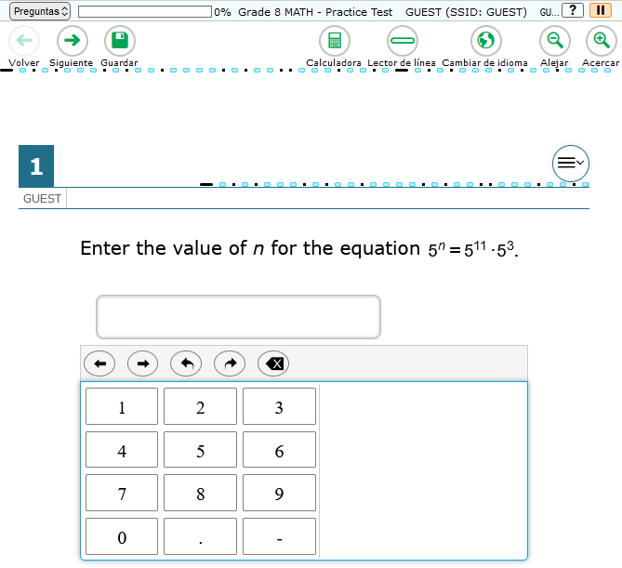
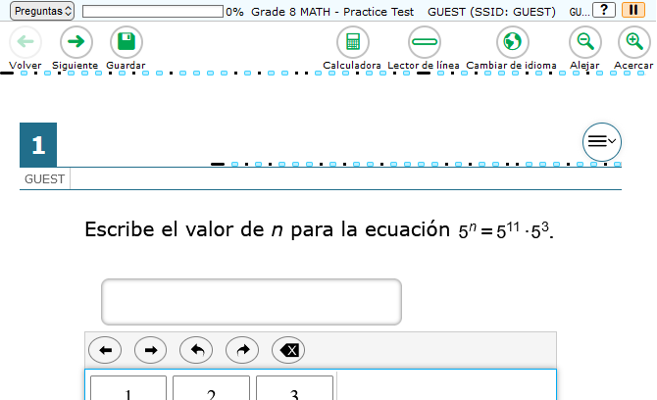
Accessibility Resources: Spanish Presentation
Notes:
In Washington, Math and Science assessments are available to qualified students in the Spanish language. Students have two different options for how the translated text will appear on their assessments.
This works by setting a student’s Presentation (Designated Supports and Accommodations) in TIDE to Spanish for Math/Science and then selecting one of the two options for Translations (dual language) Test Spanish: “Switch between Spanish only or English only” or “Show Spanish above English.”
With the “Switch between Spanish only or English only” setting selected, the student will have the option to click on a button at the top of the test page to switch between Spanish and English language text.

Slide 45
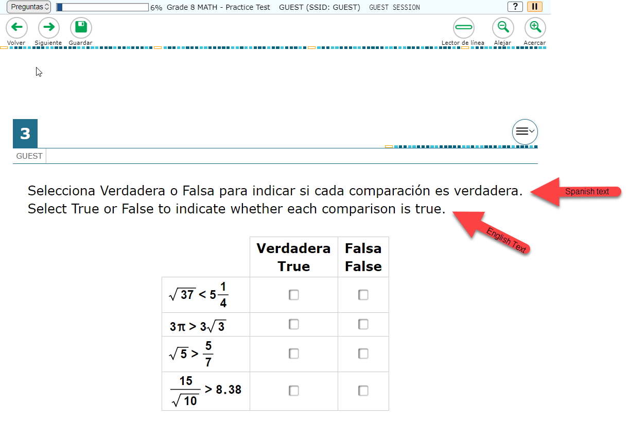
Accessibility Resources: Spanish Presentation
If a word is also included in the English glossary, the glossary will appear with two tabs, one for each language.
Notes:
In Washington, Math and Science assessments are available to qualified students in the Spanish language. Students have two different options for how the translated text will appear on their assessments.
For students with Presentation set to Spanish in TIDE, the other option is to select “Show Spanish above English.” The text in the assessment will appear in both English and Spanish.

Slide 46
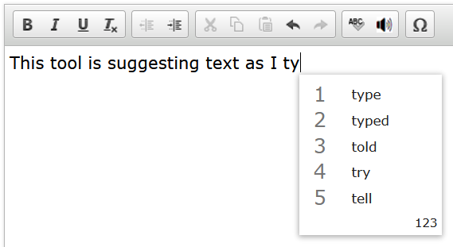
Accessibility Resources: Word Prediction
Available in the Test Delivery System (TDS) for students with the appropriate accommodations.
Predicts each word as students type a written response.
Students can select a word instead of typing it manually.
Available on supported iPadOS and ChromeOS devices.
Notes:
Word prediction assistive technology suggests words to students as they type responses for test items. This tool automatically predicts each word as students type a written response, allowing them to select a word from a suggested list instead of typing it manually.
It is recommended that students use the embedded Co:Writer word prediction tool in TDS, which is supported on all devices for most subjects.
Note: Math and science tests do not work with word prediction on Windows and MacOS devices.

Slide 47
Ending a Test
Notes:
Finally, we will look at how students end a test.

Slide 48
Test Pause
Notes:
If your school plans to test over multiple days, you may wish to have students pause their tests at a certain point so that they can resume testing at another time. You may also allow a pause if students are taking a break from testing or if they need to leave the room for any reason. Whether they have been instructed to do so or not, students can pause their test at any time by selecting the Pause button in the upper-right corner of the screen. When they do so, a pop-up message will appear, asking them to confirm that they want to pause the test. Students should select Yes to confirm the pause or No to resume testing.

Slide 49
Test Pause Rules
For WCAS and computer adaptive tests (CATs) and that have been paused for less than 20 minutes, students returning from a break in testing can revisit any items in the current test segment and change their answers if desired.
Students taking a CAT or WCAS who have paused their tests for longer than 20 minutes may only return to the most recently visited page containing unanswered test items in the current test segment. They may change any answers present on this page but may not access any items on previous pages or in previous segments of the test.
If all items on the most recently visited page were answered prior to pausing, the student will resume the test on the next page with unanswered items and will not be allowed to access previous pages or segments of the test.
For performance tasks (PTs), there are no pause restrictions. If a PT is paused for 20 minutes or more, the student can return to the PT and review or change answers and continue entering their responses.
Notes:
Some rules apply when students pause their tests, depending upon the type of test and how long the pause lasts. For WCAS and computer adaptive tests (CATs) that have been paused for less than 20 minutes, students returning from a break in testing can revisit any items in the current test segment and change their answers if desired. There are no pause restrictions for the Performance Task (PT). If a PT is paused for 20 minutes or more, the student can return to the PT and review or change answers and continue entering their responses.
Students taking the WCAS or CAT who have paused their tests for longer than 20 minutes may only return to the most recently visited page containing unanswered test items in the current test segment. They may change any answers present on this page but may not access any items on previous pages. If all items on the most recently visited page were answered prior to pausing, the student will resume the test on the next page with unanswered items and will not be allowed to access previous pages or segments of the test.

Slide 50
Test Timeout
Test Timeout Due to Inactivity
As a security measure, after 30 minutes of test inactivity, students are logged out and their tests are paused automatically.
Inactivity is determined by whether the student is interacting with the test by selecting answers or using navigation tools. Clicking an empty space on the screen is not considered activity.
Students will receive a warning message prior to being logged out and must click the OK button on the pop-up message within 60 seconds in order to avoid automatic logout and pausing of their test.
If a student’s test is paused due to inactivity, the same rules apply as when the student intentionally pauses the test.
Notes:
As a security measure, after 30 minutes of test inactivity, students are logged out, and their tests are paused automatically. Inactivity is determined by whether or not the student is interacting with the test by selecting answers or using navigation tools. Clicking an empty space on the screen is not considered activity. Students will receive a warning message prior to being logged out and must click the OK button on the pop-up message within 60 seconds in order to avoid automatic logout and pausing of their test. If a student’s test is paused due to inactivity, the same rules apply as when the student intentionally pauses the test. The student can log in to the test again and resume from the point that testing was interrupted, subject to the pause rule, if applicable.
Additionally, if a screen saver is activated during testing, the security breach feature will log the student out of the test. To avoid any such interruption, schools should either deactivate screen savers before students start testing or ensure that screen savers are set to more than the allocated testing time.

Slide 51
End of Segment
Notes:
Some of the tests are presented in segments. When students reach the end of a test segment, they will see a message on the Review screen advising that they cannot return to change their answers in the current segment once they have moved on. When the student clicks the Next button on this screen, a warning will appear asking if they are sure they want to leave the current segment and move on to the next segment. TAs should ensure that students understand the outcome of ending the test segment and encourage students to check their answers before moving on.
Students should click the Yes button to move to the next segment and the No button to return to the Review screen.

Slide 52
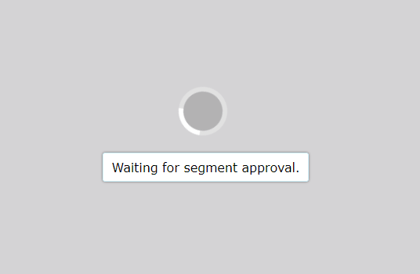
Begin a New Segment
Notes:
When students complete the first test segment in the ELA Performance Task, they will need to be approved by their TA into the next segment of their test. They will not be able to return to the previous segment.

Slide 53
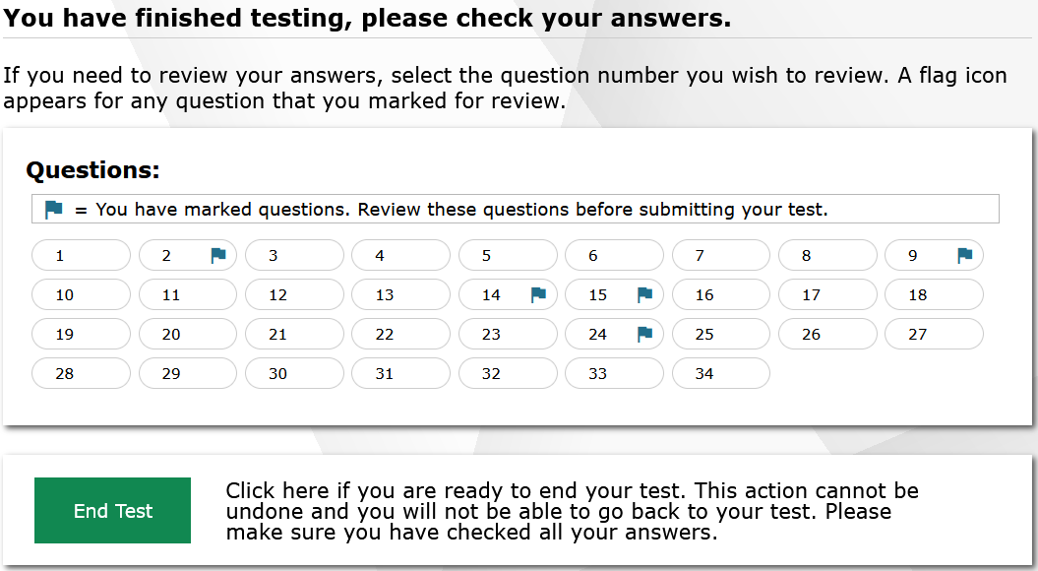
Review and End Test
Notes:
When students answer the final item on the test and click the Next button, they will see the Review and End Test screen. Items marked for review will appear with a blue flag next to the item number. Students should review their answers one last time before submitting their test.
When students are ready to end the test, they should select the Submit Test button. Students will check the box next to “I Agree” and click Yes if they are ready to end the test or click No if they are not. Clicking No will close the pop-up window and allow the student to continue reviewing items. Selecting Yes will take them to the Test Completion page.

Slide 54
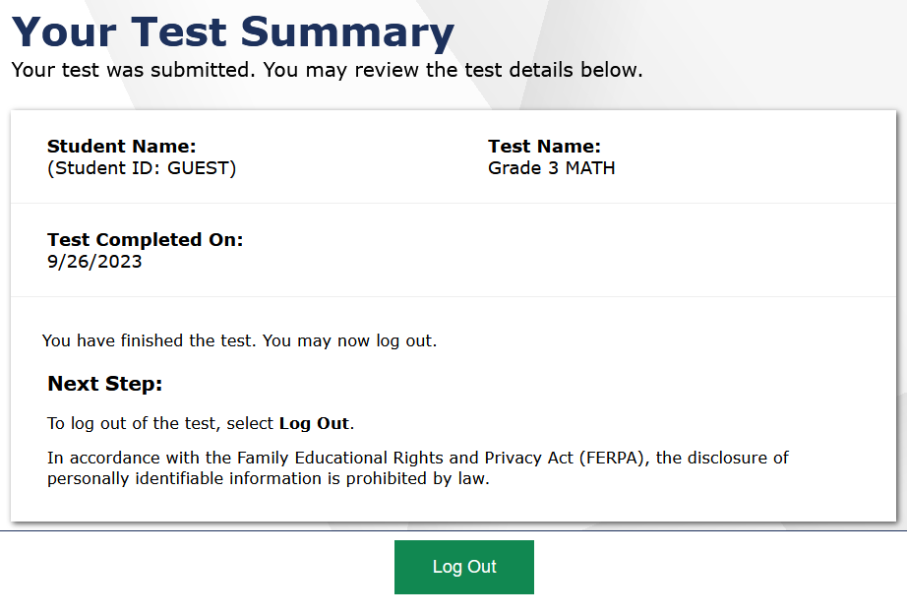
Test Completion Page
Notes:
On the Test Completion page, students will see confirmation that their test was successfully submitted. The student will click Log Out to exit the system.

Slide 55
Thank You!
For further information, please visit
WCAP Portal
https://wa.portal.cambiumast.com/
Washington Help Desk
wahelpdesk@cambiumassessment.com
1 (844) 560-7366
Notes:
Thank you for taking the time to view this training module. If you have general questions or need further information, visit your WCAP portal, the Smarter Balanced website, or consult the Washington help desk for assistance.
For information about accessibility resources, consult the GTSA, available on the WCAP Portal. You may also wish to view additional training modules and resources also available on the WCAP portal.

