Slide 1
Testing with Braille
Training Module for Technology Coordinators
Copyright © Cambium Assessment, Inc. All rights reserved.
Notes:
Welcome. In this training module, we will discuss what test administrators need to know in order to administer tests to students using braille. For more detailed information on administering tests to students using braille, please refer to the Assistive Technology Manual for Windows and macOS available on the WCAP portal.

Slide 2
Objectives
After viewing this presentation, you should be able to:
Check that required devices and software for testing with Braille are in place
Confirm that required hardware and software have been set up and configured
Notes:
By the end of this presentation, you should be able to:
Check that required devices and software for testing with Braille are in place
Confirm that required hardware and software have been set up and configured

Slide 3
Technology for Testing with Braille

Slide 4
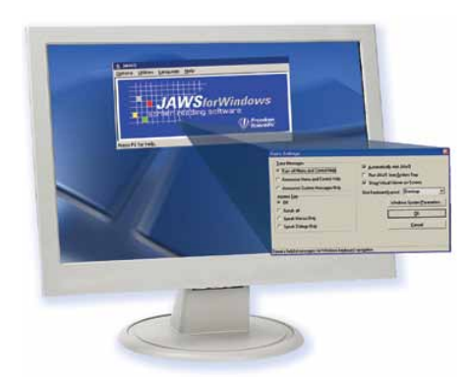
Technology for Testing with Braille: Screen Readers
Job Access With Speech (JAWS)
A computer screen-reader program that allows students who are visually impaired students to read the screen either with a text-to-speech output or by a Refreshable Braille Display (RBD).
Students use their keyboards to navigate between lines and test elements.
Only JAWS may be used on ELA tests.
4
Notes:
Specific hardware and software are required in order to administer tests to students using braille.
Student testing devices running Windows (versions 10, and 11) must have Job Access With Speech, or JAWS, installed. JAWS is a computer screen-reader program that allows students who are visually impaired to read the screen either with a text-to-speech output or by a Refreshable Braille Display. Students can use JAWS keyboard commands to navigate the test sign-in process and answer test items. We will discuss how students use JAWS later in this presentation.
Note that only JAWS may be used on ELA tests, as this is the only supported screen reader than can effectively mute reading passages. Screen readers other than JAWS should not be used on ELA tests, as they would allow students to listen to passages instead of reading them, compromising the ability to assess their reading comprehension skills.
For additional information on supported screen readers, see the Assistive Technology Manual for Windows and macOS.

Slide 5
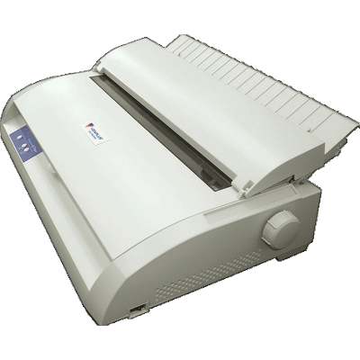
Technology for Testing with Braille: Embossers
ViewPlus Max Braille Embosser
Used to create hard copies of text and images.
Embossers work with braille translation software to print written text on the computer screen as braille.
Files used for embossing are configured to work with the ViewPlus Max Embosser.
5
Notes:
A braille embosser is a type of printer that creates hard copies of text and images in braille. Braille translation software should be installed and configured on the TA’s computer so that they can send approved emboss requests to the embosser.
Files used for embossing are configured to work with the ViewPlus Max Braille Embosser, ViewPlus Premier, ViewPlus Columbia, ViewPlus Columbia 2, or ViewPlus Rogue. Embossers from a manufacturer other than ViewPlus will not be able to print graphics and images in the online testing system.

Slide 6
Technology for Testing with Braille: Refreshable Braille Display
Refreshable Braille Display (RBD)
A device for displaying braille characters, usually by means of round-tipped pins raised through holes in a flat surface.
RBDs allow users who cannot see a computer monitor to read text output.
This device is supported but not required for online testing. RBDs cannot display images.
CAI recommends using an RBD that has at least 40 cells, such as the Brailliant 40 cell, but RBDs with fewer cells may also be used.
6
Notes:
A Refreshable Braille Display (or RBD) is a device for displaying braille characters, usually by means of round-tipped pins raised through holes in a flat surface.
In addition to braille embossers, RBDs are another means by which students can read text without a computer monitor. RBDs are recommended but not required for online testing. If using an RBD, CAI recommends one that has at least 40 cells, such as the Brailliant 40 cell, but RBDs with fewer cells may also be used.
If a question includes text and images that the RBD cannot read, the question will be sent to a braille embosser instead.

Slide 7
Technology for Testing with Braille
Student Computers
Windows 11
Windows 10
Test Administrator Computers
Windows 11
Windows 10
7
Notes:
Please note that all computers to be used by students and TAs for testing with Braille must be running Windows. The currently supported Windows operating systems are listed on this slide.
Please consult the Testing with Assistive Technology for Braille Tests
section on p. 18 of the Assistive Technology Manual for Windows & macOS.

Slide 8
Test Administrator Software Configurations

Slide 9
TA Software Configuration
Install the following embossing software on machines to be used by the Test Administrator (TA)
ViewPlus Desktop Embosser Driver used to emboss PRN files (required)
Duxbury Braille Translator (version 12.1, 12.2, 12.5, or 12.6) used to emboss BRF files (required)
ViewPlus Tiger Software Suite (required if file conversion before embossment is necessary)
Configure PRN emboss settings with ViewPlus software
Configure BRF emboss settings with Duxbury Braille Translator software
9
Notes:
On all devices used by test administrators to administer tests, technology coordinators should install and configure the ViewPlus Desktop Embosser Driver and the Duxbury Braille Translator. The ViewPlus Desktop Embosser driver includes the Tiger Viewer application used to emboss PRN files. We will discuss embossing PRN and BRF files later in this presentation.
We also recommend installing the ViewPlus Tiger Software Suite, which is available for purchase online and included for free with the purchase of any ViewPlus embosser. The Tiger Software Suite is not required but can be used as an alternate method for printing PRN files. The ViewPlus Tiger Software Suite is required if you need to convert any files before embossing them.
Before any tests are administered, technology coordinators should install this software under the Windows login account of the test administrator and configure BRF and PRN emboss settings according to the detailed instructions in the Assistive Technology Manual for Windows and macOS. If these steps are not carefully followed using sample braille files, unexpected technology issues may arise during test administration.

Slide 10
TA Software Configuration: ViewPlus Desktop Driver
The ViewPlus embosser desktop driver includes the Tiger Viewer application used to emboss PRN files.
The desktop embosser driver can be found on the USB drive that comes with the embosser, or you may download the driver from the ViewPlus website
10
Notes:
The ViewPlus desktop driver includes the ViewPlus Tiger Viewer application used to emboss PRN files. This driver can be found on the USB drive that comes with the embosser, or you may download the latest driver from the ViewPlus website.
If you are installing the driver from the ViewPlus website, the driver will be downloaded as a .zip file. Extract the contents to your hard drive and open the application file ending in “.exe.” If you get a Windows security alert, click Install to proceed.

Slide 11
Install ViewPlus Desktop Driver: Steps 1–4
Ensure that the embosser is connected to the computer with its included USB cable.
Note: You should always plug the embosser into the same USB port on your computer.
Follow the installation instructions for installing the ViewPlus desktop embosser driver. You will need to restart your computer for the installation to complete.
Download a sample PRN file. This can be found on the TA Training Site in the Help Guide.
Click the sample PRN file to open it.
11
Notes:
To install and configure the ViewPlus Desktop Embosser Driver and Tiger Viewer:
Ensure that the embosser is connected to the computer with its included USB cable.
Note: You should always plug the embosser into the same USB port on your computer. Plugging into a different USB port may cause the computer to not recognize the embosser even though it was previously installed.
Follow the installation instructions for installing the ViewPlus desktop driver. You will need to restart your computer for the installation to complete.
Download a sample PRN file. This can be found on the TA Training Site in the Help Guide’s Sample Braille Files appendix.
Click the sample PRN file to open it.

Slide 12
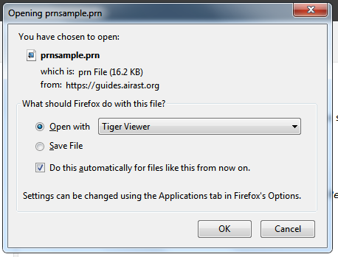
Install ViewPlus Desktop Driver: Steps 5–6
5. In the Open with drop-down list, select Tiger Designer.
If that option is not shown, click Browse and navigate to the location where it is installed.
Check the box labeled “Do this automatically for files like this from now on.”
6. Click OK.
Tiger Designer
12
Notes:
In the “Open with” drop-down list, select Tiger Designer.
If that option is not shown, click Browse and navigate to the location where it is installed.
Check the box labeled “Do this automatically for files like this from now on.”
Click OK.

Slide 13
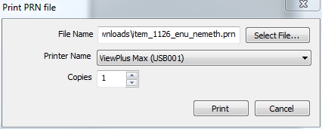
Install ViewPlus Desktop Driver: Steps 7–11
The Tiger Designer program opens and previews the file.
Go to File > Print. The Print window opens.
Ensure that the printer is set to ViewPlus Max (or other ViewPlus embosser) and that only one copy is being printed.
Click Print to emboss.
Check the embossed braille output. If it is correct, then your machine is now properly configured to print PRN files.
13
Notes:
The Tiger Designer program opens and previews the file.
Go to File > Print. The Print window opens.
Ensure that the printer is set to ViewPlus Max (or other ViewPlus embosser) and that only one copy is being printed.
Click Print to emboss.
Check the embossed braille output. If it is correct, then your machine is now properly configured to print PRN files.
Please note that if you are having difficulties embossing PRN files using the Tiger Viewer, you may be able to emboss successfully by restarting the embosser and then using the ViewPlus Designer program instead. ViewPlus Designer is part of the Tiger Software Suite included on installation USB drive that comes with all ViewPlus embossers.
If the Print button is disabled, you may need to convert the files in Tiger Designer. To do this, open the file in Tiger Designer and click Yes when a popup message asks if you want to convert the file. Then save the file as a Tiger Designer Document file (.TDSX) and try printing it again.

Slide 14
Install Duxbury Braille Translator: Steps 1–4
Install the Duxbury Braille Translator used to emboss BRF files:
Ensure that the braille embosser is turned on and connected, with the correct device driver installed.
Install DBT from the web or from an installation USB drive.
Download a sample BRF file. This can be found on the TA Training Site in the Help Guide.
Click the Sample BRF file to open it. A dialog window will pop up.
14
Notes:
The following directions can be used to install Duxbury Braille Translator versions 12.1, 12.2, 12.5, and 12.6, which can be used to emboss BRF files. For directions about installing and configuring previous versions of Duxbury, please refer to the Assistive Technology Manual for Windows and macOS.
Ensure that the braille embosser is turned on and connected, with the correct device driver installed.
Install DBT from the web or from the installation USB drive.
Download a sample BRF file. This can be found on the TA Training Site in the Help Guide’s Sample Braille Files appendix.
Click the Sample BRF file to open it. A dialog window will pop up.

Slide 15
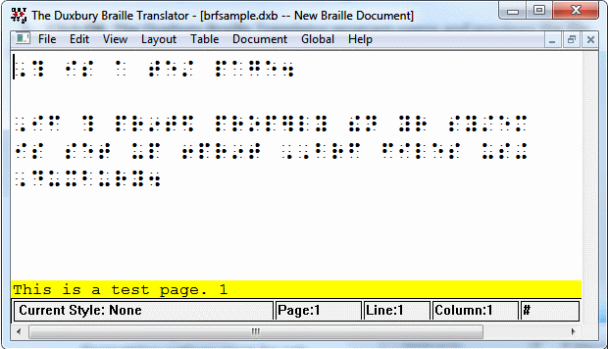
Install Duxbury Braille Translator: Steps 5–6
In the Open with drop-down list, select Duxbury Braille Translator.
If that option is not shown, click Browse and navigate to the location where Duxbury is installed.
Open the DBT folder and select dbtw.exe.
Check the box labeled “Do this automatically for files like this from now on.”
Click OK. The Duxbury Braille Translator opens and previews the file.
15
Notes:
In the Open with drop-down list, select Duxbury Braille Translator.
If that option is not shown, click Browse and navigate to the location where Duxbury is installed.
Default location: C:\Program Files (x86)\Duxbury\DBT 11.3\dbtw.exe If you are using a different version of the Duxbury software, then you will need to change 11.3 to the appropriate version number.
Check the box labeled “Do this automatically for files like this from now on.”
Click OK. The Duxbury Braille Translator opens and previews the file.

Slide 16
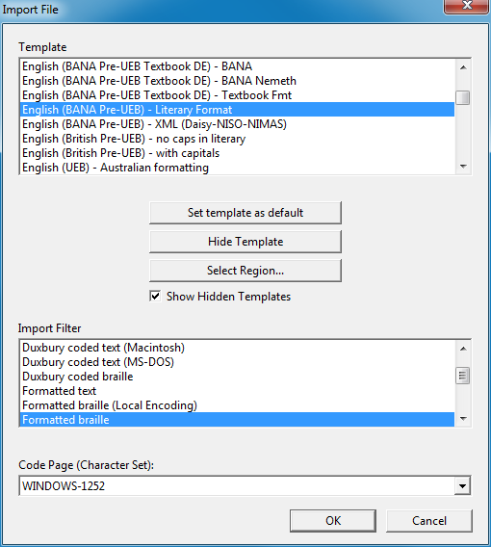
Install Duxbury Braille Translator: Steps 7–9
If the Import File window appears,
Set the Template to either English (American) – Standard Literary Format (for Duxbury 11.2 or earlier) or English (BANA Pre-UEB) – Literary Format (for Duxbury 11.3 or later).
Set the Import Filter to Formatted Braille.
Click OK to continue.
16
Notes:
If the Import File window appears,
Set the Template to either English (American) – Standard Literary Format (for Duxbury 11.2 or earlier) or English (BANA Pre-UEB) – Literary Format (for Duxbury 11.3 or later).
Set the Import Filter to Formatted Braille.
Click OK to continue.

Slide 17
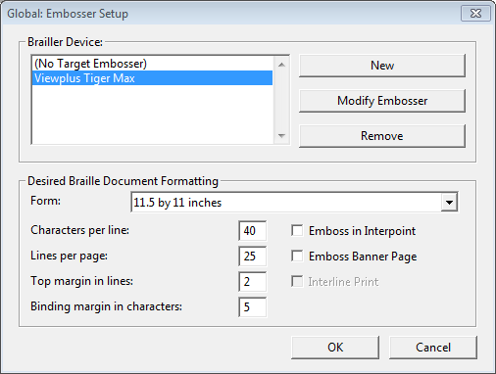
Install Duxbury Braille Translator: Step 10
In the Duxbury Braille Translator window, go to Global > Embosser Setup. The Global: Embosser Setup window appears.
17
Notes:
In the Duxbury Braille Translator window, go to Global > Embosser Setup. The Global: Embosser Setup window appears. To add a new embosser click New.

Slide 18
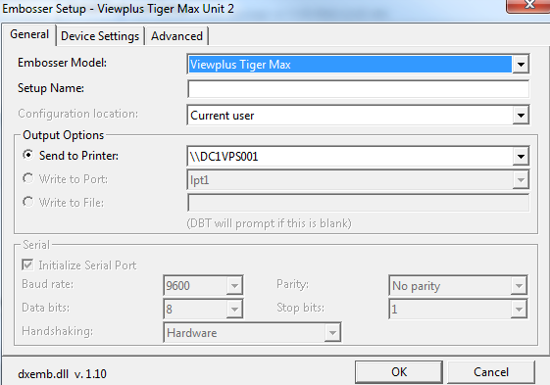
Install Duxbury Braille Translator: Step 11
To add a new embosser,
Click New. The Embosser Setup – Untitled Configuration window appears.
From the Embosser Model drop-down list, select the embosser type.
From the Send to Printer drop-down list, select the embosser’s name and click OK.
In the Global: Embosser Setup window, click OK.
18
Notes:
After clicking New to add a new embosser, the Embosser Setup window will appear.
To add a new embosser,
Click New. The Embosser Setup – Untitled Configuration window appears.
From the Embosser Model drop-down list, select the required embosser type.
From the Send to Printer drop-down list, select the required embosser’s name and click OK.
In the Global: Embosser Setup window, click OK to return to the Global Embosser Setup window.
These steps only need to be performed if your embosser does not appear in the list of braille devices.

Slide 19
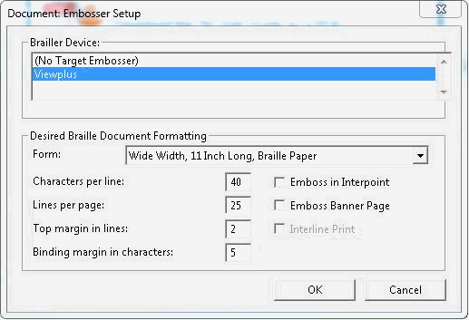
Install Duxbury Braille Translator: Steps 12–13
Once you have selected your braille embosser in the Brailler Device list, adjust the Desired Braille Document Formatting settings to those shown here.
Click OK when done.
19
Notes:
Once you have selected your braille embosser in the Brailler Device list, adjust the Desired Braille Document Formatting settings to those shown here:
Set Characters per line to 40.
Set Lines per page to 25.
Set Top margin in lines to 2.
Set Binding margin in characters to 5.
Make sure that the checkbox for Emboss in Interpoint is not selected.
Click OK when done.

Slide 20
Install Duxbury Braille Translator: Steps 14–15
You will return to the Duxbury Braille Translator window.
Go to Global > Formatted Braille Importer.
In the Global: Formatted Braille Importer window that appears, mark the Read formatted Braille without interpretation checkbox and click OK.
Select File > Emboss. The File: Emboss window appears.
20
Notes:
You will return to the Duxbury Braille Translator window.
Go to Global > Formatted Braille Importer.
In the Global: Formatted Braille Importer window that appears, mark the Read formatted Braille without interpretation checkbox and click OK.
Select File > Emboss. The File: Emboss window appears.

Slide 21
Install Duxbury Braille Translator: Steps 16–18
Ensure that only one copy is being embossed, the page range is set to All, and the Brailler Device is set to the ViewPlus embosser you wish to use.
Click OK to emboss.
Confirm that the embossed braille output is correct and that no braille text is cut off or printed beyond the edge of the page. If it is correct, then you are ready to print BRF files.
21
Notes:
Ensure that only one copy is being embossed, the page range is set to All, and the Brailler Device is set to the ViewPlus embosser you wish to use.
Click OK to emboss.
Confirm that the embossed braille output is correct and that no braille text is cut off or printed beyond the edge of the page. If it is correct, then you are ready to print BRF files.

Slide 22
Video Walkthrough: Configuring Duxbury Braille Translator
22
Notes:
This slide contains a video walkthrough showing how to install and configure Duxbury Braille Translator for embossing BRF files.

Slide 23
Student Software Configuration

Slide 24
Student Software Configuration
Install the following software on machines to be used by students testing with braille:
Secure Browser 16.0
JAWS (version 2021, 2022, or 2023)
Configuration instructions for JAWS:
Configure JAWS to recognize the Secure Browser
Apply JAWS settings for Contracted or Uncontracted Braille
Configure JAWS to speak “dollars”
For details, see the Assistive Technology Manual for Windows and macOS.
24
Notes:
Before administering tests to students with braille, TAs should confirm that their technology coordinator has installed and configured the Secure Browser and JAWS on all devices to be used by students testing with braille.
JAWS must be configured according to the detailed instructions in the Assistive Technology Manual for Windows and macOS. If JAWS is not configured, it will not work properly during test administration. Prior to launching the Secure Browser, you can also adjust JAWS voice settings for students based on their individual needs. Students should take practice tests using JAWS so they can determine whether these settings need to be adjusted.
In the next few slides, we will walk through required configuration of software on student testing devices. The following examples are applicable for installing JAWS 2021, 2022, and 2023.
For information on previous versions of JAWS software, please consult the Assistive Technology Manual for Windows and macOS.

Slide 25
Student Software Configuration, continued
The Secure Browser is available for download on the WCAP Portal.
JAWS is available online at http://www.freedomscientific.com/products/fs/jaws-product-page.asp
25
Notes:
Students use the Secure Browser to log in to the Student Interface of the Test Delivery System (TDS). Visit the WCAP Portal for more information on downloading and installing the Secure Browser. JAWS is available on the Freedom Scientific website.

Slide 26
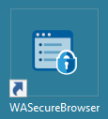
Configure JAWS to Recognize the Secure Browser
Open the JAWS ConfigNames.ini file.
Default Location: Start > All Programs > JAWS 2023 > Explore JAWS > Explore Shared Settings
In the ConfigNames.ini file, locate the line of text containing firefox:3=firefox
At the end of this line, press Enter, and on the new line type [WASecureBrowser]=firefox, where [WASecureBrowser] is the exact name of the Secure Browser found on the desktop.
When you are finished, save the file.
26
Notes:
The first step in configuring student software is to ensure that JAWS recognizes the Secure Browser. To perform this task:
First, open the JAWS ConfigNames.ini file. You can get to this file from the Start Menu by clicking: Start > All Programs > JAWS 2023 > Explore JAWS > Explore Shared Settings. If you are using a different version of JAWS, then simply change “JAWS 2023” to the correct version number.
In the ConfigNames.ini file, locate the line of text containing firefox:3=firefox.
At the end of this line, press Enter and type WASecureBrowser=Firefox, where WASecureBrowser is the exact name of the Secure Browser found on the desktop.
When you are finished, save the file.

Slide 27
Video Walkthrough: Configuring JAWS to Recognize the Secure Browser
27
Notes:
This slide contains a video walkthrough showing how to configure JAWS to recognize the Secure Browser. Please note that the JAWS version in this video may differ from your software.

Slide 28
JAWS Settings

Slide 29
Apply JAWS Settings: Steps 1–2
Open JAWS and go to Utilities > Settings Center. The Settings Center window opens.
From the Application list at the top of the window, select Firefox.
29
Notes:
In order for students to use contracted or uncontracted Literary Braille with their RBD, the correct JAWS settings must be applied prior to launching the Secure Browser. The following instructions can be used to perform this task using JAWS 2021 or later.
First, open JAWS and go to Utilities > Settings Center. The Settings Center window opens.
From the Application drop-down list at the top of the window, select Firefox.

Slide 30
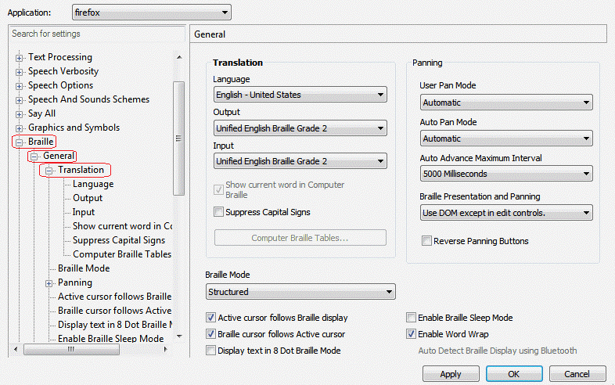
Apply JAWS Settings: Step 3
3. Expand the Braille settings, General sub-settings, and Translation sub-settings in the Search for settings panel on the left. The Settings Center window displays the options for Braille Translation.
In the Translation section, verify the Language drop-down list is set to English – United States.
For students who prefer contracted braille, select Unified English Braille Grade 2 from both the Input and Output drop-down lists.
For students who prefer uncontracted braille, select Unified English Braille Grade 1 from the Output drop-down list.
30
Notes:
Expand the Braille settings, General sub-settings, and Translation sub-settings in the Search for settings panel on the left. The Settings Center window displays the options for Braille Translation.
In the Translation section, verify the Language drop-down list is set to English – United States.1
For students who prefer contracted braille, select Unified English Braille Grade 2 from both the Input and Output drop-down lists.
For students who prefer uncontracted braille, select Unified English Braille Grade 1 from the Output drop-down list.

Slide 31
Apply JAWS Settings: Steps 4–5
In the Braille Mode section, ensure that only the following settings are checked:
Active cursor follows Braille display
Braille display/cursor follows Active cursor
Enable Word Wrap
Auto Detect Braille Display using Bluetooth (if available)
Click Apply, and then click OK.
31
Notes:
In the Braille Mode section, ensure that only the following settings are checked:
Active cursor follows Braille display
Braille display/cursor follows Active cursor
Enable Word Wrap
Auto Detect Braille Display using Bluetooth (if available)
Click Apply, and then click OK.
The necessary settings for contracted braille appear on this slide.

Slide 32
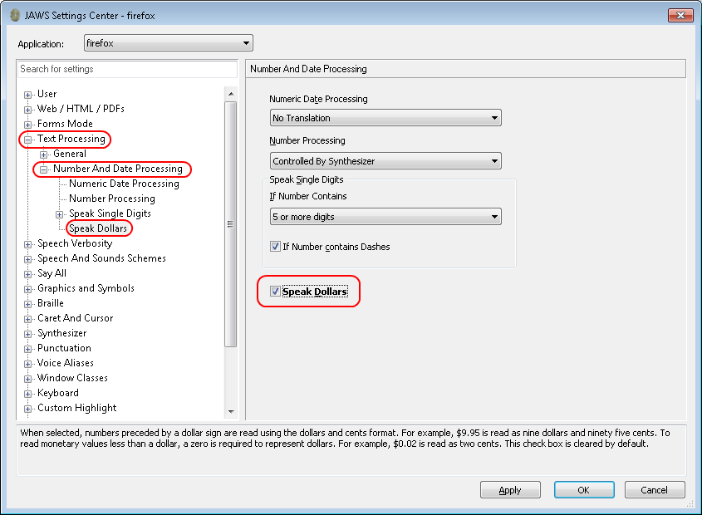
Configure JAWS to Speak “Dollars” ($)
Open JAWS and go to Utilities > Settings Center. The Settings Center window opens.
In the Search for settings panel on the left, expand the Text Processing settings and Number And Date Processing sub-settings. Click Speak Dollars. The Settings Center window displays the Number And Date Processing options.
Mark the Speak Dollars checkbox.
Click Apply, and then click OK.
32
Notes:
To ensure that JAWS correctly speaks the dollar symbol, the following steps must be performed:
Open JAWS and go to Utilities > Settings Center. The Settings Center window opens.
In the Search for settings panel on the left, expand the Text Processing settings and Number And Date Processing sub-settings. Click Speak Dollars. The Settings Center window will display the Number And Date Processing options.
Mark the Speak Dollars checkbox.
Click Apply, and then click OK.

Slide 33
Video Walkthrough: Applying JAWS Settings
33
Notes:
This slide contains a video walkthrough showing how to apply JAWS settings for contracted or uncontracted braille and how to configure JAWS to speak “dollars.”

Slide 34
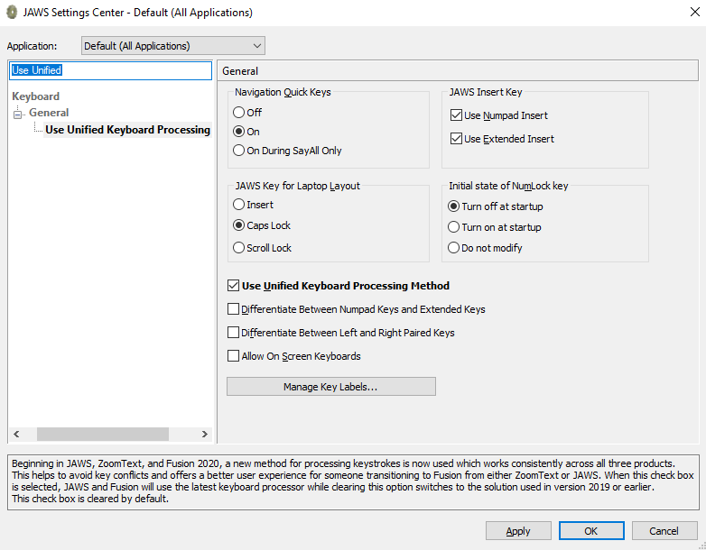
Verify the JAWS Unified Keyboard Settings
Open JAWS and navigate to Utilities>Setting Center.
Search in the Settings Center for “Unified Keyboard” and mark the Use Unified Keyboard Processing Method checkbox.
Open JAWS and navigate to Utilities > Setting Center.
Search in the Settings Center for “Unified Keyboard” and mark the Use Unified Keyboard Processing Method checkbox.
34
Notes:
JAWS includes a unified keyboard setting that allows students to use Alt+Tab to return to the Secure Browser when Permissive Mode is turned on.
The unified keyboard setting is turned on by default, but you should still verify it is enabled for students before they begin testing.
Open JAWS and navigate to Utilities > Setting Center.
Search in the Settings Center for “Unified Keyboard” and mark the Use Unified Keyboard Processing Method checkbox.

Slide 35
More Help
WCAP Helpdesk
Toll-Free Phone Support:
1.844.560.7366
Email Support:
wahelpdesk@cambiumassessment.com
Notes:
Thank you for viewing this training module. If you have general questions or need further information, please visit the WCAP Portal or consult the help desk for assistance.

Slide 36
Thank You
Notes:
Thank you for taking the time to view this training module.

