Slide 1
Administering Online Braille Tests
Training Module for Test Administrators
Copyright © Cambium Assessment, Inc. All rights reserved.
Notes:
Welcome. In this training module, we will discuss what test administrators need to know in order to administer tests to students using braille. For more detailed information on administering tests to students using braille, please refer to the Assistive Technology Manual for Windows and macOS available on the WCAP portal.

Slide 2
Objectives
After viewing this presentation, you should be able to:
Understand available Braille types
Administer tests to students using Braille
Correctly handle emboss requests during testing
Understand how students using Braille sign into the Student Testing Site and respond to test items
Notes:
By the end of this presentation, you should be able to:
Understand available Braille type
Administer tests to students using Braille
Correctly handle emboss requests during testing
Understand how students using Braille sign into the Student Testing Site and respond to test items

Slide 3
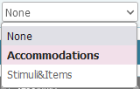
Overview of Braille Testing
Before testing, students must have the correct test settings entered in TIDE:
3
Notes:
Before any tests can be administered to students using Braille, these students must have the correct test settings entered in TIDE. The image on this slide shows some of the accommodations that need to be set by the SC, DA, or DC:
Students’ Presentation (Designated Supports and Accommodations) settings should be set to Braille.
The appropriate Braille type should be selected for each test type. Braille types include uncontracted, contracted, and Nemeth.
If students should have the ability to request embossing of stimuli and/or items, their emboss settings should be adjusted appropriately for each type of test.
For the full list of Braille types and more information on TIDE settings for students using Braille, please refer to the Assistive Technology Manual for Windows & macOS, on the WCAP Portal.

Slide 4
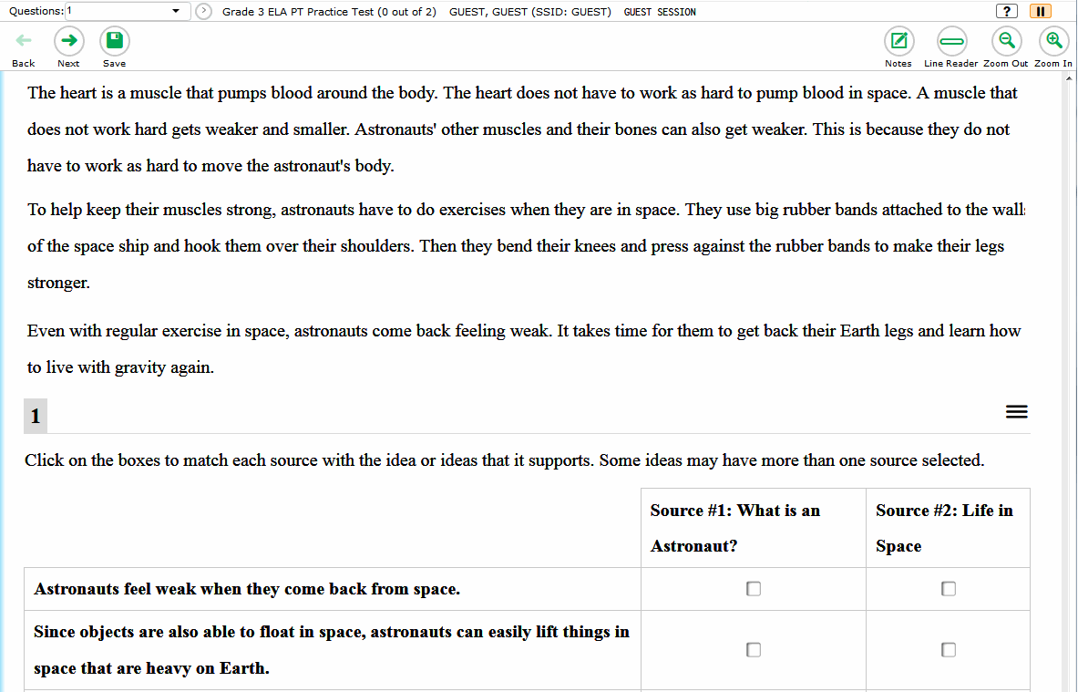
Overview of Braille Testing
Tests need to be set to streamlined mode for students with their test presentation set to Braille.
Content will be arranged vertically.
4
Notes:
When a student’s test presentation is set to Braille, Streamlined mode must also be selected by the SC, DA, or DAC in TIDE. This layout arranges the test content vertically. The stimuli appear at the top of the page, and questions appear in sequence below their associated stimulus.

Slide 5
Technology for Testing with Braille

Slide 6
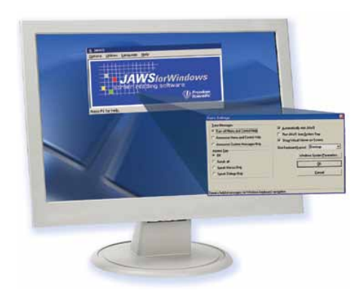
Technology for Testing with Braille: Screen Readers
Job Access With Speech (JAWS)
A computer screen-reader program that allows students who are visually impaired students to read the screen either with a text-to-speech output or by a Refreshable Braille Display (RBD).
Students use their keyboards to navigate between lines and test elements.
Only JAWS may be used on ELA tests.
6
Notes:
Specific hardware and software are required in order to administer tests to students using braille.
Student testing devices running Windows (versions 10, and 11) must have Job Access With Speech, or JAWS, installed. JAWS is a computer screen-reader program that allows students who are visually impaired to read the screen either with a text-to-speech output or by a Refreshable Braille Display. Students can use JAWS keyboard commands to navigate the test sign-in process and answer test items. We will discuss how students use JAWS later in this presentation.
Note that only JAWS may be used on ELA tests, as this is the only supported screen reader than can effectively mute reading passages. Screen readers other than JAWS should not be used on ELA tests, as they would allow students to listen to passages instead of reading them, compromising the ability to assess their reading comprehension skills.
For additional information on supported screen readers, see the Assistive Technology Manual for Windows and macOS.

Slide 7
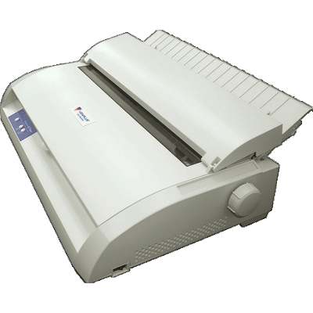
Technology for Testing with Braille: Embossers
ViewPlus Max Braille Embosser
Used to create hard copies of text and images.
Embossers work with braille translation software to print written text on the computer screen as braille.
Files used for embossing are configured to work with the ViewPlus Max Embosser.
7
Notes:
A braille embosser is a type of printer that creates hard copies of text and images in braille. Braille translation software should be installed and configured on the TA’s computer so that they can send approved emboss requests to the embosser.
Files used for embossing are configured to work with the ViewPlus Max Braille Embosser, ViewPlus Premier, ViewPlus Columbia, ViewPlus Columbia 2, ViewPlus Rogue, or PixBlaster. Embossers from a manufacturer other than ViewPlus or PixBlaster will not be able to print graphics and images in the online testing system.

Slide 8
Technology for Testing with Braille: Refreshable Braille Display
Refreshable Braille Display (RBD)
A device for displaying braille characters, usually by means of round-tipped pins raised through holes in a flat surface.
RBDs allow users who cannot see a computer monitor to read text output.
This device is supported but not required for online testing. RBDs cannot display images.
CAI recommends using an RBD that has at least 40 cells, such as the Brailliant 40 cell, but RBDs with fewer cells may also be used.
8
Notes:
A Refreshable Braille Display (or RBD) is a device for displaying braille characters, usually by means of round-tipped pins raised through holes in a flat surface.
In addition to braille embossers, RBDs are another means by which students can read text without a computer monitor. RBDs are recommended but not required for online testing. If using an RBD, CAI recommends one that has at least 40 cells, such as the Brailliant 40 cell, but RBDs with fewer cells may also be used.
If a question includes text and images that the RBD cannot read, the question will be sent to a braille embosser instead.

Slide 9
Technology for Testing with Braille
Student Computers
Windows 11
Windows 10
Test Administrator Computers
Windows 11
Windows 10
9
Notes:
Please note that all computers to be used by students and TAs for testing with Braille must be running Windows. The currently supported Windows operating systems are listed on this slide.
Please consult the Testing with Assistive Technology for Braille Tests
section on p. 18 of the Assistive Technology Manual for Windows & macOS.

Slide 10
Administer Tests to Students Using Braille

Slide 11
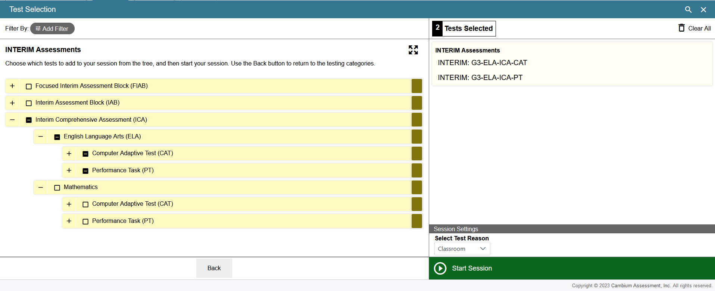
Create a Test Session
11
Notes:
The procedure to create a test session is the same as it would be for students not using Braille. The test session should be started less than 20 minutes prior to starting the test in order to prevent the system from timing out.
Mathematics assessments: in addition to the standard Braille presentation computer adaptive test requiring an on-site embosser, students may take the Braille Hybrid Adaptive Test (HAT). Pre-embossed Braille graphics and testing materials are available to order ahead of time for students who do not have access to an embosser.
For detailed instructions on creating test sessions, walking students through the login process, approving/denying student access, pausing a test, monitoring student progress, and ending a test, please review the Test Administrator Interface for Online Testing Module and the Secure Browser for Student Online Testing Module.

Slide 12
Prepare Student Testing Devices
Before testing begins, the TA must:
Open JAWS on student testing devices.
If administering an ELA test, mute the device.
You can mute the student’s device manually.
Open the Secure Browser on student testing devices.
12
Notes:
Before testing can begin, the TA must prepare all devices that students will use for testing. First, the TA should open JAWS. Please note that if students are taking an ELA test, the TA must also mute the students’ devices. To navigate the test without sound, students may use RBDs, have a TA read text aloud, and/or request that stimuli and items be embossed.
Next, the TA should open the Secure Browser that students will use to access the online testing interface. If support is needed, please reach out to your Technology Coordinator. For more detailed information and additional technical tips, please refer to the Test Administration Manual and the section Configuring Assistive Technologies section of the Technology Guide on the WCAP portal.

Slide 13
Emboss on Request
Students with Emboss changed from “None” to “Stimuli&Items” in their test settings will automatically be set to Auto-Request:
Auto-Request: Emboss requests automatically appear on the TA Interface as students navigate the test.
13
Notes:
The online testing system allows students to emboss test material with TA approval. As mentioned previously, the software that sends emboss requests to the Braille embosser must be installed on computers that TAs use for test sessions.
Students in Washington who have the Emboss setting changed in TIDE will automatically get the embossing set to Auto-Request. This means that the emboss requests automatically appear on the TA Interface as students navigate the test--no extra steps needed by the student.
A note about the Auto-Request setting: Auto-emboss request automatically “pre-fetches” (or queues up) print requests for upcoming test items before students access them. For example, when a student accesses the fifth test item, auto-emboss request may send print requests for items six and seven in advance. If a student pauses the test and you do not print out the pre-fetched print requests, the student will need to send print requests manually when resuming the test and proceed to those pre-fetched items.
TAs can see which emboss setting is selected for a given student’s test in the test settings window during the approval process.
For more information about handling emboss requests, please refer to the Assistive Technology Manual for Windows & macOS.

Slide 14
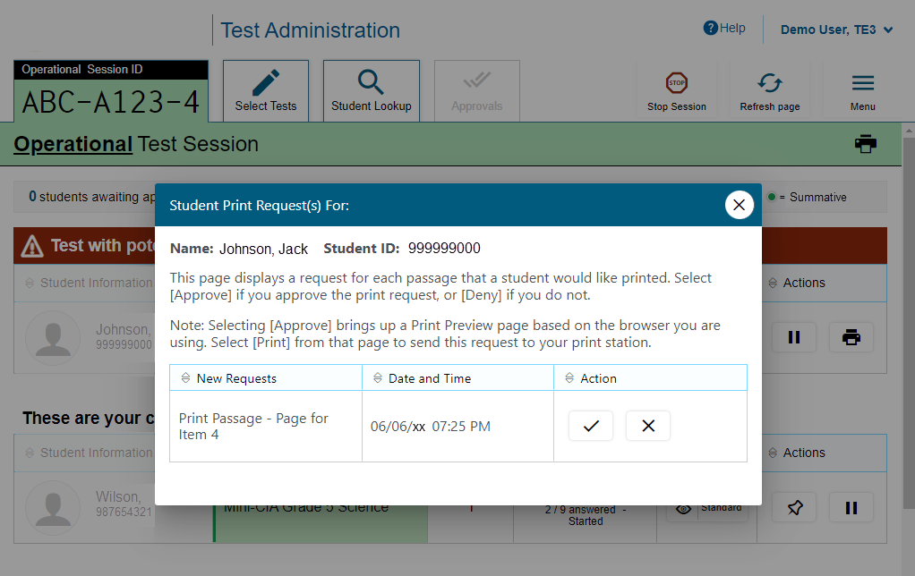
Emboss on Request: Approve/Deny Request
14
Notes:
When a student sends an emboss request, the Printer icon will appear in the Actions column of the monitoring screen. Click the button to view the request. If you click the X button to deny the emboss request, nothing will be embossed.
If you click the checkmark button to approve the emboss request, a print dialog will appear depending on the type of item you are embossing.
Before approving the student’s emboss request, ensure that it will be sent to an embosser that is monitored by staff who have been trained in test security. All printed or embossed test items, stimuli, and reading passages must be securely stored and destroyed immediately following a testing session.

Slide 15
Emboss on Request
There are two types of files that TAs may need to emboss:
Braille Ready File (BRF) types are used for emboss requests containing only text (including formatted tables). The Duxbury Braille Translator software handles BRF files.
Printer Output File (PRN) types are used for emboss requests containing tactile or spatial components (such as images). The ViewPlus Tiger Viewer software handles PRN files.
15
Notes:
The embossed output for student emboss requests depends on the file type associated with a test question. There are two types of files:
Braille Ready File (BRF) types are used for emboss requests containing only text (including formatted tables). The Duxbury Braille Translator software handles BRF files.
Printer Output File (PRN) types are used for emboss requests containing tactile or spatial components (such as images). The ViewPlus Tiger Viewer software handles PRN files.

Slide 16
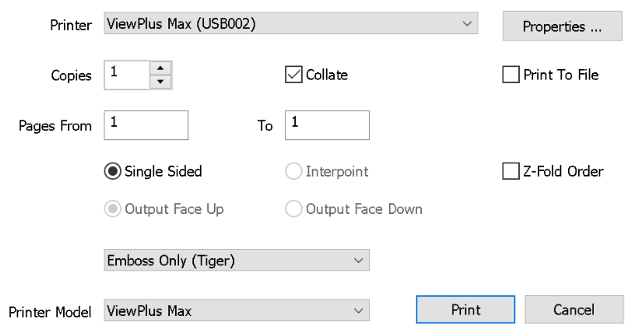
Emboss on Request: PRN
To emboss a Printer Output File (PRN):
When you approve a print request that prints in PRN format, a print dialog window opens.
Select to Save the file to your computer.
2. Locate the saved PRN file and open it.
If Tiger Designer is set as the default program for PRN files, a Print Window appears.
3. Click Print.
16
Notes:
Follow the below steps when printing a file in PRN format:
When you approve a print request that prints in PRN format, a print dialog window opens.
Select to Save the file to your computer.
Locate the saved PRN file and open it.
If Tiger Designer is set as the default program for PRN files, a Print window appears. Ensure that only one copy is being printed and the Printer Name is set to ViewPlus Max (or for the supported ViewPlus embosser you are using).
3. Click Print.

Slide 17
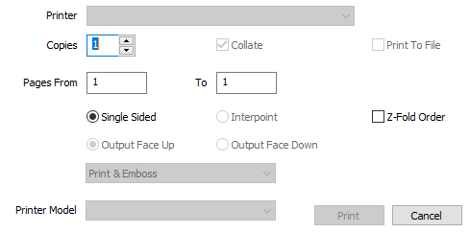
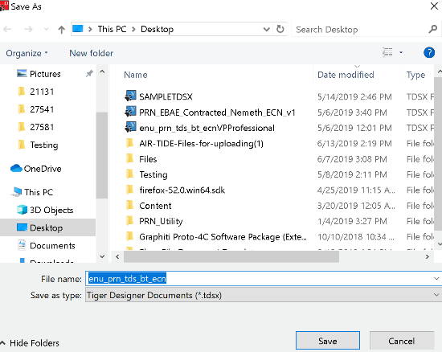
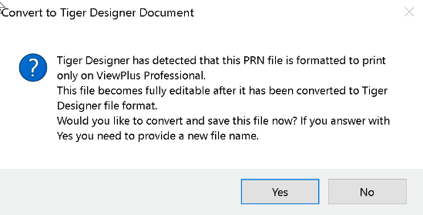
Emboss on Request: PRN, continued
If the Print button is disabled, you may need to convert the files in Tiger Designer.
Open the file in Tiger Designer and click Yes when a popup message asks if you want to convert the file.
Save the file as a Tiger Designer Document file (.TDSX) and try printing it again.
If this popup message does not appear, navigate to File>Save As. Choose the destination where you wish to save the file, then select ViewPlus Cub/Max PRN files from the Save as Type dropdown.
Disabled Print button
17
Notes:
If the Print button is disabled, you may need to convert the files in Tiger Designer. To do this, open the file in Tiger Designer and click Yes when a popup message asks if you want to convert the file. Then save the file as a Tiger Designer Document file (.TDSX) and try printing it again.
If this popup message does not appear, navigate to File > Save As. Choose the destination where you wish to save the file, then select Viewplus Cub/Max PRN files (*.prn) from the Save as Type dropdown.

Slide 18
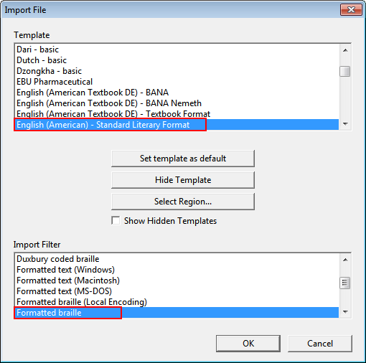
Emboss on Request: BRF
To emboss a Braille Ready File (BRF):
When you approve a print request that prints in BRF format, a print dialog window opens.
Select Open with.
In the drop-down list, select Duxbury Braille Translator.
Click OK. The Import File window opens
Ensure that the following are selected:
Template:
For Duxbury 11.2 or earlier: English (American) – Standard Literary Format
For Duxbury 11.3 or later: English (BANA Pre-UEB) – Literary Format
Import Filter: Formatted braille
18
Notes:
Follow these steps when printing a file in BRF format:
When you approve a print request that prints in BRF format, a print dialog window opens.
Select Open with.
In the drop-down list, select Duxbury Braille Translator.
Click OK. The Import File window opens.
In the Import File window, ensure that the following are selected:
Template:
For Duxbury 11.2 or earlier: English (American) – Standard Literary Format
For Duxbury 11.3 or later: English (BANA Pre-UEB) – Literary Format
Import Filter: Formatted braille

Slide 19
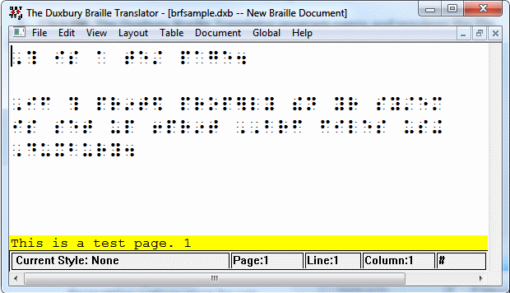
Emboss on Request: BRF, continued
To emboss a Braille Ready File (BRF):
Click OK. The Duxbury Braille Translator preview window opens.
Go to File > Emboss. The File: Emboss window opens.
Ensure that only one copy is being printed, the page range is set to All, and the Brailler Device is set to ViewPlus Max (or other ViewPlus embosser).
Click OK.
19
Notes:
Click OK. The Duxbury Braille Translator preview window opens.
Go to File > Emboss. The File: Emboss window opens.
Ensure that only one copy is being printed, the page range is set to All, and the Brailler Device is set to ViewPlus Max (or other ViewPlus embosser).
Click OK.

Slide 20
Deleting Test-Related Files
Most supported web browsers automatically save downloaded files.
If your computer saves the BRF and PRN files from emboss requests, you must delete all test-related files from your browser’s download archive for security purposes.
For more information on how to delete test-related files from your internet browser’s download archive, please consult the Assistive Technology Manual for Windows and macOS.
20
Notes:
Most supported web browsers automatically save downloaded files. If your computer saves the BRF and PRN files from emboss requests, you must delete all test-related files from your browser’s download archive for security purposes. This task is accomplished in different ways depending on which browser you are using.
For more information on how to delete test-related files from your internet browser’s download archive, please consult the Assistive Technology Manual for Windows and macOS.

Slide 21
Approved Requests
21
Notes:
The Approved Requests option allows you to view a list of every print request you approved during the current session. To see all approved requests, select the Menu button, and then select Approved Requests.
If you wish to print this list for your own records, select Print at the top of the Approved Requests window.

Slide 22
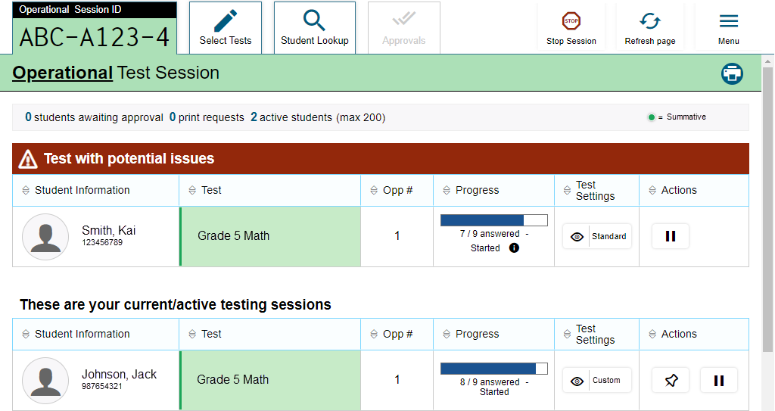
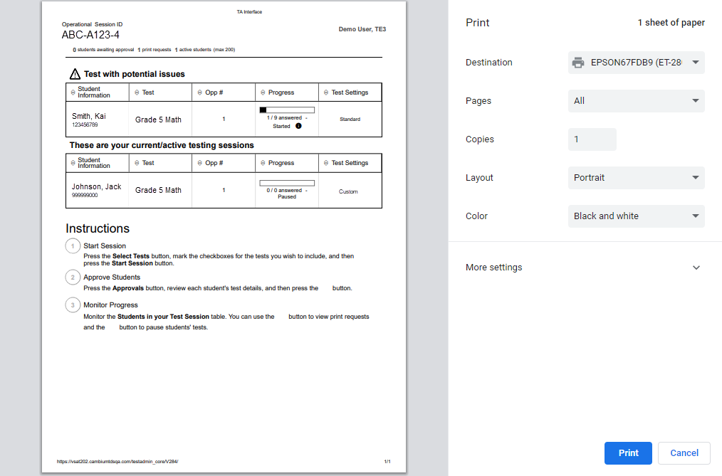
Print Test Session Information
22
Notes:
If you wish to print a snapshot of the TA Interface in its current view, select the Print icon located below the Menu button. Printing a snapshot of the test session information can be useful for tracking which students did not complete their tests and may need to be scheduled for another session.
Remember that any printouts containing personally identifiable student information must be securely stored and should be destroyed after use.

Slide 23
Navigate a Test Using Braille

Slide 24
JAWS Keyboard Commands
Action | Keyboard Command
Navigate to the next landmark element on the page. | R
Move to the next line on the page. | Down Arrow
Move to the previous line on the page. | Up Arrow
Move to the next component on the page. | Tab
Move to the previous component on the page. | Shift + Tab
Jump to the next heading on the page. | H
Jump to the previous header on the page. | Shift + H
Select an option or button. | Enter
Read everything on the page (from your current place on the page). | Insert + Down arrow
Stop JAWS from reading. | Ctrl
24
Notes:
Next, we are going to walk through the steps that students using Braille will follow in order to sign in to the online testing system and take tests.
Students should be familiar with the login process and navigation tools from taking the Practice Test, Training Test, and/or Interim Assessments.
JAWS allows students to navigate through their test by using keyboard commands. You can see some commonly used keyboard commands for JAWS in this table. We will refer back to these commands in the following slides.
Note that students testing with an RBD may have other means of navigating the online testing interface. For more information and a complete description of keyboard commands, please consult the Assistive Technology Manual for Windows & macOS.

Slide 25
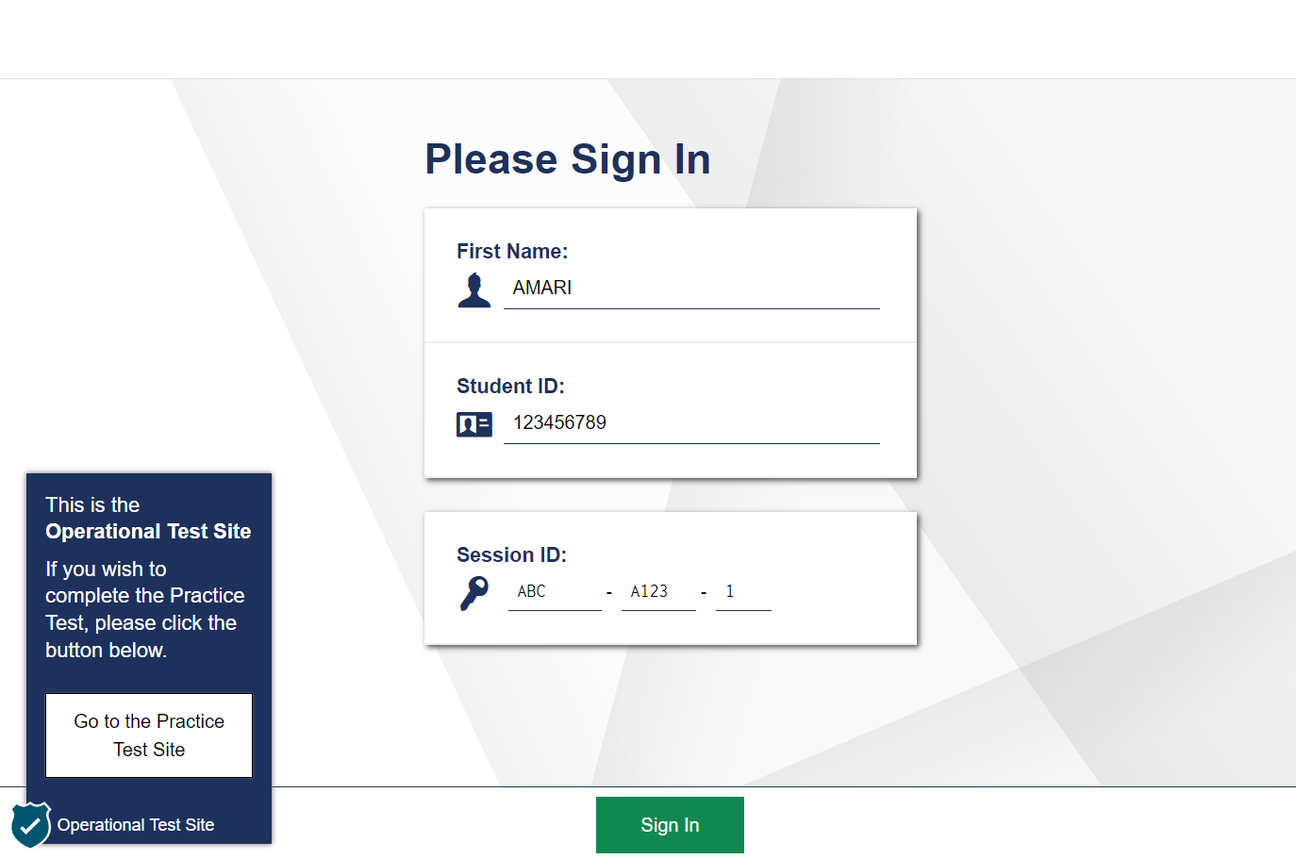
Student Sign In
Students use the Tab key to navigate between fields and enter their information.
25
Notes:
To log in to the online testing system, students must use the Secure Browser on a computer or device separate from the one used by the TA. Students must enter three pieces of identifying information: their first name, their state-assigned student identifier (SSID), and the current test session ID. The test session ID is generated when the TA creates the test session. It needs to be given to students by the TA when it is time for them to log in to the test.
Students will use the Tab key to navigate between fields and enter their information. Note that the Session ID is treated as three separate fields, though the first field is filled in automatically. When finished entering information in the final Session ID field, students can press Tab to navigate to the Sign in button and press Enter to sign in.
After entering their information, students will select the Sign In button to log in to the test. The TA may assist students with logging in, if necessary.

Slide 26
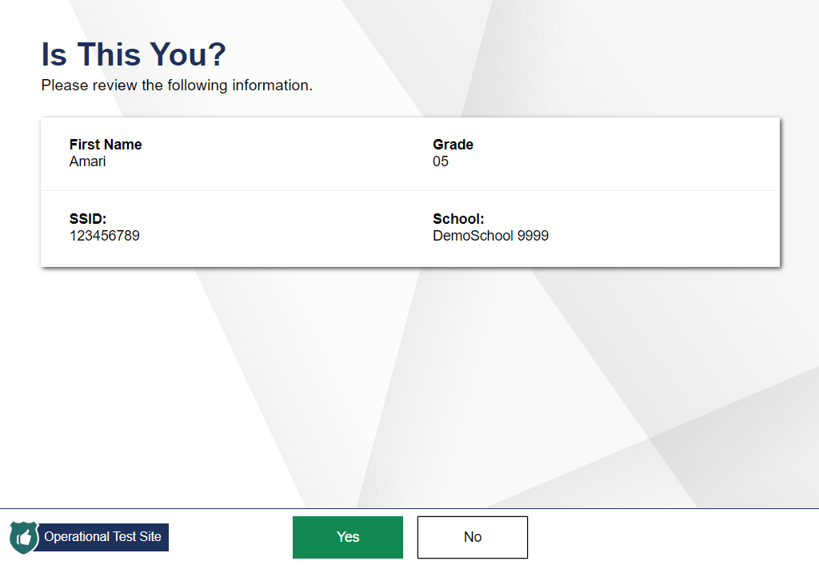
Student Verification
Students listen to each line of text by pressing the Down arrow key.
To move to the No and Yes buttons, press Tab.
26
Notes:
After logging in, students need to complete a few more steps before they begin testing. Students will be asked to view and verify their personal information. On the “Is This You?” page, students can listen to each line of text by pressing the Down arrow key. To move to the Yes and No buttons, press Tab.
If their information is correct, they should navigate to the Yes button and press Enter to proceed to the “Your Tests” screen.
If their information is incorrect, they should navigate to the No button and press Enter to return to the login page. Test administrators must then contact their school or district test coordinator to have the student information updated in the Test Information Distribution Engine (TIDE) before the student attempts to log in again.

Slide 27
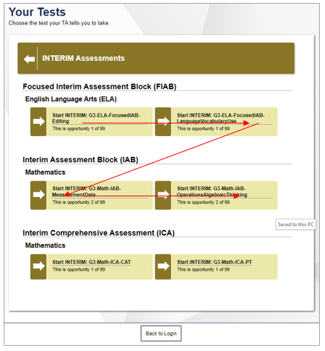
Test Selection
Press Tab to navigate to each test listed on this page. The navigation order is from left to right and top to bottom, in a zigzag pattern. Press Enter to start or resume the test.
27
Notes:
On the “Your Tests” screen, a list of assigned tests for this test session will appear on students’ screens. Students should select the correct test and wait for their TAs approval to proceed.
Press Tab to navigate to each test listed on this page. The order of navigation is from left to right and top to bottom, in a zigzag pattern. When the appropriate test is selected, press Enter to start or resume the test.
If the tests displayed are incorrect, or the expected test is not listed, students should press Tab until the Back to Login button is selected.
Press Enter to return to the login page and consult the TA to resolve the issue.

Slide 28
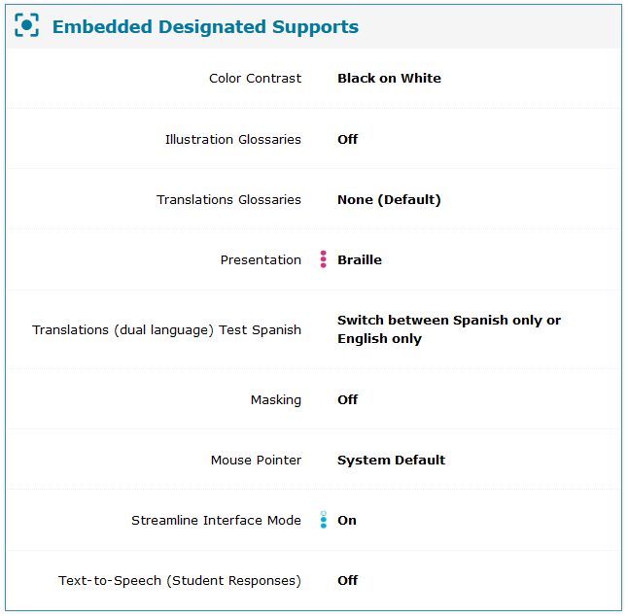
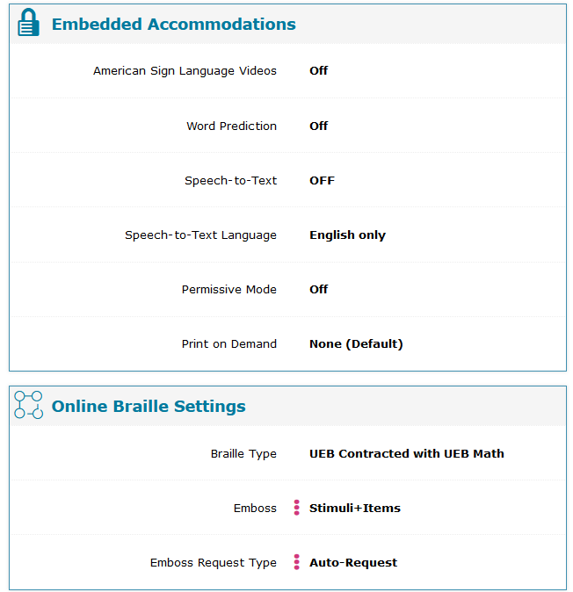
Login Confirmation
To listen to each line of text, press the Down arrow.
To move to the OK button, press Tab.
To select OK, press Enter.
28
Notes:
After the TA has approved students for a test session, a screen titled “Your Test Settings” will appear for students. This screen displays the name of the test and whether any accessibility resources have been selected.
The student should press the Down arrow to listen to each line of text.
The students should press Tab to move to the OK button.
The student should press Enter to select OK.
TAs should advise students that if any of the information is incorrect, students should navigate to the Back to Login button and press Enter.
Note that the actual settings displayed for students may vary from what is shown on this slide. Be sure to refer to the information located in the TA Scripts of Student Directions to guide students through the login and confirmation process.

Slide 29
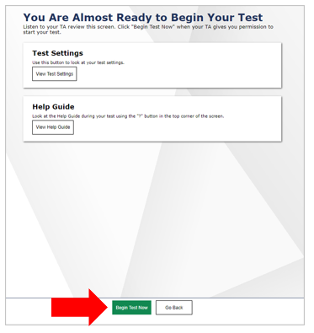
Instructions and Help
To open the Help Guide, press Tab to navigate to the View Help Guide button and press Enter. To close the Help Guide, use the Tab key to navigate to the Back button and press Enter.
To open the Test Settings window, press Tab to navigate to the View Test Settings button and press Enter. To close the Test Settings window, use the Tab key to navigate to the OK button and press Enter.
To move to the Begin Test Now and Return to Login buttons, press Tab.
To select to the Begin Test Now or Return to Login button, press Enter.
29
Notes:
On the Instructions and Help page, students can review detailed information about the tools and navigation features they will use during testing. TAs may need to assist students to navigate around the Instructions and Help page.
To open the Help Guide, press Tab to navigate to the View Help Guide button and press Enter.
To close the Help Guide, use the Tab key to navigate to the Back button and press Enter.
To open the Test Settings window, press Tab to navigate to the View Test Settings button and press Enter.
To close the Test Settings window, use the Tab key to navigate to the OK button and press Enter.
To move to the Begin Test Now and Return to Login buttons, press Tab.
To select to the Begin Test Now or Return to Login button, press Enter.

Slide 30
Test Elements

Slide 31
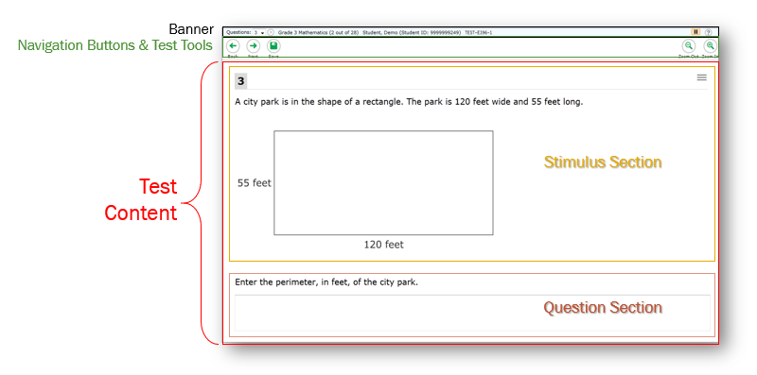
Test Elements
31
Notes:
Students will also use JAWS to navigate within their test. The first time a test loads, JAWS may start reading everything on the page until the student stops it. However, on the next test page, the focus will be initially on the first question on the page.
A test page has three different sections: the Banner, the Navigation and Test Tools, and the Test Content. Please note that this page may appear differently on the student's screen.
The Banner contains the test information. This row displays the current question number(s), test name, student name, test settings button, pause button and Help button. Selecting the Help button will bring up the on-screen Help Guide window.
The Navigation Buttons and Test Tools allows students to:
Navigate test pages using the Back and Next arrow buttons
Save their answers before moving to the next question, if desired
And Zoom In and Zoom Out of test pages
Please note that whether or not students click Save, their answers will save automatically when they navigate to the next part of the test.
The Test Content is divided into two sections: the Stimulus Section and the Question Section:
The Stimulus Section contains the stimulus title, stimulus context menu, and stimulus content.
The Question Section contains the question number, question context menu, question stem, and response area.
To navigate between the three areas, the student will press the R key. Students will use the Up and Down arrow keys to move up or down the lines of text. JAWS will read each line as a student navigates to it.

Slide 32
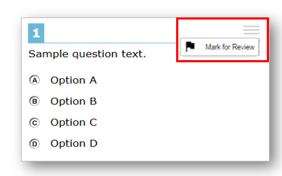
Opening Context Menus
Context menus allow students to:
Mark items for review
View item tutorials
Send emboss requests to the TA
Access additional features depending on test settings
and item types
Using context menus:
When the context menu is in focus, press Enter to open it.
Use Up and Down arrows to move between options.
Press Space to select an option.
Press Esc to exit the menu without making a selection.
32
Notes:
Students may use the context menu mentioned on the previous slide to mark items for review, send emboss requests to the TA, and access additional test features.
To open the context menu for a stimulus or question students:
First, if opening a stimulus context menu, will ensure that the focus is on the stimulus. If opening a question context menu, the student will ensure that the focus is on the question.
To navigate directly to the context menu button, the student will press Tab twice. JAWS reads aloud “Menu button.”
Press Enter. The context menu opens and displays the list of available menu options. JAWS reads aloud the first option in the menu.
To move up and down the list, the student will press the Up and Down arrow keys. JAWS automatically reads aloud each option.
To select a menu option, the student will press Space.
To exit the menu without making a selection, the student will press Esc. JAWS returns focus to the context menu button.

Slide 33
Responding to Questions with JAWS Keyboard Commands

Slide 34
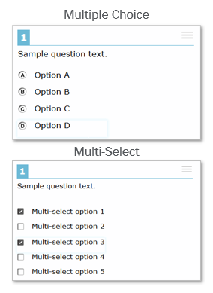
Responding to Questions: Multiple Choice and Multi-Select
Multiple choice and multi-select questions require students to choose from a group of options by selecting a radio button or checking one or more checkboxes.
How Students Respond:
After listening to the question, press Tab to hear the option letter and corresponding text.
Use Tab and Shift + Tab or the Up and Down arrow keys to move between answer options and hear each one read aloud.
Press Space to select the current response option in focus.
34
Notes:
Multiple choice questions require students to choose a response option by selecting a radio button. Multi-select questions require students to choose one or more response options by selecting checkboxes. Students follow the same procedure for responding to both types of items.
To respond to a multiple choice or multi-select question, students can follow these steps:
First, after listening to the question text, students can press the Tab key to hear JAWS read aloud the option’s corresponding text. If the option is an image, JAWS reads the text description associated with the image.
To navigate to each answer option, students will use the Tab and Shift + Tab commands, or use the Up and Down arrow keys. JAWS reads aloud the text for the option in focus.
To select a response option in focus as the response, students will press the Space bar. The response is selected, and JAWS reads “Space.”

Slide 35
Responding to Questions: Hot-Text
Hot-text questions require students to select at least one word, phrase, or sentence. Each selectable text area is pre-defined. Selecting a phrase or sentence automatically marks all the words in that text area as selected.
How Students Respond:
After listening to the question text, press Tab to hear JAWS read aloud the text that is in focus.
Use the Tab and Shift + Tab commands to move between selectable text areas and hear each one read aloud.
Press Enter to choose a selectable text area in focus as your response.
35
Notes:
Hot-text questions require students to select at least one word, phrase, or sentence. For these question types, it is critical that students follow the instructions provided in the question. Each selectable text area is pre-defined. Selecting a phrase or sentence automatically marks all the words in that text area as selected.
To respond to a multi-select question, students can follow these steps:
First, after listening to the question text, students can press the Tab key to hear JAWS read aloud the text that is in focus.
Navigate to each selectable text area using the Tab and Shift + Tab commands. JAWS will read aloud the selectable text.
To choose a selectable text area in focus as the response, students press the Enter key. JAWS announces the text is checked.

Slide 36
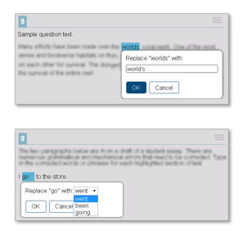
Responding to Questions: Edit Task
Edit task questions require a student to replace an incorrect selectable word or phrase in a reading excerpt. Some edit task questions require students to enter the response into a text box, and others require you to select a response from a drop-down.
How Students Respond:
Use the Down arrow to read through each line of text. If text is selectable, JAWS reads “clickable” after that word or phrase.
Use Tab and Shift + Tab to move between selectable text fields.
36
Notes:
Edit task questions require students to replace an incorrect selectable word or phrase in a reading excerpt. For these question types, it is critical that students follow the instructions provided in the question. Some edit task questions require students to enter the response into a text box. Some edit task questions require students to select a response from a drop-down list. Each selectable text area is pre-defined.
Some edit task questions, such as the first image shown on this slide, require students to make changes that are punctuation-based. For these edit task questions, JAWS needs to read in character mode. Cambium Assessment Inc. strongly recommends that students read through an entire Edit Task question before responding. Students can listen to the question as well as read it via an RBD or printout from an embosser.
To respond to an edit task question, students can follow these steps:
First, use they will use the Down arrow to read through each line of text. If a line of text has a selectable word or phrase, JAWS reads “clickable” after the word or phrase.
Navigate to each selectable text field in the question by doing one of the following:
Return to the beginning of the question.
Press Shift + H.
Press the Tab key to go to the first selectable text field.
Move backwards through the selectable text fields in the question.
Press Shift + Tab.

Slide 37
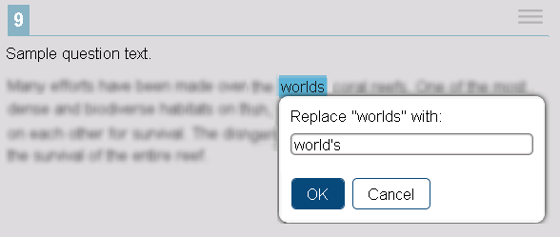
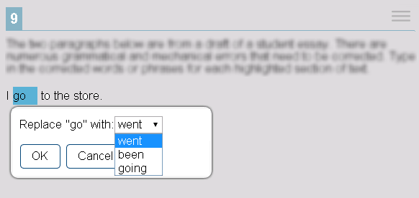
Responding to Questions: Edit Task, continued
How Students Respond (continued):
Press Space to select the current text in focus. JAWS reads “Edit tools dialog” and provides additional instructions.
The student’s actions in the edit menu will depend on the type of edit task question:
Text box: Type in the replacement word or phrase.
Drop-down list: Use the Up and Down arrows to move between options. To select an option, press Enter.
Press Tab to move to the OK button. Press Enter to close the edit menu.
37
Notes:
When the selectable text is in focus, press the Space bar. This opens the edit menu. JAWS reads “Edit tools dialog” and provides additional instructions.
From here, the student’s actions will depend on the type of edit task question.
If the edit menu contains a text box, type in the replacement word or phrase.
If the edit menu contains a drop-down list, use the Up and Down arrow keys to move between options in the list. JAWS will read aloud each option. To select an option, press the Enter key.
Finally, press the Tab key to move to the OK button. Press Enter to close the edit menu.

Slide 38
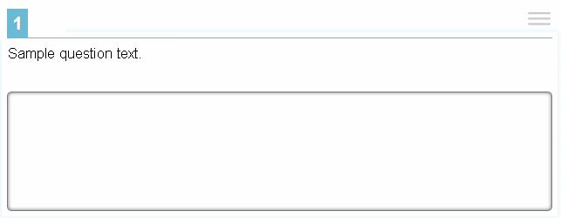
Responding to Questions: Text Response
Text Response questions require students to enter text in a text box. Students may need to write a sentence, paragraph, essay, or equation.
How Students Respond:
Listen to the question and then use Tab to move to the text box. JAWS beeps and reads “Edit, type in text.”
Enter a response. When finished, press Tab to navigate from the text box to the next question on the page. JAWS beeps again in a different tone.
38
Notes:
Text response questions require students to enter text in a text box. Students may be asked to write a sentence, paragraph, or essay. Some text response questions include a row of text formatting buttons. However, these formatting options are not available to students testing with Braille.
To respond to a text response question, students can follow these steps:
First, listen to the question and then use the Tab command to move to the text box. JAWS beeps and reads “Edit, type in text.”
Then, enter the response. When finished, press the Tab key to navigate from the text box to the next question on the page. JAWS beeps again in a different tone upon leaving the text box.

Slide 39
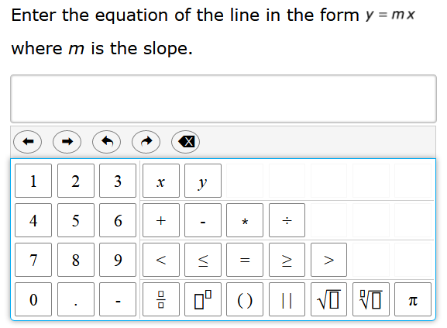
Responding to Items: Equation
Equation items require you to enter a math equation or expression in a text box using an on-screen keypad.
How to Respond:
Listen to the question and then use Tab and Shift + Tab to move between keypad buttons. JAWS reads aloud the character or action for each button.
To enter a character or perform an action, press Enter or press the corresponding key on your keyboard.
Optionally, you can add special characters to the text field by pressing Alt + 7 with the focus on the text field. A pop-up window opens, with a drop-down list of the available characters. To move between the options in this list, use the arrow keys. JAWS reads the name of each special character. To insert the selected character, press Enter.
39
Notes:
Equation items require you to enter a math equation or expression in a text box using an on-screen keypad.
To respond to an equation question, students can follow these steps:
Listen to the question and then use Tab and Shift + Tab to move between keypad buttons. JAWS reads aloud the character or action for each button.
To enter a character or perform an action, press Enter or press the corresponding key on your keyboard.
Optionally, you can add special characters to the text field by pressing Alt + 7 with the focus on the text field. A pop-up window opens, with a drop-down list of the available characters. To move between the options in this list, use the arrow keys. JAWS reads the name of each special character. To insert the selected character, press Enter.

Slide 40
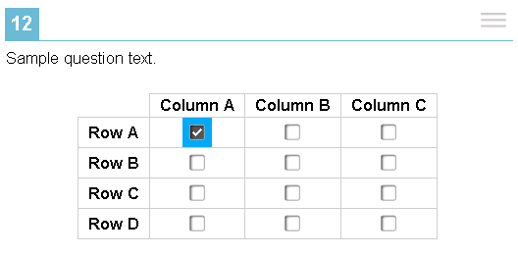
Responding to Questions: Table-Match
Table-match questions require students to mark at least one checkbox in the cells of a table consisting of multiple rows and columns. The table row heading and the column heading are not selectable.
How Students Respond:
Listen to the question, and then press Tab twice. This takes students to the first cell containing a checkbox.
To navigate to each cell that has a checkbox, press Tab. JAWS reads aloud the column and row names for that cell.
To mark a checkbox, press the Space bar.
40
Notes:
Table-match questions require students to mark at least one checkbox in the cells of a table consisting of multiple rows and columns. The table row heading and column heading are not selectable.
To respond to a table match question, students can follow these steps:
First, after listening to the question text, press the Tab key twice. This takes students to the first cell containing a checkbox. JAWS reads aloud the column and row names for that cell.
To navigate to each cell that has a checkbox, press the Tab key. Again, JAWS reads aloud the column name and row name for each cell.
To mark a checkbox, press the Space bar.

Slide 41
More Help
WCAP Helpdesk
Toll-Free Phone Support:
1.844.560.7366
Email Support:
wahelpdesk@cambiumassessment.com
Notes:
Thank you for viewing this training module. If you have general questions or need further information, please visit the WCAP Portal or consult the help desk for assistance.

Slide 42
Thank You
Notes:
Thank you for taking the time to view this training module.

