Slide 1
Online Testing System Assessment Viewing Application (AVA)
Training Module
2023–2024
Copyright © Cambium Assessment, Inc. All rights reserved.
Notes:
Welcome to the Assessment Viewing Application (AVA) training module. AVA is a component of the online testing system that allows authorized users to view interim assessments for administrative or instructional purposes. This training module is designed to help you navigate AVA; however, you should consult the Assessment Viewing Application User Guide located on the WCAP Portal for additional information.

Slide 2
Objectives
After viewing this presentation, you should understand how to
Log in to AVA;
Access the assessments; and
Navigate through the test.
Notes:
After viewing this presentation, you should understand how to
Log in to AVA;
Access the assessments; and
Navigate through the test.

Slide 3
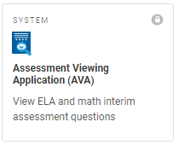
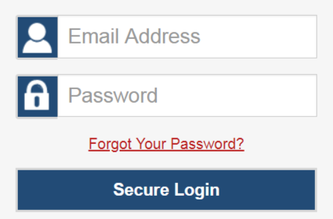
Logging in to AVA
Notes:
To log in to AVA, you must have an authorized email address and password, which are the same as the ones you use for the Test Information Distribution Engine (TIDE) and the Test Administrator (TA) Interface. Contact your school administrator if you do not have a TIDE account.
To log in to AVA, go to the WCAP Portal and select Interim Smarter Balanced ELA and Math Assessments. On the next page, scroll down to All Systems Used in Interim Testing, and click the AVA System card. Enter your email address and password, and then click Secure Login.

Slide 4
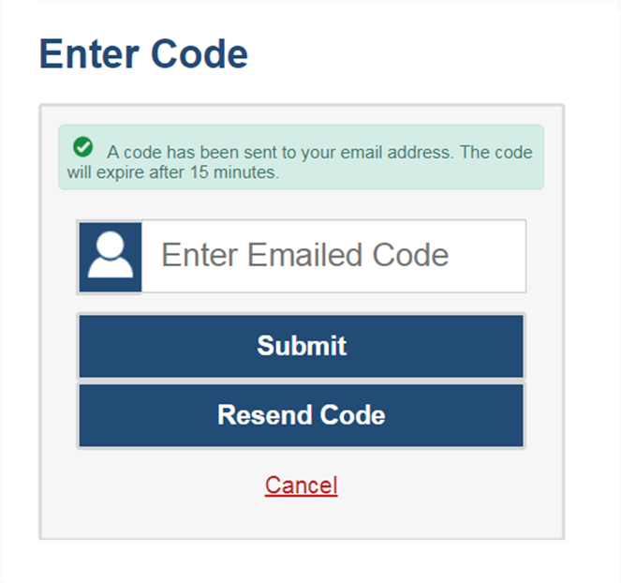
Logging in to AVA (continued)
The system has an authentication process that will be triggered when you log in from a different device or browser, or after clearing your browser’s cache.
If you see this screen, an email containing the code will have been sent automatically to your email address.
Enter the code and select Submit.
If you need the code resent, select Resend Code.
Notes:
When logging in to the system using a new device or browser, or after clearing the cache on a previously-used browser, you will see an Enter Code page.
If you see this screen, you will need to enter the code on this page within fifteen minutes of receiving the email. If you do not receive a code or do not enter the code within the fifteen-minute time limit, select Resend Code. Select Submit after entering the authentication code to access the system.

Slide 5
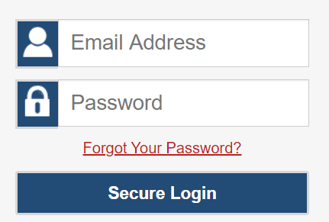
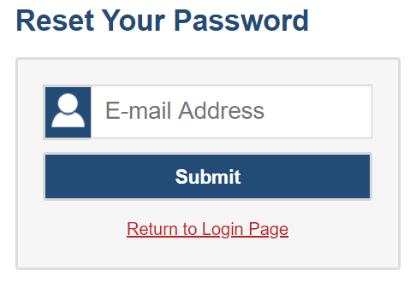
Resetting Your Password
Notes:
If you forget your password, you will need to reset it in order to access AVA.
You may need to reset your password in the following situations:
You forgot your password.
Your activation link expired.
Your account is locked because you exceeded the account login attempt limit.
It is a new school year.
To reset your password, select the Forgot Your Password? link. You will be taken to the Reset Your Password page. Enter your email address and select Submit.

Slide 6
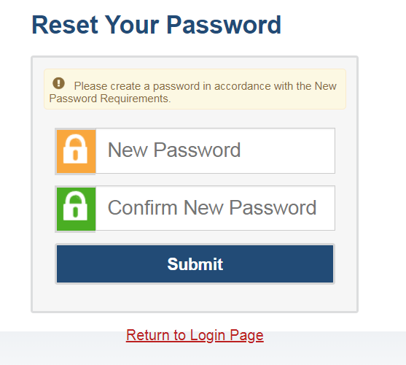
Resetting Your Password (continued)
Passwords must meet the following conditions:
Be at least eight characters long
Contain at least one lowercase alphabetic character
Contain at least one uppercase alphabetic character
Contain at least one number
Contain at least one special character
Notes:
Next, you will receive an email with an activation link. After you select the activation link, you will be taken to the Reset Your Password page.
In the New Password and Confirm New Password fields, enter a new password. The password must be at least eight characters long and must include at least one lowercase alphabetic character, one uppercase alphabetic character, one number, and one special character.

Slide 7
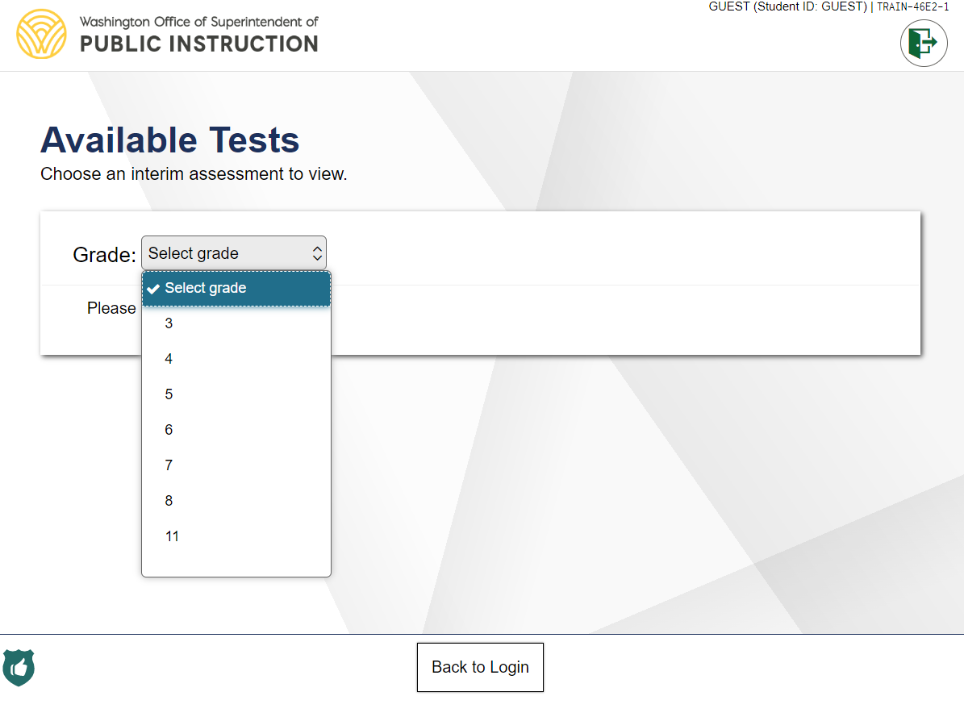
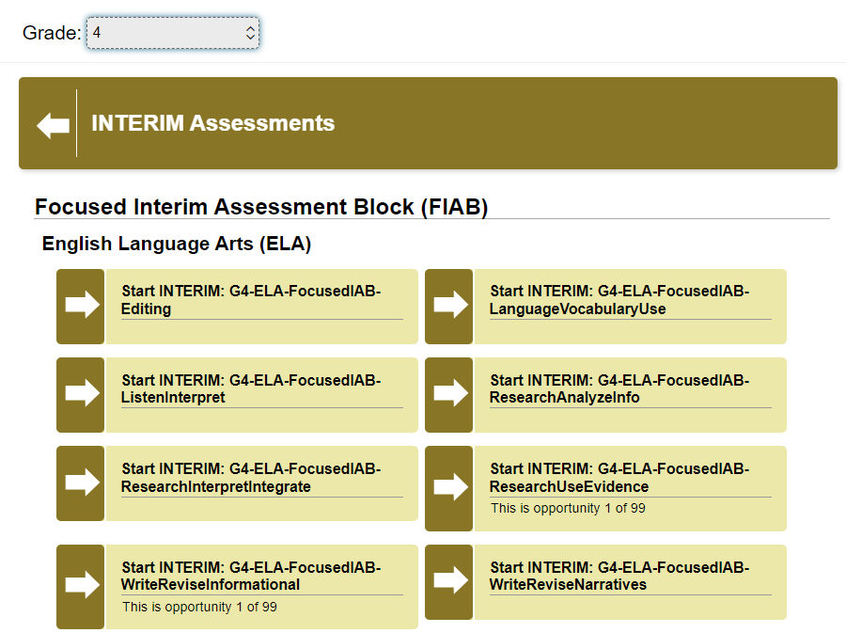
Choosing a Grade and Test
Notes:
After logging in, the Available Tests page will appear.
From the Grade drop-down list, select the desired grade level to view the available tests for the selected grade, and the available tests for that grade will appear.
The test categories are listed in this order within each grade:
Focused Interim Assessment Block (FIAB)
English Language Arts (ELA)
Mathematics
Interim Assessment Block (IAB)
English Language Arts (ELA)
Mathematics
Interim Comprehensive Assessment (ICA)
English Language Arts (ELA)
Mathematics
Within each category, each interim is listed alphabetically.
Next, click the test name you want to view, and the Audio/Video Checks page will appear.

Slide 8
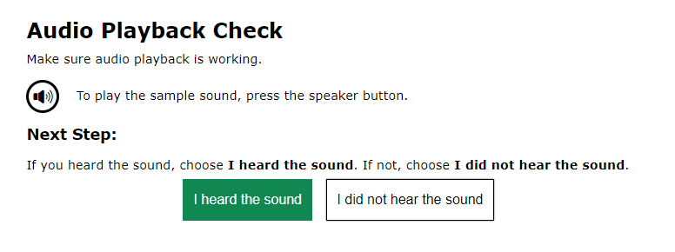
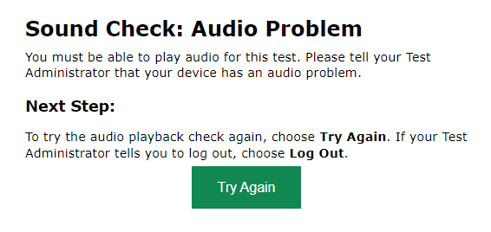
Audio Playback Check
Notes:
The Audio/Video Checks page allows you to verify the functionality of any audio and video features the test may include. Each functionality check will appear in a separate panel on the Audio/Video Checks page.
To perform the Audio Playback Check:
First, make sure that the speakers on your computer are not muted and your volume is set appropriately. Then, in the Audio Playback Check panel, select the speaker (or the ear) icon to hear a sample sound. If you hear a sound, select I heard the sound. The first page of the test will appear. If you do not hear a sound, select I did not hear the sound and consult your technology coordinator for assistance.

Slide 9
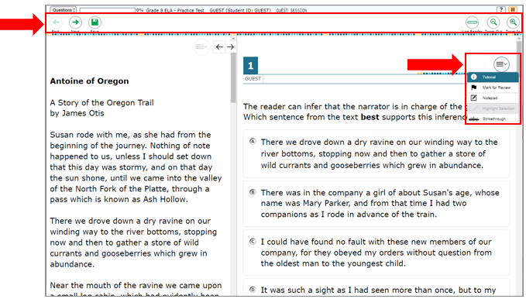
Understanding the Test Page
Notes:
This slide displays a sample test page.
AVA includes several on-screen tools, including global tools and context menu tools.
Global tools are available on every page in the banner. These include the Back, Next, Save, and Zoom buttons.
The context menu displays the tools available for that test item.
For a detailed list of tools, consult the Assessment Viewing Application User Guide on the WCAP Portal.

Slide 10
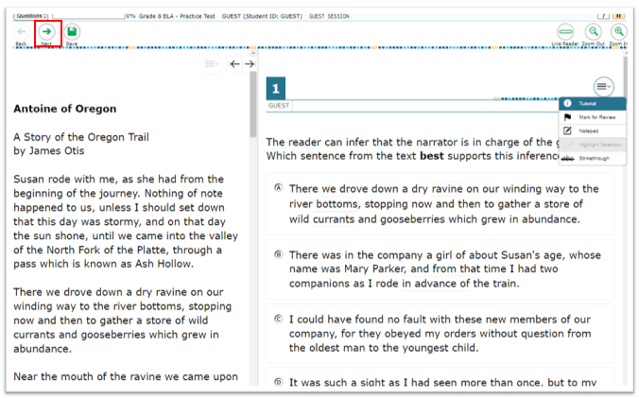
Responding to Items
Notes:
Next, we will discuss how to navigate a test, pause a test, and complete a test review.
When viewing a test, you can practice responding to each test item. You can also click Next to move through the assessment without responding to an item. Pages may have only a single item, or they may contain multiple items. Responses you enter will not be scored when you complete the test review.

Slide 11
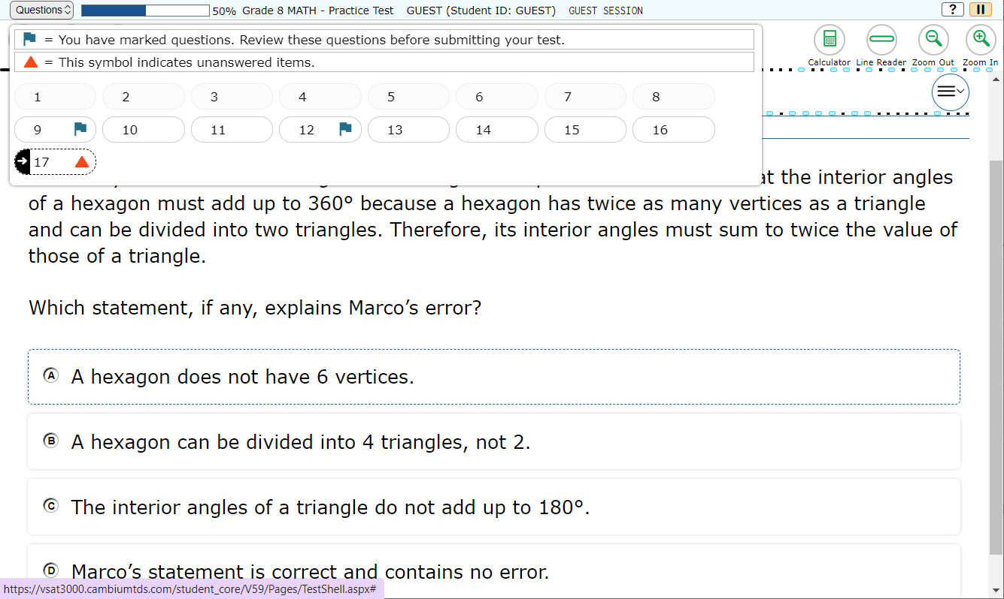
Navigating to Items
Notes:
You can navigate to items page-by-page or jump directly to an item’s page.
To navigate page-by-page, click the Back or Next buttons at the top of the screen.
To jump directly to an item page, select the appropriate item from the Items drop-down list. The Items drop-down list contains all items completed thus far and displays a blue flag for items that have been marked for review.

Slide 12
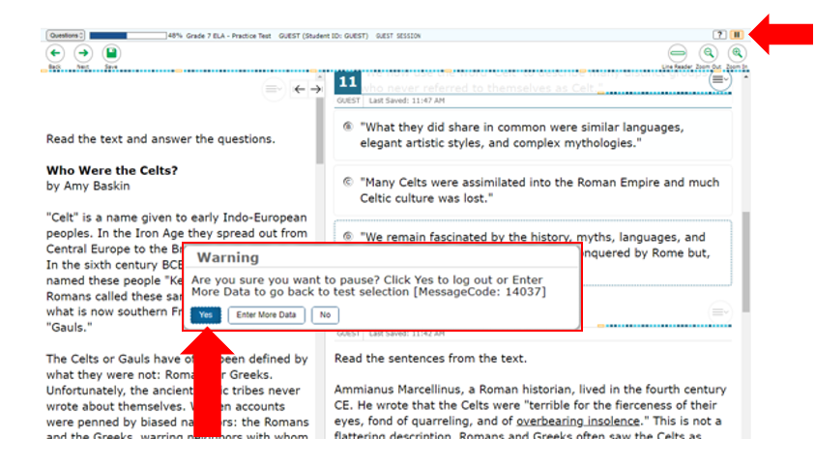
Pausing Tests
Notes:
You may pause the test at any time. Pausing the test automatically logs you out of AVA. To return to the test, you must log in and select the appropriate test again.
To pause the test, click Pause in the banner. A “log out” message will appear. Click Yes to confirm that you want to pause the test.
As a security measure, you are automatically logged out and your test is paused after 20 minutes of inactivity.

Slide 13
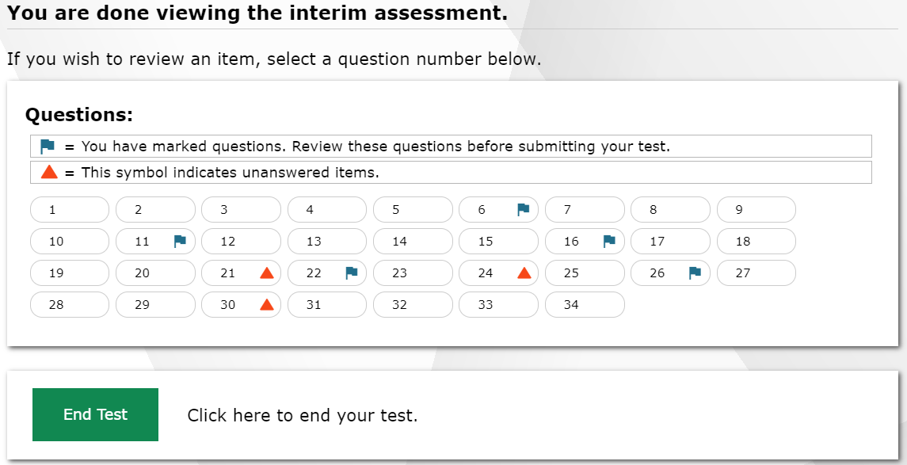
Reviewing Marked Items
Notes:
To finish reviewing the test, click Next on the last page. A review page will appear. Select an item number to return to and review that item. You can navigate through the test as before. You can return to the review page by selecting Review from the Items drop-down in the top-left corner.
When you are finished reviewing, select End Test.

Slide 14
Completing the Review
Notes:
You will be asked one more time to confirm that you are done viewing the test. Select No to return to the review page or check the “I agree” box and select Yes to complete the test.

Slide 15
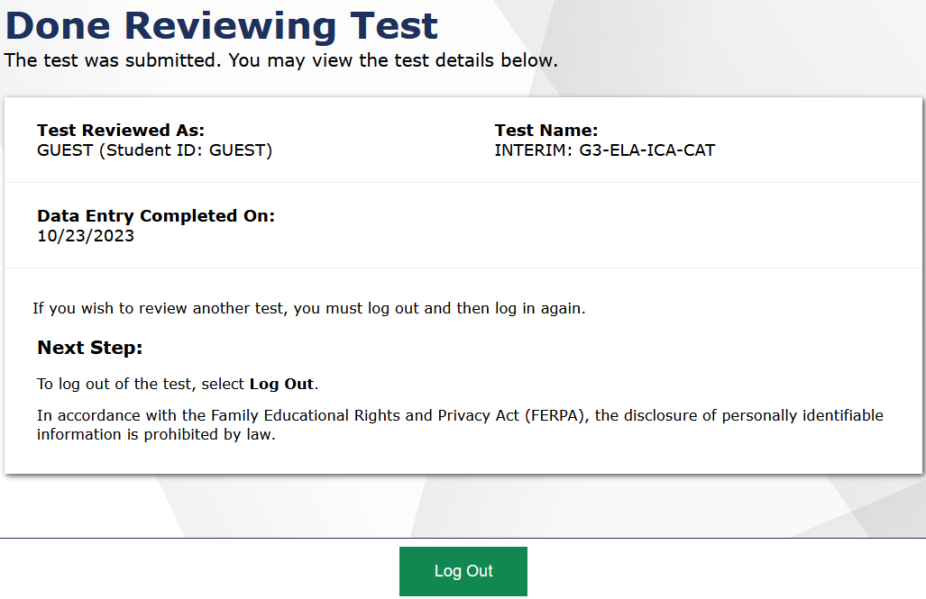
Logging Out
Notes:
The Done Reviewing Test page displays a confirmation that the test review is over. Select Log Out to return to the AVA Login page.

Slide 16
More Help
Assessment Viewing Application User Guide
WCAP Helpdesk
Toll-Free Phone Support:
1.844.560.7366
Email Support:
wahelpdesk@cambiumassessment.com
Notes:
Thank you for viewing this presentation on the Teacher Assessment Scoring Center. For more assistance, Assessment Viewing Application User Guide on the WCAP Portal or contact the WA Help Desk.

Slide 17
Thank You
Notes:
Thank you for taking the time to view this training module.

