Slide 1
Smarter Reporting System
Introduction for Washington Educators
Winter 2021
Notes:
Presenter: Anton
Welcome to this presentation about the Smarter Reporting System. This introduction was created to support Washington educators as they become familiar with this new assessment reporting system.
The presentation will consist of some informational slides and a demonstration of the Reporting System features and functions within our Sandbox.
If you want the draft version of these slides, you can find them in the WCAP Portal. Go to the Test Administrator user card, then select the Test Administrator Resources tile. Once you are in the Test Administrator Resources, select the Modules folder. Then scroll down until you find the Smarter Reporting System Training—draft.

Slide 2
Agenda
General Introduction
Things Teachers Can Do
One Thing School and District Users MUST Do
How School and District Users See Results
Visit the WA Sandbox
How Smarter Balanced Scores are Determined
Additional Things School and District Users Can Do
Notes:
Presenter: Anton
In this presentation we’ll be discussing the following topics:
A general introduction to the Smarter Reporting System
Things classroom teachers can do in the system
One key thing that school and district users must do to allow classroom teachers to see student results in the system
What school and district users can see in the system
We’ll take a short break to visit the Washington Sandbox version of the system to show you the system in action.
Then we’ll return to the slide deck and talk about
How the Smarter Balanced scores shown in the system are determined
And a few additional things school and district users can do in the system
We will end with some resources for use with the system.
In the future, we do plan to display WCAS scores in this system. When that happens, we’ll update this training to include science information.

Slide 3
Presenters
Anton Jackson, Director of Assessment Development
Serena O’Neill, Math Assessment Specialist
Kara Todd, Content Coordinator for Test Development
Maja Wilson, ELA Assessment Specialist
Notes:
Before we go too far, we’ll take a moment to introduce our speakers…
I am….
And I am joined by…

Slide 4
General Introduction
Notes:
Presenter: Kara
We’ll begin with a general introduction.

Slide 5
The Smarter Reporting System (SRS)
What is it?
Online reporting platform built by Smarter Balanced for member use
Tests are scored within vendor systems; results sent to SRS for display
How is it useful?
Educators can view student data at individual and group levels
District users can customize reports
Preserves state flexibility in choice of testing vendor, while also providing stability for districts and schools viewing scores
What it is NOT:
NOT where accountability data is displayed. That is still Report Card.
Notes:
Presenter: Kara
The Smarter Reporting System, or S-R-S for short, is an online reporting platform built by the Smarter Balanced Assessment Consortium. Educators and state representatives helped Smarter Balanced develop the system. Smarter Balanced Assessment Consortium members can each have their own state-specific version of the site. Washington users will only be able to see Washington state results within the system.
Washington’s tests are scored within Cambium's systems and sent to SRS for display. Interim questions that require handscoring must be scored in Cambium's Teacher Handscoring System, or T-H-S-S in the WCAP Portal, before scores will display in SRS.
SRS is useful because educators can use it to view student data at individual and group levels, and district users can customize reports for a variety of local purposes. OSPI also has more flexibility when choosing testing vendors in the future, because scores can be displayed in SRS no matter the vendor used to deliver or score the tests. The continued use of SRS for reporting will provide stability for district and school users. In addition, when the WCAS scores are displayed in this system in the future, all the general assessment scores will be available to educators in the same place.
All this being said, SRS is NOT where accountability data is displayed because SRS only shows results for students who take tests. Accountability data and results are still provided through the state Report Card.

Slide 6
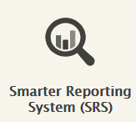
Where is the SRS located?
Live production site:
WA Sandbox site:
WCAP Portal
Select SRS card:
Use TIDE/TA Interface login credentials
https://reporting-demo.smarterbalanced.org/sandbox-login?sandbox=WA_S005
Choose a role
Select “Enter Sandbox”
Notes:
Presenter: Kara:
The Washington SRS “live production” site is accessible through the WCAP Portal. This is where test results for students from WA are displayed. From the WCAP Portal, select the SRS card and use the same login credentials as you use for all the other systems on the Portal (such as TIDE or the TA Interface).
Additionally, there is a practice site called the “WA Sandbox”. This site is publicly available, so feel free to share the url with teachers and other stakeholders interested in seeing the system. The Washington Sandbox site is what is sounds like: a sandbox to play around in. If you want to see what results might look like before your students take a test, or to train others in how to use the SRS, the Sandbox is a "no harm, no foul" place to explore. There are a few spots in the Sandbox where it doesn’t accurately reflect some of the user permissions we have set for WA users in the live production site. We’ll point those out when we encounter them in this presentation.
You can get to the Sandbox site using the URL on the screen. You will choose a user role, and then select Enter Sandbox. We will go into the Sandbox later in the presentation, so please stick with us here for a bit.

Slide 7
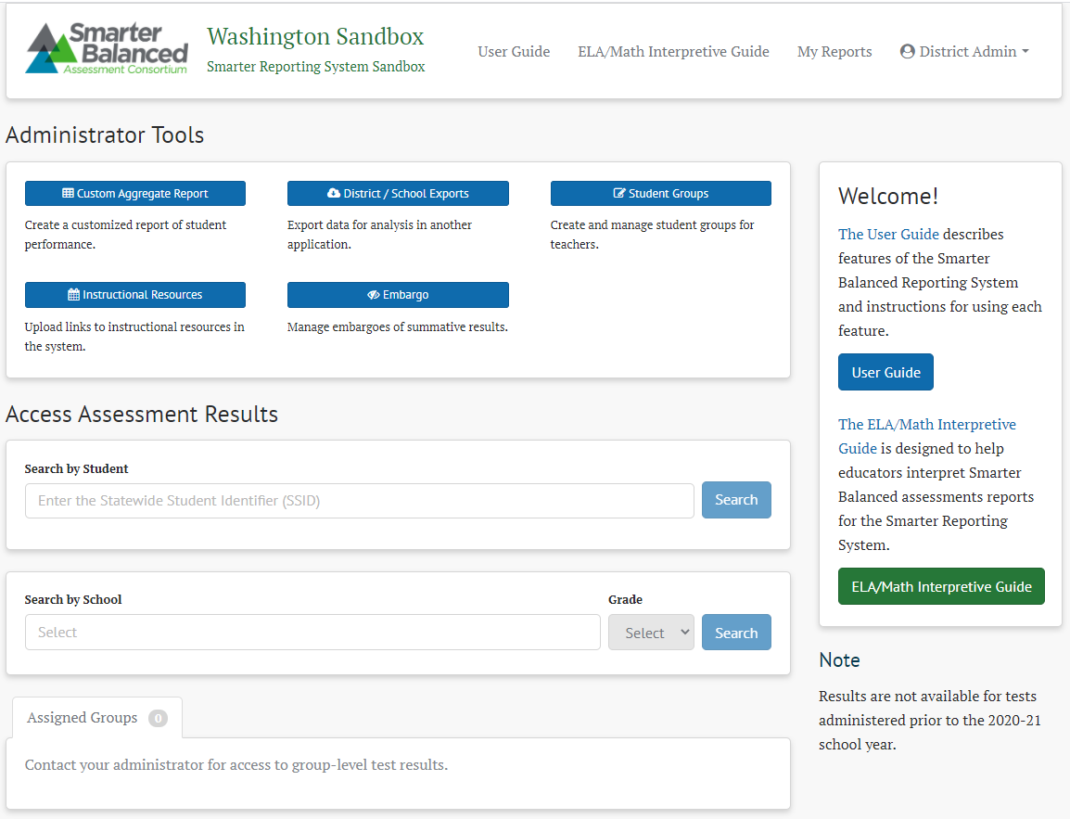
Home Page
Notes:
Presenter: Kara [Smarter System User Guide pg. 8-10]
When users log into the Smarter Reporting System, they are directed to the Home Page. This page allows users to perform tasks based on their assigned roles.
All users will be able to access the user guide, interpretive guide, and any reports they have created. These resources are available across the top side of the screen, and right side of this screen has links to the user guide and interpretive guide as well. These 2 guides are currently the generic, Smarter Balanced produced versions of the documents. We will likely have WA-specific versions of these documents next school year.
School and district administrators (users with SC, DC, or DA roles in TIDE) have access to a variety of management tools. These are in the “Administrator Tools” panel on this screenshot. We’ll discuss most of these tools at the end of this training, with the exception of the “embargo” tool. That is our first “sandbox caveat” …the embargo tool shows as available in the Sandbox site, but is not available to WA users in the live production site.
School and district administrators will have all 3 panels under the heading “Access Assessment Results” on this screenshot: search by student, search by school, and assigned groups.
Teachers (users with the TA role in TIDE) will have 2 panels under the heading “Access Assessment Results” on this screenshot: the “search by student” and “assigned groups” panels.

Slide 8
IMPORTANT NOTE
Users with multiple roles in TIDE will appear in the SRS with their highest level of role…even if you log into TIDE with a lower role.
SIDE NOTE about Cambium systems:
DC/DA/SC users do not need a separate TA role to use the TA Interface to administer tests to students.
Notes:
Presenter: Kara
A very important note is that users with multiple roles in TIDE will go into the SRS with their highest level of role…even if you log into TIDE with a lower role. In other words, users cannot impersonate a lower-level role in the SRS.
This brings us to a side note about the Cambium systems in the WCAP Portal: users with a DC, DA, or SC role do not have to have a separate TA role to use the TA Interface for administering tests.
We encourage DACs to clean up roles in TIDE if needed based on this information.

Slide 9
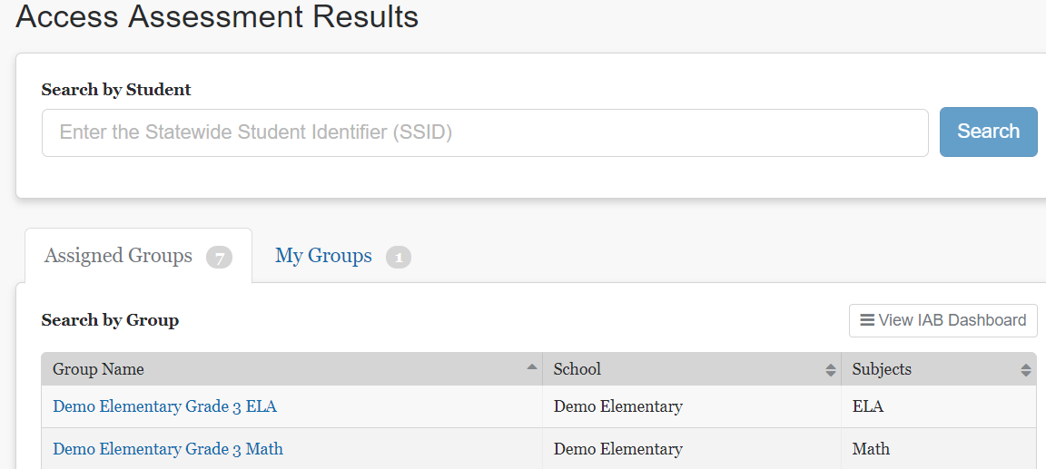
Accessing Student Results
View by individual student
View by “assigned groups”
View by customized “my groups”
Notes:
Presenter: Kara [Smarter System User Guide pg. 18]
From the home page, teachers and administrators can access student test results.
All users can view student results by individual student by entering the student’s SSID in the Search by Student field.
District level users (DA and DC) can see results for any student in their district.
School level users (SC) can only see results for the students in their school.
Teachers (TA’s) can only see the results for students that have been assigned to them within the SRS.
These “Assigned Groups” are the key to teachers seeing student assessment results. We will talk later in this presentation about how district/school level users assign groups of students to teachers.
Once students have been assigned to a teacher, the teacher can access results through those assigned groups.
Teachers may also choose to create new groups from students assigned to them for customized reporting. Those groups will show on the “My Groups” tab. Again, we will talk about that a bit later.

Slide 10
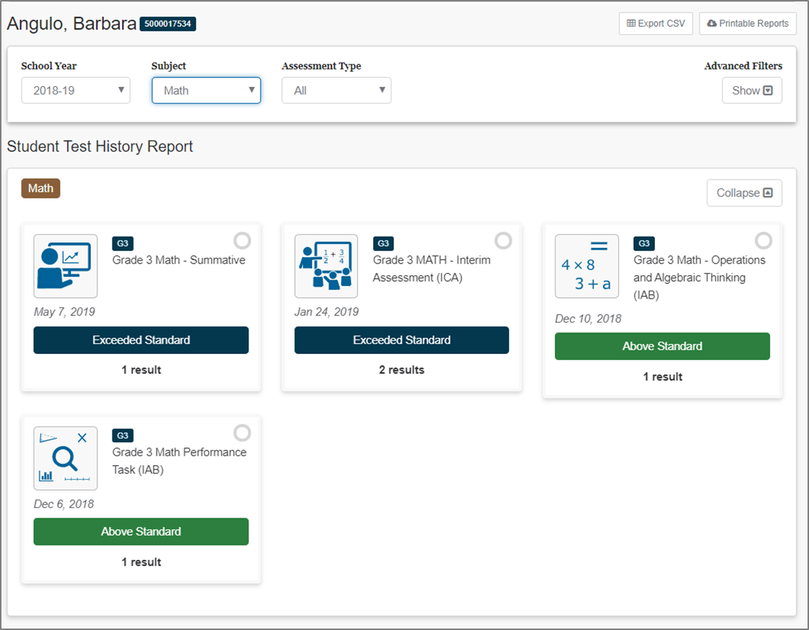
Accessing Individual Student Results
Student Test History Report page
View multiple content areas and test results together
Notes:
Presenter: Kara [Smarter System User Guide pg. 19]
If the user entered the student’s SSID in the Search by Student field and pressed [Search] they will be taken to the Student Test History Report Page. On this page educators can see all the assessments taken by a student in one, single dashboard. This can help users understand student performance across content areas or assessment types. Clicking one of the assessment tiles will open up a table with more specific information.
Additionally, from this page educators are able to print Individual Student Reports, which are PDF reports of student performance on the selected assessments.
Again, this information is available to all users:
District level users can see results for students in their district.
School level users can see results for students in their school.
Teachers can see the results for students that have been assigned to them within the SRS.

Slide 11
Navigation Pathway
Return to previous pages by following the breadcrumb trail
Blue building is “home page”
Blue text returns you to that screen
Notes:
Presenter: Kara [Smarter System User Guide pg. 10]
A quick comment about navigation: Most of the pages in the SRS have a navigation “breadcrumb trail” that can be used to get back to previous pages. The screenshots on this slide show what a few of them look like. Users can click on any of the blue items to return to that page. The blue building will take you all the way back to the Home Page; the blue text like “manage student groups” will take you back to that screen. For the middle example on this slide, clicking on “sample middle school” will take you from the student results you are looking at back to the school level results page.

Slide 12
Things Teachers Can Do
Test Administrator (TA) role in TIDE
Notes:
Presenter: Kara
Now that we’ve gone through a general introduction, let’s move to things that classroom teachers can do within SRS. For this part of the presentation, I would like to turn it over to Maja and Serena.

Slide 13
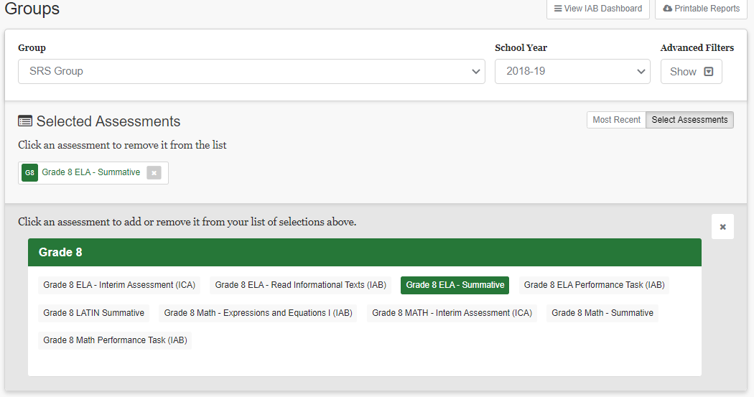
Accessing Student Group Results
View all available assessments in a given school year
Notes:
Presenter: Maja [Smarter System User Guide pg. 38]
If the teacher chooses one of their Groups from the Home Page, they will be taken to the Groups screen. On this screen they will be able to see all the assessments that particular group of students has taken in the “Selected Assessments” panel. For this screenshot, the user clicked the “Select Assessments” button on the right side of the panel, and another panel opened with all the assessments this group of students had taken.
This screenshot shows a group called “SRS Group” and the Grade 8 ELA Summative test results have been selected to view.

Slide 14
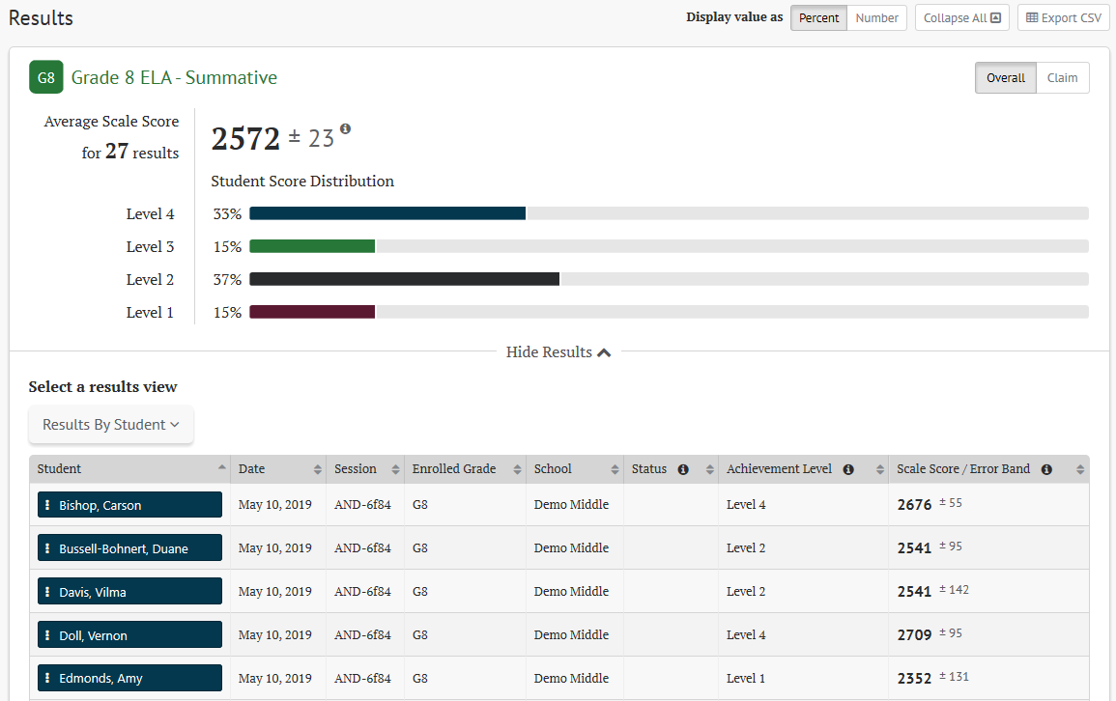
Results View Panel
Buttons and drop-down menus can change what is seen on this panel.
(ELA Summative overall view)
Notes:
Presenter: Maja [Smarter System User Guide pg. 49-52]
When the user scrolls down, they will see the Results View Panel for the chosen assessment.
For summative assessments, teachers can see overall and sub-level information, both at the group and individual student levels. This screenshot shows sample ELA summative results, but the process is the same for other content areas and tests.
Please notice the line in the middle of the screenshot with the words “Hide Results” and a sort of arrow pointing up. When you first select an assessment, this line may say “Show Results” with an arrow pointing down and have no information showing below the line. To see the table of student results as we see in this screenshot, click on the phrase “Show Results” and the panel will appear below the line. You will likely need to scroll down to see all the students in the group.
There are several buttons across the top row, and drop-down menus that can adjust what is seen in this panel. The choices available depend on the type of test and content area. [Smarter System User Guide pg. 10-17 have a great review of the menus and types of buttons used throughout the system]
For example, the overall Student Score Distribution can be changed from percentages to numbers by selecting the “number” button at the top of the panel..

Slide 15
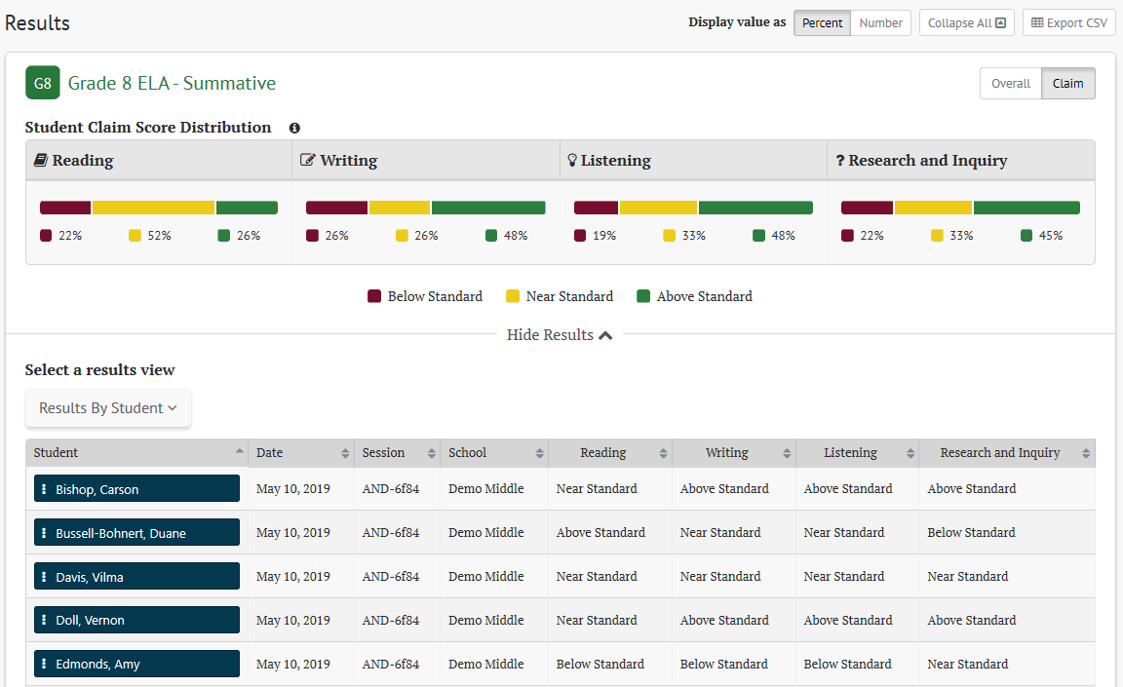
Results View Panel pt. 2
(ELA Summative claim view)
Notes:
Presenter: Maja [Smarter System User Guide pg. 51]
The user can also change from the Overall scores to the sub-scores by selecting the “claim” button on the far right. Notice that the information in the student rows also changes to their claim levels. Again, this screenshot shows sample ELA summative results, but the claims that are reported depend on the assessment and the content area of the test being viewed.
Another “sandbox caveat” is that this screenshot from the California sandbox shows the middle achievement level as “Near Standard” but when we have summative results in the Washington live production site this spring, it will display the “At/Near Standard” label we are all used to.
Please note that the section “How Smarter Balanced Scores are Determined” later in this presentation will discuss how the overall scores and sub-scores for the ELA and Math tests are determined, which will help teachers understand these main sections of results.
The other big action the user can take on this panel is to change what is shown in the rows of the “select a results view” table. The table in this screen shot and on the previous slide show “Results by Student” but that can be changed by selecting something else in the drop-down menu….

Slide 16
Select a Results View Table for Summatives
“Select a results view” drop-down menu
Results by Student
Writing Trait Scores
Target Reports
Notes:
Presenter: Maja [Smarter System User Guide pg. 47]
The choices available in the “Select a Results View Table” drop down menu will change depending on the assessment and the content area of the test being viewed.
Results by Student is the default and is available for every test.
ELA summative tests will have Writing Trait Scores listed. We have a sample of this report shown in the Points Distribution image here. This summary for the group is something we did not have in our previous system. This numbered score columns on the right display the percent of students who earned that number of points on that part of the full write essay rubric.
ELA and Math summative tests will also have Target Reports available. We have a screenshot of that view later in the presentation. It is much like the Target Reports for summative tests that were available in our previous reporting system. [Smarter System User Guide pg. 53-54]
Now I will turn it over to Serena to share about interim test results.

Slide 17
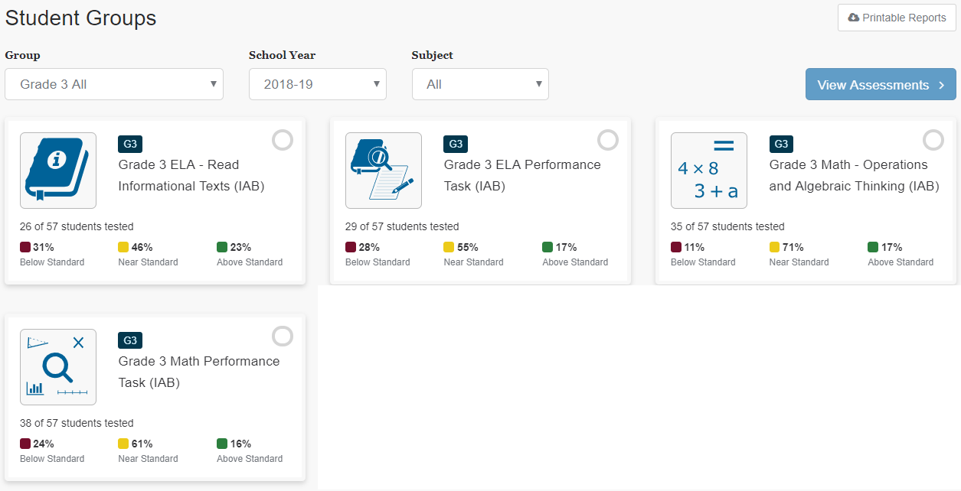
IAB Dashboard
Use the drop-downs to select the group.
Click on the tests you want to see, then click “View Assessments”
Notes:
Presenter: Serena [Smarter System User Guide pg. 48-49]
From the Home Page or the Groups screen, teachers can click the View IAB Dashboard button. They will be taken to the IAB Dashboard to see a highlight of their student group results for all IABs given in a single year on one screen.
If you want to see details for a test (or two) click on the test panel and a blue check will appear in the corner. After you have selected all the tests you want to see, click the View Assessments button in the top right of the page.
You will then be taken to the Groups screen, with the selected IABs displayed.

Slide 18
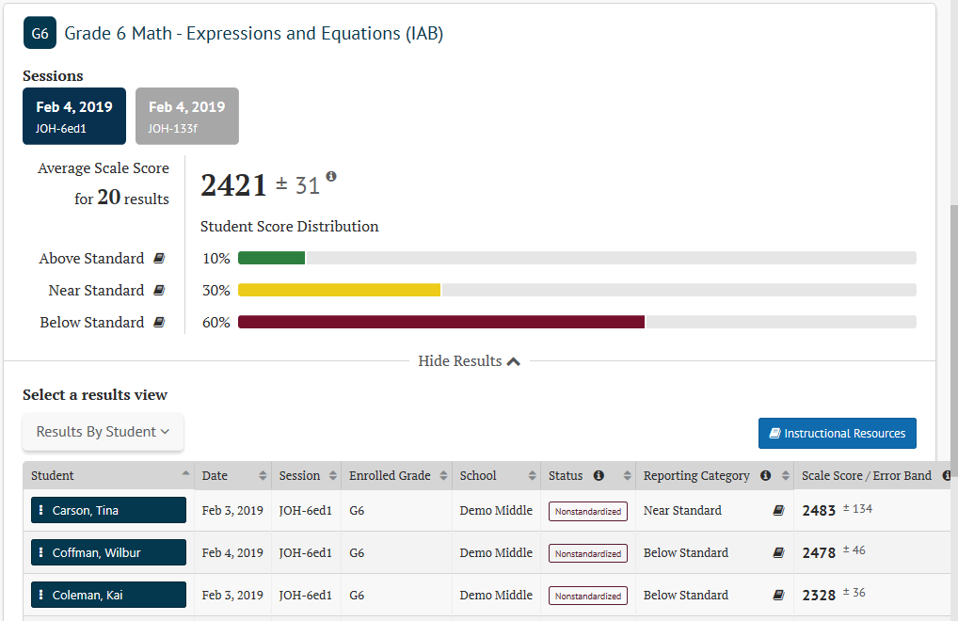
Interim Results View Panel
One session of results for 20 students
(Math interim overall view)
Notes:
Presenter: Serena [Smarter System User Guide pg. 39-41]
Here we have a math interim example.
The Group screen allows educators to select an interim assessment and review all the sessions or times that interim has been given, to that group of students, within the school year. This includes the ability to select different combinations of sessions or times and the system will aggregate the results of those different sessions immediately.
This screen shot shows the results for 20 students who took this IAB in the afternoon of February 4, 2019. That is the session shown in the blue rectangle. The morning session is listed in the grey rectangle, but those results are not included.

Slide 19
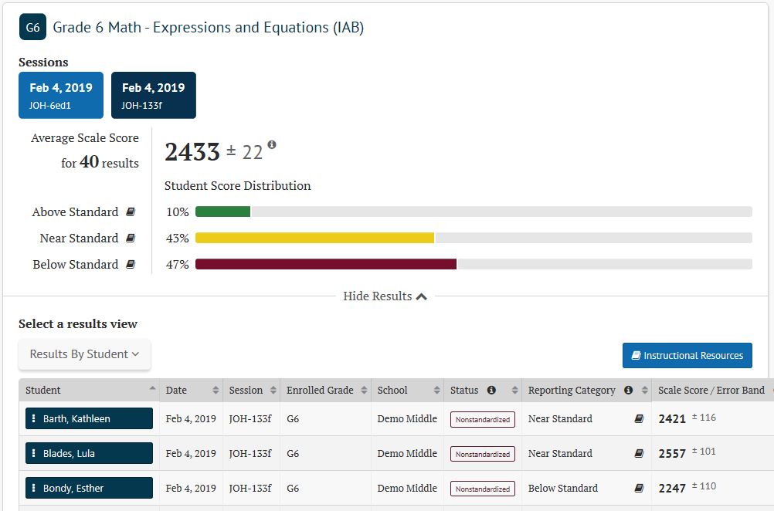
Interim Results View Panel pt. 2
Two sessions of results for 40 students
(Math interim overall view)
Notes:
Presenter: Serena
This screen shows the students from the morning test session included, for a total of 40 student results aggregated together. To make that happen, the user clicked on the grey rectangle for that session—which is now dark blue.
Along with group average scale scores and reporting category performance, each student’s individual performance on this interim is listed for review, just like we saw for summative testing.
An additional feature to note about the Results View table is that all column headers allow ascending and descending sorting of the table information.

Slide 20
Select a Results View Table for Interims
Select a results view drop-down menu
Results by Student
Writing Trait Scores
Results by Item
Key/Distractor Analysis
Notes:
Presenter: Serena [Smarter System User Guide pg. 46]
The Results View Table for interims also has some choices in the drop-down menu.
The Results by Student is still the default view.
ELA tests that include a full-write item will have the Writing Trait Scores listed as a choice.
These next two choices are only available for interim assessments:
The Results by Item displays how the group of students performed on each item in the IAB or ICA. We’ll show you a screenshot of that in 2 slides.
The Key/Distractor Analysis displays additional information about student's responses to multiple-choice and multiple-select questions, as shown in this screenshot. The “key” is the correct answer, and the “distractors” are the wrong answer choices. The analysis shows either the number or the percentage of students who chose each answer option for these types of questions. The correct answer or answers for each question is highlighted in green for easy identification.

Slide 21
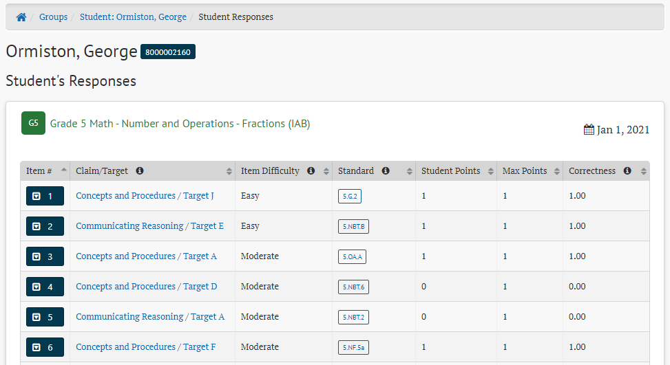
Going Deeper into Interim Results
View: Results by Student
Click: student name
Select: “Name’s Responses”
Notes:
Presenter: Serena [Smarter System User Guide pg. 25]
Teachers can dig even deeper into their interim results from the Results View tables.
When viewing Results by Student, click on the student name, then select {student name’s Responses}. You will be taken to a screen with the student’s scores for each item on that interim. If you click on the blue item number in the first column, a panel will open with the student’s actual response.

Slide 22
Going Deeper into Interim Results pt. 2
View: Results by Item
Click: item number
Notes:
Presenter: Serena [Smarter System User Guide pg. 40-45]
Another option is available when viewing Results by Item. The table lists each item in a row, with the number or percent of student who earned each score point in the last columns.
If you click on the arrow next to the item number, a panel of tabs with information about that item appears. Educators can see how each student in the group performed on that item in the first tab. They can click on the other tabs in this table to see the item itself, the item rubric and exemplar, and additional item information. The item difficulty, Depth of Knowledge (also called D-O-K) and the alignment to standards and targets are in that last lab.
Now I’m going to turn it over to Anton….

Slide 23
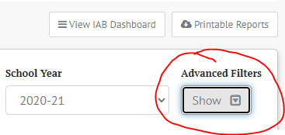
Filter Tests
Off-Grade Assessments: Show or Hide
Manner of Administration (interim): All, Classroom, or School/ District Conversation
Completeness: All, Complete, Partial
Notes:
Presenter: Anton [Smarter System User Guide pg. 20 and 28]
Educators can also access advanced filters when looking at results. The toggle is in the top left corner of the Groups screen. You can select one filter or multiple filters at the same time and the students in the Results View panel will change to match the filter.
The first set of filters is for the tests.
If you gave interims to students in a grade level other than their assigned grade level, that is considered an “off-grade assessment,” so the first filter allows you to show or hide those off-grade assessments. This filter is likely more important at the school or district level, to ensure that only on-grade level results are used to make comparisons.
The manner of administration was determined by the user who set up the testing session in the TA Interface. The “school/district” conversation should be chosen for tests that are given in a more standard way, with each student doing their own work and without previewing the items before taking the interim. The “classroom” conversation should be chosen for tests given in a more non-standard way: this could include students working in groups on items before answering, or the class viewing the items in AVA (the Assessment Viewing Application) beforehand as part of a lesson. By choosing “Classroom” conversation, the TA is letting other users in SRS know that this set of results should be taken with caution and should not be used for comparisons. If you leave the filter on the default of “All” then both manners of administration will show in the results.
The completeness filter is what it sounds like. Complete tests are those where the student provided an answer to every question. A Partial test is one that a student started but did not finish. They likely paused the test and then did not return to it. After a set time period, those partial tests are ended by the Test Delivery System and pushed through scoring. Partial tests may not have all levels of scores reported.

Slide 24
Filter Students
Gender: All, Male, Female, Non-binary
Migrant Status: All, Yes, No
504 Plan: All, Yes, No
IEP: All, Yes, No
English Learner: All, Yes, No
Race/Ethnicity: All, Hispanic or Latino, American Indian or Alaska Native, Asian, Black or African American, White, Native Hawaiian or Pacific Islander, or Demographic Race of Two or More
Notes:
Presenter: Anton [Smarter System User Guide pg. 28 and 35]
The second set of advanced filters is for the students themselves.
The information for these filters is based on what is submitted in CEDARS for the students and transferred to TIDE. If you notice an error when using these filters, report it to your SC or DC, so they can take action to fix the source file.
The system defaults to All, and the other choices are listed here for each category. You can change some or all of them at the same time.
Again, as you change the filters, the students in the Results View panel will change to match the filters.
I need to give another “sandbox caveat” here. The race/ethnicity filters in the WA Sandbox include “Filipino”, but that will not show in our live production site for SRS because CEDARS does not collect Filipino as a separate category.

Slide 25
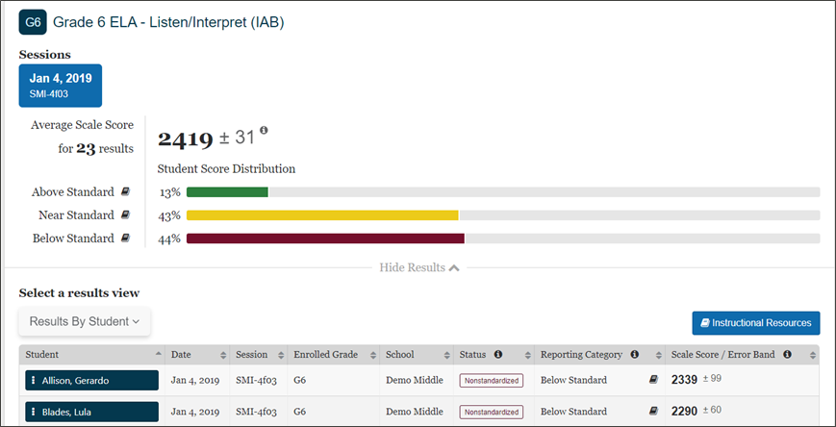
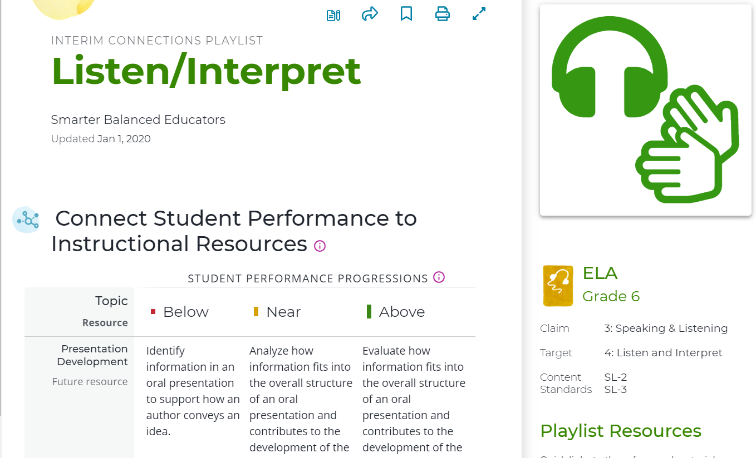
Direct Connections to Tools for Teachers
Notes:
Anton
The last feature we want to point out is that teachers have immediate access to Tools for Teachers connections playlists from each interim assessment within SRS. By clicking on the “Instructional Resource" button for a given interim, educators will be taken to a Connections Playlist for that interim within Tools for Teachers—no extra login steps necessary!
The Connections Playlists include instructional ideas. However, it is important to remember that interim results should be put into context with teachers' observations and other assessments before instructional next steps are taken.

Slide 26
One Thing School and District Users Must Do…
School Coordinator (SC),
District Administrator (DA) and
District Coordinator (DC) roles in TIDE
Notes:
Presenter: Anton
Now, for teachers to get to all of those test results we just showed, there is one critical task that school and district users must do. This task can be done by anyone with an SC, DA, or DC role in TIDE.
I am going to hand this over to Kara who will give you more details

Slide 27
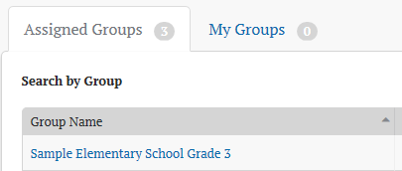
…Assign Student Groups to TAs
TAs will not see any test results until students have been assigned to them in the form of student groups.
Before: After:
Notes:
Presenter: Kara [Smarter System User Guide pg. 78-86]
That most important task is assigning student groups to teachers, or those who have the TA role in TIDE. Before this assigning of students to TAs is complete, TAs will not see any results in SRS for students who test (as shown in the screenshot on the left). After it’s done, you’ll know it’s done correctly when TAs have access to groups in the “Assigned Groups” tab in on their Home Page (as shown in the screenshot on the right).
School and district users manage and assign these groups by using the Student Groups button in the Admin Tools section of their Home Page.

Slide 28
Assigned Groups flexibility
All the students in a classroom:
Grade 5_Room 15
Students for a particular period of instruction
ELA_period 1
ELA_period 2
A student can be assigned to more than one teacher
A group of students can be assigned to more than one teacher
No limit to the number of Assigned Student Groups for a teacher
Notes:
Presenter: Kara
Student groups within SRS are controlled entirely at the local level.
You can group students by classroom, or by period of instruction.
A student can be assigned to more than one teacher. This includes teachers who were not the TA for the test session in the Test Delivery System. For example: the homeroom teacher, the math teacher, and the special education teacher could all have the same student in each of their groups and be able to see all the same information about that student’s testing results.
In addition, a group of students can be assigned to more than one teacher. We will show you how to do that in a minute.

Slide 29
‘Rosters’ in TIDE; ‘Groups’ in SRS
Rosters created within TIDE will NOT flow to SRS.
Rosters are still useful for printing test tickets, printing booklet labels, printing lists of student test settings.
Rosters can be created in TIDE with a .csv or Excel file upload.
Rosters can be edited within the View/Edit Rosters page.
Student Groups are assigned in SRS with a .csv file upload.
Assigned Student Groups can only be edited with a new .csv file upload.
Keep the .csv files used to create groups for use to update groups.
Notes:
Presenter: Kara
The step of assigning groups of students in SRS is necessary because rosters created within TIDE do not “carry over" to SRS. The rosters within TIDE are still useful for tasks completed before testing.
Creating a roster in TIDE and a group in SRS can both be done via .csv file upload. In TIDE, after a .csv file is uploaded, you can edit the rosters within the View/Edit Rosters page.
In SRS, edits to a student group must be done through a new file upload, which—if it has the same group name and school year for that school-- will overwrite the previous upload. If you change the group name, that teacher will have an additional group listed.
We are working with both Cambium and Smarter on upgrades to make this process easier in years to come.

Slide 30
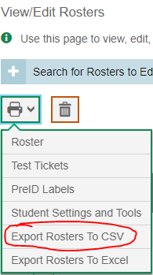
Export Rosters from TIDE
Preparing for Testing→Rosters→View/Edit Rosters
Select the rosters
Select the print button
Choose “Export Rosters to CSV”
Still have to do some manipulation before uploading to SRS.
Notes:
Presenter: Kara
The first thing that Cambium did for us is to enable users to export rosters from TIDE. This functionality is scheduled to be available in TIDE by the start of February.
In the Preparing for Testing section, users can go to the “View/Edit Rosters” section. After finding and selecting the rosters you want, select the print button and then choose “Export Rosters to CSV” and the file will download. The file still needs some manipulation before you can upload it to the Smarter Reporting System, but it has the group name and the student SSIDs together, which we hope will reduce some of your work in this process.

Slide 31
File upload examples for 1 teacher
group_name | school_natural_id | school_year | subject_code | student_ssid | group_user_login
Sasquatch | 1234 | 2021 | ALL | 9876504321 | lsasquatch@example.com
Sasquatch | 1234 | 2021 | ALL | 1234567890 | lsasquatch@example.com
Sasquatch | 1234 | 2021 | ALL | 4567890123 | lsasquatch@example.com
group_name | school_natural_id | school_year | subject_code | student_ssid | group_user_login
Sasquatch | 1234 | 2021 | ALL |  | lsasquatch@example.com
Sasquatch | 1234 | 2021 | ALL | 9876504321
Sasquatch | 1234 | 2021 | ALL | 1234567890
Sasquatch | 1234 | 2021 | ALL | 4567890123
Notes:
Presenter: Kara [Smarter System User Guide pg. 81-82]
Now let’s discuss the file format itself. [I have two example tables on this slide. I will focus on the top example first.]
The file must have these 6 columns, with these exact column headers.
Every row must have the first three columns, which are the group name, the school natural id, and the school year.
The Group name should be unique to the school and the school year. We put “Sasquatch” for our example.
PLEASE NOTE: If you have two teachers at the school with the same last name, be sure to make their group names different, or the second group will overwrite the first group.
School natural ID is the school code. This is the last 4 digits in the school code as listed in TIDE. We put “1234” here as an example.
School year needs to be the year for the Spring tests, so for this school year use “2021”. This is the most common error we have heard about in these files so far.
The subject code must be the same for the entire group. If you use “ALL” then test results from all content areas will be available to the assigned users. The other options for subject codes are ELA or MATH.
Those first 4 columns establish the parameters of the group.
The next column—student ssid--adds students to the group. We used a random set of 10 digits for example SSIDs (none of these are real as of 12/30/2020). You can assign up to 200 students to one group.
The last column—group user login—assigns this group of students to a particular user…in this case Mr. Sasquatch, the classroom teacher.
[CLICK] An alternate way of setting up this information is shown in the example on the bottom. Again, the first 4 columns establish the parameters of the group. The first row leaves the student SSID cell blank but assigns this group to a TA by putting Mr. Sasquatch’s email in the group user login column. The second row leaves the last column blank but assigns a student to this group by entering a student SSID into the cell. These 2 lines alone are what is needed to establish the group. The next two lines are adding more students to the group, but notice that the TA name does not need to be in that last cell.
This second example of setting up the group is really helpful in case you want to…

Slide 32
File upload example for more than 1 teacher
group_name | school_natural_id | school_year | subject_code | student_ssid | group_user_login
Sasquatch | 1234 | 2021 | ALL |  | lsasquatch@example.com
Sasquatch | 1234 | 2021 | ALL |  | mcascade@example.com
Sasquatch | 1234 | 2021 | ALL | 9876504321
Sasquatch | 1234 | 2021 | ALL | 1234567890
Sasquatch | 1234 | 2021 | ALL | 4567890123
Notes:
Presenter: Kara
….assign the same group of students to multiple teachers. This is what the layout could look like….
Again, these first 4 columns establish the parameters for the group.
The next column—student ssid--adds students to the group.
The last column—group user login—assigns this group of students to multiple users. We have assigned this group to both Mr. Sasquatch and Mrs. Cascade. Mr. Sasquatch is the classroom teacher for these students and was the TA for the tests, and Mrs. Cascade is the instructional coach for the school. Both of these users will see the group “Sasquatch” on their assigned groups tab.

Slide 33
Edits to Existing Groups
Keep the original files you uploaded.
Add new students (or new teacher) to the original group and upload again.
Any new upload for a group will over-write the previous upload.
Do not have to remove students who have left the school or district from the group.
Once the student is removed from the group, the teacher no longer has access to that student’s data.
Notes:
Presenter: Kara
To make edits to your existing groups easier, we recommend that you keep the original files you uploaded. Add new students and/or new teachers to the original group and upload the file again. The new upload will over-write the previous upload. This new upload and over-write is the way to make any changes to a student group in SRS.
Do not worry about removing students who have left the school or district. By keeping them in the group, the TA will have access to the tests taken while in their classroom. New test results for the student will only be seen by their new teacher in their new school/district.

Slide 34
My Groups in SRS
After students are in their “Assigned Groups” TA’s can create custom “My Groups”
Select My Groups tab
Click “+Create” button
Name the group and choose content area
Add students to the group
Students can be put in as many groups as you wish
Notes:
Presenter: Kara [Smarter System User Guide pg. 33-34]
One additional feature of student groups to know is that once a school or district user puts a student into a group for a teacher, that teacher can put those students, in any combination they want, into custom groups. Think of the students as puzzle pieces; once the teacher has access to students’ puzzle piece, the teacher can combine those pieces in any way they want and look at the picture they create.
After selecting the My Groups tab, educators can click on the “+Create” button and they will see a list of all students in their assigned groups. They can then name the group and select students to add to the group, and educators can use this process to create as many different groups as they want and put students in as many different groups as they wish. Only the teacher who created these groups will have access to these groups.

Slide 35
How School and District Users See Results
School Coordinator (SC),
District Administrator (DA) and
District Coordinator (DC) roles in TIDE
Notes:
Presenter: Maja
As described in the previous section, TAs must have student groups assigned to them prior to seeing any results.
School Coordinators, District Administrators, and District Coordinators, however, will see results for their school or district even without student groups.
To repeat….school and district users do NOT need to have groups assigned to them in order to see student results.

Slide 36
Accessing School/District Results
View by the school and grade level
Choose a school and then a grade level
Notes:
Presenter: Maja [Smarter System User Guide pg. 26-27]
In SRS, users with the SC role will see student test results in their assigned school by grade, and users with the DA and DC roles will see student test results in their assigned district, also by school and grade. If a user is the SC for more than one school in their district, they need to have the SC role for each of the schools assigned to them in TIDE.
From the SRS Home Page, start typing the name of the school into the “Search by School” field. After about 3 letters, school names will appear that you can choose from. After you choose a school, pick a grade level from the Grade drop-down. Then select Search.
If there are no results available for the school, a message stating, “No test results are available for the selected school.” will appear below the School field. If you get past that and the grade level you want does not appear in the Grade drop-down, then there are no test results for that grade level yet. Once you select a grade with results available, the Search button will be available to select.

Slide 37
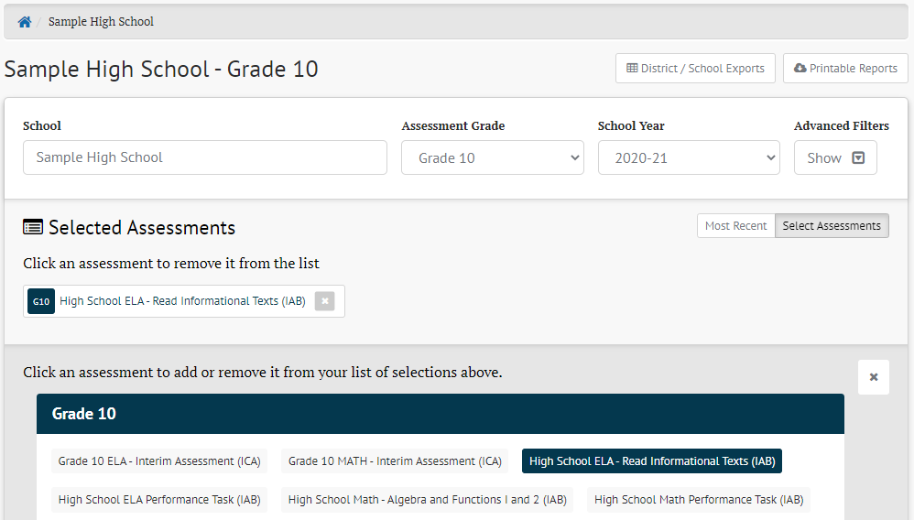
Accessing School Grade Level Results
View all available assessments in a given school year
Notes:
Presenter: Maja [Smarter System User Guide pg. 27-29]
After choosing Select, users will be taken to the School screen. On this screen they will be able to see all the assessments that particular grade of students has taken in the “Selected Assessments” panel. The page defaults to the most recent assessment taken, but the user can click the “Select Assessments” button on the right side of the panel, and another panel will open with all the assessments this grade level of students has taken.
This screenshot shows the Grade 10 students at the Sample High School, with the ELA-Read Informational Texts IAB selected to view. Other tests are available to select. Users can change the grade level they are viewing using the Assessment Grade drop-down menu higher up on the screen.
This page functions just like the Groups Results page that teachers can see, SCs and DCs just see all the results for the school—all the students in that grade level--instead of a small group.

Slide 38
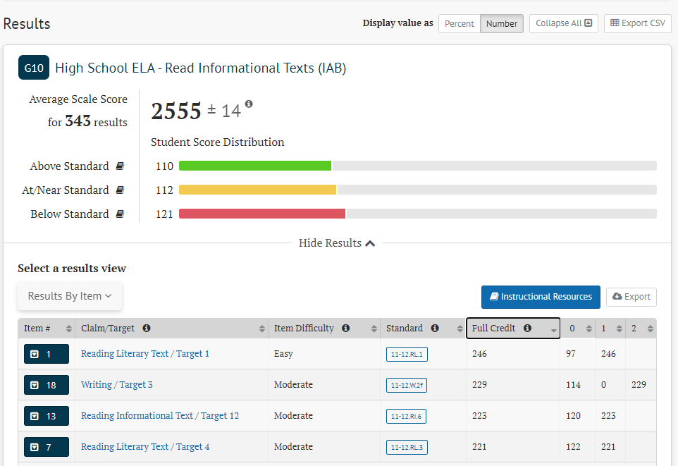
School Results View Panel
Buttons and drop-down menus can change what is seen on this panel.
ELA IAB results by item
Notes:
Presenter: Maja [Smarter System User Guide pg. 14-15 for sorting and toggle buttons]
When the user scrolls down, they will see the Results View Panel for the chosen assessment, just like the TA saw.
There are several buttons and drop-down menus that can adjust what is seen in this panel. The choices available depend on the type of test and content area.
In this screenshot, we changed the overall Student Score Distribution from percentages to numbers by selecting the “number” button at the top of the panel. This allows us to see that 110 students were Above Standard on this IAB, and 112 were below standard. We also changed the Results View Table to the Results by Item view. You can see each item listed on a row, and how many students earned which score points. For example, for item number 18, 114 students earned zero points while 229 students earned 2 points, but no students earned 1 point.
School and district level users can get to the same Results View Table information panels as teachers (which we showed in slides 16-25 so won’t repeat here), the only difference is that the results here are for the entire school.
We have had some users ask about how to find the “5 best” or “5 worst” items in the IAB, like they could get in one of our previous systems. You can mimic that functionality by using the up/down arrows in the Full Credit column to reorder the items. This screenshot shows the 4 items the students performed the best on in this sample school.

Slide 39
WA SRS Sandbox
For Training and Exploration
Notes:
Presenter: Maja
Now we are going to step away from this slide deck and go into the actual Sandbox, so you can see the system in action.
Kara and Anton will take you there.

Slide 40
Sandbox: What it is and what it shows
Is:
Consequence-free environment: click, explore, test functionality
Representation of the live SRS navigation, buttons, tools, features, data categories, reports
Shows:
Mock data from practice and training test items
Notes:
Presenter: Anton [Smarter System User Guide pg. 91-93]
First, let’s just describe what we’ll be seeing and focusing on in the sandbox. It is a consequence-free environment where users can click, explore, test and become familiar with the functionality of the live SRS system. The navigation, buttons, tools, data categories, report types, features and such that you see in the sandbox are representative of how things will work in the live SRS when you go looking for interim or summative test results.
The sandbox, though, shows mock data for publically-available practice and training test items, not any interim or summative items. Because of this, do not get hung up on the data provided in the sandbox for any test or item or on how the items are grouped into tests. It’s all mock, made-up data. Rather focus more on how to get to specific reports, what types of information, in the columns, are provided in each report, and the functions that SRS provides.
With that introduction, let’s dive in.

Slide 41
Go to the Sandbox and show…
The 3 different home pages
Group results for a TA
School results for SC
Aggregate results for DA/DC in California Sandbox
Notes:
Presenter: Anton
Now, that being said, here are the things we want to share from the sandbox.
We’ll get into the 3 different home pages that folks see based on their user role in TIDE, specifically a TA role, an SC role, and a DA or DC role. Then, for each of those roles, we’ll explore a results report we think is likely most relevant for each of those user roles.
When we post the final slide set, links to both the Washington and California sandboxes will be provided in the slide notes, and we’ll be posting these direct links online alongside the final slide set.
WA Sandbox: https://reporting-demo.smarterbalanced.org/sandbox-login?sandbox=WA_S005
CA Sandbox:
https://rdw-stage-reporting.rdw.smarterbalanced.org/sandbox-login?sandbox=CA_S028

Slide 42
How Smarter Balanced Scores are Determined
Scale Scores
Standard Error
Claim and Achievement Levels
Notes:
Presenter: Anton
Now let’s get into how the scores for the Smarter Balanced tests come to be, which includes the scale score, the standard error, and the claims.
This section is a result of questions we often hear from teachers and assessment coordinators. We hope that by including this section in the introduction to the SRS that this information will get to a larger audience than if we put it in a separate presentation.

Slide 43
Scale Scores
Provided for: Summatives, ICAs, and (newly available) IABs
From about 2000 to 3000
All tests in a grade level and content area are on the same scale
Different lengths of test
Different items seen by students on summative tests
IABs for different sub-sets of content
Notes:
Presenter: Serena
Tests results in SRS for math and English Language Arts (ELA) include an overall scale score. Scale scores for the Summatives and ICAs, or Interim Comprehensive Assessments, were available in our previous reporting systems. Scale scores for IABs, or Interim Assessment Blocks, are also provided in the SRS. Seeing the scale scores for the IABs will feel like a “new” thing because they were not visible in our previous reporting systems. We'll talk more about scale scores for IABs in a moment.
The scores are a 4-digit number on a scale from about 2000 up to about 3000. Smarter Balanced chose a range of about one thousand to ensure a statistically acceptable level of precision about student scores.
The decision to use a scale score is related to the fact that the Smarter Balanced Summative assessment is an adaptive test. Students who are performing well will begin to see harder items as they progress through the test, and students who are not performing well will begin to see some easier items. As a result, not all students in a grade level see the exact same set of items. Having a scale score allows us put all the results from a group of students on to the same measuring stick.
This also allows us to put different tests from the same content area and grade level--the Summatives, the ICAs, and the IAB--on to the same scale.

Slide 44
Evidence for Scale Scores
A score is about estimating based on evidence
Evidence comes from points earned and item difficulty
Item difficulty is generated based on student performance in field testing
Easy
Moderate
Difficult
Notes:
Presenter: Serena
When determining a student's score, the items a student answers contribute to evidence that the system uses to estimate the student’s level of performance.
Each item has an item difficulty assigned to it. The item difficulty is based on actual student performance on that item during field testing.
There are three general item difficulty groupings:
Easy means that 67-100% of students got the item correct
Moderate means that 34-66% of students got the item correct
Difficult means that 0-33% of students got the item correct
Item difficulty and whether the student got the item correct together provide the evidence to generate the student’s scale score.

Slide 45
Scale Scores to Performance Levels
Achievement level setting broke each grade level and content area scale into 4 areas
Level 1 and 2 are “below” standard
Level 3 and 4 are “above” standard
Scale score at end of Level 2 and start of Level 3 is the “proficient cut”
Notes:
Presenter: Serena
The overall scale scores are grouped into 4 levels: 1, 2, 3, and 4. Levels 1 and 2 are considered performance below grade-level expectations, or what we call the “performance standard” or just “standard,” and levels 3 and 4 are above the standard. The scale score at the very bottom of level 3 is called the “proficient cut” as it distinguishes those students whose performance is below the standard from those whose performance is above the standard.

Slide 46
Scale Score Example
Grade 7 ELA scale
Notes:
Presenter: Serena
Here's an example of scale scores and levels using grade 7, ELA:
Orange is Level 1, yellow is Level 2, green is Level 3, and blue is Level 4.
The "proficient cut" is the scale score at the bottom of level 3, so in this case a scale score of 2552, not exactly in the middle of the range at 2500.
Note that there are different ranges of points in each of the levels: you can see how the orange and blue are much bigger than the yellow and green, and there is a range of 72 points in the yellow, and 88 points in the green.
Also note that these are the specific cuts for 7th grade ELA. The 7th grade math cuts are in different spots than these, and the ELA cuts for 6th and 8th grade are also at different places on the scale. But…to be clear, this is the scale used for all the grade 7 ELA Smarter Balanced Tests: the summative and the all grade 7 the interims.

Slide 47
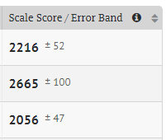
Standard Error of Measure (SEM)
Each student scale score has an SEM.
Overall score for Summative and ICA
Claim scores for each claim on Summative and ICA (not visible in SRS)
Overall scores for IABs (newly available)
This is the ± value displayed next to the 4-digit scale score, under the heading “Error Band.”
Notes:
Presenter: Maja
Each student scale score also has a Standard Error of Measure, or SEM number displayed with it. The SEM indicates a range where the student’s score is likely to be if they took the test several times. The SEM is similar to, and is sometimes called, the “margin of error” or “standard error.”
This number is displayed in the reporting system in a lighter font with a plus/minus in front of it, under the “error band” heading as shown in this screenshot.
You will see the SEM for the overall scores for the summatives, ICAs, and IABs. They also exist for each of the claims in the summative test and ICAs, they are just not displayed.
And again, seeing these for the IABs will feel new since they were not displayed in our previous reporting systems.

Slide 48
Standard Error of Measure (SEM) pt 2
This value is dependent on the items a student saw, which ones were answered correctly, and those the student did not answer correctly.
It is also dependent on the consistency of answers given to questions of similar difficulty.
Students with the same scale score can have different SEMs because they got different combinations of items correct.
Notes:
Presenter: Maja
The SEM can be different for different students because it depends on the questions the students saw and which ones they got correct. For the summative test, students often see different items because the test is adaptive. On an interim, although students see all the same items because the interims are "fixed-form" tests, they can get different combinations of items correct. These differences contribute to both different scale scores as well as different SEMs.
In this way, the SEM can be thought of as a representation of how varied a student's performance is on a test; a student with a smaller SEM was more consistent in the performance they showed on the test while a student with a larger SEM showed more variability in performance on the test. If a student gets all the easy items right but none of the moderate or hard items right, they are likely to have a smaller SEM than the student who gets some easy, some moderate, and some hard items right.
Finally, even students who get the same scale score, as an estimate of their performance, can get different SEMs because they get different combinations of items correct on the test.

Slide 49
Claim Scores and IAB Achievement Levels
Categories: Below, At/Near, Above
For a Claim on the Summative or ICA
For the whole IAB on an IAB or FIAB
The claim category earned by a student depends on both their scale score and their SEM
For only the items in a particular claim for the Summative or ICA
For all the items in an IAB or FIAB
Notes:
Presenter: Maja
In addition to the scale score, Claims for both the summative test and the ICA are reported using three categories: Below Standard, At/Near Standard, and Above Standard.
Results on interim blocks, both IABs and Focused IABs or FIABs, are also reported using these categories.
In these next few slides, we will explain how these categories are determined.
The first thing to know is that which category a student’s performance falls into depends on both the student’s scale score and the SEM of that student’s scale score.
For the IABs and Focused IABs, all the items in that IAB are used in the calculation, and a scale score of 2000 to 3000 is generated.
For the Summative or ICA Claims, the scores are only for items in that particular claim area. For example, the writing claim score in ELA will include scores from the full-write essay, as well as the other writing items included in the computer adaptive part of the test (the CAT).
The sets of items from a single claim are put through the same statistical process as for the overall score, using the item difficulty value and whether or not the questions were answered correctly, and put on the same 2000 to 3000 scale. This claim level scale score is NOT visible within the SRS. We will come back to this claim level scale score in a few slides.

Slide 50
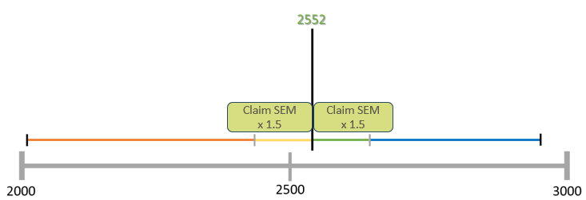
At/Near range calculation
SEM x 1.5 = n
The n is put on either side of the proficient cut for the grade level and content area.
Notes:
Presenter: Anton
After the student’s claim or interim block scale score is calculated, it is put to the side for a moment. The SEM for that student score is used in the next step, which is to calculate that student’s At/Near Standard range.
This is done by taking the student’s SEM and multiplying that by 1.5. This value is then added to and subtracted from the “proficient cut” score. The ELA proficient cut score for grade 7, remember, is 2552. In this diagram, we put the green box on either side of that line to show the addition and subtraction.
Multiplying by 1 and a half is a statistical procedure that has to do with the accuracy of the prediction being made about student achievement. There is a 95% chance that if the student were to take the test again, in the near future with no additional learning, that they would score within this range.

Slide 51
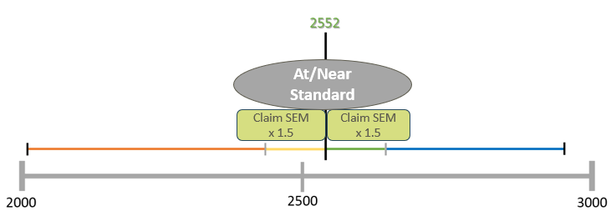
At/Near Range
Notes:
Presenter: Anton
The result of this calculation for this student is that we now have a range of scores that, for this individual student, would represent performance that is “At or Near Standard.” So, we bring back the student’s scale score for the claim or for the IAB and compare it to this range. If it falls within this range, their reported category is “At/Near Standard.”

Slide 52
Below and Above Ranges
Notes:
Presenter: Anton
If this particular student’s scale score falls above the At/Near Standard category range, their performance would be categorized as “Above Standard.” On the other hand, a scale score below the At/Near Standard range would be reported as Below Standard. This is how both the SEM and the scale score are used to determine the student’s summative claim or interim block category.
Keep in mind that the process described here to determine the claim or interim block category is repeated, individually, for each student. For the summative test, this is repeated for each claim. These three ranges are as unique to each student as their performance on this test is unique to them.

Slide 53
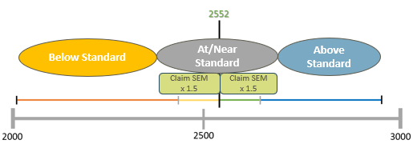
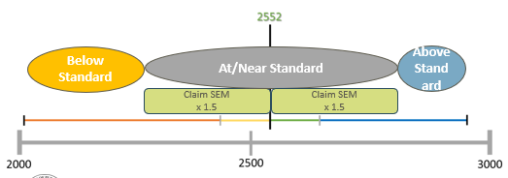
Same scale score, different category
Notes:
Presenter: Anton
And so the final piece to this conversation is to take a look at two different students for whom this process has been done. On this slide, we’re modeling two different 7th grade students’ results on the same ELA interim. What we want to show is how these two students could get the same scale score but their performance would be described in two different categories. We are predicting that more educators will be asking how this is possible because the scale scores for the IABs and Focused IABs are visible in the SRS, and educators can sort the students from highest to lowest scale scores.
The first thing to notice is that the student performance shown on the top has a smaller SEM than the student performance shown on the bottom. As a result, the “At/Near Standard” range for the student on the top is smaller than the student on the bottom. This means that the student on the top was more consistent in the difficulty of items they got right, and the student on the bottom was more variable. In this way, the range for the “At/Near Standard” category are different for these two students.
The next thing to notice is the vertical purple line. This line represents the scale score for the students, and further that both students got the same scale score on the interim. For the student on the top, that vertical line passes through the “Below Standard” category because the scale score is below 1.5 times that student’s SEM. That student’s performance on that interim would be reported as “Below Standard.” But for the student on the bottom, that vertical line passes through the “At/Near Standard” category, so that student would receive a reporting of “At/Near Standard.”
So, from a technical perspective, that’s how the categories for student performance are determined. But for this example, why does it make sense that these two students, with the same scale score, got different reporting category results? It’s all about the SEM and our level of certainty that the “Below Standard” category accurately represents the student’s performance. For the student on the top, because they had more consistent performance (evidenced by a smaller SEM) and the scale score was outside 1.5 times that SEM, we are confident enough to say that the student’s performance is best categorized as Below Standard. It is unlikely, given that student’s SEM, that if they took the interim again that they would get at least a 2552 on the interim.
The student on the bottom, however, because their performance was more varied (as evidenced by their higher SEM), we’re less confident that “Below Standard” accurately reflects their performance. It is possible that, if the student were to take the interim again, they might get a scale score of 2552 or higher, so “Below Standard” is not as good a descriptor as “At/Near Standard” of that student performance on that interim.
Finally, because these students had different SEMs, it is certain that they got different combinations of items correct on the interim. An examination of the skills each student was able to demonstrate on that interim, in combination with other evidence gathered informally and formally by the teacher, should be used to determine the instructional interventions needed for each student.

Slide 54
Additional Things School and District Users Can Do
Instructional Resources
District/School Exports
Custom Aggregate Reports
Notes:
Presenter: Anton
Finally, we want to describe a few additional things users can do in SRS. I am going to hand it over to Kara for this review

Slide 55
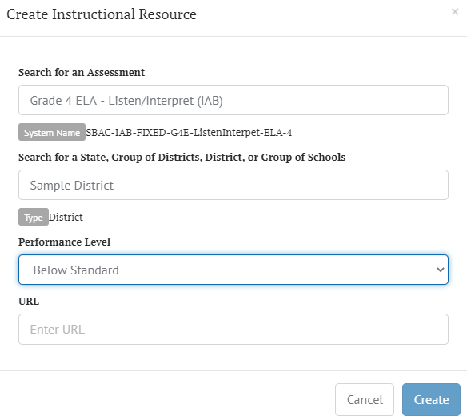
Additional Instructional Resources
Connect to district resources after interim assessments
Instructional Resources->Create
Notes:
Presenter: Kara [Smarter System User Guide pg. 86-87]
District level users (DC and DA roles) can add more instructional resources to the Instructional Resources button on the IAB Results View panel. Let’s say teachers in your district have worked together to create some listening resources connected to an IAB. You can link to the webpage where those resources are available. In the Administrator Tools panel of the home page, click on Instructional Resources. To add a new resource, click on the Create button. The window shown in this screenshot will open. You’ll need to select the assessment that you want the resource connected to. Then select the district or school you want to have access to the resource. In the Performance Level, you can pick all levels or a particular level. Then enter the url for the webpage where the resources is available. Last, click “Create”.

Slide 56
District/School Exports
Export a .csv file with all student assessment results
Depending on permissions, users can select one or more schools or districts to report
All, raw data will be exported
.csv file can be modified after it is exported
Notes:
Presenter: Kara [Smarter System User Guide pg. 73-80]
District and School users can export district or school testing data for all students into a .csv file. This file will include all the assessment data for students in the district or school selected. Depending on their permissions, users can choose how many schools are included in the report.
There is no filtering or customizing of the data that gets pulled from SRS into this report; the report will include all testing data for all students in the selected schools and/or districts. However, as an export into a .csv file format, the .csv file can be modified after it is exported.

Slide 57
Custom Aggregate Reports
The Yearly Report shows student performance for selected years across schools or grades.
The Longitudinal Report shows summative performance over time for summative assessments.
The Claim Report breaks down performance by sub-score level (claim) information.
The Target Report offers the most detailed look at performance on Smarter Balanced summative assessments for student populations.
Notes:
Presenter: Kara [Smarter System User Guide pg. 55-74]
In addition to the “all school or all district” export reports, school and district users can create custom aggregate reports to show results of groups of students. These include:
Yearly reports to show student results for the year by school or grade
Longitudinal reports, which show results over time. Note: these reports require multiple years of summative assessment data which are not available within SRS yet.
Claim reports that drill down into student performance on summative tests by sub-score
And Target reports that further drill down into student performance on related sets of math and ELA standards.

Slide 58
Assessment Attributes for Reports
Assessment Type: ICA (Summative avail in the spring)
Subjects: All, Math, ELA
Assessment Grades: 3-11
Academic Years: currently blank since we only have 2020-21
Manner of Administration: All, Classroom, School/District Conversation
Completeness: All, Complete, Partial
Notes:
Presenter: Kara [Smarter System User Guide pg. 58]
Users will need to select some assessment attributes to start building the report. These are the same attributes we described earlier when discussing the Advanced Filters.

Slide 59
Advanced Filters and Customized Groups
Gender
Race/Ethnicity
English Learner
504 Plan
IEP
Migrant Status
Notes:
Presenter: Kara [Smarter System User Guide pg. 61-66]
Users can choose to disaggregate the data by a variety of combinations of demographic and program eligibility categories, again, with the same choices as in the Advanced Filters.

Slide 60
Yearly Reports
See the results for a full year in one place
Notes:
Presenter: Kara
The Yearly Reports will be the place to see overall district and school results together. This screenshot is from the California SRS Sandbox because it has summative results already in it. Don’t be worried when you look at the report preview section of the screen and the percentages all look the same—it’s just a preview section. You need to name and create the report to see the actual numbers.

Slide 61
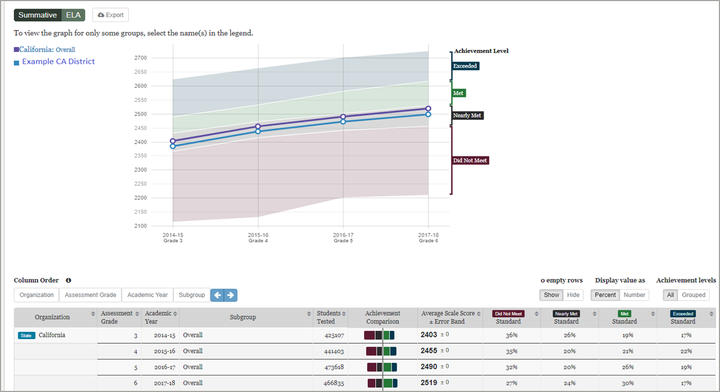
Longitudinal
Will not be available for a few years
Notes:
Presenter: Kara
Longitudinal Reports track summative assessment performance for a single student population as they progress through different grades. In addition to presenting data in a table, it includes a line graph showing how performance of the population changed from grade to grade. This screenshot is also from the California Sandbox. The Longitudinal data button will not be available in the WA Sandbox or in the live production site this school year, since we don’t have any summative data. This button won’t be available until we have at least 2 years of summative data in SRS.

Slide 62
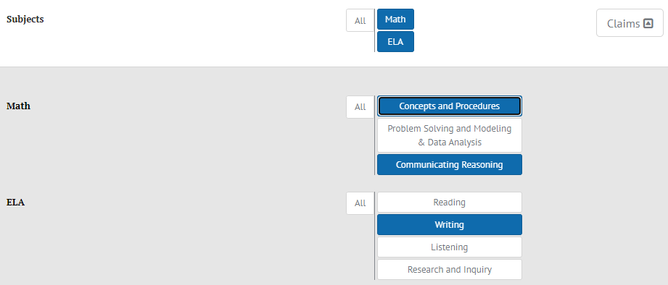
Claim Reports for ICAs and Summatives
Subject attribute has additional choices available:
Notes:
Presenter: Kara [Smarter System User Guide pg. 59-60
Claim reports are available for ICAs and summative assessments to give administrators a view of how students perform across sub-scores or claims within a subject.
In this screenshot we have selected both Math and ELA so you can see each of the claim categories available. We selected two math claims: concepts and procedures, as well as communicating reasoning. We selected on the writing claim for ELA. Users can pick as many or as few categories as they would like for the report.

Slide 63
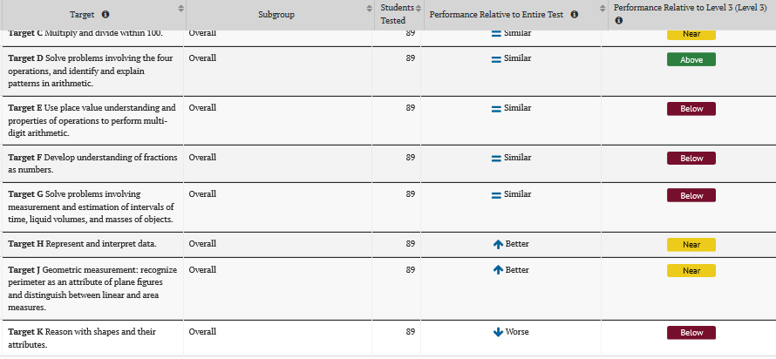
Target Reports: Math/ELA Summatives
Teachers see in Results View Table for their groups (slide 12).
School and district users access via Custom Aggregate Reports.
Notes:
Presenter: Kara [Smarter System User Guide pg. 53-54]
Target Reports are only available for Math and ELA Summative tests
Teachers can access Target Reports in the Results View Table for each of their groups (see slide 12).
SCs, DAs, and DCs, will access them via Custom Aggregate Reports.

Slide 64
Conclusion
Notes:
Presenter: Kara
We are starting to wrap up. Please put your final questions or comments into the Q&A box.

Slide 65
When will we see results?
Interim assessment results became available in September 2020.
Summative assessment reporting is planned for spring 2021.
Remember to explore the WA SRS Sandbox
See the CA SRS Sandbox for a summative preview
Notes:
Presenter: Kara
For those schools and districts that have administered interims, results have been available in SRS since September 2020. Reporting of summative test results, once students have taken those, is planned to start showing in SRS in the spring of 2021.
We also invite you to get into Washington’s SRS Sandbox and explore the features and reports available in that system. It is publically-available and a great place to try out new things and train others for using the Smarter Reporting System.

Slide 66
Additional Supports
SRS Introduction: Short document created by OSPI and available in WCAP Portal. Contains basic tasks with numbered steps, trouble shooting, and FAQ.
User Guide: Full document published by Smarter Balanced available within SRS and the Sandbox. Contains more details on these features and other features to explore. (See notes section in final slide deck for page numbers.)
Technical Support: CAI Helpdesk wahelpdesk@cambiumassessment.com
System questions & suggestions for enhancements: anton.jackson@k12.wa.us
kara.todd@k12.wa.us
ELA Assessment: maja.wilson@k12.wa.us
Math Assessment: serena.oneill@k12.wa.us
Notes:
Presenter: Kara
We created a “Smarter Reporting System Introduction” document for you. It is in the “User Guides and Manuals” section of the resources on the WCAP Portal. It has some step-by-step instructions for basic tasks in the SRS.
The full User Guide for the SRS is available to download from within the WA Sandbox or the live production site. Smarter last updated this is 2019. When you download the final version of this slide deck, the notes section will include relevant page numbers from the User Guide about that topic. We are planning to make a WA-specific version of that document for next school year.
If you run into trouble with the SRS, please contact the CAI Helpdesk. We encourage you to take screenshots of the issue and be as specific as possible.
If you have general systems questions or have suggestions for the two documents on the left or for future trainings, please contact Anton and me. If you have questions about the assessments themselves, please contact Maja for ELA and Serena for Math.

Slide 67
Recording and Final Slides
In both:
Test Administrators->Modules folder
Test Coordinators -> Modules folder
Draft slides (no notes or script): available now
Final slides (with script/notes/links): available by Monday 2/1
Q&A: available by Monday 2/8
Recording: available as soon as we can check CC
Notes:
Presenter: Kara
And lastly….the materials from this training will be available in the Modules folder for both the TA and TC users. Scroll down to the section “Smarter Reporting System Training—draft”
The draft slides are available now. The final slides, which include the ever-important notes section with our script, will be available by next Monday, Feb 1.
The Q&A document, which will have answers to the questions you posed in the Q&A and Chat, will be available by the following Monday Feb 8.
The Recording may take a little bit longer. We need to check that the closed captioning is correct. All the acronyms we use can be a bit funny, and we need to correct them.

Slide 68
Connect with us!

