Slide 1
Assessment Update Webcast
SY 2023–24
Update #2
September 20, 2023

Slide 2
9/21/2023
Notes:
I would like to acknowledge the indigenous people who have stewarded this land since time immemorial and who still inhabit the area today, the Steh-Chass Band of Indigenous people of the Squaxin Island Tribe

Slide 3
Let us recognize historical and ongoing injustice and hate targeted toward race, culture, religion, gender and gender identity, sexual orientation, disability, and nationality.
Space for Solidarity
Notes:
OSPI recognizes historical and ongoing injustice and hate targeted towards individuals and groups based on their race, culture, religion, gender and gender identify, sexual orientation disability and nationality.

Slide 4
Today’s Topics
WaKIDS
Reminders
TK Survey Responses
Office Hours
Select Assessments
WA-AIM
Spring 2023 Score Reports
Fall HS Retakes and Pre-ID
INSIGHT User Clean-up
What is New
Assessment Development
Updates to Rollover to SY 2023-24
Target Reports
Spanish TTS in math and science
Training Videos
Data
Student Growth Percentiles
CEDARS Go-Live and TIDE
EDS Applications status
Assessment Operations
WAMS Profile
Important Dates for September and October
Family Score Reports – Paper Copies
Notes:
Presenter: Christopher

Slide 5
WaKIDS

Slide 6
Reminders
WaKIDS 101 training: 2 more sessions
No teacher accounts from districts
Student import and transfer-
Instructions begin page 9 in the Quick Start Guide.
Don’t have it? Contact your ESD Coordinator.
Full-day Kindergarten checkpoint date: 11/15/2023
TK checkpoint date: 10 weeks from the program start date
Last day to make transfer request: 11/1/2023

Slide 7
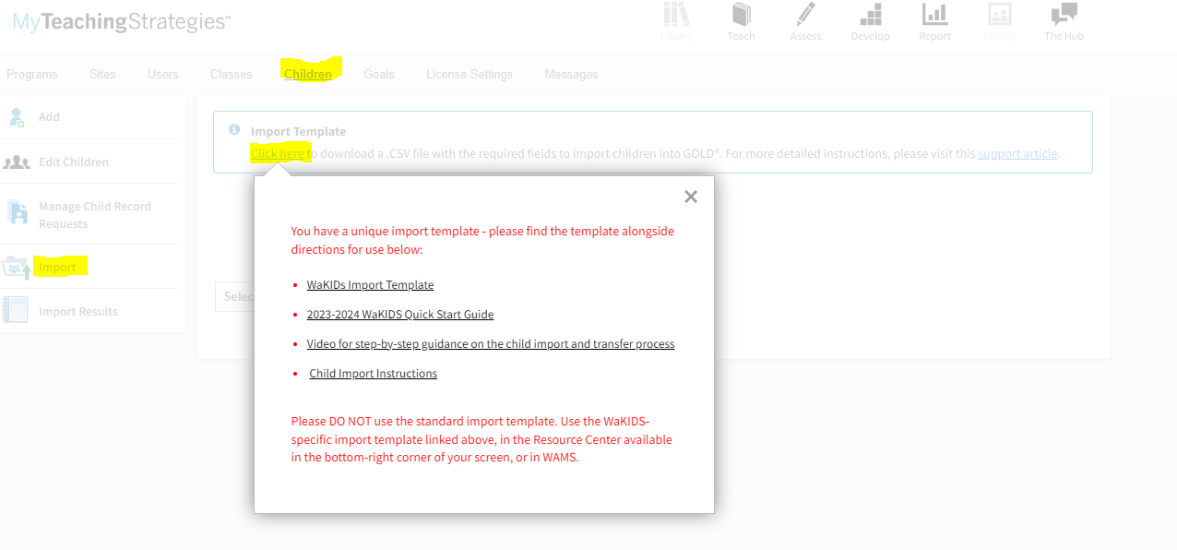
Import Template

Slide 8
TK Survey Responses
Aberdeen
Asotin-Anatone
Auburn
Battle Ground
Bellingham
Bethel
Bickleton
Blaine
Boistfort
Bremerton
Brewster
Bridgeport
Brinnon
Burlington-Edison
Camas
Cape Flattery
Cascade
Central Kitsap
Chewelah
Chief Leschi Tribal Compact
Chimacum
Clarkston
Cle Elum-Roslyn
Colfax
College Place
Columbia (Stevens)
Columbia (Walla Walla)
Colville
Concrete
Conway
Cosmopolis
Darrington
Davenport
East Valley (Yakima)
Eastmont
Eatonville
Edmonds
Ellensburg
Elma
Enumclaw
Evaline
Everett
Evergreen (Clark)
Federal Way
Ferndale
Franklin Pierce
Freeman
Grandview
Granger
Granite Falls
Grapeview
Griffin
Highland
Highline
Hockinson
Hood Canal
Hoquiam
Impact
Issaquah
Kalama
Kelso
Kennewick
Kettle Falls
Kiona-Benton City
Kittitas
La Center
La Conner
LaCrosse
Lakewood
Liberty
Longview
Lopez
Lyle
Lynden
Mabton
Mead
Monroe
Montesano
Morton
Mount Vernon
Notes:
Red: No TK in 23-24
Yellow: Maybe will open in 23-24 or in need or more information

Slide 9
TK Survey Responses
Valley
Vancouver
Vancouver
Vashon Island
WA HE LUT Indian School Agency
Walla Walla
Wapato
Warden
Washougal
Washtucna
Waterville
Wenatchee
West Valley (Yakima)
West Valley (Yakima)
White River
Wilbur
Winlock
Wishkah Valley
Yakima
Yelm
Zillah
Naches Valley
Nespelem
Nooksack Valley
North Beach
North Franklin
North Mason
North River
North Thurston
Oak Harbor
Oakville
Ocean Beach
Olympia
Onalaska
Orcas Island
Othello
Palisades
Palouse
Pasco
Paterson
Pe Ell
Peninsula
Pomeroy
Port Angeles
Port Townsend
Prosser
Puyallup
Quincy
Rainier
Raymond
Reardan-Edwall
Richland
Ritzville
Rochester
Royal
San Juan Island
Sedro-Woolley
Selah
Selkirk
Shaw Island
Skamania
Snoqualmie Valley
Soap Lake
South Bend
South Whidbey
Spokane
Stanwood-Camano
Steilacoom Hist.
Steptoe
Stevenson-Carson
Sultan
Sumner
Sunnyside
Tacoma
Tahoma
Tekoa
Thorp
Toppenish
Tukwila
Tumwater
Union Gap
Notes:
Red: No TK in 23-24
Yellow: Maybe will open in 23-24 or in need or more information

Slide 10
Office Hours
Find your ESD Coordinator's office hours
Find Yoona's office hours
Here

Slide 11
Select Assessments

Slide 12
WA-AIM

Slide 13
Spring 2023 WA-AIM Score Reports
INSIGHT>Report Delivery>On-Demand Reports
Individual Student Reports- (for family/guardians)
Individual Student Report-Engagement Rubric- (for family/guardians)
Student Roster Reports- (for teachers)
Student Status Report- final status of submissions from Spring 2023
Useful if student is missing from the reports above:)

Slide 14
WA-AIM INSIGHT- Clean-up Users
In INSIGHT>User Management>Manage Users
Administration=“WA-AIM Testing”
Add new users:
Add Single User or Upload Multiple Users tabs
Edit existing users for role or location change
Edit User tab- use filters to find user, click the View/Edit icon on right
Activate/Inactivate users
Edit User tab- use filters to find user, click the Activate/Inactivate icon on right (person- red circle=currently active, green circle= currently inactive
Notes:
The most important task for DACs during the first few weeks is to get your users in INSIGJT set-up. All user accounts should now be added, edited, activated or deactivated in the “WA-AIM Testing” option under the Administration dropdown in any of the tabs within user management.
To add new users, you can either add a Single User or Upload Multiple User by clicking on the appropriate tab.
To edit users due to a change in user role OR site location, go to the Edit User tab. User the filters to locate the users. Click the Edit user icon on the right of the table for that user.
To activate or inactive users, follow the same process for editing, but click on the activate/inactivate icon. This icon is the person with either a red or green circle. A red circle mean the user is currently active. A green circle means the user is currently inactivated.
Making sure users are appropriately permissioned at the correct location is very important in order for INSIGHT users to have access to INSIGHT Item and Form library, which is continually open. Users are encouraged to use the item and form content in this application for instructional, baseline, and progress monitoring purposes before the WA-AIM window opens, or to begin prepping final items to be used once the window opens.

Slide 15
WA-AIM HS Fall Retakes
Window: September 25-November 21, 2023
HS student in grades 11 or 12 eligible per IEP to participate in the WA-AIM
ELA and Math only!
Graduation Cut-Scores on HS WA-AIM to meet Graduation Pathway:
ELA=104
Math=103
Manual additions: Email student SSID only to wa.aim@k12.wa.us
Do not include other Personally Identifiable Information

Slide 16
WA-AIM Spring Information
Window: January 29 through May 3, 2024
OPEN NOW:
INSIGHT Item and Form Management- contains all items and forms
INSIGHT User Management- add/update user accounts
INSIGHT Report Delivery- print family or roster reports from previous administrations
OPENS JANUARY 29:
INSIGHT Registration- where forms are associated to students
INSIGHT Student Performance Data- where student responses are documented
Notes:
Here is some important regarding spring WA-AIM and when various INSIGHT applications come open.
As a reminder, one reason we changed to the general administration label of “WA-AIM Testing” was to allow us to keep some INSIGHT applications accessible all year and across years. Currently open are INSIGHT Item and Form Management, where all item and form content for the WA-AIM is housed.
INSIGHT User Management where district assessment coordinators add or edit users.
AND
INSIGHT Report Delivery- where district assessment coordinators can download or print roster or individual student reports for concluded administration windows.
On January 30 the following application will become available:
INSIGHT Registration- where final forms are associated to student
INSIGHT Student Performance Data= where the student’s responses to items on the final forms are documented.
INSIGHT Registration and Student Performance Data are the two INSIGHT applications that are defined by the test administration window of January 30 through May 5.
This is important to remember as teachers responsible for administering the spring WA-AIM can and should be accessing the content for the spring assessments at anytime. They do not need to wait until January 30 to begin determining and adapting the final form content.

Slide 17
Assessment Development
Notes:
Presenter: Kara
Last month we talked about TIDE rollover, re-creating all your TIDE accounts, and gave some reminders about TIDE user roles. Please see slides 30-33 of the August webinar for reminders about those topics.

Slide 18
Practice/Training Tests and Interims
Practice/Training Test availability: Late September
October 2 is current tentative target date
Interim availability: Early October
October 2 is target date
No new interims. A few item changes within existing tests.
G8 ELA Performance Task: replaced Argumentative task with an Explanatory task
Interim questions are available in Tools for Teachers, the Interim Assessment Item Portal (IAIP)
Notes:
Presenter: Kara
Rolling over the practice and training tests, as well as the interims….
We are working towards the practice and training tests rolling over sometime soon. We had to push out the date to early October because we are still working out some of the new features. They are currently available in the WCAP Portal with the features we had last year.
We are also working towards the interims being available in early October. There are no new/additional interims this year. But there are a few item changes. These changes are things like: updates to content, updates to accessibility features, and items removed or replaced for Bias & Sensitivity reasons. The biggest swap out is that the G8 ELA Performance task had to be changed because the permissions to use the stimulus were unable to be renewed. It’s now an explanatory task.
If teachers want to look at the interims before October, they can get them through the IAIP within Tools for Teachers. If you don’t know how that works, it’s a great question for the ASI inbox or for our monthly open-office hours call the week prior to this webinar.

Slide 19
SRS Rollover: Student Groups
SRS rollover is September 22.
Student groups for new year (with “2024”) can be uploaded
Keeping “2023” student groups in SRS until November 8, 2023.
Allows teachers to see all spring 2023 results through November
Spring 2023 WCAS results in SRS as of 8/14
Spring 2023 math/ELA results in SRS since spring
On November 9 (Thursday before the Veteran’s Day weekend), all “2023” student groups will be removed.
Notes:
Presenter: Kara
The SRS is available now, and you can add student groups with 2023 as the year between now and today, September 20. On September 21, which is tomorrow, the SRS will be unavailable as it rolls over. Then is scheduled to be available again on September 22. After the 22nd, new student groups with 2024 as the school year can be added to the system.
The groups from 2023 will remain available through Wednesday November 8. The evening of November 9, the 2023 groups will be removed.

Slide 20
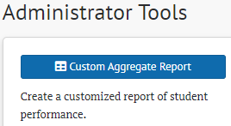
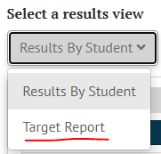
Target Reports in SRS
DC, DA, SC, and IS users
Users with student groups
District and School target reports available in Custom Aggregate Reports area.
Group target reports available in Select a results view drop-down menu.
Notes:
Presenter: Kara
We have gotten lots of questions about Target Reports. Different users have different ways of getting to Target Reports. Those of you who have the “Administrator Tools” on your homepage can get to District level and School level target reports for the spring summative tests through the Custom Aggregate Reports area. Once in there, you select Target Report and then start building your report.
If you have student groups assigned to you (which means all the TAs), then you can get Group level target reports for the spring summative tests through the “Selects a results view” drop down menu. If you are looking at student level results and you don’t see Target reports in this drop-down, look at the top of the page. Check to make sure you are in a “Group” view. The “School” view and the “Group” view are very similar, but only the group view will get you the menu shown on the right.

Slide 21
Spanish TTS: Math and Science
Both Spanish text and English text can be read aloud with Text-to-Speech.
Both Presentation Spanish and TTS (Test Content) must be activated in TIDE student test settings.
Spanish voice pack must be installed on the testing device.
Student will use buttons in the context menu to activate the TTS.
Exact buttons vary by item format.
Notes:
Presenter: Kara
Now for a recap of Spanish Text-to-Speech, with clarifications.
The student test settings of Presentation must be set to Spanish, and the Text-to-Speech (Test Content) must be activated for this to work. Most student have Stimuli+Items set.
The testing device also MUST have a Spanish voice pack installed for this to work. There is no specific voicepack that CAI says we must install. For my devices, we just downloaded a Spanish language package from Microsoft. So, for those DACs who are having pre-pandemic memories pop-up about a “Julia voice pack” installation that used to be downloaded from TIDE….your memory is correct, but technology has gone a long ways since then, and that is no longer needed. Many MAC and Chrome devices already have voicepacks on their machines.
The TTS checks during the login process will look first for a Spanish voice pack and then for the English voice. If the Spanish voice pack is not installed, the Secure Browser will not let the student proceed. You will be able to see this in the training and practice tests until after they roll over. Guest mode training tests will also not let you proceed if these two settings are selected and a Spanish voice pack is not detected.
Once the student passes the TTS check and is in the test, the student will use buttons in the context menu to activate the TTS in either Spanish or English!
The exact buttons will vary by item format.

Slide 22
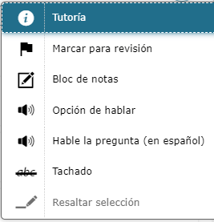
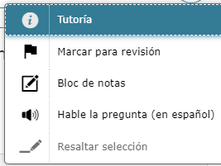
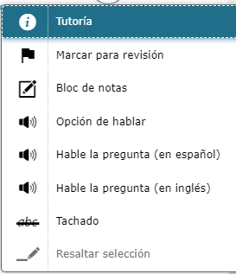
Spanish TTS: Context menu examples
Exact buttons vary by item format and presentation.
Two One Three
Notes:
Presenter: Kara

Slide 23
Training Videos
Smarter Reporting System
Student Groups https://www.youtube.com/watch?v=-FYIgEhP6AM
TA View Summative https://www.youtube.com/watch?v=5C6UqY1Rt3o
DC SC View Summative https://www.youtube.com/watch?v=P5ZCRGQfV6o
TA View Interims https://www.youtube.com/watch?v=AMVwJhqp3Iw
Custom Aggregate Reports https://www.youtube.com/watch?v=ZJh_92aCOCQ
Using the GTSA series
Episode 1: https://www.youtube.com/watch?v=EYzWWWpt0PM
Episode 2: https://www.youtube.com/watch?v=c6WNyoYhcRM
Episode 3: https://www.youtube.com/watch?v=8C4QqWpdZrQ
Episode 4: https://www.youtube.com/watch?v=Z9ohgV6oo4I
Spanish presentation choices detailed on slides 38-43 of August webinar
Notes:
Presenter: Toni
And just a quick reminder about some training videos that are available. These are all available on the WCAP Portal, but we know having the YouTube links is also handy. The SRS videos were put together by Kara Todd in spring of 2021. the Using the GTSA series was in fall of 2022. We don’t have plans to redo any of these, but we do have some ideas for supplementing these as needed.
One video we DO plan to make is about the different Spanish presentation choices now available. For now, you can review the sides that were shared in of our August webinar. Once the training tests are all sorted out, we’ll work on producing that new video.

Slide 24
Data

Slide 25
Family Report PDFs
Received from Cambium Sept. 18, currently parsing files out

Slide 26
Student Growth Percentiles (SGPs)
Data files are ready – communication being updated
Student level PDFs being generated

Slide 27
State Frequency Distribution Report
Posted to website this week
Count of each scale score by grade including percentile rank
Website: https://ospi.k12.wa.us/student-success/testing/state-testing/scores-and-reports/testing-statistics-frequency-distribution
“New” format: pivot table with source data – easier to back-calculate statewide mean, standard deviation, and percentile distributions

Slide 28
CEDARS Go-Live and Nightly TIDE Files
CEDARS is live for 2023-2024 school year
SSID Issuance not functioning correctly (as of afternoon of 9/19)
First nightly pre-ID file to TIDE scheduled evening of 9/25

Slide 29
Graduation Pathways Database “Rollover”
Database is pulling all pathways data
Student list is determined by selecting correct school year
2022-2023 student list available through end of calendar year

Slide 30
Spring Alternate Assessment Registration
WAMS application to go live after EOB on October 5
Requires CEDARS program data to function (special ed and/or multilingual learner status)

Slide 31
Assessment Operations

Slide 32
Family Score Reports – paper copies
The WAMS application to order printed family reports closed on Friday, September 15.
Smarter Balanced and WCAS family score reports will be printed and shipped by the Department of Enterprise Services (DES).
Reports should be received in-district by mid-October. A specific window will be determined and communicated to you once DES has received the files for printing.
As the default, reports will be printed for all schools and students in the district if nothing was indicated in the WAMS application.

Slide 33
Contact Information in WAMS Profile
EDS > WAMS > Profile
In WAMS Profile it is critical that you update your:
Shipping address for secure test materials
DC and DA contact information
Notes:
With the beginning of a new school year, it is very important to make sure that the contact information for your district is correct and updated in WAMS Profile. This information is critical because it is used for communication purposes and test material shipments.
Please make sure to take a couple of minutes to review the information and make any updates that might be needed, such as updating your shipping address, or removing people who may no longer be supporting assessments in your district and adding any new people.
The User Profiles include:
The District Test Coordinator (DC)
The District Administrators (Designees) known as (DAs)
And any Program Specific Coordinators you might have who support specific programs such as WaKIDS, WA-AIM, ELP assessments (WIDA), etc.
The number of DAs or additional contacts is not limited, but keep in mind that DAs will receive all the same communications as DCs.
And, as a note, if you are the DC there is no reason to also list yourself as a DA, as you are already going to receive all communications and permissions in your DC role.

Slide 34
Important Dates for September
Notes:
Important dates and tasks for September are listed here.

Slide 35
Important Dates for October
Notes:
And here are some important dates and tasks for October.

Slide 36
WCAP Contacts
OSPI Assessment Analysts for student data issues:
assessmentanalysts@k12.wa.us 360–725–6109
OSPI Assessment Development for content questions:
ELA and Math assessments: asi@k12.wa.us
Science assessment: science@k12.wa.us
OSPI Assessment Operations for assessment policy and test materials:
Assessment@k12.wa.us 360–725–6348 or 1–800-725–4311
Cambium Washington Help Desk for Technical, Network, and password issues:
wahelpdesk@cambiumassessment.com 1–844–560–7366
WIDA Client Services Center for accounts, assessments, and resources
help@wida.us 1-866-276-7735

Slide 37
Assessments & Student Information

Slide 38
Thank you

