Slide 1
Assessment Update Webcast
SY 2023–24
Update #3
October 18, 2023

Slide 2
10/23/2023
Notes:
Presenter: Leslie
The Office of Superintendent of Public Instruction rests on the ancestral territory of the Coast Salish, Squaxin, Cowlitz, and Nisqually people who have stewarded the land across the generations. OSPI is committed to ongoing partnerships with Tribal governments across Washington, as we work toward the shared goals encompassed in a stronger education for all of our children.

Slide 3
Let us recognize historical and ongoing injustice and hate targeted toward race, culture, religion, gender and gender identity, sexual orientation, disability, and nationality.
Space for Solidarity
Notes:
OSPI recognizes historical and ongoing injustice and hate targeted towards individuals and groups based on their race, culture, religion, gender and gender identify, sexual orientation disability and nationality.

Slide 4
Today’s Topics
WaKIDS
Reminders
Checkpoint: 11/15
TK Reminders
Select Assessments
WIDA
No Updates
WA-AIM
No Updates
Technology
Known Issues
Mac Secure Browser
DRC WIDA
Assessment Development
SRS Refresher
Practice and Training Tests
Data
CEDARS and data flow to TIDE
Assessment Operations
Concerning Test Responses
Updates in TCM and Non-PIRG
Recently Posted Materials
Important Dates for October and November
Notes:
Presenter: Christopher

Slide 5
WaKIDS

Slide 6
Reminders
11/1 is the last day to request transfers.
Instructions on page 11 in the WaKIDS Quick Start Guide.
Watch this video
No more WaKIDS 101 trainings, do not add teacher users.
Questions?
Attend office hours
Find office hour information
Notes:
November 1 is the last day to make transfer requests in WAMS. The last update to all rosters will be made by that night.
If you still need help with the transfer, watch the video or find instructions in the Quick Start Guide.
WaKIDS 101 training season is now over and we will not add any new teacher users. Please do not create teacher user accounts.
If you have any questions, attend one of OSPI or ESD office hours. Find more information on the website.

Slide 7
Finalize by November 15th
The fall checkpoint is November 15 at 9 pm. All children need a rating for all objectives in order for teachers to finalize the class.
If there are children with unfinalized data, the class cannot be finalized. Please archive all children in the entire district who will not be finalized.
DACs must confirm 100% completion for the entire district by November 20. Email your ESD Coordinator and let them know.
Notes:
Presenter: Yoona
The fall checkpoint is November 15. By 9pm November 15, teachers need to finalize their class data. If they do not see green check marks, then that means they are not done yet. All children on the roster must have a rating for each of 31 objectives in order for the class to be finalized.
Please archive all children who were not assessed. With even one child without a rating for one objective, teachers cannot finalize the class.
If you see any anomalies, please reach out to teachers directly and support them with their needs ASAP.
Please make sure your district is at 100% by 11/20. We provide 3 business days for DACs to confirm completion for the district. We appreciate your support throughout the fall assessment period.

Slide 8
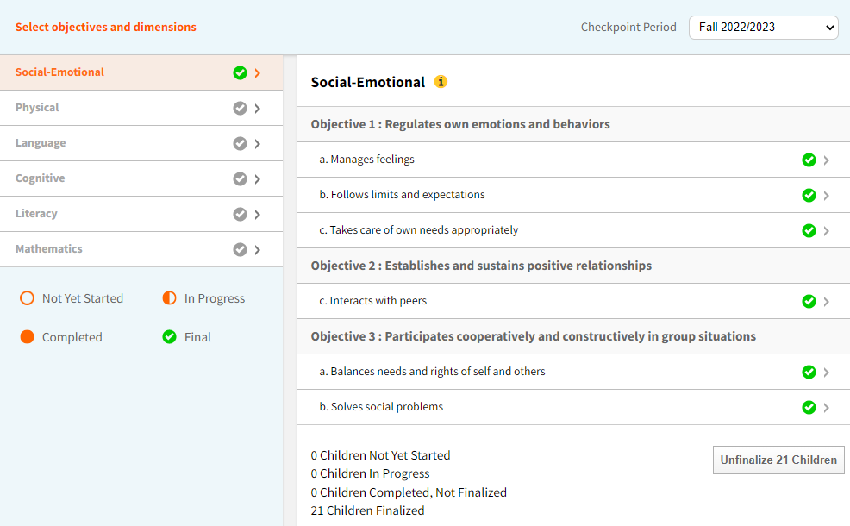
Successful finalization
Notes:
This is what teachers should see after finalizing the class successfully. They will see green check marks for all 6 domains as you can see in the yellow box.

Slide 9
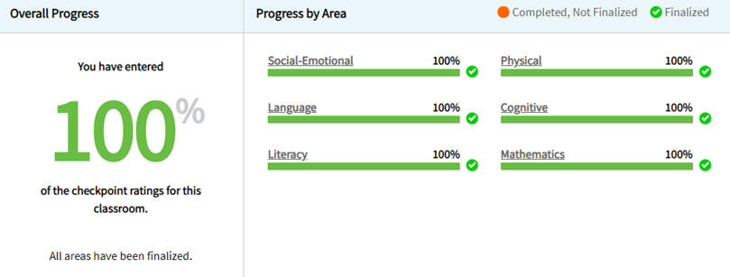
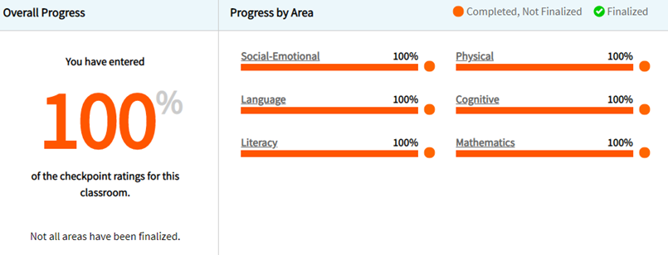
Final vs Not finalized
100% finalized | Not finalized
Notes:
The one on the left with green is what you should see after all teachers and schools have successfully finalized.
If you see 100 % in orange, that means all necessary data has been entered but the teacher didn’t hit that finalize button. All they need to do is just a click.

Slide 10
Impact of Transition to Kindergarten (TK)
Districts with TK: you may not see 100% completion.
It is important to know which schools and teachers are responsible for TK.
Let admins and teachers know when TK data is due.
Include ‘TK’ as part of the class name.
Change to blue color band for all TK students.
If teachers are responsible for the task, check out this support article to update the color band for each child.
If administrators are responsible for the task, check out this support article to update the color band for each child.
Notes:
Presenter: Yoona
This is an important item for districts with TK. Because TK may have different program start date than the rest of your full day kindergarten classes, TK checkpoint may be at a later date than November 15, which is the checkpoint for all full day, regular kindergarten classes. Remember the TK survey you filled out that gave you the TK checkpoint date? That’s the date your TK teachers need to finalize their data by, unless you have communicated that they also need to finalize by November 15.
When you look at the assessment status report to track progress, you may not see 100% completion. It is because TK is included there. This is why it is extremely important that you communicate with building admins that they don’t misunderstand when they look at the assessment status report. Please communicate with admins and teachers that all full day, regular kindergarten classes must finalize their data by November 15. then, help them understand when their TK data is due and teachers finalize their data by that date.
Make sure the class name for TK classes in the MyTeachingStrategies platform includes ‘TK’ as a part of it. Without this, we can’t do much other than considering the district incomplete if they don’t show 100%.
Also, ensure all TK students have the blue band associated with them. The blue band is for 4 year olds and each individual child record must be associated with the right color band for reports to show what’s appropriate for that age. If TK students are associated with the purple color band, which is for 5 year olds, then the data will be compared to what’s appropriate for 5 year olds and everything will be off.

Slide 11
TK Reminders
Please fill out the survey for us if you haven’t yet.
Changes to your plan? Please fill out the survey again or email Yoona.park@k12.wa.us
TK WaKIDS data is due 10 weeks from the program start date.
Please report correct TK enrollment data in CEDARS.
Program code 67.
TK is a separate grade level in P223 reports. If you have questions about this, please reach out to Becky McLean
becky.mclean@k12.wa.us
Notes:
Presenter: Yoona
If you still have not submitted your TK survey response, please do so at your earliest convenience. This will give you the exact date when your TK WaKIDS data is due. Also this is to let us adequately plan for your number of portfolios. Also, if there are changes to your TK plan, please submit a response to the survey with the new information or email me with the same information. Then I will update them. All TK WaKIDS data is due 10 weeks from the program start date.
Please also correctly report TK numbers in CEDARS. The program code for TK in CEDARS is 67.
TK is a separate grade level in P223 reports. Reach out to Becky if you have any questions about this.

Slide 12
Select Assessments

Slide 13
ELP Assessment Update
Notes:
Districts have done an amazing job this year and you all have overcome so much and in the middle of it all you also have adapted to a new test, new standards, and a new system for testing your multilingual learners and you have been so successful. Thank you for all your hard work and time and patience. Over 95 thousand students have completed testing and 85 percent of our online testing is complete. You and your teams have done excellent work.

Slide 14
WA-AIM

Slide 15
Technology

Slide 16
Strikethrough “Bug” Known Issues
Cambium has identified and is working to resolve an issue with the strikethrough feature in the updated practice and training tests that were rolled out for the school year 2023–24.
Notes:
Strikethrough in Practice and Training Tests
Cambium has identified and is working to resolve an issue with the strikethrough feature in the updated practice and training tests that were rolled out for the school year 2023–24. This issue is occurring in all non-secure and secure browsers. Rather than putting a line through the option in the answer as expected, the line is either appearing underneath the text or the line shifts. If you believe this might be distracting to students, we suggest that you turn off the strikethrough tool in the test tools and settings.

Slide 17
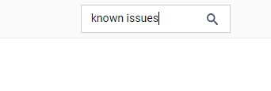
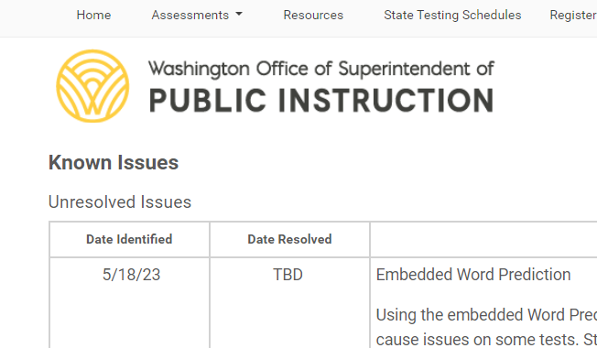
Finding the “Known Issues” on the WCAP Portal
Home => Search => Known Issues
Bookmark the Known Issues page
Register for Email Updates

Slide 18
Cambium's new version of Secure Browser
At the end of this month, Cambium will be releasing a new Secure Browser version (16.5) for macOS13 and macOS14. This browser must be downloaded and used by all students testing on macOS14 devices for the 2023–2024 school year.
Notes:
At the end of October, Cambium will be releasing a new Secure Browser version (16.5) for macOS13 and macOS14. This browser must be downloaded and used by all students testing on macOS14 devices for the 2023–2024 school year.
If you have already downloaded and installed the earlier version of macOS Secure Browser 16.0 and using macOS13 devices, you do not need to re-install this update. Devices with macOS11.6+ Big Sur or 12.6+ Monterey are not impacted.
If your school is administering Smarter Balanced Interim assessments during October on macOS14 devices, you can continue to use the Secure Browser version (16.0) that is available on the portal.

Slide 19
DRC/WIDA: iPad Secure Application Update Required
The newly released iOS version 17 contains a AutoFill feature that potentially affects writing responses in DRC INSIGHT
Feature allows a student to "click and hold" in order to automatically fill contacts or passwords into the Writing response area
New version release tonight of the DRC INSIGHT iPad Secure Application (14.1) which will disable the iOS AutoFill feature
Additionally, on the evening of October 26, 2023, DRC will force this update on iPad devices and sites will only be able to test on iPad devices if they are running version 14.1. No other testing device type will receive an update. The issue and resolution is specific to iPad devices only

Slide 20
Assessment Development

Slide 21
Student Groups vs Rosters
Student Groups
Used for SRS purposes.
Must upload in SRS.
Used to assign students to TAs (classroom teachers) so that teachers can see student test scores:
Individual scores
Target Reports
Rosters
Used for optional TIDE purposes.
Upload in TIDE.
Used to print student test settings and student test tickets by roster. Other option is to print by student list.
Students do not need to be in a roster to take a test.
Notes:
Presenter: Kara
Let’s start our little SRS refresher with the fact that Student Groups and Rosters are not the same thing. You might try to keep them in sync, and there are good reasons for that, but they have different uses and purposes. When we get questions about “rosters in SRS” we always ask for clarification.
First, Student Groups are used for SRS purposes only.
Rosters are used for optional purposes in TIDE that can support test administration using the Secure Browser.
Second, Student Groups must be created in a csv file and must be uploaded into SRS.
Rosters can be created either within TIDE or with an excel file that is uploaded into TIDE.
Student Groups in SRS do not become rosters in TIDE, and rosters in TIDE do not become student groups in SRS. They must be created and uploaded separately.
Third, Student Groups are used to assign students to TAs so that TAs can see student test scores in SRS. This is how TAs see individual student scores, and how TAs can look at Target Reports for their group as a whole.
The Rosters created in TIDE are can be used to print lists of student test settings, and to print student test tickets by roster. There is another option….that information can be printed by student list. This is one of the reasons why we say Rosters in TIDE are optional.
The last thing to note about Rosters in TIDE is that students do not need to be assigned to a roster in order to take a test in the Secure Browser. This is one of the reasons we can say that rosters in TIDE are optional.

Slide 22
Resources
Student Groups
https://www.youtube.com/watch?v=-FYIgEhP6AM
SRS Introductory Guide available in WCAP Portal https://wa.portal.cambiumast.com/resources/srs/srs-smarter-reporting-system-introductory-guide
Rosters
TIDE User Guide, p. 26-29, available in WCAP Portal https://wa.portal.cambiumast.com/resources/user-guides/tide-test-information-distribution-engine
Notes:
Presenter: Kara
If you need help with how to create Student Groups in SRS, please watch the YouTube training video and read the SRS Introductory Guide, both of which are linked in the WCAP Portal.
If you need help with creating Rosters, pages 26 though 29 of the TIDE User Guide, which is also in the Portal, has directions for you.
Please review these resources before reaching out to the CAI Helpdesk for assistance.

Slide 23
Groups View vs School View
Groups
Only view TAs (classroom teachers) have.
See results for group, e.g.:
Individual scores
Target Reports (summative)
By Item/Distractor (interim)
Can be seen by other users who have student groups assigned
School
View IS, SC, DA, DC roles have.
See results for entire grade level at the school, e.g.:
Individual scores
By Item/Distractor (interim)
These users must use Custom Aggregate Reports for Target Reports.
Notes:
Presenter: Kara
Another thing we’ll often ask for clarification about is whether you are looking at a Groups View or a School View when asking questions about SRS.
These two view were created with two different kinds of users in mind.
First, the Groups view was created with the Teacher in mind. We usually give teachers the TA role. For this role, the Groups view is the ONLY view the TA has. When a TA clicks on a group name from their home screen, they are taken to the Group view screen. Here they can see individual scores for the groups of students who have been assigned to them on the chosen test. For those students, TAs can see things like Target Reports for summative tests and things like distractor analysis for interims.
The School view was created with the school and district-level users in mind. These are the IS, SC, DA, and DC roles in TIDE. When these users choose a school and a grade level on their home screen, they are taken to the School view screen. Here they can see individual scores for all students in the school, in that grade level, on the chosen test. For the students at this school, the school-level and district-level users can see things like distractor analysis for interims. But…they can’t get Target Reports for the school on this screen. (These users have to use the Custom Aggregate Reports for school-level target reports or district-level target reports.)
So, those are the two distinct views that were created for SRS.
Then, in practice, things got complicated. They got complicated when you assigned student groups to users other than TAs. [click]. Because now, these school-level and district-level users have two different ways to see student results.

Slide 24
How can I tell which view I am in?
Notes:
Presenter: Kara
So, how can those users tell which view they are in? Look at the top of their screen.
The Groups view—shown on the top left of this slide--helpfully says “Groups” at the top three times. It then lists the group name, the school year, and the advanced filter.
The School screen—shown on the bottom right of this slide--has the name of the school repeated three times on the screen. Then it lists the assessment grade level, the school year, and the advanced filter.
When you try to help your users, and when you contact the CAI Helpdesk, please be clear in your communication about which view you are looking at that is causing issues.
[NOTE from a question during the webinar: If the user wants to see scores from a previous school year for an assigned group, change the School Year drop-down on the Groups screen. That will give you access to assessment scores from the previous school years for that particular group of students.]

Slide 25
FAQ about Uploading 2024 Groups
Q: When can I upload 2024 groups? This menu only lets me choose 2022-23 or 2021-22.
A: This menu is for choosing which groups to view. It does not prevent an upload. Once you upload a group with “2024” in the school year column, this menu will give you 2023-24 as an option.
Notes:
Presenter: Kara
Another really common question we get at the start of the year is about this screen. The user asks some version of, “When can I upload groups for this year? This menu only lets me choose the previous school years.”
The answer is that what is showing in this drop-down menu will not prevent you from uploading groups for the current school year. This menu is for choosing which year of groups to manage. If you haven’t uploaded a current year student group, there are none for you to manage. Ignore the menu for now, click on the blue Upload Groups button, and upload a group with the spring testing year in the school year column. Then, once you upload a group with 2024 in that column and return to this screen, the 2023-34 option will be available.

Slide 26
Student Groups for Users with TA role
All 2023 student groups will be deleted evening of November 9.
This only impacts Group views of student results.
This does not impact School views of student results.
Putting students into “2024” groups will allow TAs to see scores from previous school year in both the Groups view and in the individual Student Test History screen.
Notes:
Presenter: Kara
We’ve talked about this since June, and this is your final webinar reminder. All the 2023 student groups will be deleted the evening of November 9. This only impacts Group views of student results. This does not impact School views of student results.
Once you put students into 2024 groups and assign them to a user, the user will be able to see scores from the previous school year.
[NOTE from a question during the webinar: To do this, change the School Year drop-down on the Groups screen. Then you’ll be able to choose assessments from previous grade levels.]

Slide 27
Practice & Training Tests
Available with new SY23-24 tools and supports as of 10/12.
Spanish Text-to-Speech
Spanish Presentation, Switch Between Spanish and English
Notes:
Presenter: Kara
The Training and Practice test were rolled over to SY23-24 on the 12th.
This means that you can finally check to make sure you have the Spanish Voice Packages for the Spanish Text-to-Speech, and you can also see the new default Spanish Presentation of “Switch Between Spanish and English” that we shared about in August.

Slide 28
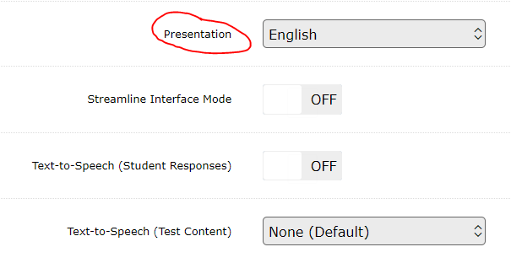
Check for Spanish Voice Package (1 of 4)
Use Guest access to get into the Practice and Training tests.
Pick a Grade level.
Pick a math or science training test.
On the Choose Settings screen, change the Presentation to “Spanish.”
Notes:
Presenter: Kara
To check for the Spanish voice package, use the Guest access to get into a training test. On the Choose Settings screen, change the Presentation to Spanish.

Slide 29
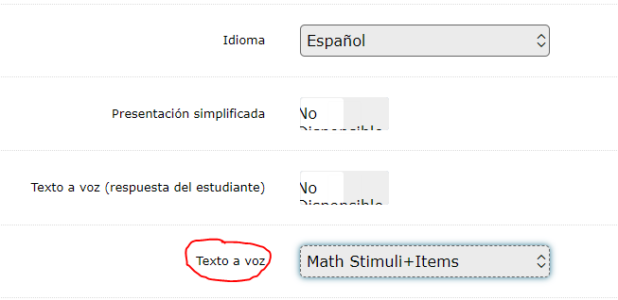
Check for Spanish Voice Package (2 of 4)
Most of the text on the screen will change to Spanish.
Then change the Texto a voz to “Math Stimuli+Items”.
Notes:
Presenter: Kara
Most of the text on the screen will change to Spanish.
Then change the Texto a voz to “Math Stimuli+Items” or “Science Stimuli+Items” if you are in the science training test.

Slide 30
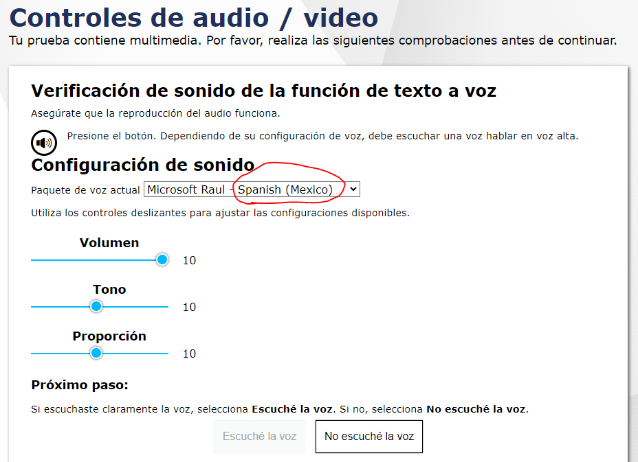
Check for Spanish Voice Package (3 of 4)
Click the green button at the bottom of the screen that says “Seleccionar.”
The next screen is the Audio check and should have your Spanish voice pack listed.
Notes:
Presenter: Kara
Then scroll to the bottom and click the green button.
The next screen is the Audio check and should have your Spanish voice pack listed. If the Test Delivery System does not detect a Spanish voice pack on the device, you’ll get an error here, and won’t be able to go any further.
[NOTE from discussion: There is no specific voice pack from Cambium that needs to be downloaded. Just download one from the device settings.]
If you do see the Spanish voice pack listed….

Slide 31
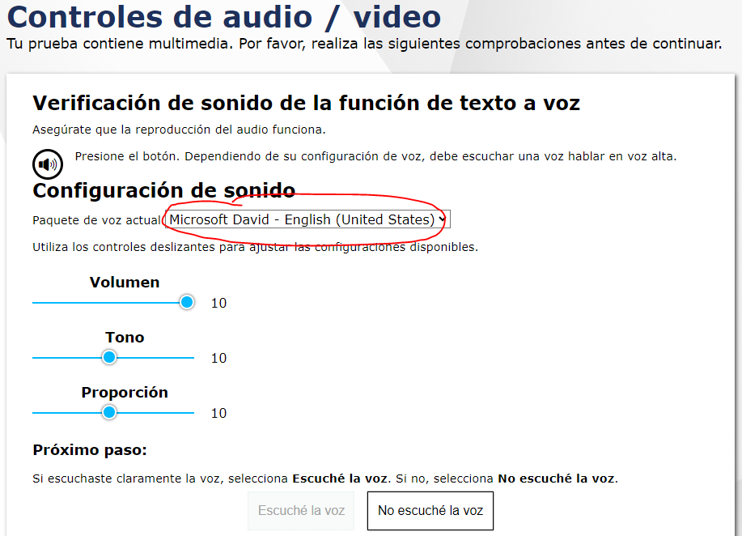
Check for Spanish Voice Package (4 of 4)
Complete the audio check for the Spanish voice with “Escuché la voz” button.
The next screen is a slightly different Audio check and should have your English voice pack listed.
Notes:
Presenter: Kara
….complete the check with the green button. The screen will then shift slightly and you’ll see the English voice pack listed. After you complete that check with the green button, you’ll be able to proceed with the login and begin the training test.

Slide 32
Data

Slide 33
CEDARS and Nightly TIDE Pre-ID Files
CEDARS load job still hitting snags, file queue still backlogged
TIDE pre-ID job now running at 7:30pm, loading successfully by roughly 8am, but “a day behind”
TIDE pre-ID job includes all records added through WAMS during the day
TIDE bulk upload in WAMS available to districts – short term solution for interim assessments until CEDARS stabilizes

Slide 34
Assessment Operations

Slide 35
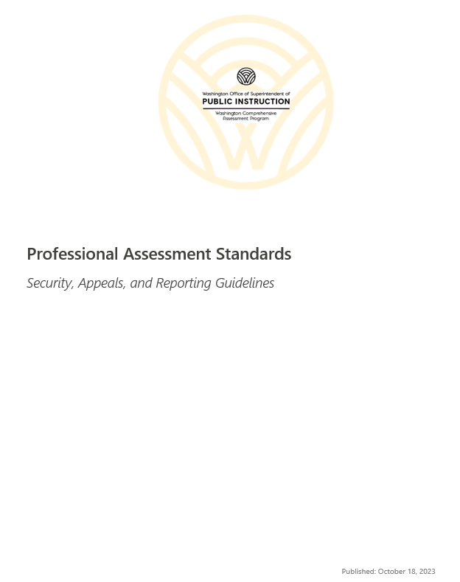
Document formerly known as the PIRG
The document formerly known as the PIRG is now the Professional Assessment Standards and is posted to the Portal.
The Test Coordinators Manual (TCM) has also been posted to the Portal.
Notes:
Presenter: Christopher
The document formerly known as the PIRG is now the Professional Assessment Standards document. Many updates have been made to the document. We will go over some of them in the next few slides. Also, the TCM has been posted.

Slide 36
Test Refusals
OSPI does not collect information from the school district about students or families who choose to refuse state assessments.
Your district should adopt its own policy when deciding if, or in what manner, refusals should be tracked.
Notes:
The Professional Assessment Standards Guidelines includes a What’s New section that highlights important changes that were made for the 2024 administration. One of the most frequently asked question last year has been addressed in the guidelines.
Test refusals
OSPI does not collect information from the school district about students or families who choose to refuse state assessments.
Your district should adopt their own policy when deciding if, or in what manner, refusals should be tracked.
In other words, this is a district decision. So, if you feel that you should collect refusals you should, however, if you feel that this information does not help your district you can choose not to.

Slide 37
District Security Reports
District Security Reports for the Smarter Balanced/WCAS administration and all WIDA assessments have been combined. So, there are only three reports total if a district participates in every test administration:
Smarter Balanced/WCAS
WIDA Assessments
WA-AIM
District Superintendent signature no longer required in ARMS.
The reporting deadline has also changed; all reports are due to OSPI no later than July 15, 2024.
Notes:
District Security Reports for the Smarter Balanced/WCAS administration and all WIDA assessments have been combined. So, there are only three reports to be completed if your district participated in every test administration:
Smarter Balanced/WCAS
WIDA Assessments
WA-AIM
The district Superintendent signature is no longer required for submittal of the District Security Report.
The reporting deadline has also changed; all reports are due to OSPI no later than July 15, 2024.

Slide 38
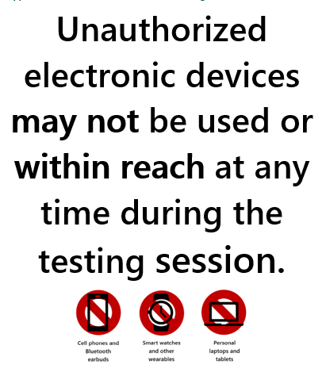
Unauthorized Electronic Devices
New guidance for unauthorized electronic devices.
Access to unauthorized electronic devices is not allowed at any time during the test session. This includes but is not limited to cell phones, Bluetooth ear buds, smart watches, and other wearables, personal laptops, and tablets.
Notes:
We updated the language in the Professional Assessment Standards for unauthorized electronic devices.
Access to unauthorized electronic devices is not allowed at any time during the test session. This includes but is not limited to cell phones, Bluetooth ear buds, smart watches, and other wearables, personal laptops, and tablets.
There is also a new Unauthorized Electronic Device sign to post at testing sites and will be available on the Portal.

Slide 39
Common Incident Protocol Table
The Common Incident Protocol table outlines common incidents that can occur during testing and the corresponding actions to be taken. These incidents may be initiated by student misconduct, adult misconduct, or system issues, and require different levels of response and escalation.
Notes:
A Common Incident Protocol table has been added to the Professional Assessment Standards Guidelines. It outlines common incidents that occur during testing and the corresponding actions that need to be taken. The incidents may be initiated by student misconduct, adult misconduct, or system issues and require different levels of response and escalation.

Slide 40
Checklists for WCAP Test Administration
Checklists for WCAP Test Administration have been updated and are now posted to the portal.
Checklist handouts are available for the following roles:
District Assessment Coordinator
Principal
School Test Coordinator
Technology Coordinator
Special Education and Multilingual Coordinators
Teachers
Test Administrators
Notes:
Checklists for WCAP Test Administration have been updated and are now posted to the portal.
Checklist handouts are available for the following roles:
District Assessment Coordinator
Principal
School Test Coordinator
Technology Coordinator
Special Education and Multilingual Coordinators
Teachers
Test Administrators

Slide 41
Concerning Test Responses
Concerning test response alerts are sent via the TIDE Secure Inbox to only those who have the DC role in TIDE
Alerts for dual enrolled students will go to the DCs for both districts
Notes:
We all take the confidentiality of students' concerning test responses seriously. For this reason, the concerning test response alerts only go to those who have the DC role in TIDE. We want to make sure you are aware that any concerning responses for students who are dual enrolled will be securely sent to both districts. You may need to coordinate with the DC from the other district to determine how to address the situation.

Slide 42
Important Dates for October
Notes:
The important dates and tasks for October are listed here. As a reminder, these calendars are also available in WAMS, in the File Downloads section.

Slide 43
Important Dates for November
Notes:
And here are the important dates for November.

Slide 44
WCAP Contacts
OSPI Assessment Analysts for student data issues:
assessmentanalysts@k12.wa.us 360–725–6109
OSPI Assessment Development for content questions:
ELA and Math assessments: asi@k12.wa.us
Science assessment: science@k12.wa.us
OSPI Assessment Operations for assessment policy and test materials:
Assessment@k12.wa.us 360–725–6348 or 1–800-725–4311
Cambium Washington Help Desk for Technical, Network, and password issues:
wahelpdesk@cambiumassessment.com 1–844–560–7366
WIDA Client Services Center for accounts, assessments, and resources
help@wida.us 1-866-276-7735

Slide 45
Assessments & Student Information

Slide 46
Thank you

