Slide 1
Assessment Update Webcast
SY 2023–24
Update #4
November 15, 2023

Slide 2

11/20/2023
Notes:
Presenter: Leslie
The Office of Superintendent of Public Instruction rests on the ancestral territory of the Coast Salish, Squaxin, Cowlitz, and Nisqually people who have stewarded the land across the generations. OSPI is committed to ongoing partnerships with Tribal governments across Washington, as we work toward the shared goals encompassed in a stronger education for all of our children.

Slide 3

Let us recognize historical and ongoing injustice and hate targeted toward race, culture, religion, gender and gender identity, sexual orientation, disability, and nationality.
Space for Solidarity
Notes:
OSPI recognizes historical and ongoing injustice and hate targeted towards individuals and groups based on their race, culture, religion, gender and gender identify, sexual orientation disability and nationality.

Slide 4
Today’s Topics
  WaKIDS
Fall checkpoint: 11/15
Select Assessments
WIDA
Important Dates
Braille/Large Print
ASL
WA-AIM
No Update
Technology
iPad OS Browser Update 9.0
Windows Secure Browser version 16.0
  Assessment Development
No update
  Data
Upcoming Pre-ID Dates
Upcoming Reporting Dates
  Assessment Operations
Recently Posted Materials
Important Dates for August and September
Notes:
Presenter: Christopher

Slide 5
WaKIDS

Slide 6
Fall Checkpoint: 11/15
Today is the fall checkpoint.
All full-day kindergarten teachers must finalize their data by 9pm today.
TK classes that have later due date may continue to assess until their own deadline.
Connect with individual teachers if they haven't finalized yet.
Notes:
Today by 9pm, all full day kindergarten teachers must finalize their data. If you still have teachers who have not finalized yet, please connect with them and support them to finalize by 9pm so your district is all complete with the assessment.
TK classes with later due date may continue to assess until their own deadline.

Slide 7
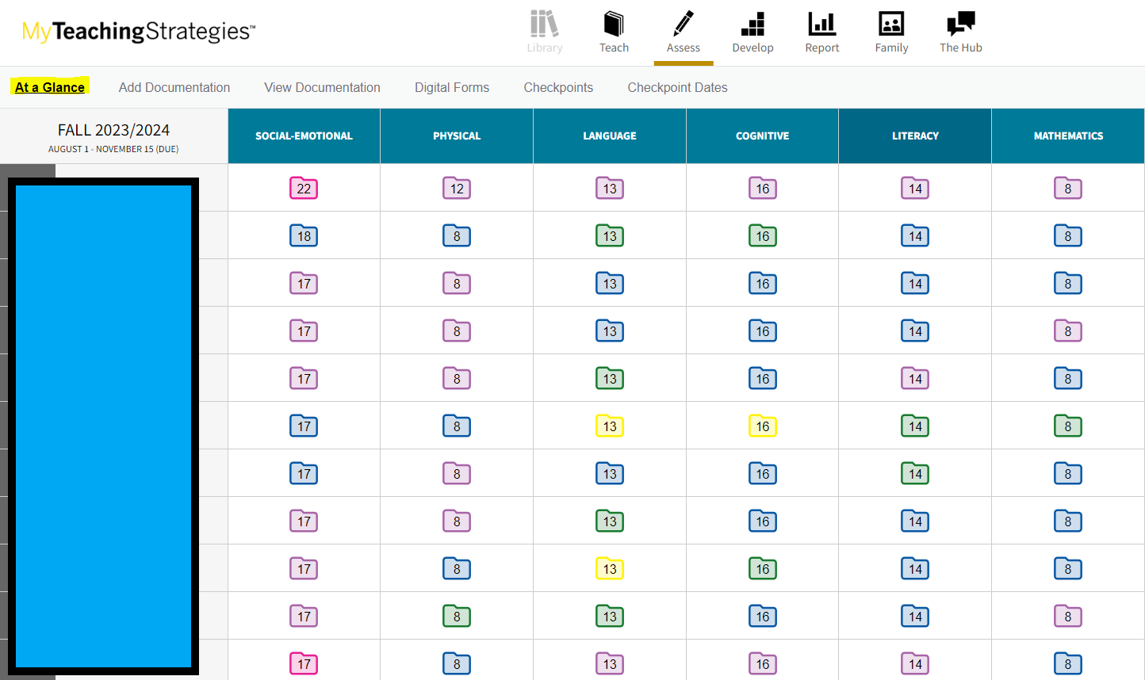
My Teaching Strategies At a Glance
Notes:
One thing users are confused about with the new platform this year is that when they click on Assess at the top, this At a Glance page is the first thing they see. This is not the Checkpoint page. The numbers you see on the slide indicate the number of documentation teachers have uploaded for each child/objective. And colors represent the age/grade band appropriate for those documentation.

Slide 8
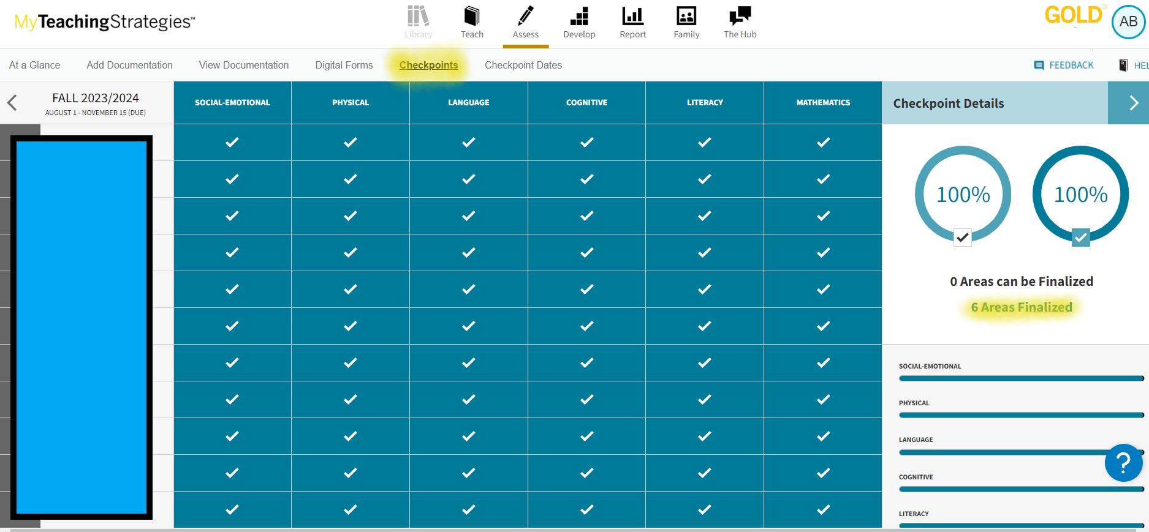
Checkpoint page
Notes:
This is the checkpoint page. This is where teachers assign finalized ratings and actually finalize their data. All the documentation this teacher have uploaded to the platform already assigned preliminary ratings which I will show you on the next slide. This teacher finalized all 6 areas so on the right, it says 6 areas finalized.

Slide 9
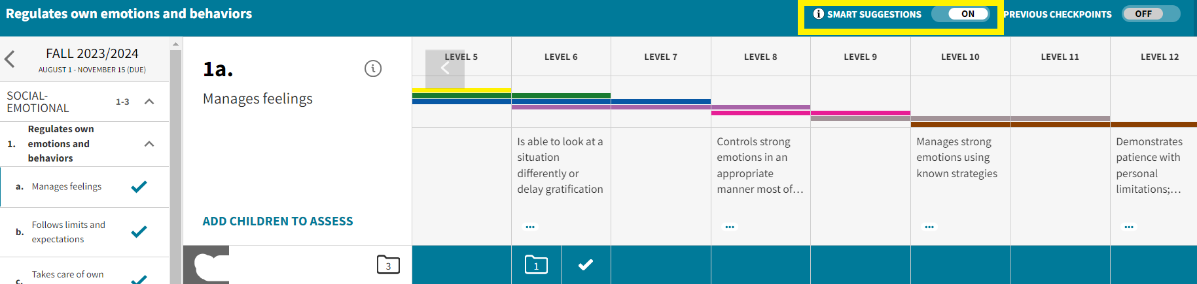
Smart Suggestions
Notes:
When teachers click on an objective for a child, they will see smart suggestions at the top. If it's toggled on, they will see preliminary levels assigned for this objective for this child based on documentation assigned to this child. Then teachers can accept these suggested ratings to finalize or simply assign new finalize ratings and finalize their data.

Slide 10
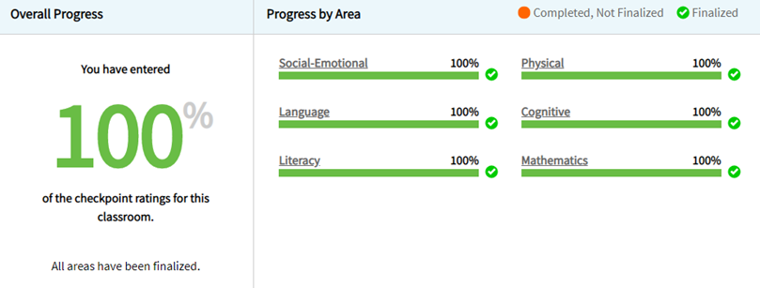
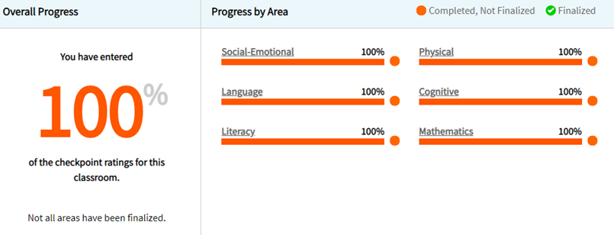
Final vs Not finalized
100% finalized | Not finalized
Notes:
This is a repeat from last month. The one on the left with green is what you should see after all teachers and schools successfully finalized.
If you see 100 % in orange, that means all necessary data has been entered but the teacher didn’t finalize .

Slide 11
Impact of Transition to Kindergarten (TK)
Districts with TK: you may not see 100% completion.
It is important to know which schools and teachers are responsible for TK.
Let admins and teachers know when TK data is due.
Include ‘TK’ as part of the class name.
Notes:
Presenter: Yoona
Also a repeat from last month. This is an important item for districts with TK. Because TK may have different program start date than the rest of your full day kindergarten classes, TK checkpoint may be at a later date than November 15, which is the checkpoint for all full day, regular kindergarten classes. Remember the TK survey you filled out that gave you the TK checkpoint date? That’s the date your TK teachers need to finalize their data by, unless you have communicated that they also need to finalize by November 15.
When you look at the assessment status report to track progress, you may not see 100% completion. It is because TK is included there. This is why it is extremely important that you communicate with building admins that they don’t misunderstand when they look at the assessment status report. Please communicate with admins and teachers that all full day, regular kindergarten classes must finalize their data by November 15. then, help them understand when their TK data is due and teachers finalize their data by that date.
Make sure the class name for TK classes in the MyTeachingStrategies platform includes ‘TK’ as a part of it. Without this, we can’t do much other than considering the district incomplete if they don’t show 100%.

Slide 12
Color band for TK
Change to blue color band for all TK students.
  If teachers are responsible for the task, check out this support article to update the color band for each child.
  If administrators are responsible for the task, check out this support article to update the color band for each child.
  This needs to be done before teachers enter data.
If there is data already?
  Search for my email
    Subject: Blue/ PK-4 band for TK
    Date: Monday 11/13 around 5:17pm
    Sent to DACs and TK contacts
Notes:
Ensure all TK students have the blue band associated with them. The blue band is for 4 year olds and each individual child record must be associated with the right color band for reports to show what’s appropriate for that age. If TK students are associated with the purple color band, which is for 5 year olds, then the data will be compared to what’s appropriate for 5 year olds and everything will be off. Changing the color band needs to be done before teachers enter any data.
However, if there is data already, then two things need to change to correctly implement the right color band. Search for my email for instructions and links.

Slide 13
Select Assessments

Slide 14
ELP Assessment Update
Notes:
Districts have done an amazing job this year and you all have overcome so much and in the middle of it all you also have adapted to a new test, new standards, and a new system for testing your multilingual learners and you have been so successful. Thank you for all your hard work and time and patience. Over 95 thousand students have completed testing and 85 percent of our online testing is complete. You and your teams have done excellent work.

Slide 15
Important Dates for WIDA Annual Testing
December 8. Make sure students’ EL status is accurately represented by the data in CEDARS. (Do this every day, but especially December 8).
January 4. Student Management opens in WIDA-AMS
January 19-22. Districts receive initial materials
January 19-March 15. Additional materials ordering window is open.
January 29 – Testing begins
March 22 – Testing ends
April 2- Shipping deadline for USP pick up.

Slide 16
Braille and Large Print
OSPI contracts with ELPA21 for Braille and Large Print annual assessments.
To make sure we have materials for your student:
  Request materials in the fall (ELPAssessments@k12.wa.us).
    SSID
    Grade level
    Test (Regular or Alt)
    Shipping address
  Sign and return NDA to OSPI (TAs, SCs, DCs)
  OSPI will ship your materials when they arrive
For student taking Alt ACCESS, OSPI has a supplement to accompany the assessment for students who are visually impaired or blind. Districts must email ELPAssessments@k12.wa.us to get the supplements.
Notes:
OSPI contracts with ELPA21 for Braille and Large Print annual assessments.
To make sure we have materials for your student:
Request materials in the fall (ELPAssessments@k12.wa.us).
SSID
Grade level
Test (Regular or Alt)
Shipping address
Sign and return NDA to OSPI (TAs, SCs, DCs)
OSPI will ship your materials when they arrive
For student taking Alt ACCESS, OSPI has a supplement to accompany the assessment for students who are visually impaired or blind. Districts must email ELPAssessments@k12.wa.us to get the supplements.

Slide 17
Students who Sign
To provide a more complete picture of students’ language development and their ability to access grade level content and instruction, OSPI has decided to allow ASL use in the delivery of Listening and Speaking domain items for students who sign.
This process requires:
  ASL interpreters to be trained as the test administrator
  TAs who use sign must attend a Zoom meeting with OSPI prior to administering the test (late January) and a focus group after testing (late March)
  Students must test on paper (all domains)
Notes:
In previous years, OSPI has recommended exempting students who are Deaf from the listening and speaking domains. However, we are changing course in recognition that students who are Deaf have a full communication system that integrates English and ASL. These students need to develop both components of their communication system in order to full access instruction and content at grade level and it is in their best interest that schools and districts are able to explore a fuller picture of where support may be needed.
Beginning in 2024, OSPI will support students who use sign as a component of their communication system to complete the listening and speaking domains using ASL. To do this, these students must complete the full paper test. And interpreters must complete WIDA ACCESS paper training to deliver the test items and score the speaking domain. In January, after materials have been received by districts, ASL interpreters who will deliver the WIDA ACCESS test will need to attend an online video conference to explore standard delivery and answer question.
If your district has a student who will need ASL assessment delivery, please notify OSPI before December 1 with contact information for the person in your who will need to attend the Zoom meeting in January.

Slide 18
WA-AIM

Slide 19
Technology

Slide 20
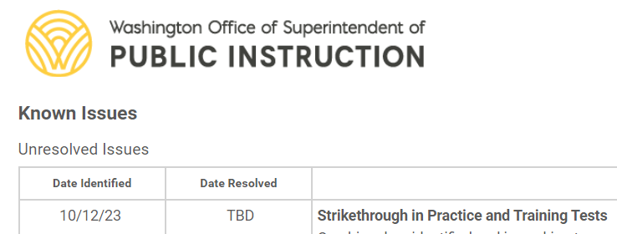
New Resource: Known Issues Page
The Known Issues page is a new resource available on the WCAP portal for SY23-24
The Unresolved Issues table lists and describes known technical issues being addressed by Cambium and provides workarounds
Once resolved, issues are moved to the Resolved Issues table and kept there for the duration of the school year

Slide 21
Assessment Development

Slide 22
Data

Slide 23
Upcoming Pre-ID Dates
WIDA Pre-ID Extract:
  Dec 8 Last Opportunity to update CEDARS data
  Extract delivered to DRC following week
  WAMS>Pre-ID>ELP Assessment>WIDA Pre-ID Student List
WA-AIM Pre-ID Process
  Spring Alternate Assessment Registration open in WAMS
  Records in INSIGHT beginning 29 January
Both use program eligibility data from CEDARS

Slide 24
Upcoming Reporting Dates
English Learner Progress currently on State Report Card
SGP on Report Card early December
WaKIDS Fall Checkpoint:
  Data to OSPI December 4
  Data posted to WAMS December 18 (tentative)
  Data posted to Report Card 2nd week of January (tentative)

Slide 25
Assessment Operations

Slide 26
Recently Posted to the Portal
  The following documents have recently been posted to the WCAP portal:
  Technology Requirements for Online Testing Module
  Test Administrator Interface for Online Testing Module
  AVA- Assessment Viewing Application Training Module
  SRS- Smarter Reporting System Introductory Guide
  Assistive Technology Manual
  Coming Soon:
  2024 Test Administration Manual (week of 11/20)
  2024 Forms and Reports (week of 11/27)
Notes:
Presenter: Jenna
The following documents have recently been posted to the WCAP portal:
Technology Requirements for Online Testing Module
Test Administrator Interface for Online Testing Module
AVA- Assessment Viewing Application Training Module
SRS- Smarter Reporting System Introductory Guide
Assistive Technology Manual
Coming Soon:
2024 Test Administration Manual (week of 11/20)
2024 Forms and Reports (week of 11/27)

Slide 27
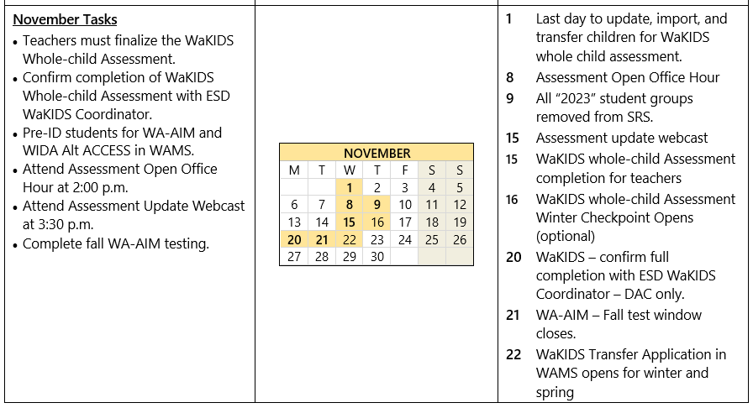
Important Dates for November
Notes:
Presenter: Jenna
These are the important dates for the month of November.

Slide 28
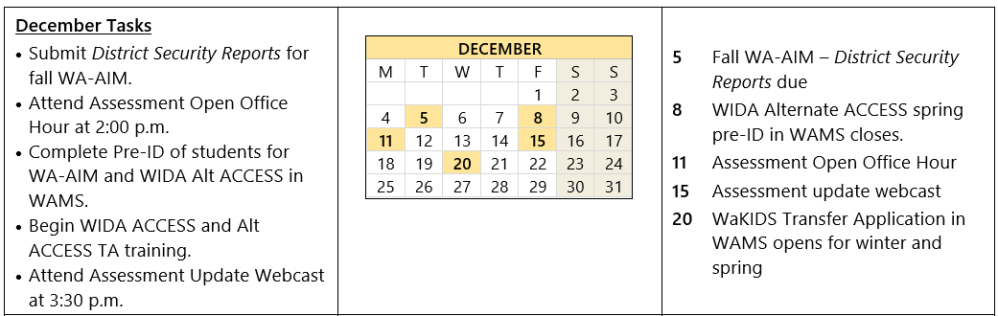
Important Dates for December
Notes:
Presenter: Jenna
And here are the important dates for December.

Slide 29
WCAP Contacts
OSPI Assessment Analysts for student data issues:
  assessmentanalysts@k12.wa.us 360–725–6109
OSPI Assessment Development for content questions:
  ELA and Math assessments: asi@k12.wa.us
  Science assessment: science@k12.wa.us
OSPI Assessment Operations for assessment policy and test materials:
  Assessment@k12.wa.us 360–725–6348 or 1–800-725–4311
Cambium Washington Help Desk for Technical, Network, and password issues:
  wahelpdesk@cambiumassessment.com 1–844–560–7366
WIDA Client Services Center for accounts, assessments, and resources
help@wida.us 1-866-276-7735

Slide 30
Assessments & Student Information
Ospi.k12.wa.us

Slide 31

Thank you

