Slide 1
Assessment Update Webcast
SY 2023–24
Update #8
March 20, 2024

Slide 2
Land Acknowledgment
Notes:
Presenter: Leslie
The Office of Superintendent of Public Instruction rests on the ancestral territory of the Coast Salish, Squaxin, Cowlitz, and Nisqually people who have stewarded the land across the generations. OSPI is committed to ongoing partnerships with Tribal governments across Washington, as we work toward the shared goals encompassed in a stronger education for all of our children.

Slide 3
Let us recognize historical and ongoing injustice and hate targeted toward race, culture, religion, gender and gender identity, sexual orientation, disability, and nationality.
Space for Solidarity
Notes:
OSPI recognizes historical and ongoing injustice and hate targeted towards individuals and groups based on their race, culture, religion, gender and gender identify, sexual orientation disability and nationality.

Slide 4
Today’s Topics
WaKIDS
No Update
Select Assessments
WIDA
Alternate ACCESS Speaking Domain
Test Window Closing
Data Validation
Results
Lunch with Leslie
Survey
WA-AIM
New WA-AIM Coordinator
Assessment Development
G11 WCAS Participation Tips
New Video Resources
Length of Tests & Preparation
Smarter Reporting System
Check Participation
Data
Pre-ID Reminders
Testing Progress Dashboard and SRS
Assessment Operations
Important Dates for March and April
Notes:
Presenter: Christopher

Slide 5
WaKIDS

Slide 6
Select Assessments

Slide 7
ELP Assessment Update

Slide 8
Alternate ACCESS Speaking Domain
Please double check your Alternate ACCESS tests, particularly in grades K-5.
WIDA has found that the new format has resulted in a large number of TAs bubbling in multiple scores for speaking items. Please make sure that no items have more than one bubble filled in. If you run across tests with more than one bubble filled in on a Speaking domain item, please check with the TA to select one and erase the other fully.

Slide 9
Test Window Closing
WIDA Testing Window: March 22
Additional Materials: Closed
Materials Return: March 29
UPS must PICK UP materials by March 29 so they are included in the regular scheduled scoring process.
For those tests not picked up by March 29, there will be no opportunity for data validation.
If you need yellow district labels email ELPAssessments@k12.wa.us. TODAY to request these. They must be mailed and will not arrive in time to meet the materials return date after today.
Notes:
The test window for ELP testing will close on March 22.
Additional materials can no longer be ordered.
Materials must be returned to DRC by March 29. That is, the materials must be picked up by UPS in order to be included in the regular scoring process. Materials that are not picked up by this date will not be included in data validation.
If you need yellow district labels, please order those today to ensure they arrive in your district in time to ship your materials by March 29.

Slide 10
Data Validation
WIDA Webinar: Available on the WIDA Secure Portal under “Webinars”
Pre-Reporting Data Validation: April 24 to May 2
Post-Reporting Data Validation: June 10 to June 24
Why?
Ensure all tests for a student are on a single student record. Pay special attention to grade 1-3 student records.
Ensure data is accurate and complete.
Notes:
Data validation is a process we do in WIDA AMS to ensure that data is accurate, and that all a students' tests are connected to a single testing record. The most common corrections made in data validation combine early grade writing tests with the online testing record.
Data validation may be done by the DAC or a team of folks in the district, but DACs will have the permissions automatically set in WIDA AMS and will have to share that permission if others will be participating.
Any corrections or adjustments made in the first window will be displayed on results in WIDA-AMS and on paper score reports. Changes made in the second data validation window will only be reflected in the WIDA AMS results.
The biggest thing you are looking for in data validation is duplicate records. This mostly happens in grades 1, 2 and 3 when the writing booklet bubbles don’t exactly match the WIDA AMS record.
WIDA has a recorded webinar about data validation on the WIDA Secure Portal. OSPI will review data validation at the April 22 Lunch with Leslie.

Slide 11
Results
Scores available in WIDA-AMS: May 20
Score reports available in district: June 10-12
Score Interpretation Guide: ACCESS https://wida.wisc.edu/sites/default/files/resource/Interpretive-Guide.pdf
Score Interpretation Guide: Alternate ACCESS https://wida.wisc.edu/sites/default/files/resource/Alt-Interpretive-Guide.pdf
Notes:
Scores for WIDA ACCESS will be available in WIDA AMS on May 20 and on paper in districts around June 10.
Please note: Alternate ACCESS results will not be available until later in the summer or early fall. WIDA will be running some standard setting activities this summer on the new test and that will delay results. If you have some exceptional educators who have experience with multilingual learners who participate in this test, WIDA is still looking for representatives from WA to participate in these standard setting activities. Please contact Leslie directly if you would like information about applying to participate.

Slide 12
Lunch with Leslie
Zoom Link: https://us02web.zoom.us/j/83455690961
No Lunch with Leslie on April 1, May 27, June 3, and June 24
Key topic: Data Validation (April 22)
Key topic: Score Reports (May 15)
Anyone with questions about WIDA assessments, processes, etc. Are welcome to join Lunch with Leslie.
Notes:
Lunch with Lesile is an opportunity at noon on Mondays to ask questions and recieve updates about WIDA testing and testing processes. We do have some key topics coming up on Lunch with Leslie. Data validation and score reports will be dedicated sessions. We will have four days this spring when Lunch with Leslie will not happen. Those are noted on the screen. Please do join us other days to ask questions or get ideas and updates.

Slide 13
Survey
Post Administration Survey went out on Monday.
This survey is used for
Advocating for improvements with WIDA and DRC
Prioritizing internal OSPI activities and projects
Anyone involved in WIDA testing is welcome to participate in the survey
Appreciate your help in connecting individuals with the survey
Link: https://survey.alchemer.com/s3/7265748/WIDA-Annual-Assessments-Post-Test-Administration-Survey-2023
Notes:
The post administration survey is available now through April 12. Please take a few minutes and give us some feedback so we can prioritize the things that will be most useful to you as we move forward.

Slide 14
WA-AIM

Slide 15
New WA-AIM Coordinator
On March 1, Leslie Huff, Ph.D. took over responsibilities associated with WA-AIM. Please update your contacts to reflect this change:
Leslie's contact information: leslie.huff@k12.wa.us
The DRC Help Desk is also a great resource for answering questions about where to find things and how to do things in the DRC Insight platform.
OSPI WA-AIM Website: https://ospi.k12.wa.us/student-success/testing/state-testing/assessment-students-cognitive-disabilities-wa-aim
Notes:
Leslie Huff recently took over responsibilities for supporting WA-AIM at OSPI. Leslie's contact information is on the screen. Information about WA-AIM is available from DRC's helpdesk as well as the OSPI website.

Slide 16
Assessment Development

Slide 17
Tips to Increase G11 WCAS participation
Message to families regarding the importance about test scores for school ranking/reports a la Zillow, etc.
Create a designated schedule using their Advisory period, expand it to be 2 hours for the 11th graders and then release them back to classes as they finished.
If you have other tips, please email Jacob Parikh (jacob.parikh@k12.wa.us)
Notes:
Presenter: Toni

Slide 18
New Resource Videos Posted
Demonstration: Spanish Presentation and Spanish Text-to-Speech
ASL Test Directions Informational Session
Location:
Accessibility Supports task, in the General Information tab list
Notes:
Presenter: Toni

Slide 19
Length of Tests
Science summative tests are the same blueprint (same test length) as spring 2018, 2019, 2022, and 2023 tests.
ELA and math summative tests are the “Adjusted Smarter Balanced blueprint.” This blueprint is…
The same blueprint (same test length) as spring 2022 and 2023 tests.
Shorter than the spring 2015-2019 tests.
What is “shorter” or “adjusted” for ELA and math?
The CAT section in the adjusted blueprint is half the length of the CAT section in the full blueprint.
Adjusted = about 20 questions; Full = about 40 questions
The PT section is the same in both blueprints.
Notes:
Presenter: Kara
Around this time of year we get questions about the length of the tests.
The WCAS test is the full-length test, the same we used in spring of 2018, 19, 22, and 24.
The Smarter Balanced tests us the “Adjusted” blueprint. This is the same blueprint we used in spring 22 and 23, but shorter than the test we used pre-pandemic. The 2015-2019 tests are now called the “full blueprint”
This shorter or adjusted blueprint has a computer adaptive test section that is about half the number of questions as that section has in the full blueprint. But the performance task section is the same.
I have linked to where those blueprints are located within the slides.
https://wa.portal.cambiumast.com/resources/wcas-test-design-folder/wcas-test-design
https://portal.smarterbalanced.org/library/en/elaliteracy-adjusted-blueprint.pdf
https://portal.smarterbalanced.org/library/en/mathematics-adjusted-blueprint.pdf

Slide 20
Math Practice PT: Highly Recommended
Math Practice PT has almost all the online features available to try out.
….has similarities with ELA and science test format.
Testing times on summative math PTs is really low. As low as 6 minutes for some students.
The percent of short answer questions hand-scored as “blank” is really high. As high as 30% for some questions.
In the adjusted blueprint, the Math PT contributes about 23% of the items to the student’s overall score.
Notes:
Presenter: Kara
The realities of the adjusted blueprint, along with a few other factors, have led us to highly recommend the use of the Math Practice PT.
First, the math practice PT contains almost all the online features available. By that I mean that all the Universal Tools, all the Designated Supports, and most of the Accommodations are available to be tried and used in the math practice PT.
Second, The math PT has a stimulus on the left and a collection of items on the right. The stimulus needs to be read in order to answer the questions. This is just like ELA and science. So, for students who’ve tested in previous grades, this is a great refresher of the setup and features. [click]
Third, the testing time for the math PTs is really low. Some students are spending as little as 6 minutes on it. [click]
Fourth, when we look at the hand-scoring statistics for the short answer questions that are included in the math Performance Tasks, the percent of blank responses are very high. As high as 30% of the responses are blank. You might ask “but, the secure browser makes them answer every question, how can an answer be blank?” The student can put their cursor in the response box and either type dot dot dot, or space space space, and the secure browser will accept that as an answer. When those get to human scorers, the responses get marked as “blank” and earn zero points. In my experience with handscoring statistics, blank rates this high tell us a few things…one of the clearest is that students are NOT familiar with this type of question and don’t know how to go about solving it. That also contributes to the small amount of time they are spending on the PT. Students could greatly benefit from their teacher showing them the math practice PT on a screen and working through it as a class or in small groups. [click]
Now let’s put that together with the information about the adjusted blueprint. If the CAT has about 20 questions, and the PT has about 6 questions, the PT contributes about 23% of the items used to calculate the student’s overall score.
If we could get more students familiar with approaching math situations like those presented in the performance task, we might see some increases in time spent on the PT, some reductions in blank responses, and some improvement in overall scores.
My final thought about this: students should be engaging with multi-step mathy situations in more that just the summative test. I hope that educators will be inspired by the situations in the math PTs and look for additional ways to engage students in putting math into practice in the real world.

Slide 21
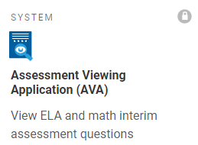
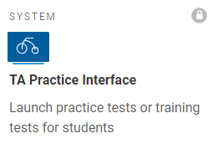
Prepare with Purpose!
Remind students of various item types.
Project an ICA from AVA onto a screen and have group discussions about how to answer different types of items. (You can skip items in AVA.)
Have students practice login process.
Use the TA Practice Interface and the Secure Browser. Start a training test.
Use the WCAS training test for grades 5, 8, and 11.
Locking items are unique. Most other tools/features will be in other tests.
Notes:
Presenter: Kara
A few other thoughts about test preparation.
Choose the method/preparation tool that best matches your purpose.
A really quick tool that can be used to remind students of how various item types function is AVA. An Interim Comprehensive Assessment will have the most variety of item types, and questions can be skipped in AVA of you’ve already discussed that item type.
If the goal is to have students practice the login steps for the secure browser, teachers can use the TA Practice Interface to set up a training or practice test. Using the TA Practice Interface can also help avoid mistakenly giving the summative test.
If students are in grades 5, 8, or 11, we also highly recommend that they do the WCAS training test. Like the math PT, all of the Universal Tools and Designated Supports will be available, as well as most Accommodations. The locking items in the WCAS are unique to the WCAS, so students need to know how those function.

Slide 22
Preparing for Tests
Training tests: Shorter than the summative tests.
Practice tests: Longer than the summative tests.
Interim Comprehensive Assessments (ICAs): “CAT” section is longer than the summative CAT; PT section is the same length as the summative PT. Must take both sections to generate a score.
Interim Block Assessments (IABs): PTs are same length as the summative PT.
Focused IABs: really focused on a particular concept.
Assessment Viewing Application (AVA): review the interim before you give it to students; work on interim as a class/group.
Notes:
Presenter: Kara
There are lots of systems and assessments available to help prepare students for tests. I’ve put a few things to remember about each of them on the screen.

Slide 23
Avoid over-testing
Example of over-testing: giving an ICA this week and the summative next week. This is more likely to fatigue students than to prepare them.
Notes:
Presenter: Kara
Lastly,
Please avoid over-testing. We track interim usage over time and always see a huge use of interims in April and May. Please encourage educators to be thoughtful about the use of interims after spring break—will you actually have time to deliver more instruction to improve student learning if you give an ICA this week and the summative test next week?

Slide 24
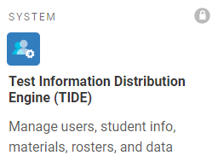
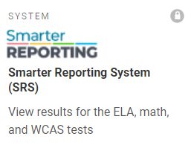
#1 Request About SRS
Version 1: Can the rosters we put in TIDE flow automatically into SRS?
Version 2: Why don’t the TIDE rosters go directly to SRS?
Version 3: Please change SRS so the TIDE rosters become the student groups in SRS.
Notes:
Presenter: Toni
It’s coming to the time of year when the #1 request we hear for SRS, the Smarter Reporting System, either in comments or emails directly to us, or through the Cambium help desk, is your wish that the rosters in TIDE would automatically become the Assigned Student Groups in SRS. We have heard this request many, many…many times and in many ways over the last 3 years. We want you to know that we do hear this request. We are VERY aware of the desire for this change.
But there is nothing we can do to change the answer… [click] TIDE does not talk to the SRS.

Slide 25
#1 Request About SRS: Response
Sorry, no, it is not possible for TIDE rosters to become SRS assigned student groups.
Reasons:
These systems are built and adjusted by two different companies: TIDE is built by Cambium; SRS is built by Smarter Balanced.
TIDE does not talk directly to SRS. A file with scores is sent from a different Cambium system to SRS.
That file does not contain any roster information, because SRS was not designed to get student group information from that file.
Related: SRS was not designed as and is not an accountability system
SRS only gets student group information from uploads of student groups.
Notes:
Presenter: Toni
There are multiple reasons for this.
TIDE and SRS are systems built by two different companies at different times for different purposes.
Because of these core, foundation differences, that leads to the two systems not actually talking to each other directly such that TIDE—specifically, in this case, the rosters—doesn’t actually “talk” to SRS, but rather it’s a different Cambium systems that has scoring information that’s transferring a file to SRS to show results.
That file isn’t coming from TIDE so can’t carry information from TIDE to SRS. Further, that file transfer doesn’t have and can’t have roster information because SRS wasn’t designed to get student group information from it, just test result information.
As an aside, this is because SRS was not designed as an accountability data system, so isn’t an accountability system, so doesn’t have that ground-level structure to get student groups from any other system. This, ultimately, ends up with why the only way to get student groups into SRS is through the upload process.

Slide 26
#1 Request About SRS: Bottom Line
TIDE Rosters and SRS Assigned Student Groups are not compatible with each other, and they never will be.
With the current contracts WA has with Cambium and Smarter Balanced, this is our reality through at least Spring 2024 testing
Let’s focus on how we can work together within these current limitations.
Notes:
Presenter: Toni
So for these reasons, the TIDE rosters aren’t compatible and won’t ever flow or go automatically into SRS to create student groups; that’s not a goal that we can achieve. And, with the current contracts we have for test administration and score reporting, that will be our reality until at least through Spring 2024.

Slide 27
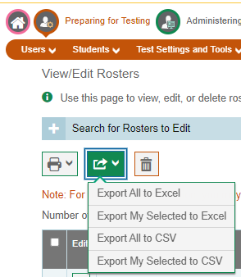
Helpful Improvements from Cambium
SY21-22: made it possible to export rosters from TIDE in the View/Edit Rosters screen
SY22-23: added the TAs email address to the export file
Notes:
Presenter: Toni
And while there will never be an automatic solution of getting student groups in SRS, I do want to acknowledge that Cambium has done several things to help leverage the work done with TIDE rosters to start the file needed for SRS.
First, they made it possible to export rosters from TIDE. As described in the SRS introductory guide, this export can reduce the time and effort for manually entering information into the SRS group upload file and also help in troubleshooting some common errors that crop up with a manual approach.
Last year, they added the TAs email address to the export file. This is very useful in making sure that the TA email is correct in the file uploaded to SRS. This alone can significantly cut down on one of the most common errors preventing teachers from seeing their student’s results: mistakes in entering the teacher’s email into the SRS upload file.

Slide 28
SRS Introductory Guide
Introduction to the system
Assigning Student Groups to Teachers
Viewing Student Results
Troubleshooting
Frequently Asked Questions
Notes:
Presenter: Toni
Here are the sections of the SRS Introductory Guide document.
Introduction contains: the login process, which users have access to which things in the system, and how to navigate
Assigning Student Groups to Teachers contains: student group creation with detailed steps and examples of correct formatting, how to start with rosters that you already created in TIDE, how to assign a group to more than one educator, how to edit an existing group, and common errors in student group uploads.
Viewing Student Results contains: detailed steps for TAs viewing results by assigned groups, as well as detailed steps for school coordinators and district level users to view results by grade level for the whole school;
Troubleshooting contains: questions to ask and steps to go through if a user can’t see test results for a particular student.
Frequently Asked Questions: this section was revised this fall to reflect the questions we got the most last year.
Please consult this document before you contact the Cambium Helpdesk for help with the SRS.

Slide 29
Troubleshooting Student Groups #1
Tips for the upload file:
Make sure the header row from the template is included in the file
Make sure that the School Natural ID is listed correctly (do not include district number)
Make sure the year is formatted correctly (2024, not 2023-2024, etc.)
Ensure there are not any extra spaces in any of the entered data
Open the file in Notepad instead of Excel to have a closer look at the csv file for any anomalies
If assigning to multiple users, make sure that it follows the correct formatting described in the SRS Introduction document
Sort/group the rows in the file by School Natural ID if uploading groups at multiple schools
When getting “Bad Data” error in SRS, click on the File Name to see what row has an error
Notes:
Presenter: Toni
The Cambium Help Desk has worked throughout these past few years with SRS to troubleshoot errors and issues preventing folks from seeing student test results and have provided these helpful tips for some the more common issues types. The first type, shown here, is related to the file upload itself.
Most of these are described in the SRS introductory guide, so I won’t read them but I want to draw attention to a couple.
Let’s look at the 5th one: Open the file in Notepad instead of Excel to have a closer look at the csv file for any anomalies. By anomalies, we mean extra spaces in the data, or a bunch of zeros in front of student SSIDs. These will not be noticeable if the file is opened in Excel but will be very quickly and easily visible if you open the file in Notepad. Often we see commas in rows or columns that don’t have any visible data in them in Excel—deleting these rows or columns is usually the solution.
The other is the last tip: When getting “Bad Data” error in SRS, click on the File Name to see what row has an error. Many of the error messages for “Bad Data” provide information about the specific row number or rows that have errors that’s preventing student group files from being uploaded. To see this detailed information, click on the File name from the screen where you get the “Bad Data” error and look for what row SRS has identified with the error. That can help narrow your search and reduce time in making corrections to the file.

Slide 30
Troubleshooting Student Groups #1
Tips for the upload file:
Make sure the header row from the template is included in the file
Make sure that the School Natural ID is listed correctly (do not include district number)
Make sure the year is formatted correctly (2024, not 2023-2024, etc.)
Ensure there are not any extra spaces in any of the entered data
Open the file in Notepad instead of Excel to have a closer look at the csv file for any anomalies
If assigning to multiple users, make sure that it follows the correct formatting described in the SRS Introduction document
Sort/group the rows in the file by School Natural ID if uploading groups at multiple schools
When getting “Bad Data” error in SRS, click on the File Name to see what row has an error
The SRS does not count the header row when telling you which row has the error.
If the SRS says the issue is in row 21, look in row 22 of the Excel file.
Notes:
Presenter: Toni
Of special note, we learned last month that the SRS does not count the header row when telling you which row number has the error. When the screen says the error is in row 21, look in row 22 of your Excel file.

Slide 31
Troubleshooting Student Groups #2
Why can’t a particular TA see scores?
Has a group for the TA successfully uploaded?
Make sure the TA email address is correct in the upload file (see previous slide about download from TIDE that includes the teacher email automatically)
Make sure that the student SSID is correct in the upload file
Is the student dual enrolled in TIDE?
Notes:
Presenter: Toni
The next issue type is around a specific TA not being able to see results. Again, I’ll just highlight one for today, and it’s the second one: Make sure the TA email address is correct in the upload file. In the Introductory guide this is FAQ #2, and page 14, Troubleshooting, has steps to go through if the email is correct.
The last one—is the student dual enrolled in TIDE—is a little more tricky. If the student is dual enrolled in TIDE at the time of testing, the school with the most recent TIDE enrollment will be the school that the score shows up for in SRS. Some of these are legitimate dual-enrollment, and some are students who were expected in one district but actually enrolled in another. If it is legitimate dual-enrollment, including the student in a fresh upload of their student groups will enable the TA to see their scores. This is also FAQ #3.

Slide 32
SRS Training Videos
Student Groups
How to create student groups and upload to SRS (21 minutes long)
TA View Summative Results
How teachers view results for their assigned groups of students (17 min)
DC SC View Summative Results
How DC/DA/SC view school level results for grade level of test (17 min)
TA View Interim Results
How teachers view interim results for their groups (30 min)
Custom Aggregate Reports
Intro DC/DA/SC/IS to yearly and target reports for schools and district
Notes:
Presenter: Toni
There is a series of videos to help your and your staff learn about the SRS. Now would be a great time to refresh your memory.
Groups https://www.youtube.com/watch?v=-FYIgEhP6AM
TA summative groups https://www.youtube.com/watch?v=5C6UqY1Rt3o
DC SC summative school https://www.youtube.com/watch?v=P5ZCRGQfV6o
TA interims, https://www.youtube.com/watch?v=AMVwJhqp3Iw
Custom Aggregate Reports, https://www.youtube.com/watch?v=ZJh_92aCOCQ

Slide 33
Prevent FERPA Violations
Please: Do not include previously enrolled students in student group uploads.
Data that tell SRS that a student moved…
Test record with a new school listed
Student added to a group at a new school
Including previously enrolled students in your groups can cause student scores to be seen by teachers and staff who should not see that score
Notes:
Presenter: Kara
Last year we gave you a new direction for you to help reduce FERPA violations.
Please do not include previously enrolled students in new student group uploads. Yes, we know that previously we said you could leave students in the group if they had left your school, and that made it easy to just add newly enrolled students to the bottom of the list and upload it again. Now we are asking you please to remove students who are no longer enrolled in your school from student groups.
There are two data points that tell SRS that a student moved: a test record comes from Cambium with a school listed OR a Student Group upload file has the student included. Remember, SRS doesn’t talk to TIDE, so it’s not validating against any changes in TIDE.
The problem is that including previously enrolled students in your groups can cause those scores to be available to teachers and staff who should not see them.

Slide 34
Problem Scenario
Timmy is in Auburn school at start of the year, moves to Kent in November.
Timmy takes math and ELA in Kent in April.
Kent school uploads student group in April.
Kent school and teacher see his test scores.
Auburn uploads student group in May with Timmy included.
Auburn school and teacher see Timmy’s ELA and math scores from Kent.
(Kent still sees the score.)
Notes:
Presenter: Kara
Here’s the scenario that causes problems [Fictional student but with real districts to keep it concrete].
Timmy starts the school year in Auburn and moves to Kent in November.
Auburn does lots of interim testing over the winter and keeps including Timmy in their student group uploads. Since Timmy isn’t there to test, and his school in Kent isn’t doing interims, Timmy’s name doesn’t show up when anyone is looking at interim scores. Not a problem so far.
Then, Timmy takes his summative ELA and math tests at Kent school in April. The test record says that he’s at the school in Kent, so SRS puts his scores in the Kent school so the principal and the DAC see Timmy’s scores. Kent uploaded student groups to SRS right after they finished testing, so Timmy’s teacher can also see his score. All is good.
Then, Auburn does their start of the month upload of student groups for May, and Timmy is still included in their groups. This tells the SRS that Timmy moved to Auburn, so Timmy’s ELA and math scores now show up for the school in Auburn, and the teacher who hasn’t seen Timmy since November now sees Timmy’s ELA and math scores. The principal and DAC for Auburn also see Timmy’s scores included on the views they have of SRS.
Kent still sees the scores, so we are not worried about Kent in this situation, but we are worried that Auburn is seeing test scores they shouldn’t.
This is why we are now saying to please remove previously enrolled students from your student groups.

Slide 35
Target Reports
Factsheet: SRS–Finding Target Reports
Explains how different users find Target Reports within SRS
Detailed steps with pictures
Notes:
Presenter: Kara
Last year we got lots of emails asking about how to find Target Reports. I created this fact sheet for your easy reference. It explains how different users find Target Reports within the SRS—group level reports are found in one place; school and district reports are found in a different place. I gave you detailed steps with pictures. It is available on the WCAP Portal.
https://wa.portal.cambiumast.com/resources/srs/srs-finding-target-reports

Slide 36
Quick way to know if a student has tested
Check Student Participation table in the View/Edit Student screen.
Student has not tested at all this school year:
Student has tested:
One row for each test (CAT and PT on different rows)
Notes:
Presenter: Kara
Here is a way to find out in TIDE if a specific student has tested:
Get to the View/Edit Student screen for the student. Scroll down to the bottom of the screen to the Student Participation section. If the student has not tested, you’ll see the first screenshot. If the student has tested, you’ll see the second screenshot with one row for each test. The columns list Test, TA name, session ID, status, date started, and date completed, among other things.

Slide 37
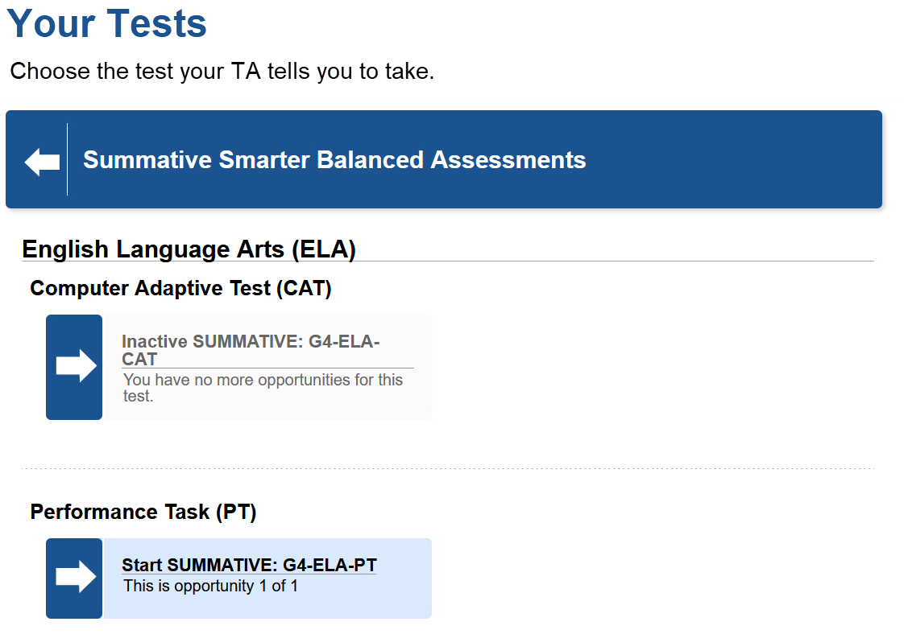
Another quick way to know…
Have student log into a session that includes the test.
On the Your Tests screen, completed tests appear as “Inactive SUMM….”
Notes:
Presenter: Kara
Another way to know is in the Secure Browser. Have the student log into a session that includes the test you are wondering if they did. When the student gets to the Your Tests screen, completed tests appear with “Inactive” in front of the word “SUMMATIVE”, only the arrow section of the button has color, and the student cannot select the test.

Slide 38
Data

Slide 39
Pre-ID Reminders
WA-AIM Students not in TIDE: "Preserve Record in TIDE" in WAMS
Mobile students with accommodations – will bounce off of TIDE if not flagged as eligible for service(s)

Slide 40
Testing Progress Dashboard and SRS
Available mid-April (tentative)
Scored tests begin arriving this week
Once open SRS will be one day ahead of TPD
TPD: monitoring completeness of test admin
SRS: teacher-facing
Scores identical in both tools

Slide 41
Assessment Operations

Slide 42
March Important Dates and Tasks
Notes:
Here are the important dates and tasks for March. You can also find these in WAMS File Downloads, and at the top of each WAW newsletter.

Slide 43
April Important Dates And Tasks
Notes:
And here are the important dates and tasks for April.

Slide 44
WCAP Contacts
OSPI Assessment Analysts for student data issues:
assessmentanalysts@k12.wa.us 360–725–6109
OSPI Assessment Development for content questions:
ELA and Math assessments: asi@k12.wa.us
Science assessment: science@k12.wa.us
OSPI Assessment Operations for assessment policy and test materials:
Assessment@k12.wa.us 360–725–6348 or 1–800-725–4311
Cambium Washington Help Desk for Technical, Network, and password issues:
wahelpdesk@cambiumassessment.com 1–844–560–7366
WIDA Client Services Center for accounts, assessments, and resources
help@wida.us 1-866-276-7735

Slide 45
Connect with us
Ospi.k12.wa.us

Slide 46
Thank you

