Slide 1
Assessment Update Webcast
SY 2023–24
Update #7
February 21, 2024

Slide 2

Land Acknowledgment
Notes:
Presenter: Leslie
The Office of Superintendent of Public Instruction rests on the ancestral territory of the Coast Salish, Squaxin, Cowlitz, and Nisqually people who have stewarded the land across the generations. OSPI is committed to ongoing partnerships with Tribal governments across Washington, as we work toward the shared goals encompassed in a stronger education for all of our children.

Slide 3

Let us recognize historical and ongoing injustice and hate targeted toward race, culture, religion, gender and gender identity, sexual orientation, disability, and nationality.
Space for Solidarity
Notes:
OSPI recognizes historical and ongoing injustice and hate targeted towards individuals and groups based on their race, culture, religion, gender and gender identify, sexual orientation disability and nationality.

Slide 4
Today’s Topics
  WaKIDS
WaKIDS Data
Mid-year WaKIDS 101 trainings
WaKIDS News
Contacts
Select Assessments
WIDA
Important Dates
Common Incidents
Technology
Reminder: Known Issues Page
  Assessment Development
Location of TTS and ASL in secure browser
  Data
Family Report Print Options
  Assessment Operations
Required Trainings
Important Dates for February and March
TIDE 16.1 Updates
Notes:
Presenter: Christopher

Slide 5
WaKIDS

Slide 6
WaKIDS Data
The district preview of WaKIDS data is now available to DACs in a tableau workbook accessed through EDS. Only those with access at the district will see the WaKIDS data.
The WaKIDS data is now live on the Report Card.

Slide 7
Current & Upcoming Trainings
Mid-year Training (concludes on Feb 26th)
Summer Training (registration opens in April)
  July – October

Slide 8
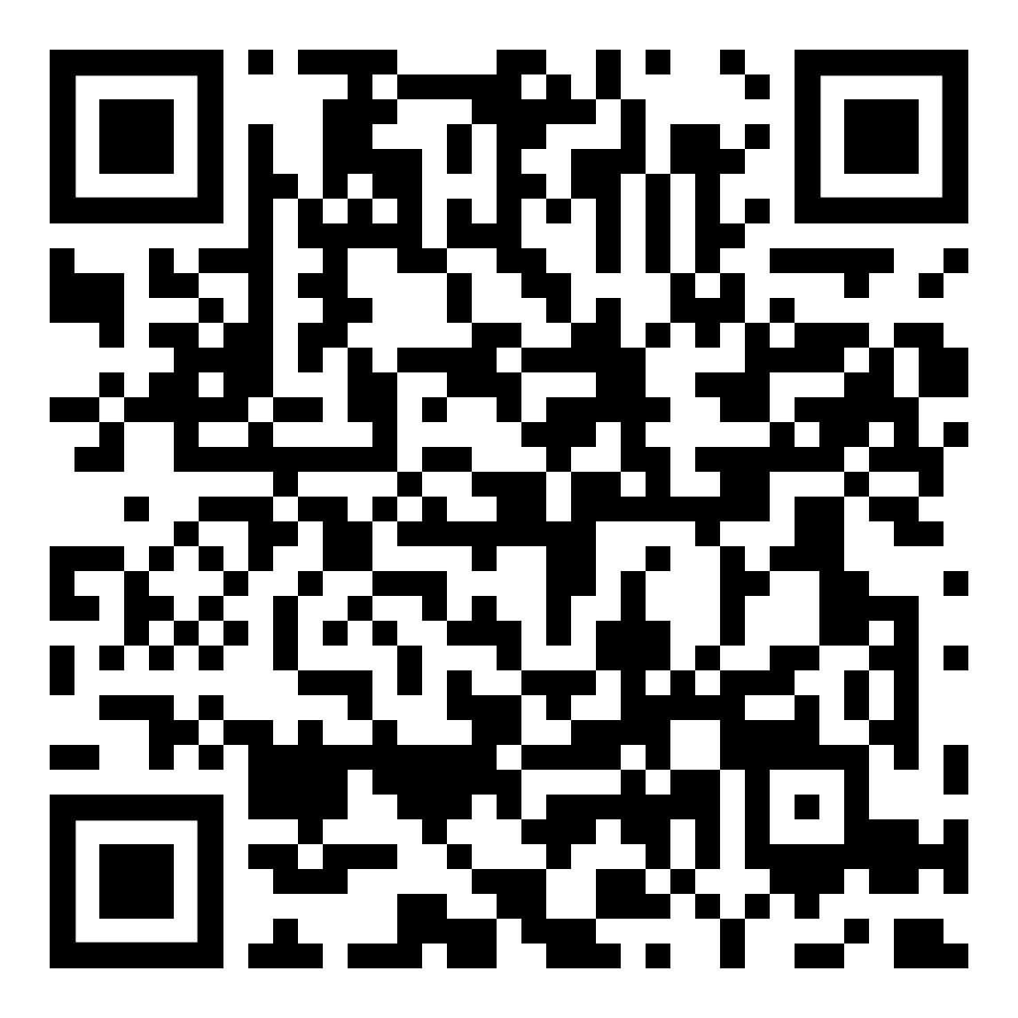
WaKIDS – In the News!
Recently released WaKIDS data show that a record-high percentage of students are demonstrating they are ready for kindergarten in all six of the domains assessed.
Read the article in the OSPI February Newletter: OSPI NEWS RELEASE: Washington’s Youngest Learners Show Record-High Kindergarten Readiness (govdelivery.com)

Slide 9
Contacts for WaKIDS
Your ESD WaKIDS Coordinator is your first point of contact for technical assistance regarding WaKIDS including questions about the Quick Start Guide and WAMS transfers.
WaKIDS@k12.wa.us for questions regarding course registration, completion, clock hours, reimbursements and WAMS transfers.

Slide 10
Select Assessments

Slide 11
ELP Assessment Update

Slide 12
Important Dates
February 24: is the first day district has the authority to decide if students enrolling in school will take both the screener and the annual test before the end of the test window. All potentially eligible students must screen within 10 days.
March 29: The deadline to return materials. (materials picked up after this date are not included in data validation).
April 24 – May 2: Pre-Reporting Data Validation
May 20: Online reports in WIDA-AMS (not Alt ACCESS)
June 10ish: Paper reports in districts (not Alt ACCESS)
June 10-24: Post-Reporting Data Validation
Notes:
Here are some important dates to keep in mind as we get into testing.
One important date I want to point out is March 29. Please ensure that all WIDA materials are picked up by UPS by March 29. This will ensure that your materials are available during the data validation windows. If you cannot make the March 29 date for pick up, materials will not be processed in time to be included in the data validation windows and duplicate records will not be able to be combined in the system.

Slide 13
Common Incidents
Helping students is not allowed in WIDA testing
Please emphasize with your staff that the following things are not allowed:
Answering students’ questions about test content (What is this called?, for example)
Reading passages for students
Paraphrasing what the question is asking (in any language)
Also, please remind staff to let main office staff know when testing is happening.
Notes:
This year we have received an uncommon number of incidents of test administrators helping students on the test. Please remind staff that helping students will result in test invalidations and interferes with the valid assessment of students’ skills. As you know, the purpose of the WIDA assessments is to confirm whether a student is linguistically ready to succeed in school without language supports. Helping a student demonstrate language skills that they cannot demonstrate independently works against the student’s success in the end.
Please take some time to remind staff that that things like answering students’ questions about test content and reading passages is not allowed.
Paraphrasing what the question is asking students to do is not allowed.
Also, please remind staff to let main office staff know when testing is happening. We have had a lot of test incidents where students are recording speaking responses when a fire drill happens or announcements are made. Let’s help students out by getting adults on the same page around testing protocols, schedules, timing and the like.

Slide 14
Technology

Slide 15
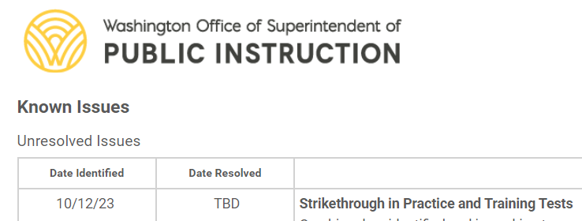
Reminder: Known Issues Page
The Known Issues page is a new resource available on the WCAP portal for SY23-24
The Unresolved Issues table lists and describes known technical issues being addressed by Cambium and provides workarounds
Once resolved, issues are moved to the Resolved Issues table and kept there for the duration of the school year

Slide 16
Assessment Development

Slide 17
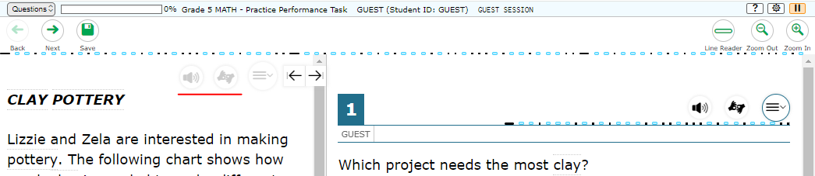
Location of TTS and ASL in Secure Browser
To reduce the number of “clicks” needed for students to access the Text-to-Speech tools and the ASL videos for test content, CAI has moved those tools to the left of the Context Menu.

Slide 18

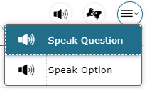
Activate TTS and ASL
Clicking TTS button gives you the options for that part of the screen.
Clicking ASL button opens ASL window and starts video

Slide 19
Data

Slide 20
Family Reports (ISRs) Spring 2024
Default format = PDF
MUST OPT-IN TO PRINTED REPORTS!!!
WAMS application will open later this year
  Select whether all/some schools will get hard-copies printed

Slide 21
Assessment Operations

Slide 22
Trainings Required Annually
Test Coordinator Training – State created presentation required annually for all Principals, District Assessment Coordinators, District Administrators, and School Test Coordinators.
Test Administrator Training – State created presentation required annually for all District Assessment Coordinators, District Administrators, School Test Coordinators and Test Administrators.
Basic Security Training – State created presentation required annually for all Technology Coordinators and staff assisting within testing locations.
The Basic Security Training is not meant for anyone who will have direct contact with the assessment.
DCs may require Technology Coordinators to participate in additional trainings.
Accommodated Test Administration Training – State created presentation required annually for all staff handling secure accommodated materials.
English Language Proficiency Assessment Training – training required annually in the WIDA Secure portal.
Notes:
The Test Coordinator Training is a state created presentation required annually for all Principals, District Assessment Coordinators, District Administrators, and School Test Coordinators.
The Test Administrator Training is a state created presentation required annually for all District Assessment Coordinators, District Administrators, School Test Coordinators and Test Administrators.
The Basic Security Training is a state created presentation required annually for all Technology Coordinators and any staff assisting within testing locations.
This training is not meant for anyone who will have direct contact with the assessment.
DCs may require Technology Coordinators to participate in additional trainings.
The Accommodated Test Administration Training is a state created presentation required annually for all staff handling secure materials.
This training must be also be completed by TA’s administering accommodated tests and is in addition to the required Test Administrator Training.
The English Language Proficiency Assessment Training is required annually in the WIDA Secure portal.
Must pass the certification quizzes with a minimum of 80%.

Slide 23
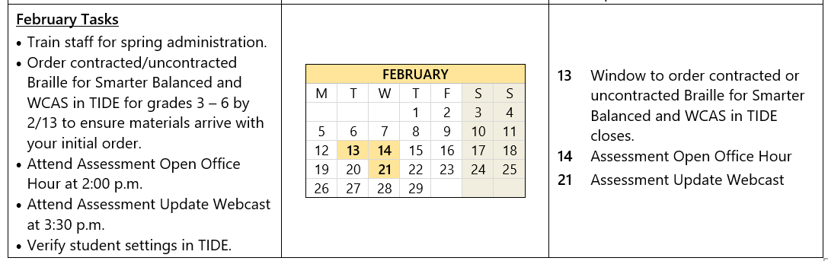
February Important Dates and Tasks
Notes:
Here are important dates and upcoming tasks for February. You can also find these calendars in WAMS File Downloads.

Slide 24
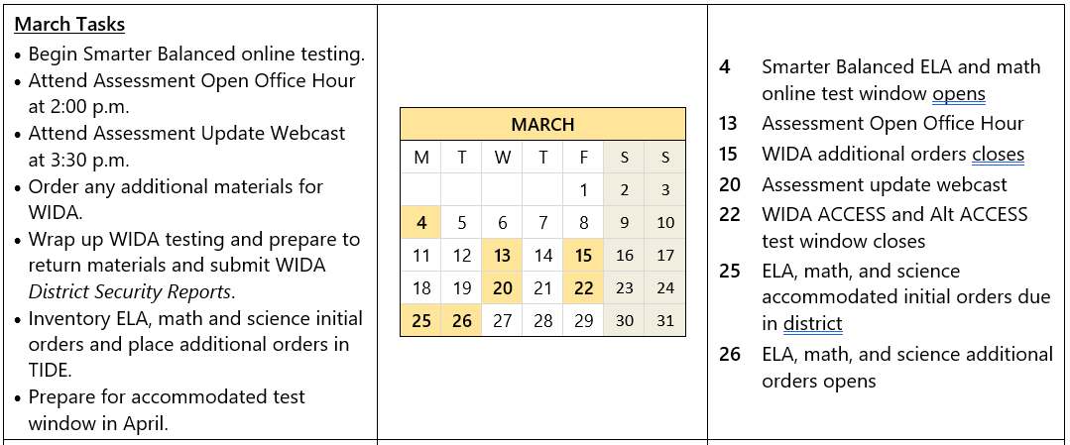
March Important Dates and Tasks
Notes:
And here are the important dates and tasks for March.

Slide 25
TIIDE 16.1 Updates

Slide 26
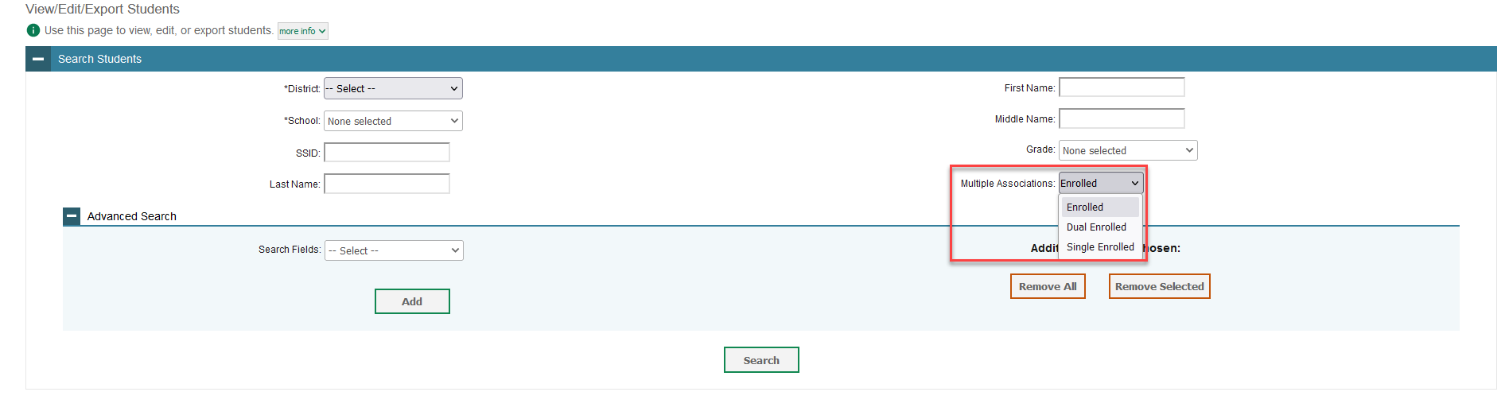
16.1 TIDE Updates
A new search filter has been added to assist with identifying dual enrolled students.
To display a list of students who are enrolled in more than one school or district or show only students enrolled in one school, use the Multiple Associations filter.
Notes:
This new search filter for the View/Edit/Export Students task identifies students who are enrolled in more than one school or district at the same time.

Slide 27
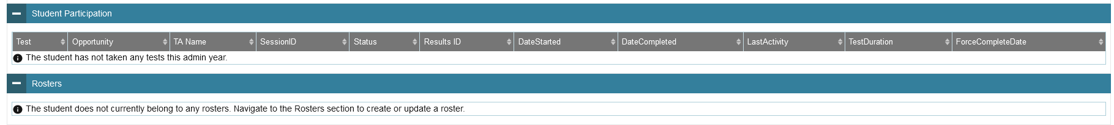
16.1 TIDE Updates
On the View/Edit Student page, the Student Participation and Roster sections will always be shown on the page. If the student has not taken any tests this year, or if they have not been added to any rosters a message will be displayed in the section.
Notes:
When viewing information about a specific student, the Rosters and Student Participation sections now display even if there is no information. If there is no data, the section will show an informational message.

Slide 28
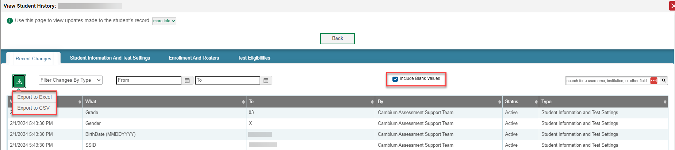
16.1 TIDE Updates
Student Update History can now be exported from the View History tabs to Excel or CSV. The export file includes the data from the tab selected. An option has also been added to include/exclude blank values in the table.
Notes:
The View Student History feature shows changes made to a student’s record. There are two new options available:
• Show or hide blank values for fields that display No Selected Value
• Export data to Excel or CSV from each tab

Slide 29
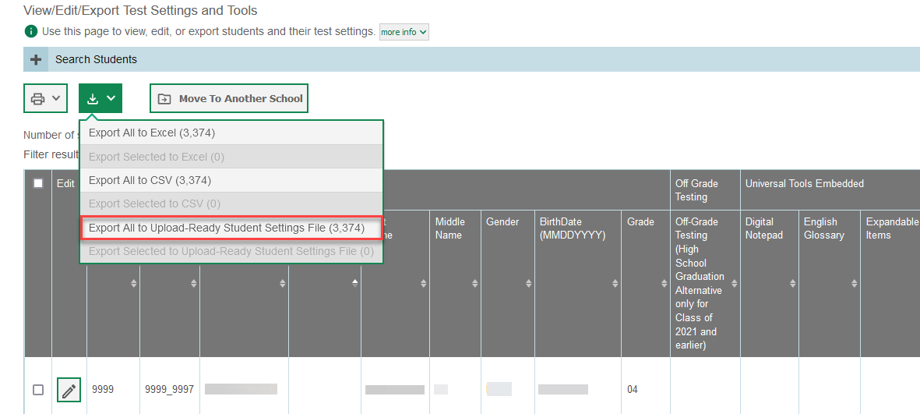
16.1 TIDE Updates
  A new Upload-Ready Student Setting File export option is available. This export provides the student settings in a file that matches the format for uploading student settings. The file contains only TIDE-selectable tools that were set by a user and do not include default tools or tool values.
Notes:
The new export option pulls data for TIDE-selectable TDS test tools in the format needed to import it back into the system. This export allows quicker edits and reuploads for changed data.

Slide 30
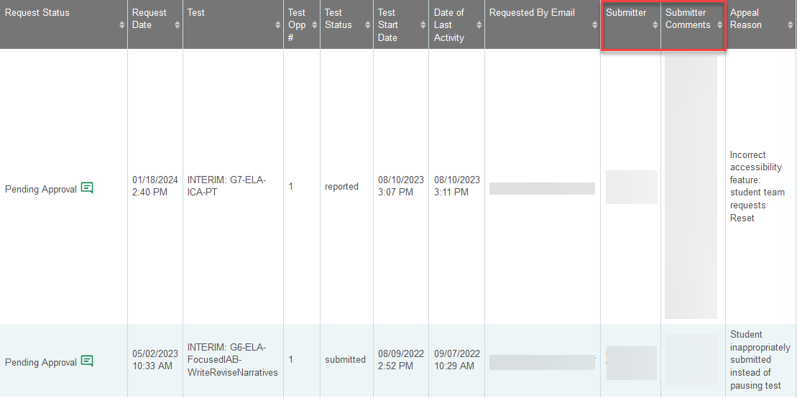
16.1 TIDE Updates
  Appeals:
  Additional Comments are now required for all appeals.
  Additional Comments was updated to allow for 500 characters.
  On the View/Approve/Export Requests page, the Submitter, Submitter Comments, and Appeal Reason will now show in separate columns.
Notes:
Previously, only the “Other” appeal reason required an additional comment. Now, all appeals require the submitted to provide additional comments to help review and approve requests.
On the View/Approve/Export Requests results grids, user comments have been broken down into several new columns to improve the readability of the information. Formerly all in one column, the columns now separate the submitter and submitted comments, appeal reasons, among other data.

Slide 31
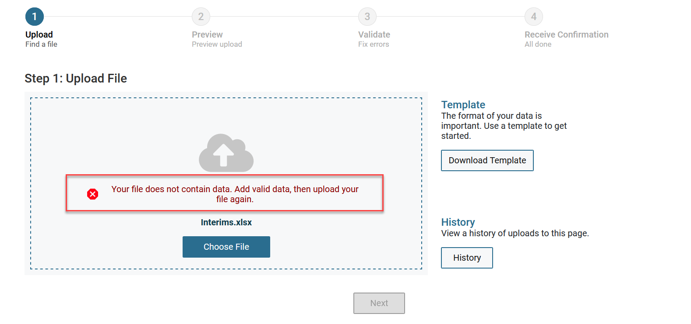
16.1 TIDE Updates
  New informational message will appear if a user uploads a blank file. This update is included in all available uploads for users.

Slide 32
WCAP Contacts
OSPI Assessment Analysts for student data issues:
  assessmentanalysts@k12.wa.us 360–725–6109
OSPI Assessment Development for content questions:
  ELA and Math assessments: asi@k12.wa.us
  Science assessment: science@k12.wa.us
OSPI Assessment Operations for assessment policy and test materials:
  Assessment@k12.wa.us 360–725–6348 or 1–800-725–4311
Cambium Washington Help Desk for Technical, Network, and password issues:
  wahelpdesk@cambiumassessment.com 1–844–560–7366
WIDA Client Services Center for accounts, assessments, and resources
help@wida.us 1-866-276-7735

Slide 33
Assessments & Student Information

Slide 34

Thank you

