Slide 1
Assessment Update Webcast
SY 2023–24
Update #5
December 15, 2023

Slide 2
Land Acknowledgment
Notes:
Presenter: Leslie
The Office of Superintendent of Public Instruction rests on the ancestral territory of the Coast Salish, Squaxin, Cowlitz, and Nisqually people who have stewarded the land across the generations. OSPI is committed to ongoing partnerships with Tribal governments across Washington, as we work toward the shared goals encompassed in a stronger education for all of our children.

Slide 3
Let us recognize historical and ongoing injustice and hate targeted toward race, culture, religion, gender and gender identity, sexual orientation, disability, and nationality.
Space for Solidarity
Notes:
OSPI recognizes historical and ongoing injustice and hate targeted towards individuals and groups based on their race, culture, religion, gender and gender identify, sexual orientation disability and nationality.

Slide 4
Today’s Topics
WaKIDS
TK color band
TK and WaKIDS Assessment
Mid-year WaKIDS 101 trainings
Select Assessments
WIDA
Important Dates
Training
ASL
WA-AIM
Spring Window
Spring Training
Technology
Reminder: Known Issues Page
Printing Test Settings
Word Prediction and OS
Spanish Voices and OS
Assessment Development
SRS things
TIDE things
Data
Data Release Dates
Family Report Print Options
Assessment Operations
Recently Posted Materials
Important Dates for December and January
Notes:
Presenter: Christopher

Slide 5
WaKIDS

Slide 6
TK Color band
Easily editing the color band for TK using the import template:
Populate the import template just for TK students
Add one column header called “COLORID” to the import template
Insert the numeric value “5” for one TK child record in the “COLORID” column (the numeric value of “5” indicates Pre-K Blue)
Import the file as usual and if it processes without an error code, spot check a few child records to validate whether or not the color band was updated at the child profile level.
Notes:
Great news for TK classes. You can use the import template to update the color band for TK students in bulk without having to change their color band one by one. It's very simple and quick so if you have TK student to import, follow these steps to change the color band to the blue band for 4 year olds.

Slide 7
TK Color Band 2
Notes:
Here is a snip of what your import template should look like for TK students. Remember, create a separate import template for TK students so you can easily add the COLORID column just for them.

Slide 8
TK and WaKIDS Assessment
The last day to begin TK program is January 31st.
Please fill out the survey if your district:
Plans to open TK classrooms before January 31, 2024, and you have not filled out the survey.
Has been offering TK this school year but you have not filled out the survey.
You have submitted a response to the survey but there are changes to the plan.
Winter checkpoint date: April 10
Notes:
All Transitional Kindergarten classes must begin by January 31 and all TK classes must complete and submit their data by the 10th week from the program start date.
On the next slide, I have a list of school districts and their TK program start date for January. please take a look and submit a response if your district is not on the list when its TK will begin next month, or if there has been any changes.
https://survey.alchemer.com/s3/7319102/Transitional-Kindergarten-Assessment-Profile-2023-24

Slide 9
Do you see your district?
ESD | District | TK Start Date | Assessment Due Date
189 | Lopez | 1/1/2024 | 3/11/2024
123 | Kennewick | 1/3/2024 | 3/13/2024
189 | Lakewood | 1/22/2024 | 4/1/2024
189 | Everett | 1/26/2024 | 4/5/2024
114 | Central Kitsap | 1/29/2024 | 4/8/2024
101 | Cusick | 1/29/2024 | 4/8/2024
121 | Tahoma | 1/29/2024 | 4/8/2024
189 | Burlington-Edison | 1/30/2024 | 4/16/2024
189 | San Juan Island | 1/30/2024 | 4/9/2024
189 | Sedro-Woolley #2 | 1/30/2024 | 4/9/2024
Notes:
Here is the list of districts with their TK start date for January according to the survey. If your district should be on the list but don’t see one, please submit a response so we have your information.

Slide 10
WaKIDS 101 trainings
WaKIDS 101 Please note that these dates are meant specifically for TK teachers, Kindergarten teachers who administer the Whole-child Assessment more than one checkpoint per year, and Certificated Special Education teacher who support kindergarteners and administer the Whole-child Assessment more than one checkpoint per year.
November 29, 2023 – December 13, 2023
January 3, 2024 – January 17, 2024
January 24, 2024 – February 7, 2024
February 12, 2024 – February 26, 2024
Notes:
Please remind your new TK teachers that they are required to take the WaKIDS 101 training in order to implement the assessment because administrators are not authorized to create new accounts for teachers. we have three trainings available in January and February to accommodate as many teachers as we can and help them get started. These trainings are for newly hired TK teachers, kindergarten teachers who assess children more than once a year and certified special education teachers. all other teachers will be welcomed in the summer for their training opportunity. If there is any teacher who transferred from another district and they have completed the training requirement, please email us so we can transfer their account to your district. Those who have completed the training are not required to be trained again.

Slide 11
Select Assessments

Slide 12
ELP Assessment Update

Slide 13
Important Dates for WIDA
January 4 or 5: Student Management will open in WIDA-AMS.
January 15-19: Initial materials orders arrive.
January 15: Additional Materials Order window opens.
January 29: Test window opens.
February 24: Newly enrolled student deadline.
Notes:
January 4 or 5 is when Student Management will open in WIDA-AMS. At that time you can arrange students in test sessions, add/edit students, etc.
January 15-19 is when districts will receive their initial materials for WIDA testing. These materials will be based on the file pulled from CEDARS on December 8.
January 15 is when the Additional Materials Order window opens. It is important that you receive your initial materials shipment before ordering additional materials as you will often receive overage on common materials. Also, please refrain from making daily or weekly additional materials orders. OSPI must approve these orders and having multiple orders from each district delays how fast we can move through and approve orders.
January 29 is opening day of the testing window. The window will close on March 22.
February 24 is the first day districts have the authority to decide if students enrolling in Washington schools will take both the screener and the annual test before the end of the test window or if they will only do the screener. Students arriving on or before February 23 must take both if they are determined eligible for program.

Slide 14
Training
Annual training is required for all WIDA Assessments.
A Refresher Training is available in Canvas for (Online ACCESS only).
Districts can choose to use it or not. TAs can take the Refresher instead of the Secure Portal Training IF:
They completed WIDA Secure Portal training for Online ACCESS for the 2023 administration.
OR
They completed WIDA Secure Portal training for the WIDA Screener (1-12) since July 1, 2023.
OSPI will post lists of Refresher training completers 2-3 times/week from Jan 2 through February.
Notes:
Annual training is required for the WIDA ACCESS tests.
A Refresher Training is available in Canvas for Online ACCESS only and can be completed in lieu of the WIDA Secure Portal Online ACCESS training. .
Districts are not required to use the refresher training and can choose to have all TAs complete the WIDA Secure Portal training. DACs have control over Refresher course access. You can contact the assessment operations team if you are a DAC and cannot find the initial email about the Refresher Training that was sent on 12/1.
Annual training is required for the WIDA ACCESS tests.
TAs can take the Refresher instead of the Secure Portal Training IF
1. They completed WIDA Secure Portal training for Online ACCESS for the 2023 administration
OR
2. They completed WIDA Secure Portal training for the WIDA Screener (1-12) since July 1, 2023.
OSPI will post lists of Refresher training completers 2-3 times/week from Jan 2 through February. (Probably Monday and Thursdays, but it will vary with holidays and schedules).

Slide 15
Students Who Sign
If you have a student who will be accessing the WIDA assessments using ASL here are the steps to follow:
Order a paper test. This step is not necessary for kindergarten students.
Contact ELPAssessments@k12.wa.us with the name and contact information of the interpreter who will be administering the WIDA test.
The interpreter must complete test administrator training on the WIDA Secure Portal (paper testing).
When materials arrive, the interpreter can review the materials.
On January 24 at 3:00 interpreters who are delivering WIDA assessments will need to join a Zoom meeting to clarify standardized test delivery and get questions answered.
During the testing window deliver the assessment.
After the testing window closes, interpreters will be asked to reconvene on a Zoom meeting with OSPI.
Notes:
OSPI has updated our policy regarding the use of ASL on ELP assessments. In order to provide access to WIDA assessments, Washington now allows ASL to be used on the WIDA assessments for students who are learning both American Sign Language and English literacy skills as part of a complete communication system. In Listening, Speaking, and Writing domains, prompts can be delivered using ASL. In Speaking, students can respond using ASL.
Order a paper test. This step is not necessary for kindergarten students. Paper tests can be ordered once the Additional materials window opens on January 15.
Contact ELPAssessments@k12.wa.us with the name and contact information of the interpreter who will be administering the WIDA test.
The interpreter must complete WIDA paper test administrator training on the WIDA Secure Portal.
When materials arrive, the interpreter can review the materials.
On January 24 at 3:00 interpreters who are delivering WIDA assessments will need to join a Zoom meeting to clarify standardized test delivery and get questions answered.
During the testing window deliver the assessment.
After the testing window closes, interpreters will be asked to reconvene on a Zoom meeting with OSPI to discuss what additional supports are needed in the future and what worked/did not work this year.

Slide 16
WA-AIM

Slide 17
WA-AIM Spring (January 29-May 3, 2024)
Pre-ID in WAMS>Pre-ID (tab)>Spring Alternate Assessment Registration (link on left) is open and will remain open through the school year.
INSIGHT Item and Form Management is open.
These INSIGHT applications open on January 29, 2024:
Student Management
Registration
Student Performance Data
Notes:
Toni

Slide 18
WA-AIM Spring Administration Training
No OSPI led in-person training
Utilize the WA-AIM Trainings
An excel of titles, times, and recommendations for who should watch what training.
PPTs can be provided if district opts to create their own training.
Contact wa.aim@k12.wa.us if you need further support
Notes:
Toni

Slide 19
Technology

Slide 20
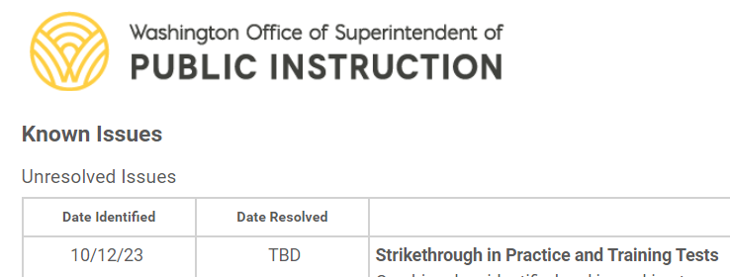
Reminder: Known Issues Page
The Known Issues page is a new resource available on the WCAP portal for SY23-24
The Unresolved Issues table lists and describes known technical issues being addressed by Cambium and provides workarounds
Once resolved, issues are moved to the Resolved Issues table and kept there for the duration of the school year

Slide 21
Known Issue - Printing Test Settings and Tools from Roster List in Safari
Safari browser users who attempt to print student test settings and tools from the Print from Roster List screen. Selecting Test Settings and Tools from the Print from Roster List dropdown currently generates printable test tickets for the students in that roster instead of the printable table of student test settings and tools. This is known to impact only the Safari browser and Cambium is working to further investigate the issue. No resolution timeline is available at this time.
Workaround: Cambium recommends not using the Safari browser to print student test settings and tools from the Print from Roster List page.

Slide 22
Word Prediction and Operating Systems
Embedded word prediction fully vetted with Chrome operating systems.
Known issue: the Word Prediction box may appear but not function on some math and science tests
Solution: Windows and MacOS systems may still need to use the non-embedded options
Assistive Technology Manual
Pages 8 and 9 of document (pages 11 and 12 of pdf)
Try WCAS Training Test or Math Practice Performance Task with Secure Browser, but still not a guarantee

Slide 23
Spanish Voices and Operating Systems
For TTS in math and science tests with Spanish Presentation and TTS setting(s) enabled
Assistive Technology Manual
Pages 15 and 16 of document (pages 18 and 19 of pdf)
Most systems have built-in voice packs
Windows devices need “Spanish (Mexico)” added to the device

Slide 24
Assessment Development

Slide 25
Smarter Reporting System (SRS)
WA Sandbox site refresh happening December 12-22. The site may be down intermittently between these dates.
Planned SRS maintenance window outages:
February 22, 2024
March 21, 2024
From 5:00pm-8:00pm (Pacific time)
Impact on users: don’t use the system

Slide 26
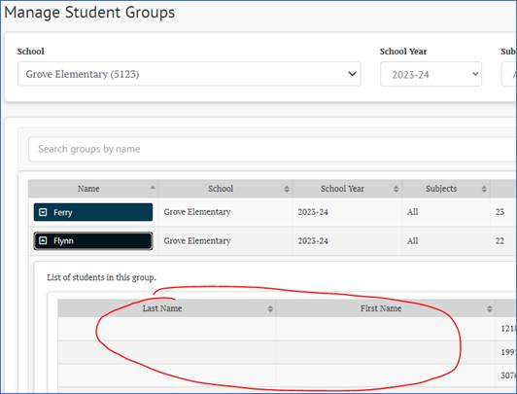
Smarter Reporting System (SRS) cont.
Problem: Grade 3 student names not appearing in Groups list
Solution:
Names will populate after a test result for the student gets to the SRS.

Slide 27
TIDE & Tools for Teachers
TIDE account gives access to Tools for Teachers
DC, DA, SC, TA, IS, and PS users automatically have access to Tools for Teachers
TFT_SC role is only for users, at a school, who do not have one of the above roles but does need access to Tools for Teachers
Tools for Teachers includes things like:
Digital playlists
Interim Assessment Item Portal

Slide 28
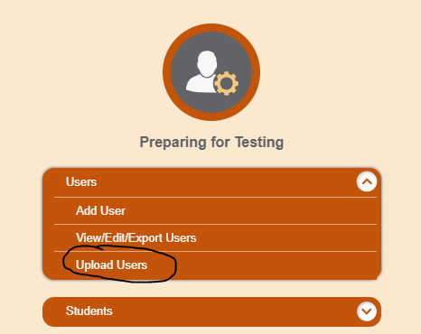
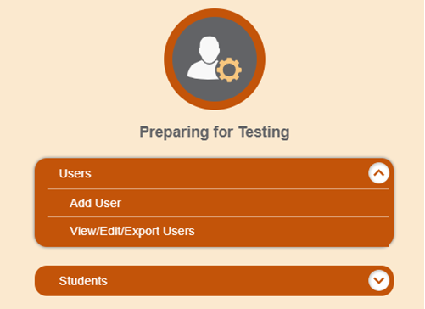
TIDE: SC User Uploads
From 2019 until this week, SC users could only add users one at a time; the file upload wasn’t an option.
This became a burden with all user accounts needing to be created anew this fall.
Solution: As of 12/14, SC users have the “Upload Users” option.

Slide 29
Data

Slide 30
Upcoming Pre-ID Dates
WIDA Pre-ID Extract:
Completed this week
All other pre-ID-type activities happen in WIDA AMS
WA-AIM Pre-ID Process
Spring Alternate Assessment Registration open in WAMS
Records in INSIGHT beginning 29 January
Both use program eligibility data from CEDARS

Slide 31
Upcoming Reporting Dates
SGP on Report Card early December
WaKIDS Fall Checkpoint:
Data to OSPI December 4
Data posted to WAMS December 6 (last week)
Data posted to Report Card 2nd week of January (tentative)
Grad Pathways Class of 2023
Tableau Secure report available by end of calendar year
Public-facing report due 10 January

Slide 32
Family Reports (ISRs) Spring 2024
Default format = PDF
MUST OPT-IN TO PRINTED REPORTS!!!
WAMS application will open later this year
Select whether all/some schools will get hard-copies printed

Slide 33
Assessment Operations

Slide 34
Trainings and Requirements
Test Coordinator Training – State created presentation required annually for all District Assessment Coordinators, District Administrators, and School Test Coordinators.
Test Administrator Training – State created presentation required annually for all District Assessment Coordinators, District Administrators, School Test Coordinators and Test Administrators.
Basic Security Training – State created presentation required annually for all Technology Coordinators and staff assisting within testing locations.
Accommodated Test Administration Training – State created presentation required annually for all staff handling secure materials.
English Language Proficiency Assessment Training – training required annually in the WIDA Secure portal.
Notes:
Really what type of training staff participates in is dependent on whether they will have exposure to actual test content. If test content is involved then the full TA Training is required and a Test Security Staff Assurance Report must be filled out.
The Test Coordinator Training is a state created presentation required annually for all District Assessment Coordinators, District Administrators, and School Test Coordinators.
The Test Administrator Training is a state created presentation required annually for all District Assessment Coordinators, District Administrators, School Test Coordinators and Test Administrators.
The Basic Security Training is a state created presentation required annually for all Technology Coordinators and any staff assisting within testing locations.
DCs may require Technology Coordinators to participate in additional trainings.
The Accommodated Test Administration Training is a state created presentation required annually for all staff handling secure materials.
This training must be completed by TA’s administering accommodated tests and is in addition to the required Test Administrator Training.
The English Language Proficiency Assessment Training is required annually in the WIDA Secure portal.
Must pass the certification quizzes with a minimum of 80%.

Slide 35
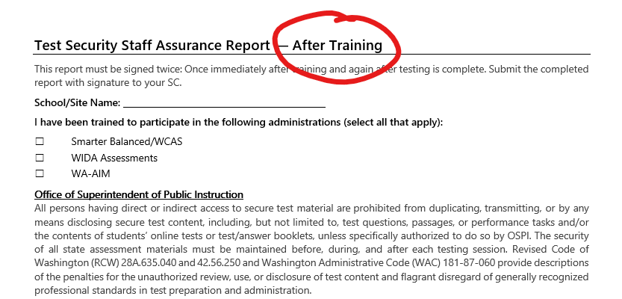
New Test Security Staff Assurance Reports
Training Logs are no longer required. We have changed the Test Security Staff Assurance Reports so that it captures the information that the Training Log did.
Test Security Staff Assurance Reports must now be signed immediately after training is completed.
This documents that training has been completed and ensures that a Test Security Staff Assurance is on file for each staff member that participated in training.
Notes:
Training Logs are no longer required so we have changed the Test Security Staff Assurance Reports so that they capture the information that the Training Log did.
Test Security Staff Assurance Reports must now be signed immediately after training is completed.
This documents that training has been completed and ensures that a Test Security Staff Assurance is on file for each staff member that participated in training.

Slide 36
12th Graders and WCAS
High school students who want to improve their science assessment score or use the test for school or district purposes (e.g., credit retrieval) will have one opportunity to retake the WCAS when they are enrolled in grade 12.
This does not change the requirement for students to take the WCAS in grade 11 for state and federal accountability.
Students that miss/do not take the WCAS in grade 11 are not required to participate in grade 12.
Notes:
High school students who want to improve their science assessment score or use the test for school or district purposes (e.g., credit retrieval) will have one opportunity to retake the WCAS when they are enrolled in grade 12.
This does not change the requirement for students to take the WCAS in grade 11 for state and federal accountability.
Students that miss/do not take the WCAS in grade 11 are not required to participate in grade 12.

Slide 37
New Resource
DC Bootcamp Training - This new presentation covers the Washington Comprehensive Assessment Program (WCAP), the assessments given annually, the systems used to administer the tests, the trainings required for staff who assist with testing, accommodations for students, security of the test environment, reporting of scores, and district supports and networks.

Slide 38
December Important Dates
Notes:
Here are the important dates for December.

Slide 39
January Important Dates
Notes:
Here are the many important dates coming up in January. Remember, you can find the important dates calendar, with all dates for the school year, on WAMS, in the File Downloads for 2024 section.

Slide 40
WCAP Contacts
OSPI Assessment Analysts for student data issues:
assessmentanalysts@k12.wa.us 360–725–6109
OSPI Assessment Development for content questions:
ELA and Math assessments: asi@k12.wa.us
Science assessment: science@k12.wa.us
OSPI Assessment Operations for assessment policy and test materials:
Assessment@k12.wa.us 360–725–6348 or 1–800-725–4311
Cambium Washington Help Desk for Technical, Network, and password issues:
wahelpdesk@cambiumassessment.com 1–844–560–7366
WIDA Client Services Center for accounts, assessments, and resources
help@wida.us 1-866-276-7735

Slide 41
Assessments & Student Information

Slide 42
Thank you

