Slide 1
Assessment Update Webcast
SY 2023–24
Update #1
August 16, 2023

Slide 2

8/22/2023
Notes:
Presenter: Leslie
The Office of Superintendent of Public Instruction rests on the ancestral territory of the Coast Salish, Squaxin, Cowlitz, and Nisqually people who have stewarded the land across the generations. OSPI is committed to ongoing partnerships with Tribal governments across Washington, as we work toward the shared goals encompassed in a stronger education for all of our children.

Slide 3

Let us recognize historical and ongoing injustice and hate targeted toward race, culture, religion, gender and gender identity, sexual orientation, disability, and nationality.
Space for Solidarity
Notes:
OSPI recognizes historical and ongoing injustice and hate targeted towards individuals and groups based on their race, culture, religion, gender and gender identify, sexual orientation disability and nationality.

Slide 4
Today’s Topics
  WaKIDS
Setting Up for New Year
Changes for Fall
Contacts for WaKIDS
Select Assessments
WIDA
Screening
Training and Zoom
Data Validation
WA-AIM
Fall HS Retakes and Pre-ID
INSIGHT User Clean-up
What is New
Technology
iPad OS Browser Update 9.0
Windows Secure Browser version 16.0
  Assessment Development
Rollover to SY 2023-24
Spring 2024 Testing
Spanish Presentation for math and science
  Data
Family Report Print Options
TIDE Rollover and account creation
End-of-year timelines
  Assessment Operations
WAMS Profile
Recently Posted Materials
Important Dates for August and September
Notes:
Presenter: Christopher

Slide 5
WaKIDS

Slide 6
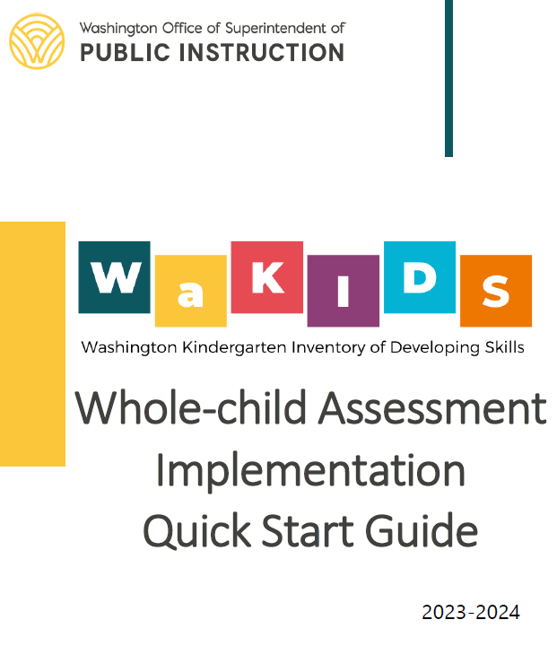
Setting Up for New Year
Step by step guidance in the Quick Start Guide
  Where you can get this:
  From your ESD WaKIDS Coordinator
  From the MyTeachingStrategies platform
Notes:
If you are the registered DAC in WAMS for your district, you should have received the wakids quick start guide 23-24 from your esd wakids coordinator. If you haven’t, please connect with your coordinator asap and request a copy. They have other important information to share regarding wakids.
In the quick start guide, you can find step by step guidance to implement wakids whole child assessment and monitor teachers’ progress. There are relevant links embedded to find detailed instructions so make sure to click them.
Another place where you can find this document is from the myteachingstartegies platform. But if you don’t have access, you can’t get to this place.

Slide 7
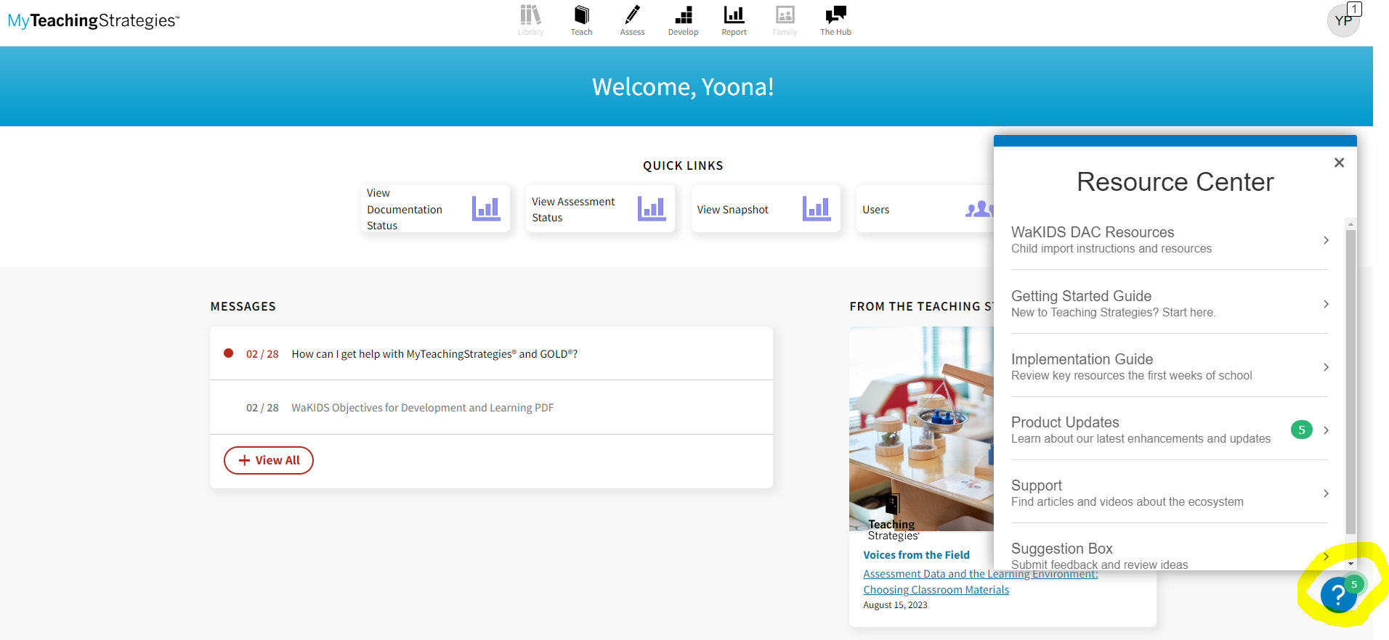
Assessment and Student Information
Notes:
Once you log in to the platform, you will find a question mark at the bottom right corner. Click that and you will find wakids dac resources at the top of the resource center. There are couple other resources for dacs only for you to administer the assessment. Teachers don’t have access to this dac resource center.

Slide 8
Setting Up for New Year Cont.
Ensure you have access to the platform
  Instructions in the Quick Start Guide
Create classes
  Confirm your teachers have completed the required WaKIDS 101 training. If you don’t see an account for teachers, they need to completed the training. DO NOT create accounts for teachers.
Import/transfer students
Set up classes ASAP so teachers can confirm their roster and begin entering data!
Notes:
Like I said, if you don’t have access to the platform, you cant get it. So please ensure you are set up correctly in both wams and the myteachingstrategies platform. That’s the first thing listed as the instruction in the quick start guide.
Once you get in, create classes. If you don’t see a teacher to link a class with, that means they didn’t get the training. Do not create an account for them and confirm with them on their training records. If you need help, email us wakids@k12.wa.us
Once classes have been set up, you may begin importing and requesting transfers for students.
Set up classes asap so teachers can confirm their roster and begin entering data.

Slide 9
Changes for Fall
New fall checkpoint November 15 at 9PM
New platform for teachers
  Support videos
New color band for TK
  Make sure to set up as PK/4-year-olds
  If teachers do it
  If admins do it
4 checkpoints
Notes:
There are several changes for fall.
The fall checkpoint is now November 15 moving forward. Teachers need to finalize their data by 9pm November 15 and dacs have 3 business days after this to confirm 100% full completion for the district. Please let your esd wakids coordinator know that you’ve confirmed full completion.
When teachers first log in to the platform, they will see many changes. You can help them get familiarized with the new platform.
Tk now has blue band showing up for the class. Individual child records must be updated to show blue band for them. Refer to the links in this slide for instructions.
If you read the quick start guide, you might have noticed that there will be 4 available checkpoints this year. However, with anticipated changes and updates coming to assessment implementation for TK in 24-25 school year, we realized it was premature to make this shift. So in the 23-24 school year, there are still 3 available checkpoints, fall, winter and spring. There will be no changes. We apologize for any confusion.

Slide 10
Checkpoint Dates
Fall: November 15, 2023
Winter: April 10, 2024
Spring: June 21, 2024

Slide 11
Contacts for WaKIDS
Update in WAMS
Inform your ESD WaKIDS Coordinator
Inform WaKIDS office
  wakids@k12.wa.us
Your first point of contact? Your ESD WaKIDS Coordinator
Office hours
  OSPI office hours and ESD office hours
Notes:
Please ensure contact information has been updated in WAMS to reflect changes in roles. That’s where I get and confirm DAC information to send any information.
After updating this in WAMS, please inform both your esd wakids coordinator and the ospi wakids office so we have them.
We have many office hour options for you. There is at least one per month during the fall implementation period hosted by me. It’s the first Wednesday between august and November at 1pm.
Each esd wakids coordinator has their own office hour, also at least once a month. You can find their office hour information on our website. Please join your own esd coordinator’s office hour as they do not have access to districts outside of their own regions.

Slide 12
Select Assessments

Slide 13
ELP Assessment Update
Notes:
Districts have done an amazing job this year and you all have overcome so much and in the middle of it all you also have adapted to a new test, new standards, and a new system for testing your multilingual learners and you have been so successful. Thank you for all your hard work and time and patience. Over 95 thousand students have completed testing and 85 percent of our online testing is complete. You and your teams have done excellent work.

Slide 14
Updated Resources
ELP Assessment Page:
  WIDA Assessment Guidance (Updated)
  WIDA District Contact List (Updated)
  Overview of Annual ELP Assessment Activities (dates will be updated soon)
ELP Screener Page:
  WIDA Screener Quick Start Guide (Updated)
  Accessibility and Accommodations Manual (Updated)
  Screener FAQ (Updated)
Notes:
We have been working hard to provide useful and up to date information on the website. Many documents were updated over the summer. Please use these resources to answer questions you have about WIDA testing.

Slide 15
Regenerating Test and Unlocking Scoring
To request that a screener test be regenerated or that scoring be unlocked, please email ELPAssessments@k12.wa.us
  Subject line: “Test Regeneration Request” or “Unlock Scoring Request”
  Include:
    Student SSID (or other number used on the record if SSID was not used)
    Description of the scenario (why are you requesting the test be regenerated)
    What steps will be taken to avoid this happening in the future?
We do not unlock screener scoring because a scorer has had time to think about the score and would like to change it.
We do not regenerate tests because a student was very close to exiting and if they got a second go they might not qualify.
Notes:
In rare occasions screeners will need to be regenerated due to an error in administration such as a technology issue or a student testing on the wrong grade band. Please emphasize with your staff the importance of checking that they are testing the correct student on their own SSID and that the grade level is accurate. If a regeneration request is needed, please send it to the ELP Assessments inbox shown here. You can use the same process for requesting that a test be unlocked for scoring. However, we do not unlock scoring because a scorer feels they want to do a different score. Please make sure all scorers know how to use the system before they start scoring and that they are double checking names on paper tests before they enter a score in the system.

Slide 16
Out of State Students
Washington ONLY accepts WIDA ACCESS (annual) assessments in lieu of local screening.
Scenario 1: Student exited on WIDA ACCESS using WA exit criteria. This student does not screen and is not eligible for services.
Scenario 2: Student did not exit on the WIDA ACCESS test but does have test scores from within 12 months. This student is eligible for services and does not screen.
Scenario 3: Student does not have evidence of WIDA results. This student must screen.
Scenario 4: Student has a WIDA ACCESS result from more than 12 months ago. This student must screen.
Scenario 5: Student has WIDA Screener results that show they are not eligible from another state. This student must screen.
Notes:
Washington accepts scores from other WIDA states in lieu of screening in some situations. In all situations, a score can only be used if you have evidence of the scores from the student’s family or previous school. OSPI does not have access to scores from other states.
The first two scenarios are the only two scenarios when out of states tests can be used to determine a student’s eligibility for ELD services without screening. In the first scenario, a student exited ELD services (using the WA exit criteria) at any time during their schooling. This student would not be eligible for services based on that out of state WIDA ACCESS score. In the second scenario, the student’s most recent WIDA ACCESS score is from within 12 months and indicates that the student is eligible for services based on WA’s eligibility criteria.
Other scenarios require students to screen in WA to determine service eligibility.

Slide 17
Screener Rules
10-day window to test
Test on grade level
Kindergarten tests only on Listening and Speaking through Dec. 31
TAs must complete training annually
Scorers must complete training annually
Notes:
While federal law allows for a 30-day testing window at the beginning of the school year, Washington law does not. All students whose Home Language Survey indicates that they may be eligible for English language development services must be screened and begin receiving services within 10 days of when they enroll and begin attending school.
In Washington, all students must be screened on grade level. This is different from WIDA recommendations. Please ensure that students are testing on the screener for the grade in which they are enrolled.
Kindergarten students will test only on the Listening and Speaking portions of the Kindergarten Screener through December 31. From January 1, new Kindergarten students will screen on all four domains.
The screener training consists of test administrator trainings and scorer trainings. If test administrators will not be scoring, they need only complete the test administration training. If they are also scoring, they will need to also complete scoring training. All training must be completed for all grade bands a TA will administer.

Slide 18
Getting Information on WIDA Testing
Lunch with Leslie is Mondays at noon:
  Zoom links can always be found on the ELP Assessment page. Through December: http://us02web.zoom.us/j/88580011161
  September 4 Zoom will be held on September 5 to accommodate the holiday.
WIDA Webinars:
  What’s New in 2023: September 12, 11:00 to 12:30
Email
  Leslie.huff@k12.wa.us OR ELPAssessments@k12.wa.us (please don’t email both).
Notes:
Every Monday, OSPI offers an informal opportunity to hear updates, ask questions, and share experiences around the WIDA assessments. Anyone involved with WIDA testing is welcome to join these conversations. If you are not able to join, you can also get your questions answered via email, however, please only email one of the two options in order to streamline responses.

Slide 19
WA-AIM

Slide 20
WA-AIM HS Fall Retakes
Last Fall Retake Opportunity!
Window: September 25-November 21, 2023
HS student in grades 11 or 12 eligible per IEP to participate in the WA-AIM
ELA and Math only!
Graduation Cut-Scores on HS WA-AIM to meet Graduation Pathway:
ELA=104
Math=103

Slide 21
WA-AIM Fall Pre-ID
OSPI file to DRC- students who tested in spring 2023 BUT did not meet graduation cut-scores.
File will not contain students who did not participate during spring 2023!
2) Manual addition by contacting Toni Wheeler (toni.wheeler@k12.wa.us OR 360-725-4970)
Notes:
Students will be populated into INSIGHT for WA-AIM Fall HS Retakes through one of the following two ways.
The first is a file from OSPI which will contain any HS student who took the WA-AIM in Spring of 2023 but did not meet the graduation cut-scores noted on the previous slide. This file will not contain any students who did not test during spring 2023.
If you have students that need to be added because they are new to your district OR because they did not test last spring, I will manually add them.

Slide 22
WA-AIM INSIGHT- Clean-up Users
In INSIGHT>User Management>Manage Users
Administration=“WA-AIM Testing”
Add new users:
Add Single User or Upload Multiple Users tabs
Edit existing users for role or location change
Edit User tab- use filters to find user, click the View/Edit icon on right
Activate/Inactivate users
Edit User tab- use filters to find user, click the Activate/Inactivate icon on right (person- red circle=currently active, green circle= currently inactive
Notes:
The most important task for DACs during the first few weeks is to get your users in INSIGJT set-up. All user accounts should now be added, edited, activated or deactivated in the “WA-AIM Testing” option under the Administration dropdown in any of the tabs within user management.
To add new users, you can either add a Single User or Upload Multiple User by clicking on the appropriate tab.
To edit users due to a change in user role OR site location, go to the Edit User tab. User the filters to locate the users. Click the Edit user icon on the right of the table for that user.
To activate or inactive users, follow the same process for editing, but click on the activate/inactivate icon. This icon is the person with either a red or green circle. A red circle mean the user is currently active. A green circle means the user is currently inactivated.
Making sure users are appropriately permissioned at the correct location is very important in order for INSIGHT users to have access to INSIGHT Item and Form library, which is continually open. Users are encouraged to use the item and form content in this application for instructional, baseline, and progress monitoring purposes before the WA-AIM window opens, or to begin prepping final items to be used once the window opens.

Slide 23
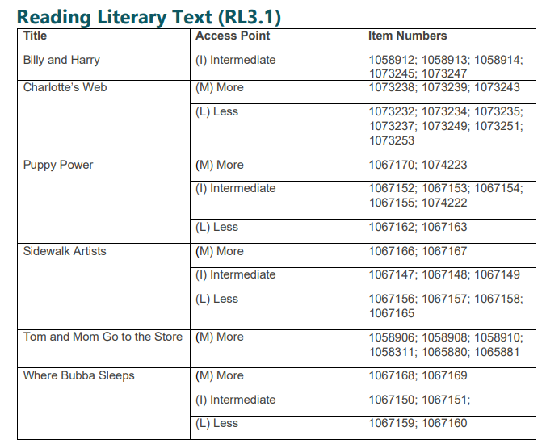
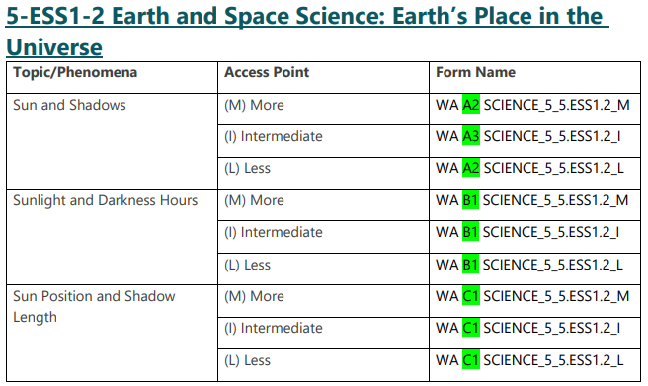
WA-AIM- What is New
Performance Task Title/Topic Map
Found at back of Grade Level Performance Tasks
Notes:
New to the Performance Tasks found on the OSPI WA-AIM webpage are Title or Topic item maps to assist teachers in finding related item content. These table are for any passage-based standards and all science forms. Hopefully this will help educators identify and use more of the items available. Showing on the screen on the left is an example from Grade 3 Literary text- here you can see the passage titles in the far left column, the access points that title is available in the middle column, and the specific item numbers for each access point with content written to that passage in the far right column. If we look at the last title in the table, Where Bubba Sleeps the user can see that this passage can be used across all three access point, and each access point has two items written at that level.
The next example is from grade 5 science, where instead of item numbers in the last column you have the Form Name, since all science content is only available at the form levels. Starting on the left you have the Topic or Phenomena, the middle column contains the access point with content written to that topic or phenomena, and the specific form names for that access point. The alpha numeric labeling system is highlight to point out that, specific to standards where only fixed forms are available, the major labeling convention that distinguishes the form. For example, when looking at the phenomena of Sun and Shadow the user can see there are forms at each access point. The More complex form is A2 with an M for More at the end. The Intermediate form is A3 with an I at the end, and the Less form is A2 with an L at the end.

Slide 24
WA-AIM- What is New
Updated Engagement Rubric Module
The Engagement Rubric training module has been updated. To note, this is the content that was updated:
If the submitted Engagement Rubric is complete and activities are aligned to the specific content areas:
Student will be reported as a participant
Student will earn the base score of 100
Student will be reported at Level 1
HS students: Engagement Rubric DOES NOT satisfy or waive the Graduation Pathway graduation requirement.
Notes:
The Engagement Rubric training module has been updated. The major update is explicit language speaking to the use of the Engagement Rubric for high school student does not satisfy or waive the graduation pathway requirement.

Slide 25
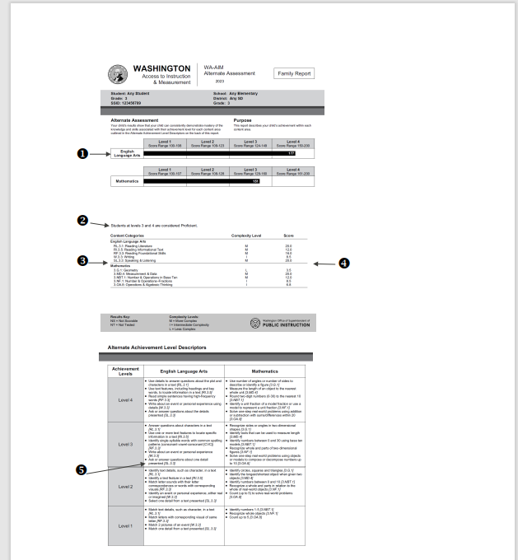
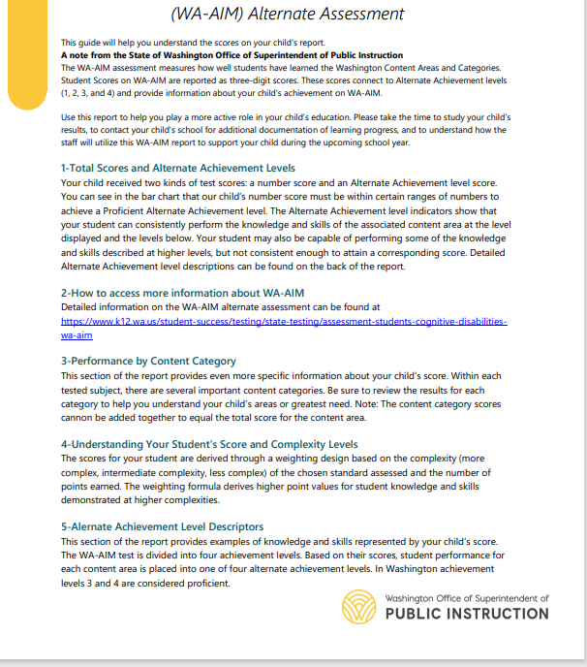
WA-AIM-What is New
Parent Guide
Parent Guide
Notes:
The Parent Guide explaining the components of the Individual Student Reports has been updated to reflect the current ISR format. It is a two-page document that can be provided to families or guardians. Page 1 contains a brief introduction followed by the explanation of the five components that make up the ISR. Page 2 shows an example ISR with the five components identified.

Slide 26
Technology

Slide 27
iPad OS Update
Secure Browser 9.0 for iPadOS
Cambium has resolved issues that were identified in the earlier version of the Mobile Secure Browser.
Mobile Secure Browser 9.0 is now available to download in the Apple App Store.
This browser must be downloaded and used by all students testing on iPad devices for the 2023–2024 school year.

Slide 28
Windows Secure Browser Update
Cambium has resolved the warning message affecting some users during the Secure Browser 16.0 installation for the Windows operating system.
The updated Windows Secure Browser 16.0 was deployed to the WCAP portal on Friday, August 11, 2023.
If you have already downloaded and installed the earlier version of Windows Secure Browser 16.0, you do not need to re-install this update.

Slide 29
Assessment Development

Slide 30
TIDE Rollover
July 3-Aug 21: TIDE is closed, no new users, no password resets
  July 3-Aug 20: existing users can still log into Smarter systems like SRS and Tools for Teachers
Aug 21: All district/school/teacher users scrubbed from TIDE.
  All CAI systems, plus SRS and Tools for Teachers unavailable to all users
Aug 22: TIDE opens for SY23-24.
  OSPI uploading DC accounts at 9am.
    DCs based on WAMS>Profile “District Test Coordinator” as of EOD 8/18
  DCs activate own account and then add other users.
  Once the account in activated in TIDE for the new school year, users will have access to available systems again.
Notes:
Presenter: Kara
First up, rolling over to the new school year.
As you have likely noticed, TIDE is currently listed as “coming soon” on the WCAP portal. Users can still log into the Smarter Reporting System and Tools for Teachers.
This coming Monday, August 21, all users except state-level and private school users will be scrubbed from TIDE. This will mean that no systems are available through the WCAP portal on Monday.
Then on Tuesday, August 22, TIDE will open for the 23-24 school year. At 9am that morning, I will upload a list of District Coordinator names and emails to TIDE, and those accounts will be added to TIDE at that time. The list we are using will be pulled from the WAMS profile after End-of-Day this FRIDAY.
Once the DC accounts are added to TIDE, DC users will need to activate their account. Then they’ll be able to log in and add other users for the district.
Once users activate their TIDE account for the new year, they’ll be able to access systems like the SRS and Tools for Teachers again.
The action item for you: by EOD this Friday, please log into WAMS and go to the Profile tab. Confirm that the person listed as the District Test Coordinator is the correct person.

Slide 31
TIDE Email for Activation
DCs get activation email on August 22 soon after 9am from DoNotReply@cambiumassessment.com with link to create a new password
  Link active for 15 minutes; secondary link in same email if original expires
  Work with your IT staff to add email address to safe senders list
DCs then required to create accounts for school/district users
  A list of accounts from June 2023 are available in WAMS, in the user upload format. If you use this list, please clean and confirm users before uploading.
Notes:
Presenter: Kara
Here’s how TIDE activation works…
Once your account has been created, you will receive an email containing two secure links: An activation link and a second link to request a new activation email.
If this email does not appear in your inbox, you may need to check your junk mail or spam folders for a message from the DoNotReply@cambiumassessment.com email address. You may also want to work with your school/district technical contact to add this address to your safe senders list.
Click the first link, follow the on-screen prompts and requirements to create a new password, and click Submit when finished.
Please note, the secure link is only active for 15 minutes. If you miss the 15-minute window to reset your password, you can click on the second link in the email to request a new link.
If you require any further assistance with the TIDE login, please contact the Help Desk:
Tel 1.844.560.7366
wahelpdesk@cambiumassessment.com
Again, after the DC has activated their account, the next action is to add users for your district/school. We are not being prescriptive about how to do this, since we know districts have different processes—some of you do this at the district level with the DC or DA creating all accounts. Some of you spread this out and have more work done at the school level.
One thing we have done to help you is that we have made an upload file for you, using the accounts that were in TIDE in June of ‘23. If you decide to use this list, please be sure to clean the list first. I’ll talk about that in two slides.

Slide 32
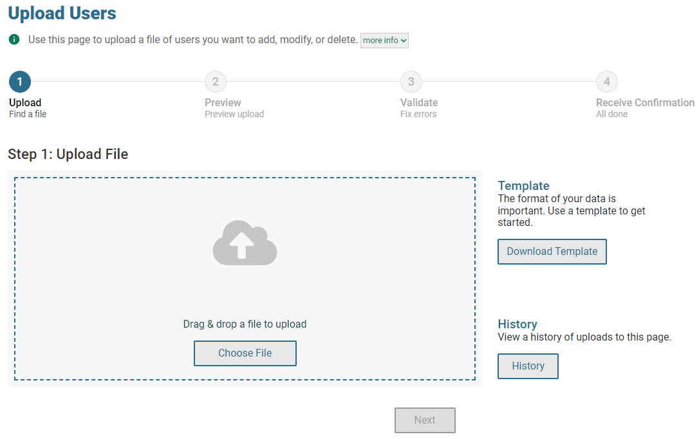
Refresh of File Upload in TIDE
Notes:
Presenter: Kara
But first I want to let you know about a little refresh to the file upload screen. The new screen is shown here. You will find that everything is bigger and more visible on the screen.
You can drag-and-drop a file in the big box. The Download Template and History buttons are no longer hidden. When you get to the preview and validate steps, the tables are easier to read and errors are explained better.
There are directions for how to work with this screen in the embedded TIDE Help Guide. Just click Help in the upper right corner of the screen, then look at the Uploading Records section.
This is very intuitive and easy to work with. I don’t want to do a deep dive on this today, but didn’t want you to be surprised next week when you start to upload users for this new year.

Slide 33
Reminders about TIDE User Roles
Multiple user-roles within TIDE causes the SRS to be confused.
Only 2 DCs per district: one primary and one backup (if desired)
  Only difference between DC and DA:
    Get alerts about Concerning Test Responses
    NEW: can change IDEA, 504, ELP status flags
All other district-level users should be DAs.
DC/DAs should not be SCs or TAs at specific schools.
  DC/DAs can do everything at the school the SC/TA roles can do.
SCs should not be a TA at the same school.
TFT_SC is only for users with no other role in TIDE but need access to Tools for Teachers.
Notes:
Presenter: Kara
Now back to cleaning up those users, making sure your staff have the access they need, and not more.
First, users with multiple roles in TIDE can cause confusion in SRS. Try to minimize multiple roles wherever possible.
Second, there should only be 1 or 2 users with the DC role per district. We think of these two roles as your district assessment coordinator and a backup. There are only two things that the DC role can do that the DA roll cannot do: 1) The DC role gets the “Concerning Test Response alerts.” and 2) which is new this year, the DC role can change the IDEA, 504, or ELP status flags in case a student breaks an arm and needs Speech to Text for testing.
We want to make sure that only a couple of people have access to that sensitive information, that’s why we are saying only 2 DCs per district.
Other users who need district-wide access for adding users, updating student test settings, monitoring testing, etc. should be given the DA role.
Third, if you are a DC, you should only be that role. DC/DAs should not be SCs or TAs at specific schools. DC/DAs can do everything at the school the SC/TA roles can do. Even administer tests.
Fourth, the SC should not be a TA at the same school. Again, it’s redundant.
Last, we also see a lot of users with the TFT_SC role who do not need it. We have this role so that ESD coaches and university staff can have access to the Smarter Balanced site Tools for Teachers. But it is only needed if the user has no other role in TIDE. All the other roles in TIDE (DC, SA, PS, SC, TA, and IS) already have access to Tools for Teachers.

Slide 34
Practice/Training Tests and Interims
Practice/Training Test availability: Mid September
  September 18 is current tentative target date
Interim availability: Early October
  October 2 is current tentative target date
No new interims. A few item changes within existing tests.
  G8 ELA Performance Task: replaced Argumentative task with an Explanatory task
Interim questions are available in Tools for Teachers, the Interim Assessment Item Portal (IAIP)
Notes:
Presenter: Kara
Rolling over the practice and training tests, as well as the interims….
We are working towards the practice and training tests rolling over in mid-September. They are currently available in the WCAP Portal with the items and features from last year.
We are also working towards the interims being available in early October. There are no new/additional interims this year. But there are a few item changes. These changes are things like: updates to content, updates to accessibility features, and items removed or replaced for Bias & Sensitivity reasons. The biggest swap out is that the G8 ELA Performance task had to be changed because the permissions to use the stimulus were unable to be renewed. It’s now an explanatory task.
If teachers want to look at the interims before October, they can get them through the IAIP within Tools for Teachers. If you don’t know how that works, it’s a great question for the ASI inbox or for our monthly open-office hours call the week prior to this webinar.

Slide 35
SRS Rollover: Student Groups
SRS rollover is just before the interims are available.
  September 22 is current target date.
Keeping “2023” student groups in SRS until November 8, 2023.
  Allows teachers to see all spring 2023 results through November
    Spring 2023 WCAS results in SRS as of 8/14
    Spring 2023 math/ELA results in SRS since spring
Student groups for new year (with “2024”) can be uploaded when SRS rolls over.
On November 9 (Thursday before the Veteran’s Day weekend), all “2023” student groups will be removed.
Notes:
Presenter: Kara
And the last rollover topic is the SRS.
The SRS is available now, and you can add student groups with 2023 as the year between now and September 20. On September 21, the SRS will be unavailable as it rolls over. Then is scheduled to be available again on September 22. After the 22nd, new student groups with 2024 as the school year can be added to the system.
The groups from 2023 will remain available through Wednesday November 8. The evening of November 9, the 2023 groups will be removed.
This is the end of the rollover topic.

Slide 36
Spring 2024 Testing
No changes to Smarter Balanced (math and ELA) structure or reporting
  Same blueprint as used in spring ‘22 and ‘23 “adjusted blueprint”
  Students receive scale score, level, and (for ELA) writing trait scores
  Claim level and scores are not able to be reported
  Student groups, schools, districts have Target reports available in SRS
No changes to WCAS structure or reporting
  12th graders will be eligible to take the WCAS
    Support of local district policies including credit retrieval/recovery
Notes:
Presenter: Kara
Now, for spring ‘24 testing.
There are no changes to the structure or reporting of the ELA, math, or science tests.
The ELA and math Smarter Balanced tests will continue to use the “adjusted blueprint” and the same types of data available in spring 23 will be available in spring 24. We know that many of you would like to get claim scores again. The Smarter Balanced Consortium did some explorations and came up with a plan to report some new claim scores for the adjusted blueprint. We looked at their plan and concluded that the options they offered do not add enough precision or specificity to warrant any specific actions or ideas of what to do next with the student, so we will not be using those. Instead, we encourage you to use the Target reports, which are available at the group, school, and district level.
The only update to WCAS stuff is that….because of popular demand…students in grade 12 are now eligible to take the WCAS. Please note that this is only to support district policies about credit retrieval.

Slide 37
Math and Science Presentation: Spanish TTS
Both Spanish text and English text can be read aloud with Text-to-Speech.
  Must have both Presentation Spanish and TTS (Test Content) activated in TIDE student test settings
  Must have Spanish voice pack installed on the testing device
  Student will use buttons in the context menu to activate the TTS
 | Button text is in Spanish
Speak Option | Opción de hablar (en inglés)
Speak Passage | Diga el pasaje (en inglés)
Speak Question | Hable la pregunta (en inglés)
Speak Spanish Option | Opción de hablar (en español)
Speak Spanish Passage | Diga el pasaje (en español)
Speak Spanish Question | Hable la pregunta (en español)
Notes:
Presenter: Kara
Now for some fun new stuff to support students taking the Spanish version of the online math and science tests.
First up is Spanish Text-to-Speech! The student test settings of Presentation must be set to Spanish, and the Text-to-Speech (Test Content) must be activated (usually by choosing Stimuli+Items) for this to work.
The testing device also MUST have a Spanish voice pack installed for this to work. The TTS checks during the login process will look first for a Spanish voice pack and then for the English voice. If the Spanish voice pack is not installed, the Secure Browser will not let the student proceed. You will be able to see this in the training and practice tests after they roll over in early September. Guest mode training tests will also not let you proceed if a Spanish voice pack is not detected.
Once the student passes the TTS check and is in the test, the student will use buttons in the context menu to activate the TTS in either Spanish or English!
I don’t have a screenshot of the context menus for you yet. What I do have is a list of what the button text will be in the interface. That text is the right-hand side of this table.

Slide 38

Math and Science Presentation: Spanish
New default for how the text is presented on the screen
  Student will first see only Spanish version on screen
  Student click the change language button in the top menu to switch to seeing only the English version on the screen
  “Switch between Spanish only or English only”
If the previous years’ layout is preferred, change Translations (dual language) Test Spanish in TIDE student settings to:
  “Show Spanish above English”
PLEASE have students try this out in a Training test to determine their preference before testing!!!!!
Notes:
Presenter: Kara
We also have a new way for the test to be displayed on the screen. [I have screenshots in the next few slides. Hold tight for this explanation first.]
The new default for the Spanish translated test will be that at first, the student will only see the Spanish version of the stimuli and questions on the screen.
The student will have a globe button in the top menu. They can use that button to switch between this Spanish only version to an English only version of the text.
Please note: the text of the buttons and menus will stay in Spanish the whole time. It is just the stimulus and the questions that will change between the two languages.
And, each time the student uses the Next button to move on in the test, the Spanish version will display first.
This default setting is called “Switch between Spanish only or English only”
If the layout used in previous years is preferred by the student, the setting “Translations (dual language) Test Spanish” can be changed to “Show Spanish above English” in TIDE.
This has to be set before testing. Please have students try these out in a Training test to figure out which one they prefer.

Slide 39
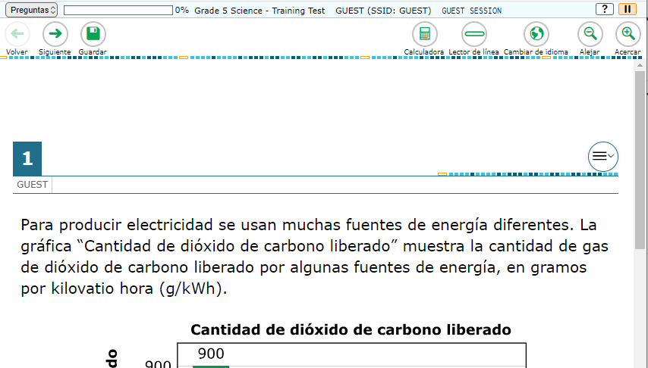
Spanish Presentation default:
Switch between Spanish only or English only
Notes:
Presenter: Kara
Now for the screenshots.
This shows the Switch between Spanish only or English only. The change languages globe button is circled in red. The text of the question is only in Spanish.
Next slide…

Slide 40
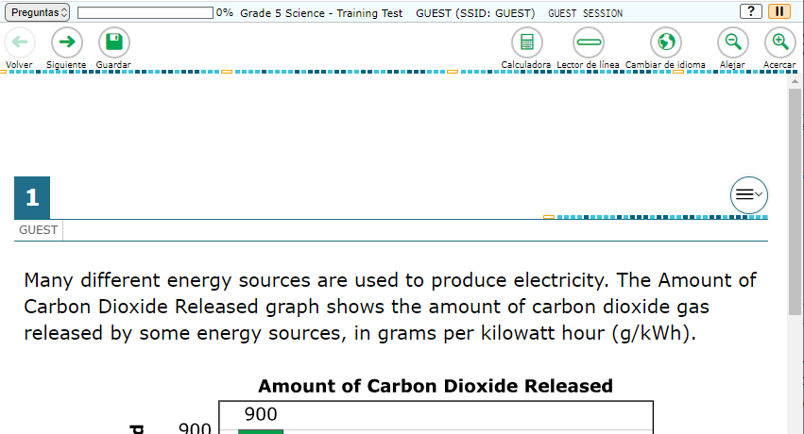
Spanish Presentation default: 1
Switch between Spanish only or English only
Notes:
Presenter: Kara
When the student uses the globe button, the text of the question changes to English. The student can use the globe button to switch between these views.
Next slide.

Slide 41
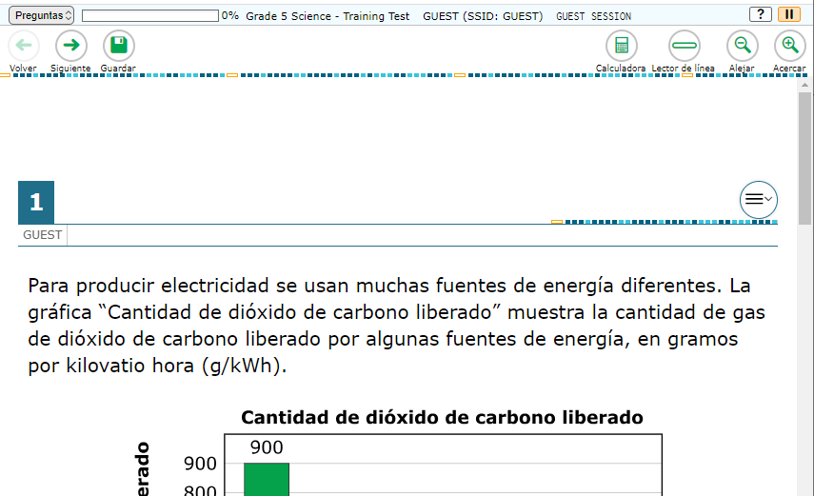
Spanish Presentation other choice:
Show Spanish above English
Notes:
Presenter: Kara
This shows the previous version. Notice there is no globe button to change the language.
The Spanish shows at the top….then you scroll down….next slide.

Slide 42
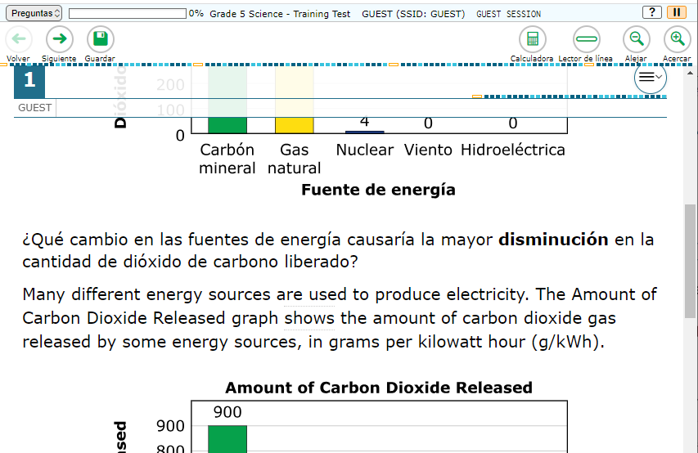
Spanish Presentation other choice: 2
Show Spanish above English
Notes:
Presenter: Kara
And you can see in the middle of the screen, after the question in Spanish the English version of the question appears.
Again, this was the only way these Spanish tests were shown in previous years.

Slide 43
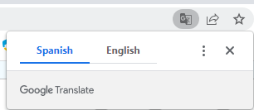
Spanish Presentation:
Note about practice/training versions
Chrome will offer to translate the Spanish text into English
This will pop up when the first question is on the screen
Students should ignore this, as it won’t happen in the Secure Browser.
Notes:
Presenter: Kara
One last note. When you use the Spanish Presentation in the practice or training tests, when you get to the questions, the web-browser may helpfully offer to translate the screen for you. Students should be told to NOT do this. They should ignore this, because this option will not be presented to them during the summative test in the Secure Browser.

Slide 44
Data

Slide 45
Spring 2023 Assessment Reporting
ELA/Math/Sci data V2 in WAMS
  Correction to WCAS claim issue (level/met)
WIDA data now in WAMS
WCAS data now in SRS
EDS Applications populated by end of week
  Pathways Database
  Washington Query
  Tableau Secure Preview
  LEP
Report Card Go Live September 8 (TENTATIVE)

Slide 46
Fall 2023-2024 Systems Go Live
TIDE Rollover: next week
CEDARS: early-September (TBD)
WAMS pre-ID applications: mid-September (after CEDARS, before interims)
First nightly file to TIDE: mid-September (after CEDARS, before interims)

Slide 47
Selecting Print Options for Family Reports
New “Family Reports” tab – to select all/some/zero paper reports for SBA/WCAS (not WIDA or WA-AIM)
Default is “all paper reports;” you can opt for PDF-only
All districts receive PDFs of every report
Select for entire district or by school
Notes:
A new Family Reports tab in WAMS allows districts to select their preferred option for printed spring 2023 Smarter Balanced and WCAS family reports shipped from OSPI in fall of 2023. This tab will close in early September on a date yet to be determined.
DACs can indicate whether printed family reports should be printed and shipped for students in all schools ("Print All District Reports"), only for certain schools ("Print Selected Schools"), or not for any schools ("No Printed Reports") if your district uses only electronic family reports. If "Print Selected Schools" is selected, you will be prompted with a list of schools and asked to select which of those schools should receive printed reports.
Any district that does not want printed copies MUST opt out by checking the "No Printed Reports" column or you will automatically receive printed copies for your district. All Smarter Balances ELA/Math/WCAS family reports will still be available electronically in WAMS for students in all schools.
WIDA and WA-AIM family reports will continue to be provided by their respective vendors and are not included on the Family Reports tab.

Slide 48
Assessment Operations

Slide 49
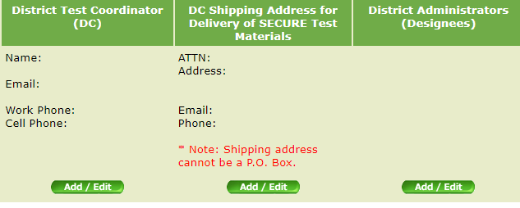
Contact Information in WAMS Profile
EDS > WAMS > Profile
In WAMS Profile it is critical that you update your:
Shipping address for secure test materials
DC and DA contact information
Notes:
With the beginning of a new school year, it is important to make sure that the contact information for your district is correct and updated in WAMS Profile. This information is critical because it is used for communication purposes and test material shipments. The DC information in WAMS Profile will also be used to assign the DC role in TIDE just prior to it opening for the 2023-24 school year, so it is very important that the correct information is in there prior to August 22.
Please make sure to take a couple of minutes to review the information and make any updates that might be needed, such as updating your shipping address, or removing people who may no longer be supporting assessments in your district and adding any new people.
The User Profiles include:
The District Test Coordinator (DC)
The District Administrators (Designees)(DAs)
And any Program Specific Coordinators you might have who support specific programs such as WaKIDS, WA-AIM, ELP assessments (WIDA), etc.
The number of DAs or additional contacts is not limited, but keep in mind that DAs will receive all the same communications as DCs.
And, as a note, if you are the DC there is no reason to also list yourself as a DA, as you are already going to receive all communications and permissions in your DC role.

Slide 50
Recently Posted to the WCAP Portal
Register for Monthly Assessment Update Webinars Registration links for monthly Assessment Update Webinars
Quick Start Guide This Quick Start Guide provides District Test Coordinators with information on user’s roles and responsibilities, test
Student Records Management for Assessment Accountability User Guide (SRMAAUG) The Student Record Management for Assessment Accountability User Guide details when and how to pre-ID students, TIDE student
Guidelines on Tools, Supports and Accommodations for State Assessments (GTSA)
Notes:
Here is a list of some of the resources that were recently updated and posted to the WCAP Portal. We also have a number of resources that will be posted in the next few weeks. Remember, new resources that are posted to the Portal, WAMS, or the OSPI website are communicated every week in the WAW newsletter.

Slide 51
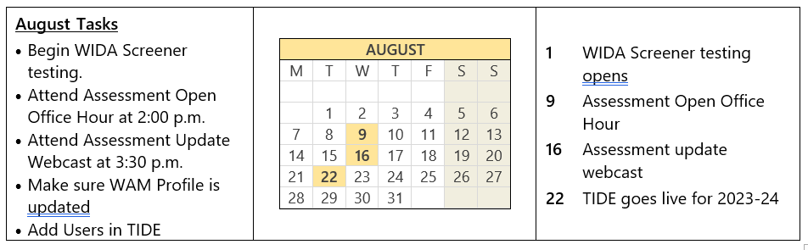
Important Dates for August
Notes:
Here are some important dates and tasks for August.

Slide 52
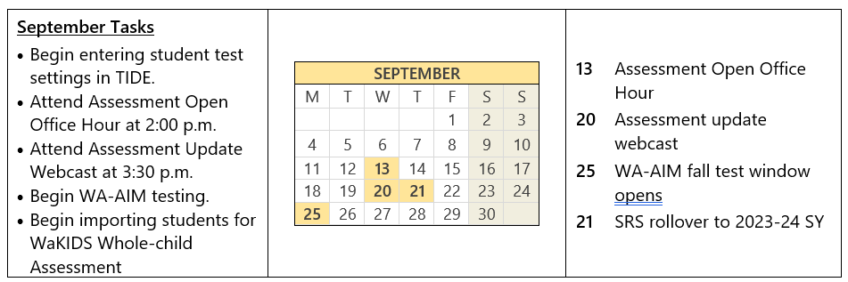
Important Dates for September
Notes:
And here are important dates and tasks for September.

Slide 53
WCAP Contacts
OSPI Assessment Analysts for student data issues:
  assessmentanalysts@k12.wa.us 360–725–6109
OSPI Assessment Development for content questions:
  ELA and Math assessments: asi@k12.wa.us
  Science assessment: science@k12.wa.us
OSPI Assessment Operations for assessment policy and test materials:
  Assessment@k12.wa.us 360–725–6348 or 1–800-725–4311
Cambium Washington Help Desk for Technical, Network, and password issues:
  wahelpdesk@cambiumassessment.com 1–844–560–7366
WIDA Client Services Center for accounts, assessments, and resources
help@wida.us 1-866-276-7735

Slide 54
Assessments & Student Information

Slide 55

Thank you

