Slide 1
Test Administrator Training
Template for Training TAs
This presentation contains a script in the notes section. If you are accessing this information with a screen reader, be sure you are reading the notes section as well as the text contained in the slides.
SMARTER BALANCED AND WCAS 2024
Updated January 9, 2024
Notes:
THE NOTES ON THIS SLIDE ARE SPECIFIC FOR DCs, DAs, AND SCs TO USE FOR TRAINING TAs:
This PPT template was created for DCs, DAs, and SCs to use when training Test Administrators (TAs) and other staff who support the 2024 online and accommodated paper-pencil test administration of the Smarter Balanced and Washington Comprehensive Assessment of Science (WCAS). It is recommended that this template be supplemented with information specific to your district and schools.
Considerations
During your training, you may want to demonstrate the WCAP Portal systems and resources by accessing the portal online and sharing the purpose of each system and resource as you are walking your audience through them.

Slide 2
Introductions
____________________________, District Assessment Coordinator (DC)
____________________________, District Administrator (DA)
____________________________, School Test Coordinator (SC)
____________________________, Principal
Notes:
Consider including an introduction to each team member presenting this training. You may also want to make note if you have a Principal attending.

Slide 3
Acronyms
Acronym | Definition (Systems, Applications, Manuals)
CAT | Computer Adaptive Testing
GTSA | Guidelines on Tools, Supports, & Accommodations
PT | Performance Task
SRS | Smarter Reporting System
TAM | Test Administration Manual
TIDE | Test Information Distribution Engine
TSBP | Test Security and Building Plan
WCAP | Washington Comprehensive Assessment Program
WCAS | Washington Comprehensive Assessment of Science
Acronym | Definition (Users)
DC or DAC | District Assessment Coordinator
DA | District Administrator
SC | School Test Coordinator
TA | Test Administrator
Notes:
As we move through this presentation, there will be times that acronyms are used instead of displaying the full name of a system or material. This slide defines those acronyms.

Slide 4
Teacher Resources
The table lists some resources that can help teachers and TAs become more familiar with the testing components:
General Information | User Guides and Manuals | Trainings
Classroom Resources on WCAP Portal | TA User Guide | Test Administrator Interface for Online Testing
Assessment Blueprints for Smarter Balanced | Test Administration Manual | TA and Summative Scores video
Achievement Level Descriptors | Smarter Reporting System Introductory Guide | Secure Browser for Student Online Testing
WCAS Test Design and Item Specifications
Notes:
This slide lists a few of the resources available to help teachers and TAs become knowledgeable about the assessments and online testing components. There are many other resources as well, too many to include on this slide.
A greater level of understanding about the assessments can help you to be more comfortable with administering the assessments, which in turn can help students be more comfortable taking the assessments.
Most of these resources can be found in the Smarter Balanced or WCAS Preparing for Testing section of the Portal
The WCAS Achievement Level Descriptors can be found on the OSPI website at the following URL: https://ospi.k12.wa.us/student-success/testing/state-testing/state-testing-scores-and-reports/achievement-level-descriptors
The WCAS Test Design and Item Specifications can be found on the OSPI website at the following URL: https://ospi.k12.wa.us/student-success/testing/state-testing/washington-comprehensive-assessment-science/wcas-educator-resources

Slide 5
Accessibility Features
Some accessibility features are available to all students as universal tools, others are only available as designated supports or as accommodations.
The GTSA provides information on accessibility features available for students for the Smarter Balanced and WCAS assessments.
Accessibility features not listed in the GTSA are not allowed
Non-Standard Accommodation and Designated Support Requests If a student’s IEP or 504 plan stipulates access to an accessibility feature not listed in the GTSA, the student’s IEP team can ask the DC to submit a formal request to the state for consideration.
Notes:
Accessibility features are helpful for some students who use them regularly during classroom instruction, or who have a documented need.
Refer to the Guidelines on Tools, Supports, & Accommodations, also referred to as the GTSA, for specific questions about restrictions and use.
Accessibility features not listed in the GTSA, are not allowed.
If a student’s IEP or 504 plan stipulates the use of a feature not listed in the GTSA, the student’s IEP team can ask the DC to submit a Non-Standard Accommodation or Designated Support Request to the state for consideration.
Any accessibility features used on a state assessment should be familiar to the student.
The GTSA and the TA Script of Student Directions provide details about what is permitted for each assessment.
There are also trainings on using the GTSA, which can provide more information:
YouTube links Using the GTSA
Episode 1: https://www.youtube.com/watch?v=EYzWWWpt0PM
Episode 2: https://www.youtube.com/watch?v=c6WNyoYhcRM
Episode 3: https://www.youtube.com/watch?v=8C4QqWpdZrQ
Episode 4: https://www.youtube.com/watch?v=Z9ohgV6oo4I

Slide 6
Security

Slide 7
Basic Security
Security of the assessments is vital to maintaining the fairness and validity of the results.
Student information is confidential and should be kept secure.
In addition to attending training, staff must fill out and sign the Test Security Staff Assurance Report both after training and after testing.
Notes:
The security of test content and the confidentiality of student information are vital to maintaining the validity, reliability, and fairness of the test results.
In addition to attending all required training, staff must fill out and sign the Test Security Staff Assurance Report both after training and after testing.

Slide 8
Prohibited Activities
Under no circumstances should staff:
Review, discuss, or copy secure test content or student responses
Use secure test content to develop instructional resources
Assist with or interpret test content for students
Alter student responses in any way
Leave secure test content unattended in a non-secure location
Leave students unattended during testing
Notes:
Under no circumstances should staff:
Review, discuss, or copy secure test content or student responses
Use secure test content to develop instructional resources
Assist with or interpret test content for students
Alter student responses in any way
Leave secure test content unattended in a non-secure location
Leave students unattended during testing

Slide 9
Commonly Reported Incidents
Student access to non-approved electronic devices.
Student access to non-approved accessibility features.
Calculator use on a non-calculator portion of an assessment or hand-held calculator use during an online math assessment.
Instructional materials not being covered or removed from the testing location.
TAs deviating from the approved script of student directions or test schedule.
TAs leaving the testing location unattended.
TAs administering an incorrect assessment, such as a summative assessment instead of a training, practice, or interim test.
Notes:
We will share a few of the incidents most commonly reported:
Student access to non-approved electronic devices, such as cell phones, smart watches, or blue-tooth earbuds.
Student access to non-approved accessibility features. Example: using a hand-held calculator during an online math test session (unless needed as a documented accommodation) The GTSA and the Calculator Policy provide information on the availability, use, and restrictions of calculators for assessments.
Instructional materials not being removed from the testing location may require invalidation of student test results. Be sure to check your testing location prior to administering a summative assessment.
TAs not following the script of student directions.
TAs leaving the testing location unattended.
TAs administering an incorrect assessment, such as a summative assessment instead of a training, practice, or interim test. It is important to have a clear understanding of the test being administered.

Slide 10
Top Testing Incidents Requiring Test Invalidation
Students having access to non-approved electronics.
Students left unattended in the testing location.
Notes:
The top testing incidents requiring test invalidation were students having access to non-approved electronics (such as cell phones) and students left unattended while testing. When tests are invalidated, the student gets a score of zero.

Slide 11
Test Incidents
When test incidents occur, it is important to:
Stop the test session for the individual student or class.
Take corrective action to mitigate the incident.
TAs report incidents as quickly as possible to the SC, who contacts the DC. The DC works with OSPI when required.
If required, TIDE appeals are submitted by the DC or DA. Approval is required at a state level. Appeals will be processed within 24 hours.
Breaches must be immediately reported to your SC and DC, who will then report to OSPI right away. For more information, see The Test Incidents section of the TAM.
Notes:
There are several types of test incidents. Each type may be addressed differently, but TAs must promptly report all incidents to the SC. This helps to ensure a fair and equitable testing environment for all students. Refer to the Appendix A of the TAM for full details.
If an incident occurs:
Stop the student(s) testing session by pausing the individual student test or group session.
Take corrective action to mitigate the incident and notify your SC right away for guidance.
Gather all necessary information to be reported.
Document the incident with as much detail as possible, including information such as date, time of day, who was involved (SSID), and the item number (when applicable). For technology or system related issues, you should also have the following:
TA session ID, device used during testing, network configuration, and operating system
Prompt communication is important and should follow your district plan.
Breaches are considered a high risk. An example of a breach would be if a student or adult had collected or released secure test content or student responses. This is immediately reported to the SC, DC, and state. Do not use electronic devices or email for transferring secure/confidential information.

Slide 12
Security, Policies, and Responsibilities
State and local laws and policies specify practices to ensure test security and the standardized and ethical administration of assessments.
Students must be monitored throughout testing.
Only staff members trained for state assessments can administer or be in a testing room.
Volunteers, media, parents, or students not testing are not allowed in a testing room.
Reviewing and disclosing test questions is a violation of state law.
Professional Code of Conduct
The Professional Code of Conduct is codified by the Washington State Legislature in WACs and RCWs. A list of complete rules and regulations can be found online: www.k12.wa.us/ProfPractices/CodeConduct.aspx
The Office of Professional Practices (OPP) is charged with enforcement, including discipline of educational practitioners for violation of the Professional Code of Conduct. The office receives, investigates, and makes legal findings regarding complaints. Unprofessional conduct is reported to OPP (360) 725-6130.
Notes:
As with all state assessments, state laws must be adhered to, and best practices followed in the classroom.
Allowed and prohibited behaviors are detailed in Appendix A of the TAM.
Know who should and should not be in the testing environment. Trained staff can be in a testing room, under the general supervision of a certified staff member. Volunteers, parents, or students who are not being assessed during the current segment, and media are not allowed.
Reviewing and disclosing test content or student responses is a violation of state law.
The Office of Professional Practices (OPP) is charged with enforcement, including discipline of educational practitioners for violation of the Professional Code of Conduct. OPP receives, investigates, and makes legal findings regarding complaints.

Slide 13
TA Responsibilities
Before, During, and After Testing

Slide 14
TA Responsibilities Before Testing
Complete test administration training and review all state testing policies and administration documents prior to administering state tests
Complete and sign a Test Security Staff Assurance Report (After Training)
Become familiar with the TAM and the TA Script of Student Test Directions (SAY boxes)
Have a list of students and their accessibility features needed for the test
Familiarize yourself with your school’s TSBP
Make sure all instructional materials are covered or removed from the testing location
Identify a location for students to place their electronics and bags
Notes:
The TA is the primary role for administering state assessments and ensures testing goes smoothly. This slide and the next two slides outline the duties of the TA before, during, and after testing.
After completing training, carefully read and then sign the Test Security Staff Assurance Report.
Review and follow the information in the TAM on preparing the test environment.
The rules for each administration may differ slightly. For example, the accommodated WCAS paper testing allows a maximum of 3 students per TA for administration. Before testing, please be sure that you read the TAM for clear instructions to help you become familiar with the role of a TA. Review the TA Script (SAY boxes and TA text) and the Final Processing Steps for TAs, prior to administering tests.
Have a list of students and any accessibility features they need for testing.
Know which materials are permitted for each test.
Inventory and alert your SC if additional materials are needed.
Become familiar with your school’s TSBP. This should include the information on testing schedules, seating arrangements, processes for handling secure materials, testing students, and reporting incidents.
Know how to contact your SC and/or DC should you need assistance during testing.
Students must be actively monitored at all times by a trained TA during testing. At least one TA must be in the testing location at all time.
Know your break schedule and hall monitor plan.
Make sure all instructional materials are covered or removed from the testing location
Identify a location for students to store non-approved electronic devices and bags.
The student directions being read by the TA will instruct students to turn off electronic devices and place them, along with bags, in a location identified by you.

Slide 15
TA Responsibilities During Testing
Receive materials no earlier than the current day of testing and just prior to the test session being administered.
Check materials out to students, and be prepared to check them back in.
Read the TA Script of Student Test Directions verbatim.
Monitor students at all times during testing.
Report testing incidents to the SC.
Notes:
TAs play an important role to ensuring a positive testing environment and maintaining test security.
Follow your school’s TSBP for tracking and returning all test materials to ensure that there are no missing secure materials.
Access testing materials just prior to each test session.
Inventory materials to ensure that you have the appropriate students’ materials. If a discrepancy is noted, immediately alert your SC for resolution.
Check test materials out to students. All papers passed out during testing are considered secure, this include scratch paper and Test Tickets.
TAs may use the state-provided Ancillary Materials Tracking Log template for tracking.
Ensure there are sufficient TAs to monitor students during testing. The WCAS paper administration requires one TA for every three students due to the design of the test.
Be sure to promptly report any testing incidents to your SC.

Slide 16
TA Responsibilities After Testing
Implement your check-in process for collection of testing materials prior to releasing students.
Process materials according to the TA Script and your school’s TSBP
Return materials to the SC immediately after each testing session.
Complete and sign the (After Testing) section of the Test Security Staff Assurance Report.
Notes:
TAs have multiple responsibilities after testing is complete, including processing materials at the end of a testing session
All materials checked out during a testing session are considered secure and must be checked back in prior to releasing students. This includes all materials distributed (e.g. test booklets, braille, large print, scratch/graph paper, glossaries, test tickets etc.).
If materials are noted as missing, immediately notify your SC.
Process materials according to your TSBP.
Immediately return all testing materials to your SC after completion of that day’s testing session. This includes test booklets and ancillary papers passed out during testing.
Complete and sign the after testing section of your Test Security Staff Assurance Report. As required by OSPI, sign and submit the report, along with your secure testing materials, to your SC.

Slide 17
WCAP Portal
Resource For Information About The
Washington Comprehensive Assessment Program (WCAP)
Notes:
We are now going to walk through the systems available on the WCAP Portal.

Slide 18
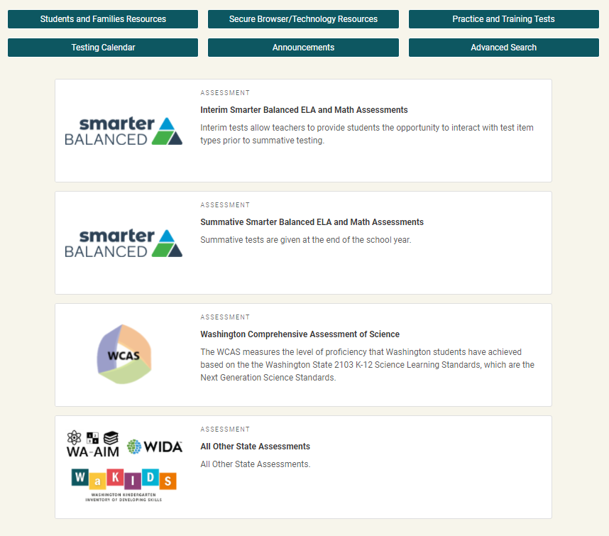
WCAP Portal
Test/task-based
Each test button will connect you to the systems and resources used in preparing, administering, and completing the test administration.
https://wa.portal.cambiumast.com/
Notes:
The WCAP Portal is located at the URL shown on the screen, which is wa.portal.cambiumast.com . You can also find it if you google “WCAP portal”.
The portal is a test/task-based system. When you select a test, it takes you to a page with only the tasks and systems needed for administration of that test.
A training on navigating the Portal can be found on the Portal by selecting a test, and then selecting the “Webinars and Trainings” Task.

Slide 19
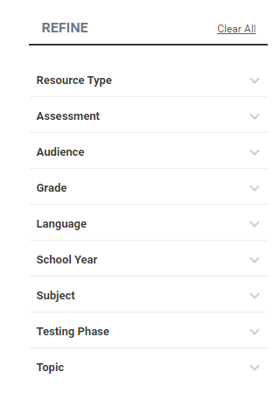
Advanced Search Button
The Advanced Search button allows you to refine your search with 9 primary search categories and more than 50 subcategories.
If you are looking to define a term instead of search for resources, you can select the Browse the Glossary button.
Notes:
You can search for documents using the Advanced Search, which is accessed from the button on the Portal home page. You can filter by Resource Type, the Assessment, etc. You can also find a list of definitions of terms by browsing the glossary.

Slide 20
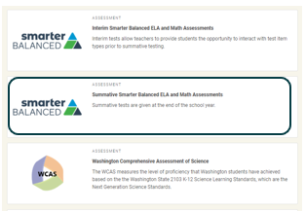
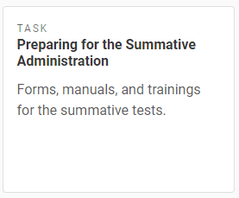
Preparing for Testing
Select the test you are preparing to administer, for example, the Smarter Summative
Smarter Interim
Smarter Summative
Summative Science
Select the Preparing for the Summative Administration task
Notes:
As an example, if you were preparing to give the Smarter Balanced Summative Assessment, on the home page of the Portal you would select the test you are preparing to administer, in this case, the Summative Smarter Balanced ELA and Math Assessments. On the Summative Smarter Balanced ELA and Math Assessments page, you would see “Tasks Associated with Summative Testing,” and would select the “Preparing for the Summative Administration” task.

Slide 21
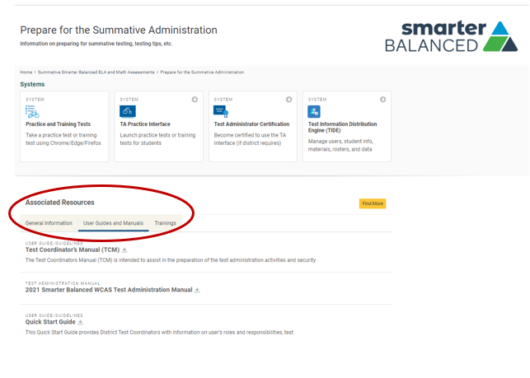
Preparing for Testing Continued
Associated Resources
General Information
User Guides and Manuals
Trainings
Notes:
Once you click on the “Preparing for the Summative Administration” task, you would be taken to the “Prepare for Summative Administration” page, where all the systems you would use in preparing for testing can be accessed, such as the Practice and Training Tests, TA Practice Interface, TA Certification, and TIDE.
Under the Associated Resources, you can look in the General Information tab to find things like the Checklists for WCAP Test Administration, Keyboarding Shortcuts, etc., in the User Guides and Manuals tab is where you will find the TAM, the Smarter Balanced Online or paper-pencil script of student directions, or the TA Interface User Guide. The Trainings tab is where you will find the Test Administrator Interface for Online Testing module, and the Secure Browser for Student Online Testing Module.

Slide 22
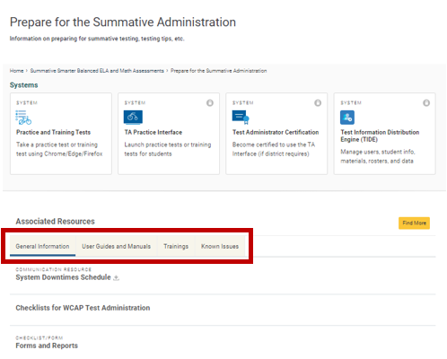
WCAP Portal-Associated Resources
Associated Resources
General Information
User Guides and Manuals
Trainings
Known Issues
Notes:
When you click on the “Preparing for the Summative Administration” task, you will go to the “Prepare for the Summative Administration” page, where you will see all the systems used in preparing for testing, such as the Practice and Training Tests, TA Practice Interface, TA Certification, and TIDE.
Under the Associated Resources, you can look in the General Information tab to find things like the Duties and Responsibility Checklists, in the User Guides and Manuals tab you can find resources like the TAM, the TA Script Of Student Directions, or the TIDE User Guide. The Trainings tab is where you will find the Test Administrator Interface for Online Testing module, and the TIDE Training Module. The Known Issues tab is where you can look at any known issues for the current school year.

Slide 23
WCAP Portal-Register for Email Updates
Notes:
Use the Register for Email Updates button to sign up to get notifications when new resources and/or announcements are posted to the portal.

Slide 24
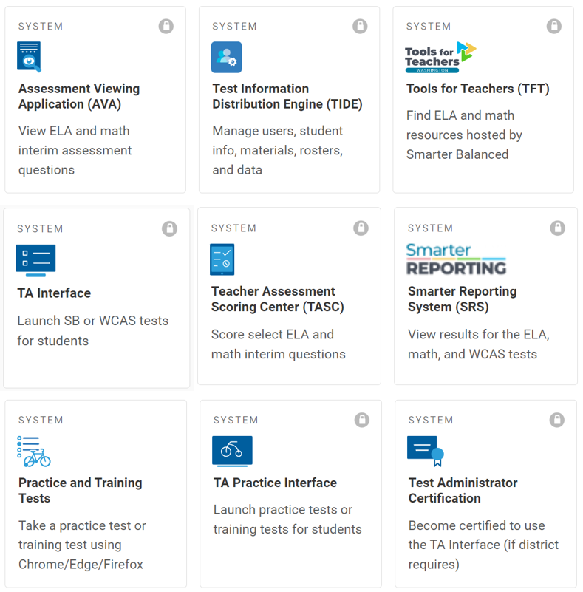
WCAP/Cambium Portal
Technical support for Cambium systems is available through the Washington helpdesk: wahelpdesk@cambiumassessment.com
Notes:
The graphic above shows the WCAP/Cambium portal tile cards and the technical support information for the Washington helpdesk.

Slide 25
WCAP Portal Materials for TA Review
User Guides and Manuals
TA Script of Student Directions*
Test Administration Manual (TAM)*
Guidelines on Tools, Supports, and Accommodations (GTSA)*
TA Interface User Guide*
TIDE User Guide
The materials the state requires TAs to review are marked with an asterisk (*).
The TA Certification course and other training resources may also be required by your district.
Trainings
Test Administrator Certification
TA Training for 2023-24* (this training)
TA Interface for Online Testing Module *
Secure Browser for Student Online Testing Module
TIDE Training Module
General Information
Calculator and Electronic Device Policy *
Notes:
This is a summary of the materials required to be reviewed annually by TAs.
School districts may also have additional resources that are required for review, and that may include completing the Test Administrator Certification course.
The User Guides and Manuals and Trainings are available on the WCAP Portal, within the Smarter Balanced and WCAS Preparing for Testing Associated Resources. The GTSA is found on the Portal in the Smarter Balanced and WCAS Accessibility Supports section, in the Associated Resources – User Guides and Manuals.

Slide 26
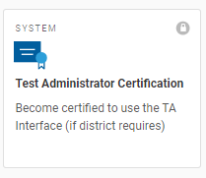
Test Administrator Certification
The Test Administrator Certification training includes a walkthrough of the TA Interface.
This system is locked and requires your secure login.
This training is highly recommended by the state and may be required by your district.
Notes:
The Test Administrator Certification is an available training tool that is strongly recommended by the state and may be required by your district.
This online training course provides an overview for:
Navigating the TA Interface
Starting a Test Session
Approving a student to test
Pausing and stopping a test session
Logging into a test as a student
The estimated time of completion for this training is 30 minutes.
At the end of the training, there is an option print a certificate, to verify you completed the training.

Slide 27
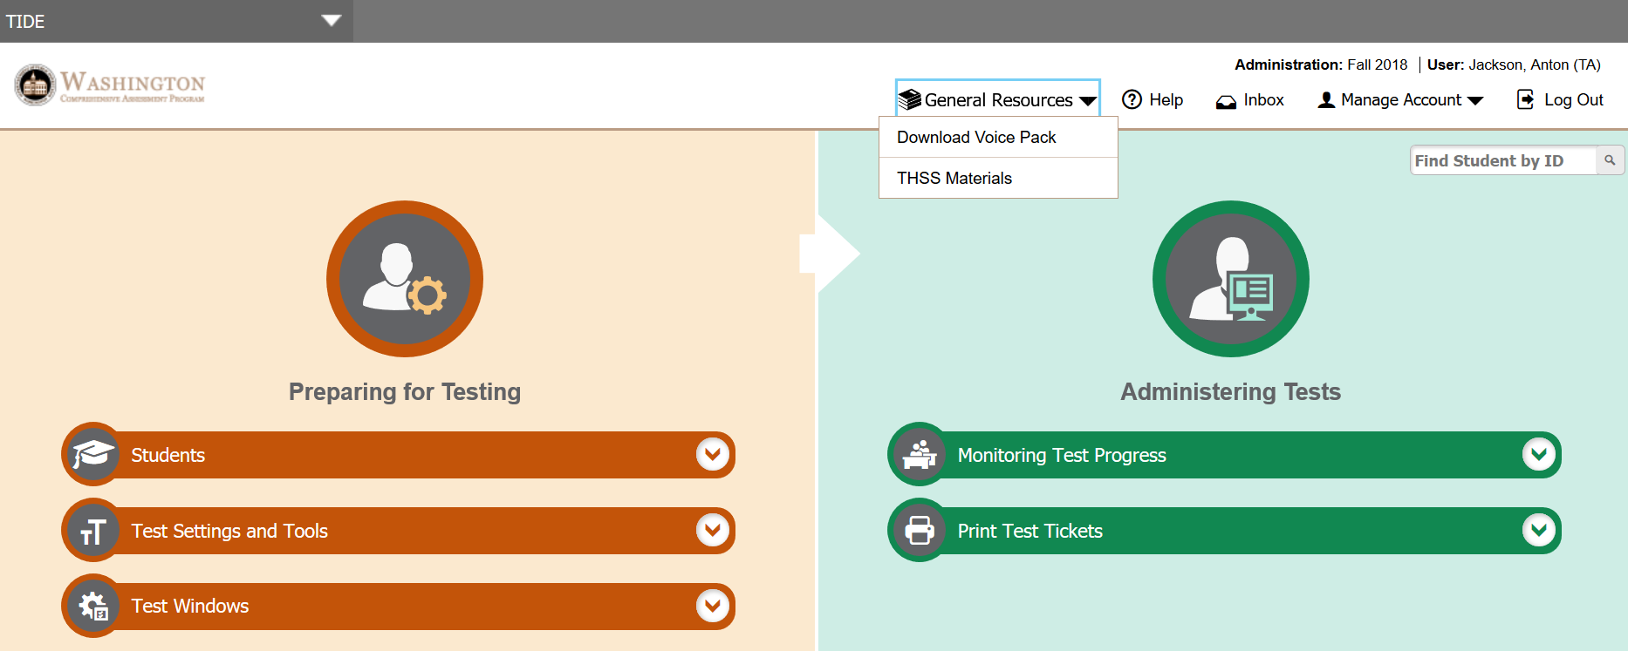
TIDE Overview
With the TA Role you can:
Verify student information
View test windows and rosters
Print test tickets (if requested by the coordinator)
Export a list of students with their test settings
Notes:
With the TA user role in TIDE, you can perform tasks the following tasks:
Verify your students’ information under the Students drop-down menu.
View your school’s testing schedule under Test Windows.
Print test tickets (if requested by the coordinator)
Print test rosters with a list of students and their test settings
Export a file which contains a list of students, as well as their test settings. If you want the list to only be the "non-default" settings, like only the Designated Supports and Accommodations for the students, be sure to export the list to the Inbox, and then download the list from that Inbox.
For detailed instructions about using TIDE, refer to the TIDE User Guide by clicking Help in the upper right banner in TIDE.

Slide 28
Training, Practice, Interim, and Summative Assessments
Understanding Testing Options

Slide 29
Practice Test and Training Test Options
Practice Tests
Smarter Balanced
Longer than the summative in length, but is not scored, approx. 30 questions
Includes tools, supports, and accommodations
Training Tests
Smarter Balanced and WCAS
Designed specifically to practice tools, supports, and accommodations
Includes a range of questions,
Organized by grade-band, approx. 6-12 questions, not scored.
Notes:
What needs to happen before administering online summative assessments?
Provide your students with an opportunity to become familiar on each content area through the Training Test and/or Practice Test before they take the Summative (accountability) assessments. Consider administering the practice tests with student login to include access to accessibility supports, per the student’s plan.
PRACTICE TESTS: Smarter Balanced math and English language arts only
The online Practice Tests are used to familiarize students with the type of grade-level content they will find on the summative assessments and to practice responding to them. Each practice test has a variety of items types across approximately 30 questions, with content across all claim areas. Practice tests include two types: one similar to the summative CAT and one similar to the Performance Task.
TRAINING TESTS:
The online Smarter Balanced Training Tests are used to familiarize students with how to log into a test, navigate tool buttons, and learn how to complete the different item types.; they are training on the software, not the test content. The intent is not to look at grade-level content.
ELA is organized by grade bands: 3-5, 6-8, and High School.
A grade 3 student may see a grade 5 question.
Math is organized differently to support calculator use.
Options include grade band 3-5, grade 6, grade band 7-8 and High School.
Grades 6-8 and High School include the embedded online calculator.
For ELA and Math there are 6-9 questions that include all item types.
The online WCAS Training Test is recommended for all students taking the summative science assessment.
Students can work with all three Training Tests (grades 5, 8, and 11), including those not in their grade level.
There are 8-12 questions per Training Test.
The sets of items within a single Training Test cover most of the features and item types that will be on the summative assessment.
Teachers are encouraged to answer students’ inquiries and give support while students are working in the Training Tests.
Emphasize that students should not be concerned with the science content or correct answers, but should concentrate on exploring the features, navigation, and tools.
All designated supports and accommodations, except the Stacked Spanish Translations and translated glossaries are available in the training tests.
The only item type not currently represented on any of the Training Tests is a simulation.
The Training Tests are set up for practice only; students’ answers are not scored or saved.

Slide 30
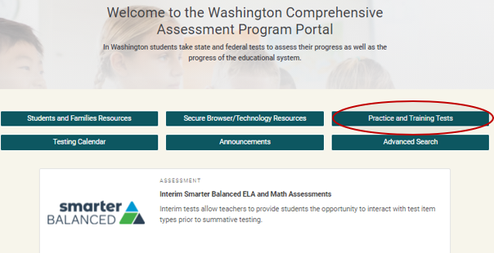
Practice Tests & Training Tests Non-Secure Location
Practice & Training Tests accessed from the WCAP Portal homepage
Guest student, Guest Session
No TA required
Students can take the Practice or Training Test at home
Parents and other members of the public can also access these tests
TA can use on-screen for student training
Notes:
There is a non-secure location the practice and training tests can be located from on the Portal.
As a guest, students may take the Practice Test or Training Test at home:
A TA is not required to proctor the Practice or Training Tests from the non-secure site

Slide 31
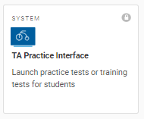
TA Practice Interface
Trained TAs can administer practice tests or training tests using the TA Practice Interface to:
Become familiar with setting up test sessions, establishing student access, and session approval.
Have free communication on testing process and content.
Conduct a group walkthrough promoting familiarity with basic test rules.
Notes:
The TA Practice Interface is locked and requires secure login.
This is used to administer a practice or training test while using the secure student browser.
Only trained TAs may administer tests using this secure TA Practice Interface.
In a Training Test session:
The TA will log in to the TA Practice Interface using login credentials.
Using this option anyone can be a student – a teacher, principal, staff, etc. They just sign in as a Guest User and use the Session ID provided by the TA.
Students should use their name, SSID, and the Session ID to practice the login process.
TAs will become familiar with setting up a test session, establishing student access, and test session approval.
This administration process provides an opportunity for TAs to have free communication on the testing process and content with students, while also describing the limitations to the support they will be able to provide during the summative test session.
Conducting a student group walkthrough of the training test or practice test promotes familiarity with the basic test rules, including:
testing format,
embedded tools,
pause rules,
alert messages, and
ending a test session
Conducting a practice test through the TA Practice Interface is also a way for students with designated supports and/or accommodations to practice with the settings, and for TAs to verify the student’s settings for the accessibility features are set correctly in TIDE.
The Practice and Training Test Guidance is located on the Portal in the Associated Resources.

Slide 32
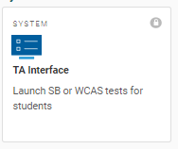
Secure TA Interface
The TA Interface is used by trained TAs to securely administer an interim or summative assessment.
Summative assessments: This is an official accountability test that will generate a state score for students.
Interim assessments (Smarter Balanced only) can provide students and educators with information that can inform instructional decisions.
Notes:
The TA Interface is locked and requires secure login.
This site is used only to administer summative (accountability) assessments and interim assessments using the secure browser. It is critical that you have a clear understanding of the differences between practice, training, interim, and summative assessments and where to go to administer each.
Only trained TAs may administer summative (accountability) tests or interim tests using this secure site.
The summative assessments include the Smarter Balanced ELA and mathematics assessments, and the Washington Comprehensive Assessment of Science (WCAS). The summative ELA, mathematics, and science assessments are official accountability tests that will generate a state score for students.
Interim assessments (Smarter Balanced only) allow students further interaction with test items and the testing platform and can provide students and educators with information that can inform instructional decisions.

Slide 33
Preparation for Testing

Slide 34
Preparing the Testing Location
Instructional materials or any other information displayed in the classroom that might assist students in answering questions must be removed or covered.
Seating must be arranged so students cannot look at each other’s work. This may mean using tabletop partitions or physical distance between students.
The appropriate TA Script of Student Directions is in the classroom.
Additional resources, as identified in the TAM and TA scripts are available for use.
A Testing-Do Not Disturb sign is placed on the door of testing locations.
Identify a location for students to place their backpacks, bags, non-approved items and electronics. These items cannot be within students’ reach during testing or during breaks.
Notes:
Be prepared for testing:
Check your room to make sure materials in the testing location related to the content of the test being administered have either been covered or removed. This includes materials that might be taped to students’ desks. Access to non-approved materials may require invalidation of a student’s test results.
Verify your student seating chart to ensure students are seated far enough apart to prevent them from viewing peers’ tests. An exam type layout, as opposed to a collaborative setting is recommended.
Have all necessary materials in the classroom prior to testing sessions. This includes the TA Script of Student Directions, tools, supports, and/or accommodations, and any glossaries, scratch and graph paper that may be permitted or required.
Add a Testing—Do Not Disturb sign on the door outside of your testing location. Take care not to obscure security windows on doors;
Establish the location in the testing room where students will place their non-approved electronics, backpacks, and bags when directed to do so in the TA Script.
Students must be directed to move these items prior to beginning the test.

Slide 35
General Rules of Testing
Follow your district approved testing schedule
Students must be supervised at all times by a trained TA
Verify that permitted materials are available for student use
Administer accessibility features appropriately
Read the TA Script of Student Directions, word-for-word
No coaching or reviewing of student work
Review your school’s Test Security and Building Plan
Notes:
It is required to follow your district approved testing schedule.
Once a summative (accountability) test session has been set up for students to begin testing, the students within the session must be supervised at all times by a trained TA until testing concludes and all materials provided during the test session have been collected and accounted for. Review your school’s plan for trained TA replacements should you need to leave a testing session due to an emergency.
It is important to have a clear understanding of what materials are available for student access during each testing session. Materials vary depending on the grade level and content being administered. Students may be permitted accessibility features as outlined in the GTSA.
Use of non-approved accessibility features may result in the students’ test results being invalidated.
It is important to ensure that a process is in place for collecting and accounting for all materials distributed to students during a test session, prior to releasing the student from the testing location.
Become familiar with the school’s Test Security and Building Plan, including material chain-of-custody.

Slide 36
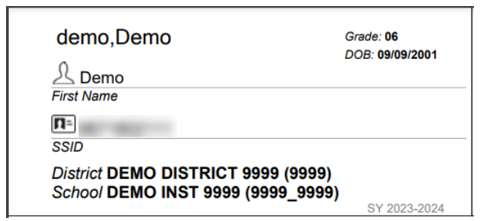
Student Test Tickets
Test tickets have student information and are considered secure materials.
Test tickets may be provided to you by your SC, or you may be requested to print them yourself. Coordinate with your SC on how and when they will be provided to you.
Tickets should be handed out to students and then collected as soon as possible and prior to releasing students.
At the end of the day’s testing, all test tickets should be returned to your SC with other secure materials.
First name and SSID used for test login
Notes:
Test tickets provide student information to assist them with signing into the secure browser. These tickets contain private student information and must be treated as secure materials and collected prior to the release of students.

Slide 37
Starting a Test Session
Overview Of Steps To Start And Select
The Correct Test Session

Slide 38
How to Start a Test Session
Log in to the TA Interface
This is a secure system that will require your username and password.
If using a new device, you will need access to your email for an authentication code as part of your first login using the device.
Notes:
First, from the Portal home page, you will select the test you are going to be administering. If you are administering an Interim assessment, you will select the Interim Smarter Balanced ELA and Math Assessments. If you are administering a summative assessment, you will select either the Summative Smarter Balanced ELA and Math Assessments or the Washington Comprehensive Assessment of Science. You will then select the “Administering Tests” task, this will put you on the page where you can access the TA Interface system.
Log in to the secure TA Interface, and the Test Selection window will open automatically, allowing you to select the appropriate test for your district approved test session.
If you are using a new device, you will need access to your email for an authentication code as part of your first login using the device. See the TA User Guide for more information.

Slide 39
New Look to TA Interface Test Selection
Session ID is in upper LEFT corner
Start Operational Session in lower right.
Notes:
There is a new look to the TA Interface test selection page. Now the Session ID is generated BEFORE you start your test session, and is now in the upper LEFT corner of the screen.
There are also tabs at the top for Select Tests, Student Lookup, and Approvals.
The Start Operational Session is in the lower right as it was before.

Slide 40
Selecting the Correct Test
It is very important you select the correct test to be administered for your current test session.
Interim assessments are YELLOW
Summative Assessments:
Smarter Balanced are BLUE
WCAS are GREEN
Notes:
The test labels for summative (accountability) assessments are coded Blue for Smarter Balanced and Green for WCAS. The Yellow labels are for the interim assessments.
Select only the test that will be given in your test session. There are different methods for selecting tests.
Tests are grouped, and may include one or more sub-groups. All test groups and sub-groups appear collapsed by default. You can expand a test group by clicking on the plus sign next to the testing category of the test you are administering. Do not place a check mark in the box until you have reached the specific test subject and grade you are administering.

Slide 41
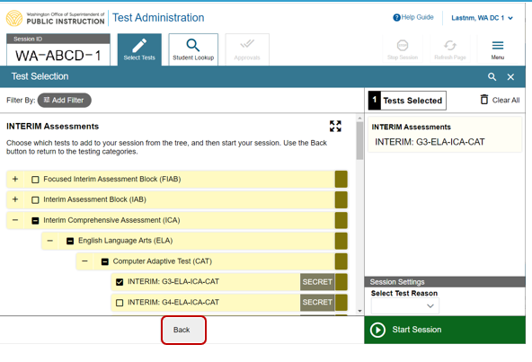
Correct Method of Test Selection
Only allows access to the one test being administered.
Notes:
OSPI strongly recommends drilling down until a checkbox appears next to the test name and test grade, as shown.
This is the correct method, displaying how a TA drilled down to select only the Interim Grade 3 ELA CAT test. This means this will be the only test the student will see and will be able to select for this session.
Once you have selected the correct test, you will click Start Session in the lower left of the screen to start the test session.

Slide 42
New Summative Test Prompt
Notes:
New this year, test administrators attempting to administer a Summative assessment will receive a prompt when selecting the Start Session button. The TA will need to type “I Agree” before proceeding with the test session.
It is very important that you remember that you will only receive this prompt if you have selected to administer a SUMMATIVE assessment.
Administering a summative test by accident is a test incident, and your students will have to retake the test over again.

Slide 43
Approvals Tab
Once you have selected the correct test and clicked Start Session, the session will be active and the Approvals tab will no longer be grayed out.
Notes:
Once students are waiting for approval, the Operational Session ID tab displays the session ID and will show the test session table after students are approved to enter the test session and have logged in.
The Approvals tab will become active when any students are waiting for approval. In this example, two students are waiting for approval. In addition, the Stop Session button will become active.
Below the Menu button, you will see a Print icon. Select the print icon to print the test session information.
It is a good idea to write down the Session ID number, in case you need it to restart the session. You may want to write it on the board in your classroom, for students to see and access.

Slide 44
Signing into Tests and Monitoring Students

Slide 45
Test Sign In
Obtain a list of approved students for your test session
Follow step-by-step login instructions within the TA Script of Student Directions
Launch the secure browser on the student’s testing device. The Student Sign In page appears
Students will enter their first name, their SSID, and Session ID
Students will verify information
The Your Tests page displays with the tests the TA selected
Depending on the test content and the specified test settings, students may need to verify that audio or other technology is functioning properly
Common Sign In Errors
TA selected incorrect test
Incorrect accessibility supports identified
Session does not exist
Student information entered incorrectly
Session has expired
Student is not associated with your school
Notes:
Tips to remember prior to launching the secure browser.
Obtain the list of approved students to test within your session from your SC. This should include student name, SSID, subject, and any embedded designated supports and/or accommodations the student requires.
It is important to follow the TA Script of Student Directions, word-for-word, using a natural tone and manner, unless simplified test directions are permitted as a support. Review the script early so that you are familiar with what you will say and need to do.
When logging students in to a test session, you will need to check each student carefully and deny a student access if an ineligible or unknown student is seeking approval for your session. If this happens you should immediately notify your SC. You will also deny a student when:
An incorrect test was selected.
When a student enters your testing room and is not feeling well. Notify your SC to see if the student should be tested during a makeup session.
Incorrect test settings were applied. If online embedded test settings are incorrect for a student, you will need to deny the student access, or in the case that the student already began testing, pause the test immediately. Contact your SC to change the settings in TIDE. Changes in TIDE are immediate so the student can rejoin the session that is already in progress. The exception to this is Braille, ASL, and Spanish Stacked Translations – those require a reset through the TIDE appeals system. Once the Reset has been approved by the state, the SC can make the appropriate change in TIDE. The student can then be tested. This process 24-48 hours.
Launch the secure browser on the student’s testing device and the Student Sign In page appears.
You will provide students with their login information, including first name, SSID, and the Session ID. Student information can be printed on Test Tickets and the Session ID can be written on your classroom board.
Students will be asked to verify personal information:
If all the information is correct, students will be directed to move on.
If any of the information displayed is incorrect, the student must not proceed with testing. The student should click No. You should immediately notify your SC so that the student information can be corrected in TIDE.
The Your Tests page displays all the tests that a student is eligible to take. Students can only select tests that were included in the session. Be very specific when telling students which test to select. You will then need to check the student settings and allow entry into the test via the TA interface.
Depending on the test content and specified test settings, students may need to verify their testing device is functioning properly. This includes Text-to-Speech, Audio Playback, Recording Device Check and Sound and Video Playback.
When students see the Audio Playback Check as they log in, this is the indication that a headset is required for that session.

Slide 46
Test Sign In Continued
Students will verify their test settings.
Students will view the Help Guide to review the basic rules and tools available on the specific test.
Students will be reminded that this test is private and that they cannot discuss the content of the test with others.
Once students begin testing, the TA actively monitors students’ testing progress
Notes:
On the last screen of the student login process, the TA will guide the student through 3 sections on the screen.
The student will verify their test settings. If a student has the wrong settings, TAs must stop testing for that student and contact the SC.
The student will look at the Help Guide and the TA will review some specific test rules.
The student will verify that they understand that the test content, including items, passages, and all stimuli associated with items, is private and cannot be discussed.

Slide 47
Monitoring Students During Online and Paper-Pencil Testing
Actively monitor students to ensure they are:
Only using allowed accessibility features, calculators, and/or electronic devices.
Not writing on the ½ inch outer edge of the page of a paper booklet.
Not sharing their work.
As a TA, you may:
Read and re-read the Student Test Directions (SAY Boxes) to students (not test questions).
Remind all students to be sure to complete all items. This can take place prior to testing and again when students begin to complete their tests.
Assist students with navigating the online system or with turning pages in a paper booklet.
Notes:
Create a comfortable testing environment; smile and make eye contact whenever possible.
Students are required to be monitored by trained staff until testing is complete.
For accommodated paper-pencil testing, students may only use a number 2 pencil. If a different pencil lead type is used, you may never know what questions were not scanned and scored accurately. Notify your SC right away.
Only permit allowed calculators for student use and only on calculator approved sections of a paper-pencil test. See the Calculator and Electronic Device Policy and the GTSA for use and restrictions.
Student access to non-approved electronic devices will require that the student’s test results be invalidated which will generate a zero for testing.
For paper-pencil testing, if students write within a half inch from the outer edges of the test booklet, they should be reminded that work can only be scored if it is within the student response area.
TAs are allowed to:
Re-read test directions as many times as needed to support students. It is not permitted to read aloud passages, scenarios, stimuli, or test items.
Help students by navigating the online system or with turning pages in paper booklets, when needed. TAs may not assist students with responding to test items.
Be prepared for students asking for more help than you are permitted to support. The TA Script provides what you can say to students who are asking for help.
For online testing, students must enter an answer for all items before moving to the next screen:
Students can mark a question for review but should provide their best response prior to moving on
When students enter random text (gibberish), the system counts the question as answered; the student may not be able to return to the question if the system times out, a technology issues occurs, or the student moves to a new segment without first completing the flagged question.

Slide 48
Online Test Monitoring in the TA Interface
Notes:
Once students log in and are approved for testing, you can monitor their status from the table(s) displayed on the TA Interface. The table shows Student Information, Test Name, Opportunity Number, Progress, Test Settings, and Actions options.
The Progress column displays the student’s progress through the items in the test. The Progress column progress bar indicates the percentage of questions a student has completed, out of the total number of questions
The Test Settings column displays either Standard or Custom. This column displays Custom when a student’s test settings are different from the default settings for that test. Select the Eye button to view a student’s test settings. The number of accommodations and designated supports will also appear.
The Actions column allows you to pause a student’s test or pin a student’s information to the top of the test session table.
For further information on the TA Interface, be sure to read the TA Interface User Guide available on the WCAP Portal.

Slide 49
Online Test Segments
The Smarter Balanced CAT and PT are presented in segments. When students reach the end of a test segment, they will receive a warning message asking them to confirm that they want to move on to the next segment.
Students cannot return to change their answers in the current segment once they have moved on.
Math CAT – Grades 6–8 and HS: after review, the student moves on from the non-calculator segment to the calculator segment.
ELA PT: After completion and review of PT1, TA approval is needed for students to move on to PT2
Important: If you approve a student to move to the next segment and the student was not finished with the previous segment, the student will not have an opportunity to go back and complete the previous segment.
Notes:
Segment Instructions
The Smarter Balanced CAT and PT are presented in segments. When students reach the end of a test segment, they will receive a warning message asking them to confirm that they want to move on to the next segment.
Math CAT: Grades 6-8 and high school: after review, the student moves on from the non-calculator segment to the calculator segment.
ELA PT: After completion and review of PT1, TA approval is needed for students to move on to PT2. Students cannot return to change their answers in the previous segment once they have moved on to the next one.
The warning message also reminds students to check their answers before moving on.
Prior to administering the summative assessment, TAs should ensure that students understand the outcome of ending the test segment. This can be done while administering a training test or interim assessment to students.
Important: If you approve a student to move to the next segment and the student was not finished with the previous segment, the student will not have an opportunity to go back and complete the previous segment.

Slide 50
Ending Online Test Sessions
Ending a Test Session
When there are approximately ten minutes left in the test session, the TA will give students a brief warning from the TA Script of Student Directions. Students who need more time will need to log back into another session.
When students have finished testing, you should:
Print the session report before selecting Stop Session
Stop this session by clicking STOP in the upper-right corner. A confirmation message appears.
Click OK. The test session stops.
Notes:
Ending a Test Session
When there are approximately ten minutes left in the test session, the TA will give students a brief warning from the TA Script of Student Directions. Students who need more time will need to log back into another session.
When students have finished testing, you should:
Print the session report before selecting Stop Session
Stop this session by clicking STOP in the upper-right corner. A confirmation message appears.
Click OK. The test session stops.

Slide 51
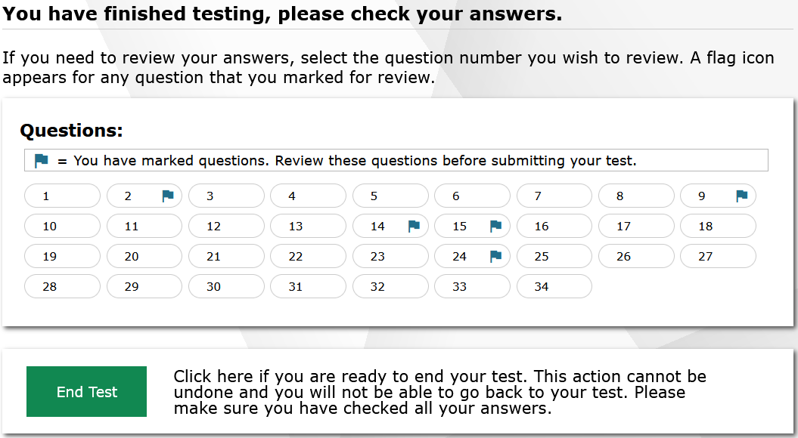
New End Test for Students
To try to prevent students from accidentally submitting their tests, there is clear wording and an additional check box for students to end and submit their online tests.
Important: If a student clicks through all end test screens they will not have another opportunity to go back in and review/complete their answers.
Notes:
To try to prevent students from accidentally submitting their tests, there is clear wording, and an additional check box for students to check to end and submit their online tests.
When students answer the final item on the test and click the Next button, they will see the Review and End Test screen. Items marked for review will appear with a blue flag next to the item number. Students should review their answers one last time before submitting their test.
When students are ready to end the test, they should select the End Test button. The message next to the button explains this cannot be undone and that they will not be able to go back to their test. Make sure your students clearly understand they must not click End Test unless they have completed their test. If a student clicks through all the end test screens, they will not have another opportunity to go back in and review or complete their answers.
Students will also need to check the box next to “I Agree” and click Yes if they are ready to end the test or click No if they are not. Clicking No will close the pop-up window and allow the student to continue reviewing items. Selecting Yes will take them to the Test Completion page.

Slide 52
If Students Stay in the Testing Room after Completing their Online Test
If students will be staying in the room after completing their online tests, they must NOT be allowed to use their testing device once they have finished testing.
Using their testing device for non-testing activities in the test location is considered a testing incident, and the student’s test will be invalidated.
Only activities such as reading a book or working on a paper-pencil assignment for a non-related subject is allowed.
Notes:
If students will be staying in the room after they have completed and submitted their online tests, they must not be allowed to use their testing device for other activities, such as playing games or doing other assignments. This is considered the same as having access to non-approved electronics and is a testing incident that must be reported, and the student’s test will be invalidated.

Slide 53
Break Procedures
Pause online tests or close test booklets
Instruct students not to discuss the test
Students are monitored by staff
Bathroom break – one student at a time
Ensure students do not have access to unapproved electronics
Break Procedures
[Add your staff break information here]
Who will test where? Extended time location
[Add your extended testing time information here]
Notes:
Add building specific notes and the process for reminding students of the importance of this testing opportunity and for identifying the schedule and location. Students arriving late may test if approved by the school district.
Break procedures include instructing students to:
Pause online tests or close test booklets and not to discuss test content with their peers. (It is a test incident if tests are not paused and are left open during a break)
Students should not have access to electronics or other unapproved materials, including cell phones, during breaks.
Students must be monitored during breaks and lunches.
Prior to testing, be sure to have your break information and emergency contact information available should a need arise.
Follow the break procedures in the unlikely event the class has to leave the room for an emergency. Do not attempt to collect the test booklets. Student safety first; follow your emergency procedures.
TA should pause the assessment, if possible, but not at all necessary.
Test sessions should be scheduled around extended breaks (e.g. lunch), so a test doesn’t need to be paused for longer than 20 minutes

Slide 54
Contact Us
Contact your School Test Coordinator for questions, or to report issues:
School Test Coordinator
Office phone: (__ __ __) __ __ __ - __ __ __ __
Cell phone: (__ __ __) __ __ __ - __ __ __ __
Notes:
The following communication plan has been established:
TAs must contact your SC and or Technology Coordinator for technical questions.
SCs will contact the DC.
The DC will contact OSPI, when necessary.
OSPI will refer all school staff questions back to your DC for support. This will ensure that you receive the most up to date information including school district procedures and policies.

Slide 55
Revision Log
Updates to the module made after January 9, 2024 are noted below.
Slide | Section | Description of Revision | Revision Date
Blank | Blank | Blank | Blank
Blank | Blank | Blank | Blank
Notes:
If updates are needed throughout the school year, they will be outlined on this revision log and communicated in the WAW newsletter

