Slide 1
New District Test Coordinator Training
An Introduction to Washington’s Assessments
and District Test Coordinator Responsibilities and Resources
Notes:
Welcome to the training PPT for new District Assessment Coordinators!
This training was developed for district level assessment staff who are NEW to their assessment role. Some of you may have been involved in the state assessment system in another role, and some of you may be very new to the land of assessments. The title of the role in districts is usually called the District Test or Assessment Coordinator, commonly abbreviated to DC. To make things fun/challenging, different test systems call the top “user roles” in districts by different names. Some refer to your role as the District Coordinator or “DC”, District Assessment Coordinator or “DAC”, and in others places the reference may be the District Test Coordinator or “DTC.”

Slide 2
Goals/Objectives
Introduce the assessment programs
1
Provide a grounding in the assessments within the system
2
Provide an overview of district roles and responsibilities
3
Provide a specific list of next steps
4
Provide recommendations for future readings and meetings
5
Notes:
There are a lot of aspects of the state assessment system that are not the focus of this training, such as graduation pathways or details on spring testing. Those topics will be covered in other trainings, during monthly assessment update webinars, the monthly Open Office Hours, the weekly WIDA “Lunch with Leslie”, and the Washington Assessment Weekly (WAW) newsletter.
The goals and objectives listed on this slide are what will be covered in this PPT.
This PPT provides a very broad overview of the statewide assessments and includes some of the primary responsibilities of district staff as they participate in the assessment cycle. We will then provide you with some additional reading recommendations and professional development opportunities.

Slide 3
WCAP
Washington Comprehensive Assessment Program

Slide 4
The “A” in WCAP
The assessments in the Washington Comprehensive Assessment Program (WCAP)
Notes:
In the following section we will describe the assessments that make up the Washington Comprehensive Assessment Program, which we call the “W-CAP” program.
Here you will learn some common acronyms and technical terms.

Slide 5
Assessment Names
National Assessment of Educational Progress (NAEP)
Smarter Balanced Assessments (Smarter Balanced)
Washington Comprehensive Assessment of Science (WCAS)
Washington Access to Instruction & Measurement (WA-AIM)
WIDA ACCESS for ELLs, and WIDA Screener
WIDA Alternate ACCESS for ELLs
Washington Kindergarten Inventory of Developing Skills (WaKIDS)
Notes:
First, we have the test names and abbreviations;
The National Assessment of Educational Progress, or NAEP;
The Smarter Balanced Assessments, which are developed by the Smarter Balanced Assessment Consortium, includes our English Language Arts and Mathematics tests, and are referred to as simply Smarter Balanced;
The Washington Comprehensive Assessment of Science, or W-CAS;
The Washington Access to Instruction & Measurement, or WA-AIM, which is the alternate assessment for ELA, math, and science for students with significant cognitive disabilities;
The Washington Kindergarten Inventory of Developing Skills is shortened to “WaKIDS;”
WIDA ACCESS for ELLs (English language learners), and WIDA Screener. The WIDA Alternate ACCESS is for ELLs with significant cognitive disabilities.
In the next set of slides we’ll give information about the purpose of these tests.

Slide 6
Key for the Next Slides
What is Assessed: standards or goal
Grade Level: grade level of tested students
Population: all students or a specific group
When and Type: season, SUMMATIVE and/or something else
Primary Mode: online, paper, other
Vendor:
Test Name and Logo
Notes:
This slide is the template for the next set of slides.
The title of the slide will be the name of the test itself. Then on the left is the test logo.
On the right is information about the test. This is a very high-level overview, and each test is unique, so these labels may change slightly.
For What is Assessed, we’ve stated which set of learning standards is tested, or what the main goal of the assessment is.
Grade Level could be just one grade of students, it could be a range of grades, or it could be specific grade levels.
Population indicates the students who need to take the assessment. Some of the tests are for all students to take, and some are for specific groups of students.
The fourth bullet, when and type, will indicate which season (fall, winter, or spring) the test is administered in, and may also state if the test is a Summative test or some other type. If there is more than one type, the Summative tests are the ones whose results are used in the accountability data on the State Report Card.
The fifth bullet will say either Mode or Primary Mode. If it says only Mode, then there is only that one way to test students. If it says Primary Mode, then there are options for how to test students. For the tests where online is the primary mode, please note that paper-pencil test forms are available as an accommodation for students with a documented need in an IEP or 504 Plan.
The last bullet says Vendor, and here we will list the primary vendor (or test company) that we work with for the given test. Vendors do things like deliver online tests to students, print and ship paper-pencil test forms, score student responses to the test items, and apply scoring rules to determine overall test scores for students. For some tests, educators will use the test vendor system to give tests directly to students; for other tests, the educators will use the test vendor system to enter data and information about the student responses, after the student has completed testing.

Slide 7
National Assessment of Educational Progress
What is Assessed: Civics, math, reading, science, technology engineering literacy, U.S. history, and writing
Grade Level: grades 4, 8, and 12; or age-based for students ages 9, 13, and 17
Population: A representative sample (state or national)
When: Winter
Primary Mode: Tablet
Vendor: National Center for Education Statistics (NCES) via Westat
Notes:
The National Assessment of Educational Progress (NAEP) is the only assessment that measures what U.S. students know and can do in various subjects across the nation, states, and in some urban districts. NAEP is a congressionally mandated project administered by the National Center for Education Statistics (NCES) within the U.S. Department of Education.
NAEP is given to a representative sample of students across the country. Results are reported for groups of students with similar characteristics (such as race or gender), not individual students.
The NAEP State Coordinator for Washington is Amadou Ba, and you can find more information about NAEP on the OSPI website at https://www.k12.wa.us/student-success/testing/national-assessment-educational-progress-naep.

Slide 8
Smarter Balanced Assessments
What is assessed: Washington state K-12 learning standards in ELA and Math
Grade Levels: 3–8 and 10
Population: All students
INTERIM: Anytime; to inform instruction.
SUMMATIVE: Each spring; online to monitor progress towards college and career readiness by the end of high school
Primary Mode: Online
Vendors: Cambium and Smarter Balanced
Notes:
The Smarter Balanced Assessment Consortium is an assessment consortia to which Washington state belongs. We participate in committees and work groups, along with other states in the consortium, to produce many different resources and support the two content assessments.
English Language Arts and mathematics are evaluated through the Smarter Balanced Assessment.
Interim assessments created by Smarter Balanced can be given to students at any time to help inform instruction, and we also have the summative Smarter Balanced assessments which help monitor progress towards college and career readiness.
The Smarter Balanced assessments are given primarily online. Cambium is the vendor that we use for the delivery of the tests. Smarter Balanced is the vendor through which the test results are first available to teachers, school and district staff.
Serena O’Neill, Mathematics Assessment Specialist, is the primary contact for Smarter Balanced Math test development.
Maja Wilson, ELA Assessment Specialist, is the primary contact for Smarter Balanced ELA test development.
General information about the Smarter Balanced tests and the Consortium can be found on the OSPI website at https://www.k12.wa.us/student-success/testing/state-testing/washington-state-smarter-balanced-assessment-consortium.

Slide 9
Washington Comprehensive Assessment of Science
What is assessed: Washington state 2013 K–12 Science learning standards
Grade Levels: 5, 8, and 11
Population: All students
SUMMATIVE: Each spring; to monitor success with grade-band learning expectations in Science
Primary Mode: Online
Vendor: Cambium and Smarter Balanced
Notes:
The Washington Comprehensive Assessment of Science, the WCAS, assesses the 2013 Washington State K-12 Science Learning Standards which are the Next Generation Science Standards. The grade 5 test assesses the grades 3-5 band of standards, the grade 8 test assesses the middle school band, and the grade 11 test assesses the high school band.
The WCAS is a state-specific test, which means it is developed by a collaboration between the OSPI science assessment team, Washington science educators, and a development vendor. We convene four educator work groups for each of the grade level tests every year.
The WCAS is given primarily online. Cambium is our test delivery vendor. Smarter Balanced is also our vendor for teachers, schools, and districts viewing the WCAS results online.
The OSPI Science Assessment team, which includes Jacob Parikh, Jessica Cole, and Korey Peterson, is the primary contact for WCAS, and more information about the WCAS can be found on the OSPI website at https://www.k12.wa.us/student-success/testing/state-testing/washington-comprehensive-assessment-science, or on the WCAP Portal.

Slide 10
Washington Access to Instruction & Measurement
What is assessed: Washington state K–12 learning standards in ELA, Math, and Science
Grade Levels: 3–8 and high school
Population: Students with the most significant cognitive disabilities
SUMMATIVE: Spring administration with a fall retake opportunity for graduation
Mode: Performance tasks
Vendor: Data Recognition Corporation (DRC)
Notes:
The Washington Access to Instruction & Measurement, referred to as the WA-AIM, is also a state-specific test. It assesses the state ELA, Math, and Science standards in a way that is appropriate for students with the most significant cognitive disabilities. This is done through a series of performance tasks students engage in, using online, paper-pencil, or whatever mode works best for the student.
Data Recognition Corporation or DRC is the vendor for the WA-AIM.
Toni Wheeler, Alternate Assessment Coordinator, is the primary contact for WA-AIM. More information and most resources for the WA-AIM can be found at https://www.k12.wa.us/student-success/testing/state-testing/assessment-students-cognitive-disabilities-wa-aim.

Slide 11
Washington Kindergarten Inventory of Developing Skills
What is inventoried: 6 areas of developing skills
Grade Level: Kindergarten
Population: All students in full-day kindergarten and Transitional Kindergarten
When: Required in fall and optional in winter and spring (full day Kindergarten). Implemented in the first 10 weeks from the program start date (Transitional Kindergarten)
Mode: Observational
Vendor: Teaching Strategies, LLC.
Notes:
The Washington Kindergarten Inventory of Developing Skills, known as WaKIDS, is different because it is an observational assessment looking at the skills and abilities of kindergarten students as they come into school, instead of what they can do after a year of instruction.
It is formative, observational assessment that has to be embedded into an everyday, play-based setting. It is critical that observations happen throughout the day while children are engaged in their learning as it is not a pull-out test. It is conducted by kindergarten and transitional kindergarten teachers and the vendor is Teaching Strategies.
The Early Learning team is the primary contact for WaKIDS. Information about the WaKIDS assessment can be found on the OSPI website at https://www.k12.wa.us/student-success/testing/state-testing/washington-kindergarten-inventory-developing-skills-wakids and the team can be reached via email wakids@k12.wa.us

Slide 12
WIDA ACCESS for ELLs and WIDA Screener
What is assessed: English language proficiency
Grade Levels: K–12
Population: English learners
SCREENER: Upon enrollment
ANNUAL SUMMATIVE: Each winter to monitor progress and continued ELD program eligibility
Primary Mode: Online
Vendor: Data Recognition Corporation (DRC)
Notes:
WIDA is one of the assessment consortia to which Washington state belongs. OSPI staff participates in committees and work groups, along with other states in the consortium, to provide two WIDA tests: the WIDA ACCESS for ELLs and the WIDA Screener. These two WIDA tests serve two different purposes for us here in WA. First, the WIDA Screener which is used when a student first enrolls to determine eligibility for the English Language Development (ELD) program. The second is the WIDA ACCESS for ELLS given each year around February and March, to monitor progress and continued ELD program eligibility. WIDA is primarily given online, and our vendor is Data Recognition Corporation (DRC).
Leslie Huff is the English Language Proficiency Assessment Coordinator and is the primary contact for WIDA. Information about all the WIDA assessments can be found at https://www.k12.wa.us/student-success/testing/state-testing/english-language-proficiency-assessments.

Slide 13
WIDA Alternate ACCESS
What is assessed: English language proficiency
Grade Levels: K–12
Population: English language learners with significant cognitive disabilities
SUMMATIVE: Each winter to monitor progress
Mode: Paper-pencil
Vendor: DRC
Notes:
The WIDA Alternate ACCESS is used to monitor the progress of English learners with significant cognitive disabilities. It is a paper pencil test.
Leslie Huff is the primary contact for WIDA Alternate ACCESS.

Slide 14
Roles & Responsibilities of District Level Assessment Staff

Slide 15
District and school roles
District Assessment Coordinator (DC): General oversight of all testing activities in the district. Liaison between district and WCAP staff.
District Administrator (DA): Supports DC in testing activities within the district.
Technology Coordinator (TC): General oversite of technology needed for all online testing activities in district.
School Coordinator (SC): Oversight of testing activities in the school.
Test Administrator (TA): Administers tests to students.
Notes:
These are the five main district staff roles for assessments that OSPI addresses in all assessment resources. We are mainly discussing the DC role in this presentation.
For more detailed information about these roles and their responsibilities see the section on Duties and Responsibilities in the Professional Assessment Standards manual. For information about permissions different roles have in the Cambium systems, please see the “User Roles Permissions” section in the appendix of the TIDE User Guide (https://wa.portal.cambiumast.com/resources/user-guides/tide-test-information-distribution-engine) . Both of these resources can be found on the WCAP Portal. We’ll explain how to get to that in the next section.
Depending on your district, you may have multiple people as DAs and TCs, SCs and TAs, or you may be filling all those roles yourself.

Slide 16
Note About Roles in the Cambium Systems
Most users only need 1 role in the Cambium systems which are used for the Smarter Balanced and WCAS assessments.
There is a hierarchy in the roles:
DCs have the most permissions, DAs have slightly fewer permissions
DCs/DAs can access information for all schools/students in the district
DC/DAs can do everything the SC/TA roles can do, and do not need to be SCs or TAs at specific schools
SCs have the most access at their school, and can administer tests without the TA role
Access to the Smarter Balanced Digital Library is built into all the school and district roles. No need to also have the SC_TFT role.
Notes:
Even if you fill more than one of the roles on the previous slide in your district, that does not mean that you need to have all of those roles in the Cambium systems.
There is a hierarchy of permissions in the Cambium roles.
At the top of the hierarchy is the DC, followed closely by the DA. These two district level users perform functions for all the schools, users, and students in the district. These users can start test sessions for students and administer tests without having a TA role at a school in the Cambium systems. You should only have a few DAs, if someone only needs school access, give them the SC role.
The next level is the SCs. These school coordinators perform functions for the users and students in their particular school. These users can start test sessions for students and administer tests without also having TA role at their school as well. If someone is an SC for more than one school, you are able to give them the SC user role for more than one school.

Slide 17
Main Responsibilities
DC: Ranges from broad oversight down to the needs of individual students. For example: coordinating staff training, planning, security, scheduling, and submitting reports to OSPI.
DA: Supports activities outlined by DC.
Tech Coordinator: Configuring the devices, software, and networks used for online testing.
Notes:
A DC’s responsibilities range from broad oversight of your district’s assessments, such as making sure all district staff are trained, including the DAs, planning, security, scheduling, and submitting reports to OSPI; down to addressing the needs of individual students, such as making sure students have necessary supports or accommodations needed for testing.
A DA is basically a DC’s main right-hand person (or persons). DA’s have most of the same permissions in the vendor and OSPI systems as the DC and can assist DCs with their tasks in overseeing assessment in the district.
Your District Technology Coordinator will be responsible for configuring the devices, software and networks for online testing.

Slide 18
DC Tasks: Before Testing
Establish district testing schedule
Create Test Security and Building Plans
School testing schedule
Train staff in testing and security procedures
Prepare for accommodations for students
Ensure all TAs are trained to administer assessments
Order accommodated (paper-pencil) test materials
Guarantee availability of non-embedded test materials for online and paper tests
Input student settings in TIDE
Pre-ID in WAMS for alternate assessments (WIDA Alternate Access and WA-AIM)
Read the WaKIDS Quick Start Guide and make sure teachers are trained and children have been imported in MyTeachingStrategies® (WaKIDS). Submit TK survey response.
Notes:
Before testing begins, some of the critical tasks of a DC include:
Working with the Technology Coordinators and the School Test Coordinators to establish the district testing schedule.
Reviewing and approving each school's Test Security and Building Plan. Each plan will include the school testing schedule, a plan for staff training in testing and security procedures, a plan for technology use during testing, and a plan for identifying and preparing designated supports and accommodations for students. It is the DC’s responsibility to make sure each school's plan is followed, and a list of trained TAs is maintained. You can find a template and process document to assist in creating a Test Security and Building Plan on the WCAP Portal athttps://wa.portal.cambiumast.com/resources/forms/test-security-and-building-plan-templates .
Probably the most important of all tasks for a District Test Coordinator before testing is to ensure that all staff who will be administering state tests are fully trained in how to properly administer the tests.
Ordering accommodated test materials. Accommodated tests are the “paper-pencil” tests for students whose IEP or 504 plan states that they cannot test online. Depending on the test, these paper-pencil tests can include a “standard-size” paper booklet; a “large-print” paper booklet where the font and paper size is larger than the standard size; a “Braille” booklet where the text is printed in Braille and graphics are presented as raised images; or a “Spanish” paper booklet with the text translated into Spanish. These booklets arrive in districts a week or so before the start of testing. It is the DC’s responsibility to make sure they get to the school where the student is testing.
Ensuring input and accuracy of student settings in the CAI Test Information Distribution Engine (known by the acronym, TIDE) and the availability of non-embedded test materials such as headphones or scratch paper.
Registering students who require alternate assessments for the WA-AIM and WIDA Alternate ACCESS.
Carefully reading the WaKIDS Quick Start Guide. Make sure teachers are trained and children have been imported in MyTeachingStrategies platform for WaKIDS. If district offers TK, respond to the TK survey with as much information as possible at their earliest.

Slide 19
DC Tasks: During Testing
Ensuring that schedules are followed
Coordinating technology resources with TC
Managing material chain of custody
Monitoring testing activity and participation
Responding to and investigating testing incidents
Documenting and reporting testing incidents and appeals
For WaKIDS – Communicating with building administrators to track and monitor assessment completion until the fall checkpoint (11/15). Share the data due date with TK teachers and administrators and monitor assessment progress.
Notes:
During testing, critical DC tasks include:
Ensuring that schedules are communicated and followed.
Coordinating technology resources with your Technology Coordinator.
Managing material chain of custody—this includes the accommodated forms, and student log-in information.
Monitoring testing activity and participation—this includes visiting schools during testing, and monitoring participation in the vendor systems
Responding to and investigating testing incidents—this includes talking to students and Test Administrators to figure out what happened and figuring out what to do next. There are some documents available to help you do this, which we’ll tell you about towards the end of this slide deck.
Documenting and reporting testing incidents and appeals.
For WaKIDS, continue communicating with building administrators to track and monitor assessment completion until the fall checkpoint on 11/15 and offer support throughout. TK has its own deadline; share the due date with TK teachers and aminidstrators and monitor their assessment progress.

Slide 20
DC Tasks: After Testing
Verify materials are accounted for and returned to vendor
Collect and retain training and security documentation
Review test incidents and outcomes
Submit District Administration and Security Report to OSPI
For WaKIDS - Confirm 100% completion for the district and email your ESD WaKIDS Coordinator to confirm.
Notes:
After testing, major DC tasks include:
Verifying secure and confidential materials are accounted for and returned—this includes returning the accommodated or 'paper-pencil' student test forms and TA materials to the vendor, and the shredding of things like scratch paper.
Collecting and retaining training and security documentation—from all testing sites in the district.
Reviewing test incidents and outcomes
Submitting District Administration and Security Reports to OSPI through the Assessment Reporting Management System (ARMS) in EDS, within ten business days after the completion of testing, which is required for state audit.
For WaKIDS - confirm 100% completion for the district and email your ESD WaKIDS Coordinator to confirm.

Slide 21
Next Steps
Now what do I do?
Notes:
You might be asking “what do I need to do next?”

Slide 22
Step #1: Read the Quick Start Guides
District Assessment Coordinator “Quick Start Guide”
Overview of role and testing cycle
Where to find resources
How to get the appropriate access to all OSPI and vendor-managed systems
Overview of what the vendor-managed systems do
Tables with vendor user roles
Tables with other resources
WaKIDS Quick Start Guide: Email your ESD WaKIDS Coordinator for a copy
Notes:
Step 1: Read the. Assessment Coordinator Quick Start Guide. This document is only about 14 pages long, This document will parallel points in this presentation but provides greater detail. It will also go further into detail about the OSPI-managed systems, the vendor-managed systems, and has lists of training materials available.
You will find this document on the WCAP portal at https://wa.portal.cambiumast.com/resources/user-guides/quick-start-guide, or by using the Advanced Search, or selecting the Smarter Balanced or WCAS test, and clicking on the Smarter Balanced Summative or WCAS Resources tile. The Quick Start Guide will be listed in the User Guides and Manuals section.
WaKIDS has its own Quick Start Guide for DACs. If you need a copy, make sure to email your ESD WaKIDS Coordinator.

Slide 23
Step #2: Get Access to EDS
Meet your District Data Security Manager (DDSM) list
Ask them to create or update your account in EDS (Educational Data System) eds.ospi.k12.wa.us
Then email wakids@k12.wa.us and ask for an access to the MyTeachingStrategies platform.
Role: District Test Coordinator & District Assessment Coordinator
WAMS (Washington Assessment Management System)
ARMS (Assessment Reporting Management System)
Washington Query
Graduation Alternatives
CAA/CIA Database
OSPI Customer Support: 1-800-725-4311
Notes:
Step #2: Obtain access to the Educational Data System at OSPI.
You do this by meeting your District Data Security Manager. If you don’t know who that is, we’ve included a link to a list of DDSMs by district: https://eds.ospi.k12.wa.us/SecurityManagerList.aspx
Ask them to either update your existing EDS account with your new role or create an account for you. Once your new role has been established, reach out to the WaKIDS team to get access to the MyTeachingStrategies platform.
You will need to have the role of District Test Coordinator or District Assessment Coordinator, depending on the application. We have listed the four most important applications within EDS that you need to have access to. The Washington Assessment Management System (known as WAMS) is central to the before and after testing tasks we talked about previously. You will do things in WAMS like sign up students for the WA-AIM or the WIDA Alternate ACCESS. After testing is complete, WAMS is one of the places to download score files from.
The Assessment Reporting Management System (known as ARMS) is central to the during and after testing tasks like reporting and tracking testing incidents and submitting security reports to OSPI. The ARMS Training Module is available on the WCAP Portal at https://wa.portal.cambiumast.com/resources/trainings/arms-training-module.
Washington Query is another place where final score files at the end of a testing cycle are available.
And the Graduation Alternatives and CAA/CIA Database applications are where you track the graduation pathways for students.
If you are unable to connect with your DDSM, or you are also the new DDSM, please call OSPI customer support directly and they will help you get set up.

Slide 24
Step #3: Update District Profile in WAMS
Log in to EDS
Choose “View my applications”
Choose “Washington Assessment Management System (WAMS)” from your list of applications
Select the tab at the top row labeled “Profile”
Use the “Add/Edit” function in each box to update the contact information for each role and/or test.
Notes:
Once you get access to EDS, you need to input or update your district profile in WAMS
This is our source for knowing that you are the DC, and for knowing who should get information about tests including Smarter Balanced, WCAS, WaKIDS, WA-AIM, and WIDA. The contacts listed in WAMS Profile are the ones that are given to our test vendors. It is very important that this list is kept up to date.
We’ve included the steps for how to update your district profile information on this slide.

Slide 25
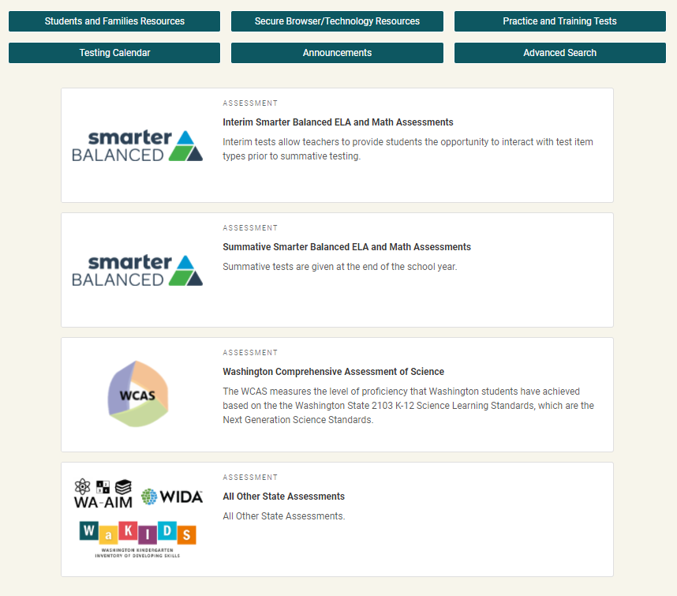
Step #4: Become Familiar with the WCAP Portal
Test/task-based
Each test button will connect you to the systems and resources used in preparing, administering, and completing the test administration.
https://wa.portal.cambiumast.com/
Notes:
The WCAP Portal is located at the url shown on the screen, which is wa.portal.cambiumast.com . You can also find it if you google “WCAP portal”.
The portal is a test/task-based system and is primarily for the Smarter Balanced and WCAS tests. When you select a test, it takes you to a page with only the tasks and systems needed for administration of that test. A training on navigating the Portal can be found on the Portal at https://wa.portal.cambiumast.com/resources/navigating-the-new-wcap-portal, or by selecting a test, and then selecting the “Webinars and Trainings” Task.
Selecting the WA-AIM, WIDA, WaKIDS “All other state assessments” button, will put you on the OSPI website, where you can select the assessment to access the information and systems for those tests.

Slide 26
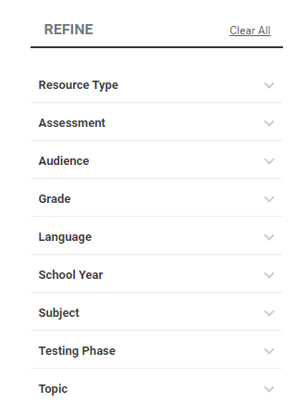
Portal Advanced Search Button
The Advanced Search feature allows you to refine your search with 9 primary search categories and more than 50 subcategories.
If you are looking to define a term instead of search for resources, you can select the Browse the Glossary button.
Notes:
The Advanced Search button on the WCAP Portal home page will help you to find resources quickly, and can be refined by resource type, assessment, audience, e.g. Test Coordinators (DCs, SCs), Test Administrators, etc., and other criteria such as Testing Phase.
When you go on the Advanced Search page, before you enter any search terms or select any filtering, you will see the most recently posted resources listed. This is a great way to easily see what resources have been most recently posted to the Portal.
If you are looking for information on what a term means, such as Testing Irregularity, you can browse the glossary to find that term and it’s meaning.

Slide 27
Step #5: Become Familiar with the WIDA Secure Portal and WIDA Resources
WIDA Secure Portal, requires an account to access, and is password protected
Where you access and monitor WIDA assessment trainings, webinars, and resources.
Explore ELP Assessment pages on OSPI's website.
Notes:
Step 5: Become familiar with the WIDA secure portal. This portal is different from the WCAP Portal, in that the WIDA portal is secure and requires an account to be set up, and a password to access. The WIDA secure portal is where you access the WIDA assessment trainings and resources.
The WIDA Secure Portal is different from the WIDA AMS, the WIDA AMS is the testing platform for WIDA where students take the online test.

Slide 28
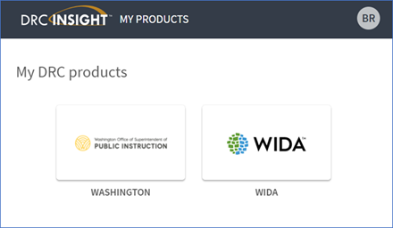
Step #6: Become Familiar with the AMS/ DRC INSIGHT Portal
WA-AIM
Referenced as DRC INSIGHT Portal
WIDA Screener, and ACCESS tests and results, and
Alternate ACCESS results
Referenced as WIDA AMS
Notes:
The WIDA tile is used for all online WIDA ACCESS assessments including the Alternate ACCESS and the online screener. In all WIDA materials, trainings, and modules this is referred to as WIDA AMS.
Some DRC INSIGHT users will see two tiles associated with the DRC INSIGHT Portal. The Washington tile is used for our WA-AIM alternate assessment. In all WA-AIM materials and modules, this system is referenced as DRC INSIGHT Portal.

Slide 29
Step #7: Become Familiar with WA-AIM Resources
WA-AIM OSPI Website (https://www.k12.wa.us/student-success/testing/state-testing/assessment-students-cognitive-disabilities-wa-aim)
IEP Guidance for Participation in State Assessments
WA-AIM Test Administration Manual
WA-AIM Access Point Frameworks and Grade Leve Performance Tasks
WA-AIM Accountability and Graduation Pathway Cut-Scores
WA-AIM Score Interpretation Guide
WA-AIM Training Modules
DRC INSIGHT
Notes:
Most of the WA-AIM resources can be found on the OSPI website. Here is a list with links to important WA-AIM primary resources, as well as a link to the DRC INSIGHT Portal mentioned in the previous slide.

Slide 30
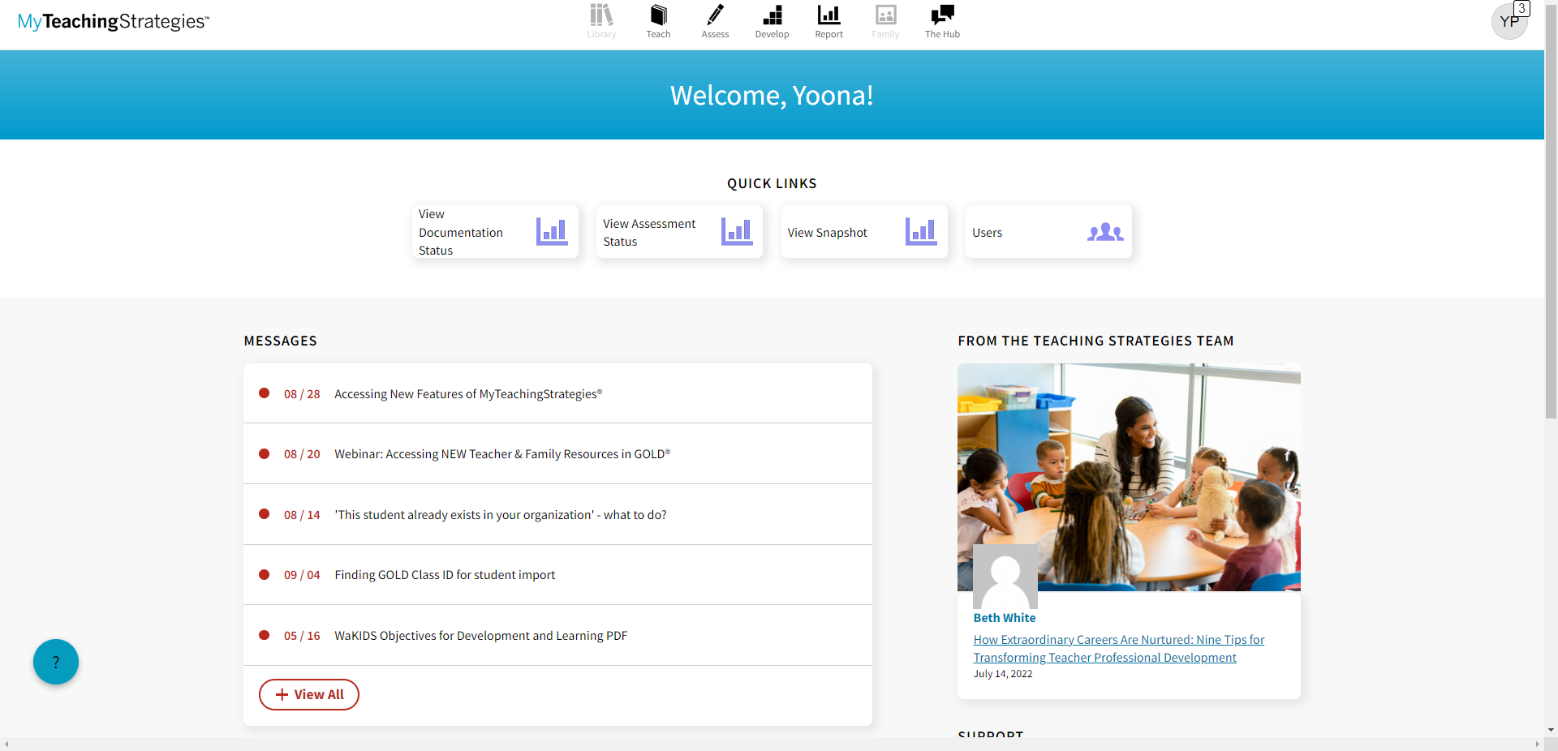
Step #8: Explore and Learn the Details of MyTeachingStrategies®
Teaching Strategies, LLC. (2016–2022). GOLD®. [Electronic version]. Bethesda, MD: Author. Excerpts of GOLD® objectives and dimensions, and representation of the color bands within this document, are reprinted with permission of Teaching Strategies, LLC. Any other use without permission from Teaching Strategies, LLC is strictly prohibited. GOLD and TEACHING STRATEGIES are registered trademarks of Teaching Strategies, LLC and are used with permission.
Notes:
Explore and learn the details of MyTeachingStrategies® for the WaKIDS assessment. Make sure you have the DAC-level access in MyTeachingStrategies®. Ensure all schools and classes have been set up and children have been imported for the right teacher. Be familiar with different types of reports available under the reports tile. You will need to check the assessment status report frequently throughout the assessment period to monitor progress. On the checkpoint day, which is November 15 for fall, you will have to see 100% in green to confirm completion for the district. Anything in orange means you need to reach out to the teacher individually and support them finalizing their data so you see the bars in green. You will have until November 20 to fix any anomalies and reach 100% in green.

Slide 31
Step #9: Attend DC Webcasts, Open Office Hours, and Lunch with Leslie
Monthly Assessment Update Webcasts
Monthly Open Office Hours via Zoom
Weekly “Lunch With Leslie” Zoom meetings at noon for WIDA specific information
Special presentations provided throughout the school year detailing new or changing systems.
Notes:
And step 9:
Attend the assessment update webcasts. All presentations are recorded and posted both to the WCAP Portal and to WAMS. The link to register for the webcasts can be found on the Portal and is also provided monthly in the WAW newsletter.
We also have Open Office Hours which are held monthly via Zoom. Information on the schedule, topic and link to join will be in the Washington Assessment Weekly newsletter and posted on the WCAP Portal. These Open Office Hours give you a chance to chat informally with OSPI Assessment staff and ask questions. You can also just listen in to what other people are asking.
And for those of you with multilingual students, every Monday at noon, Leslie Huff hosts “Lunch with Leslie” also known as the Zoom at Noon, noontime Zoom meetings for WIDA specific information. These are held in the fall and during the WIDA testing window. Between April and August, these sessions are focused on upcoming tasks. The Zoom at Noon sessions are intended to help clarify processes, responsibilities, and questions you have about ELP assessments. Dates, times, and links for joining the Zoom at Noon can be found in the WAW, and on the OSPI English Language Proficiency Assessments webpage at https://www.k12.wa.us/student-success/testing/state-testing/english-language-proficiency-assessments.
Throughout the year there may also be special presentations to provide information regarding new or changing systems. If any of these come up, they will be communicated in the weekly assessment newsletter.

Slide 32
Additional Recommendations…

Slide 33
Reading Requirements
Test Coordinator’s Manual (TCM)
Guidelines on Tools, Supports & Accommodations (GTSA)
Student Records Management Guide (SRMAAUG)
Professional Assessment Standards
The resources here can be found on the WCAP Portal
Notes:
Here are some resources required for reading by DCs, important for getting started. All can be found on the WCAP Portal in the Summative Assessments (Smarter Balanced or WCAS) by clicking on the Smarter Balanced Summative or WCAS Resources tile. These resources are in the User Guides and Manuals section. Some of these may not be updated for the current school year yet, but as soon as they are it will be communicated in the WAW newsletter and the links here will take you to the most recent versions.
This training provides a high overview of a DC’s roles and responsibilities, but the Test Coordinator’s Manual is the complete information. It is updated every year with information specifically for test coordinators and provides more detailed information specific to your role.
The Professional Assessment Standards is the document that will guide you through all the security and test incident tasks discussed previously. This document also provides the most details on user roles.
The Guidelines on Tools, Supports & Accommodations (GTSA) is all about the accessibility features available during state testing. You and your special education teams will want to be very familiar with this document. There is also a recorded training series on the GTSA that is very helpful, which is also located on the Portal at https://wa.portal.cambiumast.com/resources/wa-guidelines/training-series-using-the-gtsa/training-series-using-the-guidelines-for-tools-supports-and-accommodations.
The Student Records Management Guide (SRMAAUG) describes how data moves between OSPI and vendor-managed systems, what to do when you need to test a student who does not have an SSID, and has expectations for which students should test, and explains how data come together at the end of the Spring testing cycle.

Slide 34
Assessment Communications
Washington Assessment Weekly (WAW) newsletter
Notifications about webinars and trainings, including registration links
Reminders about deadlines
Data and reporting information
Updates and resources for state assessments
Contacts for assessment, student information, and other OSPI programs
Systems information
Notes:
Regular communication is sent to DCs through the Washington Assessment Weekly newsletter. The newsletter is sent to you weekly and may be shared, as appropriate, to staff in your district. Some of the main types of topics included in the newsletter are listed on this slide.
The people listed as the DC and the DA (designees) in the District Profile in WAMS are the only staff who will receive the WAW.

Slide 35
Important Contacts
Your district CEDARS Administrator
Comprehensive Education Data and Research System
District student information system talks to CEDARS
OSPI Customer Support: CustomerSupport@k12.wa.us
Your special services staff (bilingual, special education)
Other DCs in your area
List of DC contact information
Notes:
You will need to know who has been designated as your district’s CEDARS Administrator. CEDARS is the Comprehensive Education Data and Research System, and it is where all the data OSPI has begins. Your CEDARS administrator facilitates getting the data from your districts student information system into CEDARS. If you do not know who your CEDARS administrator is, email OSPI customer support and they will be able to identify that person for you.
You will need to know who is being designated as the district bilingual and special education coordinators. OSPI also recommends that you touch base with other DCs in your area. The link on the slide goes to a list that is kept on the OSPI website, listing all the DCs in the state (based on WAMS profile again) and their contact information.

Slide 36
Recommendations for Professional Development and Resources
Washington Education Research Association (WERA)
Annual conference in December
Sponsors workshops throughout the year on timely and relevant topics
Test Directors Network
Test Directors Network (WERA Special Interest Group)
Notes:
WERA is an important organization for all of us, providing information about education in Washington, much of which is specific to assessment. WERA’s annual conference, which is co-sponsored by OSPI, is typically held the first or second week of December. WERA also convenes workshops throughout the year on important topics in education, including assessment-related topics. Please visit WERA’s website for more information. Notifications of all WERA-sponsored events are published in the Washington Assessment Weekly newsletter.
WERA sponsors a special interest group called the Test Directors Network. You are invited to join this incredible group of colleagues from around the state. The Network meets twice annually: In early August and during the December WERA conference. The Network can connect you with other DCs, representing districts similar in size and structure. Contact OSPI’s Assessment team if you would like to learn more about the Network.

Slide 37
WCAP Contacts at OSPI
OSPI Assessment Analysts for student data issues:
assessmentanalysts@k12.wa.us 360-725-6109
OSPI Assessment Development for content questions:
ELA and Math assessments: asi@k12.wa.us
Science assessment: science@k12.wa.us
OSPI Assessment Operations for assessment policy and test materials:
Assessment@k12.wa.us 360-725-6348 or 1-800-725-4311
ELP Assessments for WIDA policy, training, and test materials:
ELPAssessments@k12.wa.us
WA-AIM for policy, training, and test materials:
wa.aim@k12.wa.us
WaKIDS for policy, training, and test materials:
WaKIDS@k12.wa.us

Slide 38
WCAP Vendor Contacts
Cambium Washington Help Desk for Smarter Balanced and WCAS Technical, Network, and password issues:
wahelpdesk@cambiumassessment.com 1-844-560-7366
WIDA Client Services Center (DRC) for WIDA user accounts, instructional resources, professional learning and research:
help@wida.us 1-866-276-7735
DRC Customer Service (WIDA) For WIDA-AMS, testing/scoring issues, data validation questions:
wida@datarecognitioncorp.com
WA-AIM Help Desk (DRC) for WA-AIM user accounts, resources:
waaimhelpdesk@datarecognitioncorp.com 1-800-569-2667
Notes:
Here is a list of vendor contacts

Slide 39
In Summation . . .
We are interested in knowing what you would like to learn more about - systems, processes, procedures, and how you prefer to get information - news articles in the WAW, webinars, posted presentations?
Our monthly or special webinars are always posted to the WCAP Portal, as well as the Answers to Questions collected during the live presentations.
Let us know how we can support you and the work you do.
Assessment@k12.wa.us
Notes:
There is a steep learning curve for new District Coordinators. Understanding the programs and systems will take time. But there are many resources available on our Portals, in WAMS, and through our communications. Also, OSPI Assessment staff are here to answer your questions.
We are interested in knowing what you would like to learn more about- systems, processes, procedures and how you prefer to get information - news articles in the WAW, webinars, posted PPTs?
Our monthly or special webinars are always posted to the WCAP Portal as well as answers to questions that were collected during the live presentation.
Let us know how we can best support you and the work you do.

Slide 40
Thank you!
Notes:
Congratulations and welcome to your new role. The OSPI team is here to support you and your work for a very successful 2021–22 school year!!

Slide 41
Connect with us!
Notes:
Social Media

