Slide 1
Test Coordinator Training
Smarter Balanced and WCAS
Template Training for DCs, DAs, SCs, and Building Administrators
This presentation contains a script in the notes section. If you are accessing this information with a screen reader, be sure you are reading the notes section as well as the text contained in the slides
Updated December 2023
Notes:
Welcome to the Test Coordinator Training for Smarter Balanced and WCAS testing.

Slide 2
Acronyms
Acronym | Definition (Systems, Applications, Manuals, Assessment)
GTSA | Guidelines on Tools, Supports, and Accommodations
SRMAAUG | Student Records Management for Assessment Accountability User Guide
SRS | Smarter Reporting System
TAM | Test Administration Manual
TCM | Test Coordinator’s Manual
TDS | Test Delivery System
TIDE | Test Information Distribution Engine
TSBP | Test Security and Building Plan
WCAP | Washington Comprehensive Assessment Program
WCAS | Washington Comprehensive Assessment of Science
Acronym | Definition (Users)
DAC or DC | District Assessment Coordinator
DA | District Administrator
SC | School Test Coordinator
TA | Test Administrator
Notes:
Let’s begin with a list of some common acronyms that we will use in this training.

Slide 3
Roles and Responsibilities
ASSESSMENT ROLES AND RESPONSIBILITIES
Notes:
Now we’ll briefly go over the roles and responsibilities different staff members have for state testing.

Slide 4
What are the roles? And what part do they play in state testing?
DCs
Oversee all test administration activities.
Main point of contact with OSPI for state assessments.
Main point of contact for state assessments for their district/school staff.
Responsible for making sure all staff are trained in test administration, security policies and procedures.
DAs
Support all testing activities as outlined by the DC.
SCs
Oversee test administration at the school level under the direction of the DC or DA.
TAs
Trained staff who administer the state assessments to students.
Notes:
This is a general overview of the different roles, and their primary responsibilities in state testing.
District Assessment Coordinators (DCs) and School Test Coordinators (SCs) are responsible for general oversight of all test administration activities, and test security.
District Administrators (DAs), also known as DAC Designees, have the same permissions as the DC in the online testing systems, to support the DC with their test administration activities.
Test Administrators (TAs) are the trained staff who administer the state assessments to students.
Depending on the size of your district, there may be many others in your district with the same role (with the exception of the DC role), or you may have more than one role that applies to you.
In this training we will also address the role principals and special education and bilingual coordinators play, as well.
The next few slides will provide a broad overview of the responsibilities for these roles.

Slide 5
District Assessment Coordinators
Train staff/make sure all staff working with assessments are trained
Provide staff access to appropriate systems
Review and approve school testing schedules
Communicate with staff and families about testing schedules and reporting
Review and approve school Test Security and Building Plans and make sure they are being followed
Monitor testing locations
Report testing incidents and submit appeals and forms to OSPI
Answer staff and parent assessment questions
Report technical issues
Submit District Administration and Security Reports to OSPI within 10 business days after testing
Notes:
DCs are the main contact on state assessments for school and district staff, and must become proficient with the user guides, manuals, modules, and PPTs posted to the WCAP Portal. DAs may also assume or assist with these responsibilities.
For a complete list of DC responsibilities, see the Professional Assessment Standards.
Some of the main responsibilities of the DC are to:
Conduct annual training to ensure all staff working with assessments have been trained and have the information they need to administer assessments correctly and efficiently.
Review school testing schedules, verifying the schedules do not fall outside of the state-mandated windows and enter the approved schedules in TIDE for the spring test administration.
Communicate with school staff, families, and students about test administration activities, schedules, attendance, and reporting.
Approve and verify Test Security and Building Plans are being implemented and security protocols are being followed.
Actively monitor testing locations during the assessment window.
Report test incidents, missing or damaged materials, or ambiguities in a test item, to OSPI. Submit appeals through TIDE, and submit forms through ARMS.
Investigate and report any test security issues, missing materials, or other test incidents and implement a corrective action plan to prevent future occurrences.
Submit test incidents required to be reported to the state through ARMS.
Report technical issues to the technology coordinator and/or to the Washington Help Desk if needed.
Submit the required District Administration and Security Reports to the state through ARMS.

Slide 6
School Test Coordinators
Train school staff/make sure all school staff working with assessments are trained
Ensure staff are familiar with the Test Security and Building Plan and follow security protocols
Communicate with school staff, families, and students about testing schedules, attendance, and reporting
Verify accessibility features are entered in TIDE for students/provide TAs with a list of students and accessibility features needed
Inventory accommodated paper materials and order additional materials if needed
Actively monitor testing locations
Report all testing incidents to the DC.
Submit the School Site Administration and Security Report to the DC no later than 5 business days after testing concludes
Notes:
SCs must become proficient with user guides, manuals, modules, and training PPTXs. To keep up to date, it is important to attend required trainings and webinars.
For a complete list of SC responsibilities, see the Professional Assessment Standards document.
SCs are responsible for:
Attending all required trainings, and ensuring that TAs, individuals supporting accessibility features, and other staff who process secure materials attend and complete trainings and have the information they need to administer the tests.
Making sure staff follow test security protocols and are familiar with the school’s Test Security and Building Plan.
Collecting a signed Test Security Staff Assurance Report from all staff receiving test administration training.
Verifying student test settings and accessibility features are correctly set in TIDE and providing TAs with the student accessibility features lists to support testing.
Inventorying any accommodated paper materials immediately upon arrival and ordering additional materials if necessary. District specific materials (e.g., pencils, headphones, scratch paper) should also be inventoried, to make sure there are enough supplies for testing.
Making sure all accommodated paper materials are correct and have the correct pre-ID label applied for each student who needs them.
Verifying that TA rosters are set up correctly.
Printing any necessary student pre-ID labels for test booklets, and test tickets for online testers.
Actively monitoring testing locations during the assessment window.
Following the school’s Test Security and Building Plan.
Filling out the School Site Administration and Security Report and submitting it to the DC within a week of the conclusion of testing for each test administration.

Slide 7
Principals
Appoint SCs and assigning TAs
Attend required trainings and verify all staff supporting testing receive training
Plan testing schedules and locations/ensure adequate staff to support each location
Communicate with families and staff members about testing schedules, importance, and how test results will be reported
Work with the SC and DC to develop the school’s Test Security and Building Plan/ ensure school staff are familiar with and follow the plan
Notes:
Principal responsibilities include the following:
Appointing SCs and assigning TAs.
Attending all required trainings and ensuring that all applicable staff, as their responsibilities support state testing, have also attended required trainings.
When assigning testing areas, ensuring sufficient space for students to work independently and for security of test materials, and making sure to provide adequate staff to support testing locations. At least one trained TA must be in the testing location at all times.
Communicating with parents, staff members, and departments regarding testing schedules, the importance of attendance, and how test results will be reported. OSPI created before and after testing Principal letter templates which are available on the OSPI website at: https://ospi.k12.wa.us/student-success/testing/test-administration/principal-letter-templates
Actively monitoring testing locations during the assessment administration.
For a complete list of Principal responsibilities, see the Professional Assessment Standards.

Slide 8
Special Education and Bilingual Coordinators
Attend all required trainings.
Work with SCs and TAs to ensure each student has access to the permitted accessibility features the student needs.
Make sure any changes to accessibility features for students are completed before testing begins.
Notes:
Special Education and Bilingual Coordinators are responsible for:
Attending all required training sessions and reading all assigned training materials.
Working closely with the SC and TAs to ensure each student has been identified for the correct test settings and accessibility features. The Guidelines on Tools, Supports, and Accommodations (GTSA) is a resource for information on what features are available for state testing.
Making sure students identified for paper materials such as large print, Spanish, Braille, or standard print paper forms (IEP or 504 plan required) are reported to the DC so there is plenty of time to order accommodated paper forms or to provide appropriate accessibility features.

Slide 9
Training
BRIEF OVERVIEW OF TRAINING REQUIREMENTS AND RESOURCES
Notes:
Now we’ll briefly go over the training requirements and resources for test coordinators, and how to find the resources.

Slide 10
Training Requirements
Annual training is required for all staff supporting testing.
All new staff supporting testing must be trained before testing.
Experienced staff must have a clear and thorough knowledge and understanding of the training resources and must review all resources for updates new to 2023-24 administrations.
Make sure all staff understand their roles and responsibilities for supporting each test administration.
Notes:
It is the responsibility of the DC, principals, and SCs to ensure all staff who oversee or administer state tests are trained on test security and administration procedures and have access to the appropriate administration systems and materials.
Coordinators are responsible for making sure all staff involved with state testing in any way are appropriately trained on security policies; this includes staff who may be present in, or assisting in the testing location, or handling secure materials.

Slide 11
Materials Required for Coordinator Review
Manuals/User Guides | Modules | Other
TCM TAM GTSA Professional Assessment Standards SRMAAUG Quick Start Guide TA User Guide TIDE User Guide | Test Coordinator Training Accommodated Test Administration Training (if administering accommodated tests) | Calculator and Electronic Device Policy State Testing Calendar
Notes:
DCs, DAs and SCs must become proficient with the information and applications described in user guides, manuals, modules, and PPTs posted to the WCAP Portal which are listed here.
All of the materials listed here can be found on the WCAP Portal, so next we will give a brief overview of the Portal, focusing on where you will find these materials.

Slide 12
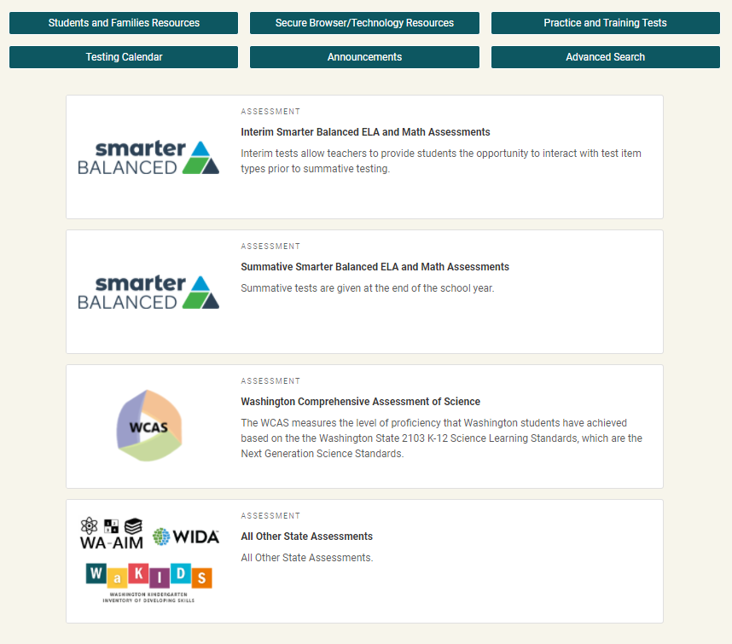
WCAP Portal
Test/task-based
Each test button will connect you to the systems and resources used in preparing, administering, and completing the test administration.
https://wa.portal.cambiumast.com/
Notes:
The WCAP Portal is located at the url shown on the screen, which is wa.portal.cambiumast.com . You can also find it if you google “WCAP portal”.
The portal is a test/task-based system. When you select a test, it takes you to a page with only the tasks and systems needed for administration of that test.
A training on navigating the Portal can be found on the Portal by selecting a test, and then selecting the “Webinars and Trainings” Task.

Slide 13
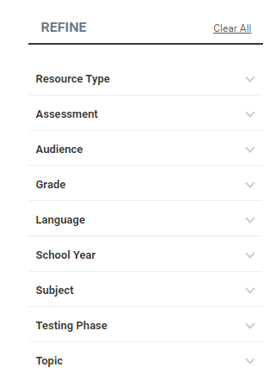
Advanced Search Button
The Advanced Search button allows you to refine your search with 9 primary search categories and more than 50 subcategories.
If you are looking to define a term instead of search for resources, you can select the Browse the Glossary button.
Notes:
You can search for documents using the Advanced Search, which is accessed from the button on the Portal home page. You can filter by Resource Type, the Assessment, etc. You can also find a list of definitions of terms by browsing the glossary.
When you go to the Advanced Search page, the most recently posted documents will be posted with the newest at the top. This is an easy way to find the newest documents posted.

Slide 14
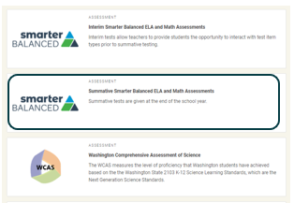
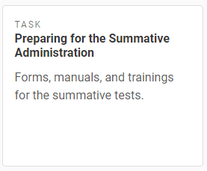
Preparing for Testing
Select the test you are preparing to administer
Select the Preparing for the Summative Administration task
Notes:
As an example, if you were preparing to give the Smarter Balanced Summative Assessment, on the home page of the Portal you would select the test you are preparing to administer, in this case, the Summative Smarter Balanced ELA and Math Assessments. On the Summative Smarter Balanced ELA and Math Assessments page, you would see “Tasks Associated with Summative Testing,” and would select the “Preparing for the Summative Administration” task.

Slide 15
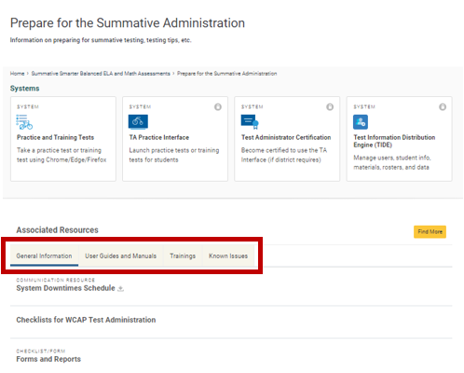
WCAP Portal-Associated Resources
Associated Resources
General Information
User Guides and Manuals
Trainings
Known Issues
Notes:
When you click on the “Preparing for the Summative Administration” task, you will go to the “Prepare for the Summative Administration” page, where you will see all the systems used in preparing for testing, such as the Practice and Training Tests, TA Practice Interface, TA Certification, and TIDE.
Under the Associated Resources, you can look in the General Information tab to find things like the Duties and Responsibility Checklists, in the User Guides and Manuals tab you can find resources like the TAM, the TA Script Of Student Directions, or the TIDE User Guide. The Trainings tab is where you will find the Test Administrator Interface for Online Testing module, and the TIDE Training Module. The Known Issues tab is where you can look at any known issues for the current school year.

Slide 16
WCAP Portal-Register for Email Updates
Notes:
Use the Register for Email Updates button to sign up to get notifications when new resources and/or announcements are posted to the portal.

Slide 17
Preparing for Testing
COORDINATOR AND ADMINISTRATOR TASKS
Notes:
Now we’ll go over tasks coordinators and administrators need to do to prepare for testing.

Slide 18
Before Testing Tasks
Creating Test Security and Building Plans (TSBPs)
Working with your Technology Coordinator to set up testing devices
Working with Spec Ed, Bilingual and 504 coordinators to determine which test settings and accessibility features students may need and setting them in TIDE
Preparing the testing environment
Notes:
There are a number of tasks District and School Coordinators need to tackle prior to testing. We will discuss the tasks listed here.

Slide 19
Test Security and Building Plans
Test security and building plans detail critical aspects of the testing process.
DCs work with SCs and Principals to create the Test Security and Building Plan for a school.
The plan should include:
Test schedules and locations
Staff responsibilities and training
Chain of custody for secure materials
Student individual testing needs, such as any accessibility features
Communication with school staff, students, and families
Notes:
The Test Security and Building Plan outlines the plan for state testing for each school. The plan details the testing schedule, staff roles and responsibilities, training, security, and the plan for secure handling of test materials.
The SC creates the plan with the principal and submits it to the DC for approval. The DC reviews and approves the plan, and schools’ testing schedules. A state created a Test Security and Building Plan template and process document that are available on the WCAP Portal. The template should be adjusted with information to meet the needs of your school district.
To assist in establishing the number of TAs needing to be trained, consider that at least one trained TA is required to be present during each test session at all times. If students are left unattended their scores will need to be invalidated.
Also, the WCAS accommodated paper-pencil assessments require one TA for no more than three students in a test session.

Slide 20
Work with Your Technology Coordinator
School Coordinators need to work with the Technology and District Coordinators on making sure all testing devices are set up for online testing.
It is also important to identify any students who may need non-embedded assistive technology, and work with your Technology Coordinator to ensure that the device is set up appropriately prior to the student’s testing session.
It is highly recommended that any students who may need non-embedded assistive technology have a chance to use the accessibility feature and device during a practice and/or training test to ensure compatibility and student familiarity.
Notes:
In advance of testing, you should work with your Technology Coordinator to prepare for online testing. Make sure all computer software is up to date and supported, and that the current school year’s secure browser is installed.
Your Technology Coordinator will also need to set up any non-embedded assistive technology devices needed by students. Dual monitors should be disabled on computers used for student testing, unless needed for an accessibility feature, in which case they should be set up to mirror each other.
If there are any students who may need non-embedded assistive technology, coordinators need to work with their Technology Coordinator to ensure that the device is set up appropriately prior to the student’s testing session. Students eligible for assistive technology require Permissive Mode to be set in TIDE, and computers need current browser and system software.
It is strongly recommended that students are allowed to use the accessibility feature and device during a practice and/or training test to ensure compatibility and student familiarity.

Slide 21
Further preparations:
Identify an area for students who need extra time to go to complete testing, if moving to a different location.
Ensure all instructional materials are removed or covered in the testing areas.
Create a seating plan so students are seated far enough apart or provide partitions.
Make sure all the materials needed by students and TAs for testing are available to them.
Notes:
District Assessment Coordinators and/or School Test Coordinators and principals should work with TAs to prepare for student testing by:
Identifying an area for students who need extra time to go to complete testing, if they will be moving to a different location.
Ensuring all instructional materials are removed or covered.
Creating a seating plan so students are seated far enough apart to not see others’ work or provided partitions.
Making sure all the materials needed by students and TAs for testing are available to them.

Slide 22
Materials Locally Supplied, When Allowed
Locally Supplied | Available to Print From Portal
Abacus | 100’s Number Table
Bilingual Dictionary Word-for-Word | English Glossary
Calculator | Illustration Glossaries
Color Overlay | Multiplication Table
English Dictionary | Periodic Table
Graph Paper | Translations Glossaries
Headsets | Translated Test Directions
Pencils
Scratch Paper
Thesaurus
Notes:
This table provides the materials allowed for Smarter Balanced and WCAS assessments that are provided locally by the school district. Some of these are only available as designated supports or accommodations. Follow the information provided within the GTSA for use and restrictions of these materials.
Materials should be inventoried for availability early enough to obtain additional quantities, if needed.
The items marked with a star will be included with the accommodated paper-pencil test. But if you need additional copies, they are also available on the Portal.

Slide 23
Identify Accessibility Features
Some accessibility features are available to all students as universal tools, others are only available as designated supports, or accommodations.
The GTSA provides information on accessibility features available for students for the Smarter Balanced and WCAS assessments.
Accessibility features not listed in the GTSA are not allowed.
Non-Standard Accommodation and Designated Support Requests If a unique circumstance requires a student access to an accessibility feature not documented for use in the GTSA, the student’s IEP team would ask the DC to submit a formal request in ARMS for consideration.
Notes:
Accessibility features can be helpful for some students who use them regularly during classroom instruction, or who have a documented need.
SCs enter and verify student test settings and accessibility features, including identifying for initial orders of accommodated paper tests. If the deadline for the initial orders is missed, SCs will need to submit additional orders in TIDE for accommodated paper test materials.
Refer to the GTSA for specific questions about restrictions and use.
Student accessibility features not listed in the GTSA, are not allowed.
In unique circumstances in which a student with a documented disability requires a support or accommodation not detailed in the GTSA, the DC may submit a Non-Standard Accommodation and Designated Support Request in ARMS for OSPI review.
Verify that accessibility features have been accurately entered for students in TIDE.
Any allowed tool, support, or accommodation used on a state assessment should be familiar to the student.

Slide 24
Tasks Done in TIDE BEFORE AND DURING TESTING
Notes:
Now we will go over tasks before and during testing which are done in TIDE.

Slide 25
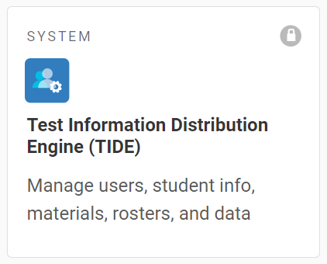
TIDE Tasks
A number of the Coordinator tasks before and during testing are done in TIDE:
Adding and managing users
Viewing and editing student test settings
Setting test windows
Ordering additional materials
Managing rosters
Submitting appeals
Notes:
DCs, DAs and SCs have the permissions to add and manage users in TIDE. Do not assign multiple roles to users in TIDE – only assign the highest role a person has (DA, SC). If a person has a higher role assigned to them, they will be able to perform all tasks of lower roles. For example, if a person has the role of SC assigned to them in TIDE, they will be able to perform all the tasks of a TA as well, such as administering tests.
DCs and/or SCs can enter and verify student test settings and accessibility features, including identifying for initial orders of accommodated paper tests.
Test windows for the spring administration are set in TIDE by the DC.
Additional orders of accommodated paper test materials are entered by DCs in TIDE.
Rosters are managed in TIDE.

Slide 26
TIDE Preparing for Testing
Users
Add Users
View/Edit/Export Users
Upload Users
Students
View/Edit/Export Students
Upload Interim Grades
Upload Student Settings
Frequency Distribution Report
Test Settings and Tools
View/Edit/Export Test Settings and Tools
Upload Test Settings and Tools
Test Windows
Add Test Windows
View/Edit/Export Test Windows
Upload Test Windows
Rosters
Add Rosters
View/Edit Rosters
Upload Rosters
Notes:
The Preparing for Testing section of TIDE is where you will find the following applications that support activities in preparation for testing:
Depending on your user role, the Users application may allow you to add, delete, or upload users and view, edit, or export users already in the system.
The Students section is where you can view, edit, upload, or export student information and test settings (tools, supports, and accommodations). You can also:
Upload Interim Grades
Access the Frequency Distribution Report
Print pre-ID labels for paper test booklets
In the Test Settings and Tools section you can view, edit, and export student test settings. Users can also upload student test settings and tools.
The View/Edit/Export Test Settings and Tools section is where you can pre-ID students to receive accommodated paper-pencil test forms in an initial shipment for the spring administration, by selecting the form in the “non-embedded accommodations” drop down.
Rosters are groups of students associated with a teacher in a particular school. Rosters typically represent entire classrooms in lower grades, or individual classroom periods in upper grades. Rosters can also represent special courses offered to groups of students. In the Roster section, you can add, view, edit, and upload rosters
The Test Windows section is utilized by DCs to establish school testing schedules for the summative assessments.
For more information on how to do these tasks in TIDE, see the TIDE User Guide and the TIDE User module, both posted to the portal.
The one task for before testing in TIDE that is not done through Preparing for Testing, is ordering any additional accommodated paper-pencil materials needed. We will cover how to do that in TIDE on the next slide.

Slide 27
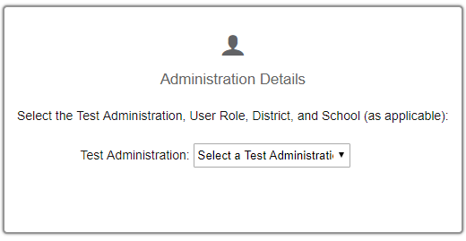
TIDE Additional Orders
To place additional orders in TIDE, select
Additional Paper Orders – Spring Summative
from the Administration Details page.
Notes:
To place additional orders for accommodated paper-pencil materials in TIDE, you will select Additional Paper Orders – Spring Summative from the Test Administration drop-down. The additional orders for Summative tests will not appear in the drop down until the additional order window opens.

Slide 28
TIDE During Testing
Appeals
Create Requests
View/Approve/Export Requests
Upload Requests
Monitoring Test Progress
Plan and Manage Testing
Test Session Status Report
Test Completion Rates
Test Status Code Report
Participation Search by SSID
Print Test Tickets
Print from Student List
Print from Roster List
Notes:
Appeals are set in TIDE and submitted by a DC or DA during test administrations. Appeals are submitted for online testers to either allow a student access to their testing opportunity or to invalidate a student’s test results.
The TIDE Appeals application is not used to log all test incidents, only those that require an appeal.
Districts will still need to submit a Testing Incident report through the Assessment Reporting Management System (ARMS) when the situation may have had an impact on student performance or test security, or if the incident is due to adult misconduct. We will talk more about submitting forms in ARMS later.
Appeals may be submitted for the interim and summative test administrations.
The Test Session Status Report is available under Monitoring Test Progress in TIDE. District-level users can now view status reports of active and inactive test sessions happening in their district for the current day. These reports show how many students in each school are testing and how many have started, paused, and completed their test.
You can print Test Tickets from your student list or rosters to support students as they login to test sessions.
It is important to ensure security of test tickets, before, during, and after testing.

Slide 29
Security SECURITY DURING TESTING AND TESTING INCIDENTS
Notes:
We will now cover test security and security documentation needed for the assessments. It is the responsibility of the DC and SCs to ensure all staff administering state tests are trained on test security. Coordinators are responsible for making sure all staff involved with state testing in any way are appropriately trained on security policies.

Slide 30
Security, Policies, and Responsibilities
State and local laws and policies specify practices to ensure test security and the standardized and ethical administration of assessments.
Students must be monitored throughout testing.
Only staff members trained specifically for state assessments can administer or be in a testing room.
Volunteers, media, and parents, or students not testing are not allowed in a testing room.
Reviewing and disclosing test questions is a violation of state law.
Professional Code of Conduct
The Professional Code of Conduct is codified by the Washington State Legislature in WACs and RCWs. A list of complete rules and regulations can be found online: www.k12.wa.us/ProfPractices/CodeConduct.aspx
The Office of Professional Practices (OPP) is charged with enforcement, including discipline of educational practitioners for violation of the Professional Code of Conduct. The office receives, investigates, and makes legal findings regarding complaints. Unprofessional conduct is reported to OPP (360) 725-6130.
Notes:
As with all state assessments, state laws must be adhered to and best practices followed in the classroom.
Allowed and prohibited behaviors are detailed in the Professional Assessment Standards.
Know who should and should not be in the testing environment. DCs, DAs, Principals, and SCs need to actively monitor testing locations to ensure adequate support. Trained staff can be in a testing room, under the general supervision of a certified staff member. Volunteers, parents, and students who are not being assessed during the current segment, as well as media, are not allowed.
Reviewing and disclosing test content or student responses is a violation of state law.
The Office of Professional Practices (OPP) is charged with enforcement, including discipline of educational practitioners for violation of the Professional Code of Conduct. OPP receives, investigates, and makes legal findings regarding complaints.

Slide 31
Basic Security
The security of assessment instruments, and the confidentiality of student information, are vital to maintaining the validity, reliability, and fairness of the test results.
In addition to training, staff must fill out the Test Security Staff Assurance Report both before testing and after testing.
Notes:
The security of test content and the confidentiality of student information are vital to maintaining the validity, reliability, and fairness of the test results.
In addition to training, staff must fill out the Test Security Staff Assurance Report both before testing and after testing. This form can be found on the Portal in the Test Coordinator Resources card, in the General Information section.

Slide 32
Prohibited Activities
Under no circumstances should staff:
Review, discuss, or copy secure test content or student responses
Use secure test content to develop instructional resources
Assist with or interpret test content for students
Alter student responses in any way
Leave secure test content unattended in a non-secure location
Leave students unattended during testing
Notes:
Under no circumstances should staff:
Review, discuss, or copy secure test content or student responses
Use secure test content to develop instructional resources
Assist with or interpret test content for students
Alter student responses in any way
Leave secure test content unattended in a non-secure location
Leave students unattended during testing

Slide 33
Test Incidents
Whether intentional or by accident, failure to comply with rules, either by staff or students, constitutes a test incident that needs to be documented and reported.
When test incidents occur, it is important to:
Stop the test session for the individual student or class.
Take corrective action to mitigate the incident.
Make sure TAs report incidents to the SC. The SC contacts the DC, and the DC works with OSPI when required.
Document through a test incident report by the end of the day, which must be reviewed by the DC or state within 24 hours.
Submit an appeal in TIDE, if required. TIDE appeals are submitted by the DC or DA. Approval is required at a state level.
Breaches in test security must be reported immediately to the SC, DC, and the State.
When required the DC submits a Test Incident Report to the state through ARMS.
Test Incident:
Notes:
Test incidents, such as a low risk (fire drill, minor student disruption, etc.), medium risk (student access to non-approved electronics, adult misconduct, etc.), and high risk (test questions/answers shared or made public), are behaviors prohibited either because they give a student an unfair advantage or because they compromise test validity or score reliability. Whether intentional or by accident, a situation that falls into these categories constitutes a test incident that needs to be documented and reported, whether being retained at local district-level or escalated to the state. Refer to the Professional Assessment Standards for full details.
When an incident occurs it is important to:
Stop the student(s) test session by either pausing the individual tests, or by ending the entire session in the TA Interface.
Take corrective action to mitigate the incident and report the situation, as required.
Gather all necessary information to be reported.
Document with as much detail as possible, including information such as date, time of day, who was involved (SSID), and the item number (when applicable).
For technology or system related issues, please be ready to provide:
Session ID, device used during testing, network configuration, and operating system
Prompt communication is important and should follow the Professional Assessment Standards.
Appeals will be processed within 24 hours.
Breaches are considered a high risk. An example would be if a student or adult had collected or released secure test content or student responses. This is immediately reported to the SC, DC, and OSPI. Do not use electronic devices or email for transferring secure/confidential information.

Slide 34
Commonly Reported Incidents
Student access to non-approved electronic devices.
Students not provided the correct accessibility features/inappropriate student access to non-approved accessibility features.
Calculator use on a non-calculator portion of an assessment or hand-held calculator use during an online math assessment.
Instructional materials not being covered or removed from the testing location.
TAs deviating from the approved script of student directions or test schedule.
TAs administering an incorrect assessment, such as a summative assessment instead of a training, practice, or interim test.
Notes:
We will share a few of the incidents most commonly reported to the OSPI Assessment Operations office.
Student access to non-approved electronic devices.
Students not being provided the correct accessibility features, and inappropriate student access to non-approved accessibility features is a commonly reported incident. As an example, the use of calculators, such as use of a hand-held calculator during an online math test session (unless needed as a documented accommodation), will require that the DC set an appeal in TIDE to invalidate the students test results. The GTSA and the Calculator Policy provide information on the availability, use, and restrictions of calculators for assessments.
Materials not being removed from walls in the testing location may require invalidation of student test results. Be sure to have a plan in place to check testing locations prior to the administration of a summative assessment.
We also have received reports of TAs not following the script of student directions and of staff not being trained prior to administering an assessment. These situations may also require invalidation after conclusion of an investigation.
TAs administering an incorrect assessment, such as a summative assessment instead of a training, practice, or interim test continues to be reported. It is important that TAs have a clear understanding of the test being administered.
When TAs incorrectly select a summative assessment, the DC will be required to investigate and report findings through a Test Incident Report within ARMS.
An appeal will also need to be submitted in TIDE to reset the incorrect test results so that students may access their summative testing opportunity.
When a test is reset due to an incorrect test selection, a certification letter will be provided by the state to be attached to the ISRs that are placed in the student folder and sent home to parents.

Slide 35
Top Testing Incidents Requiring Test Invalidation
Students having access to non-approved electronics.
Students left unattended in the testing location.
Notes:
The top testing incidents requiring test invalidation are students having access to non-approved electronics (such as their cell phones) and students left unattended while testing.
When testing incidents occur, they need to be reported in ARMS, and if necessary, an appeal may need to be submitted through TIDE.

Slide 36
Reporting Test Incidents in ARMS
The Assessment Reporting Management System (ARMS) provides district-level users the opportunity to electronically document information on test incidents, which can then either be retained in district or submitted to OSPI.
Security breaches must be reported immediately to the state. Do not rely on submitting the incident report in ARMS for communicating the situation with OSPI.
Notes:
DCs are responsible for reporting information in ARMS, and SCs are responsible for submitting reporting documents to the DC.
Test incidents are reported in ARMS using the Test Incident Report form. The form can either be retained in district or submitted to the state.
More information about test incidents, including which should be retained in district, and which need to be submitted to the state can be found in the Professional Assessment Standards.

Slide 37
Overview of Other Forms Submitted in ARMS
Modified Testing Schedules
Medical Exemption Requests
Test Question Ambiguity
Test Material Variance
Non-Standard Accommodation Requests
Notes:
If extraordinary circumstances limit students’ abilities to participate in a state assessment, districts will request a Modified Testing Schedule that may allow testing to take place outside of school hours (this does not need to be submitted if testing will conclude before 6pm on a weekday), at an alternate test site, or outside of the state mandated window.
DCs may submit a request for students who are unable to participate in state assessments due to a significant medical emergency to be exempted from state testing. It is important to note that a student’s disability alone cannot be used as the justification for a medical exemption (i.e., this is not an option for chronic medical conditions).
If there appears to be an error on a state assessment, districts should use the Test Question Ambiguity form in ARMS to document the problem and perceived error. District and school staff must not copy the problem, share with colleagues, or transmit this information through any device with cellular, messaging, or wireless capabilities (e.g., email, cell phones, email, photo technology). Test content must not be reviewed except to the extent necessary for administration of state assessments. If needed, OSPI will provide a remedy for all students in the state.
The Test Material Variance Form is used to document and any discrepancy in the test materials received from the contractor or returned from the school. Discrepancies may represent shortages in the quantity of materials, missing materials, or damaged materials.
A Non-Standard Accommodation Request is submitted when a student requires an accommodation that is not listed in the GTSA.
The Professional Assessment Standards or ARMS Training PowerPoint provide more detailed information about these forms, and step-by-step information on how to use them.

Slide 38
Overview of Security Reports Submitted After Testing
School Site Administration and Security Report:
Used to document whether training and test security protocols were followed at the building level and to note any exceptions.
Must be submitted to the DC after conclusion of testing.
District Administration and Security Report:
Used to document for the entire district, whether training and test security protocols were followed and to note any exceptions.
Must be submitted to OSPI By July 15.
Notes:
The School Site Administration and Security Report is used to document whether training and test security protocols were followed at the building level and to note any exceptions, as outlined in the Professional Assessment Standards.
SCs are responsible for submitting a completed School Site Administration and Security report to the DC after conclusion of each testing cycle which includes the:
WIDA, Smarter Balanced and WCAS, and WA-AIM
The purpose of the District Administration and Security Report is to document whether training and test security protocols were followed by the district and to note any exceptions, including those submitted by schools, as outlined in the Professional Assessment Standards manual.
DCs are responsible for submitting the completed report to OSPI through ARMS by no later than July 15, 2024.
The information in the School Site Administration and Security Reports is used by the DC for filling out the District Administration and Security Report, so it is important the school forms are completed on time.

Slide 39
Document Retention and Audit Report
SCs submit to DC or DC retains at the school
Test Security and Building Plans
Printed copy of the signed roster, if used and required by DC
Report of students not tested and why (refused, absent, etc.), if required by DC
Test Security Staff Assurance Forms
School Site Administration and Security Report
Test incident reports (ARMS or paper)
DCs submit to OSPI through ARMS
Modified Testing Schedules
Medical Exemption Requests
Test Question Ambiguity Forms
District Administration and Security Report
Test incident reports, as required
Test Material Variance Form
Remember to follow the WA State Retention Guidelines and local district policies for document retention.
Notes:
The WA State Auditors Office implemented a process for auditing schools and the state. They are looking to ensure that school districts have a building plan in place and that it is being followed by the school and district staff.
They also ensure that all required documentation is readily available.
As long as the DC has immediate access to reporting documents, the DC will determine whether the school level reports will be archived at the school or district. The only exception is the School Site Administration and Security Report which must be returned to the DC to support completion of the District Administration and Security Report.
Retain a copy of required reports at district and have immediate access to reports retained at schools for purpose of state audit.
Retention of materials should follow the WA State Retention Guidelines and your local school district policy.

Slide 40
After Testing
After testing has been completed, prepare materials to be returned to the scoring contractor.
Make sure responses for students taking the braille or large print version of the test have been transferred to standard test or answer booklets.
Printed test items/passages, including embossed braille printouts, scratch paper, and test tickets must be collected and inventoried and then securely destroyed.
Notes:
After testing is complete, DCs and SCs need to track and account for all secure test materials.
All secure materials, including ELA Listening Transcripts and WCAS TA Script of Student Directions for accommodated tests must be returned to the scoring contractor along with all test booklets and answer booklets.
Make sure all responses for students taking the braille or large print version of the test have been transcribed into a standard print answer booklet for Smarter Balanced ELA or math tests, or a standard print test booklet for WCAS tests.
All print on demand printed test items/passages, including embossed braille printouts, scratch paper, and test tickets must be securely destroyed according to your TSBP.

Slide 41
Contact Us:
School Test Coordinators
Contact the District Assessment Coordinator
Office Phone: ( ) -
Cell Phone: ( ) -
District Technology Coordinators
Contact WCAP Help Desk (844) 560-7366 or by email: wahelpdesk@cambiumassessment.com
Notes:
DAs contact their DC for support prior to contacting the state.
SCs contact the appropriate person in your district if you have questions. OSPI will refer all school staff to the DC.

Slide 42
Revision Log Updates to the module after December 29, 2023, are noted below.
Slide | Section | Description of Revision | Revision Date
0 |  | Blank | Blank
Blank | Blank | Blank | blank
Notes:
If updates are needed throughout the school year, they will be outlined on this revision log and communicated in the WAW newsletter.

